Slide 1
www.carteeh.org

Slide 2
Lecture #25: Introduction to Air Pollution Epidemiology
Haneen Khreis
Texas A&M Transportation Institute
H-Khreis@tti.tamu.edu, (979) 317-2799 x42799
The author declares that there is no conflict of interest
Lecture Track(s): HT/TT/PPT
Notes:
Health Track (HT)—mainly targeted at urban planners, transportation planners, and engineers with limited knowledge of public health-related concepts;
Transportation Track (TT)—mainly targeted at environmental epidemiologists and public health professionals with limited knowledge of transportation-related concepts; and;
Planning and Policy Track (PPT)—mainly targeted at planners, civil servants, and policy and decision makers with particular interest in the science-policy link.

Slide 3
Introduction
Epidemiology is a cornerstone field of public health
“Epidemiology is the study of the distribution and determinants of health-related states or events in specified populations, and the application of this study to the control of health problems ” (Last, 2001)
The study refers to scientific, systematic and data-driven approaches
Distribution refers to the frequency and pattern of health events in a population
Determinants refer to causes and risk factors
Health-related states and events do not just refer to diseases
Specified populations are communities of many individuals who are viewed collectively
This scientific knowledge is applied as a discipline of public health to drive health promoting or protecting policies based on the science and causal reasoning of epidemiology (Centers for Disease Control and Prevention, 2012)
Notes:
The following is extracted from the Centers for Disease Control and Prevention (2012):
The key terms bolded above in the definition of epidemiology reflect some important principles of the field as overviewed below:
“Study: Epidemiology is a scientific discipline with sound methods of scientific inquiry at its foundation. Epidemiology is data-driven and relies on a systematic and unbiased approach to the collection, analysis, and interpretation of data. Basic epidemiologic methods tend to rely on careful observation and use of valid comparison groups to assess whether what was observed, such as the number of cases of disease in a particular area during a particular time period or the frequency of an exposure among persons with disease, differs from what might be expected. However, epidemiology also draws on methods from other scientific fields, including biostatistics and informatics, with biologic, economic, social, and behavioral sciences.
Distribution: Epidemiology is concerned with the frequency and pattern of health events in a population. Frequency refers not only to the number of health events such as the number of cases of meningitis or diabetes in a population, but also to the relationship of that number to the size of the population. The resulting rate allows epidemiologists to compare disease occurrence across different populations. Pattern refers to the occurrence of health-related events by time, place, and person. Time patterns may be annual, seasonal, weekly, daily, hourly, weekday versus weekend, or any other breakdown of time that may influence disease or injury occurrence. Place patterns include geographic variation, urban/rural differences, and location of work sites or schools. Personal characteristics include demographic factors which may be related to risk of illness, injury, or disability such as age, sex, marital status, and socioeconomic status, as well as behaviors and environmental exposures.
Determinants: Epidemiology is also used to search for determinants, which are the causes and other factors that influence the occurrence of disease and other health-related events. Epidemiologists assume that illness does not occur randomly in a population, but happens only when the right accumulation of risk factors or determinants exists in an individual. To search for these determinants, epidemiologists use analytic epidemiology or epidemiologic studies to provide the “Why” and “How” of such events. They assess whether groups with different rates of disease differ in their demographic characteristics, genetic or immunologic make-up, behaviors, environmental exposures, or other so-called potential risk factors. Ideally, the findings provide sufficient evidence to direct prompt and effective public health control and prevention measures.
Health-related states and events: Epidemiology was originally focused exclusively on epidemics of communicable diseases but was subsequently expanded to address endemic communicable diseases and non-communicable infectious diseases. By the middle of the 20th Century, additional epidemiologic methods had been developed and applied to chronic diseases, injuries, birth defects, maternal-child health, occupational health, and environmental health. Then epidemiologists began to look at behaviors related to health and well-being, such as amount of exercise and seat belt use. Now, with the recent explosion in molecular methods, epidemiologists can make important strides in examining genetic markers of disease risk. Indeed, the term health-related states or events may be seen as anything that affects the well-being of a population. Nonetheless, many epidemiologists still use the term “disease” as shorthand for the wide range of health-related states and events that are studied.
Specified populations: Although epidemiologists and direct health-care providers (clinicians) are both concerned with occurrence and control of disease, they differ greatly in how they view “the patient.” The clinician is concerned about the health of an individual; the epidemiologist is concerned about the collective health of the people in a community or population. In other words, the clinician’s “patient” is the individual; the epidemiologist’s “patient” is the community. Therefore, the clinician and the epidemiologist have different responsibilities when faced with a person with illness. For example, when a patient with diarrheal disease presents, both are interested in establishing the correct diagnosis. However, while the clinician usually focuses on treating and caring for the individual, the epidemiologist focuses on identifying the exposure or source that caused the illness; the number of other persons who may have been similarly exposed; the potential for further spread in the community; and interventions to prevent additional cases or recurrences.
Application: Epidemiology is not just “the study of” health in a population; it also involves applying the knowledge gained by the studies to community-based practice. Like the practice of medicine, the practice of epidemiology is both a science and an art. To make the proper diagnosis and prescribe appropriate treatment for a patient, the clinician combines medical (scientific) knowledge with experience, clinical judgment, and understanding of the patient. Similarly, the epidemiologist uses the scientific methods of descriptive and analytic epidemiology as well as experience, epidemiologic judgment, and understanding of local conditions in “diagnosing” the health of a community and proposing appropriate, practical, and acceptable public health interventions to control and prevent disease in the community.”

Slide 4
Introduction
Air pollution epidemiology is a subset of epidemiology; specifically the larger field of environmental epidemiology
Air pollution epidemiology focuses on air pollution as the determinant of health or risk factor to be studied in relation to many health outcomes and short or long-term air pollution exposure
Air pollution is one of the most important and most studies environmental exposures due to:
Its ubiquitous nature
The large range of health-related states and events which it affects
Impacts on all segments of population
The huge, but modifiable, health burden it poses (Andersen, 2020)
Notes:
Environmental epidemiology studies the health consequences resulting from exposures which occur the general environment of humans such as air, water, diet, soil
Air pollution epidemiology is a subset of environmental epidemiology which focuses on air pollution
Many different air pollutants have been studied in environmental epidemiology including, but not limited to, the following:
CO: carbon monoxide
BC: black carbon
Pb: lead
NO2: nitrogen dioxide
NOx: nitrogen oxides
O3: Ozone
PM2.5: particulate matter with diameter < 2.5µm
PM10: particulate matter with diameter < 10µm
SO2: sulfur dioxide
UFP: ultra-fine particles, particulate matter with diameter < 0.1µm
In urban areas, where people congregate and where a lot of people are moving to, traffic is a major source of ambient air pollution and it acts in close proximity to an increasing proportion of the population

Slide 5
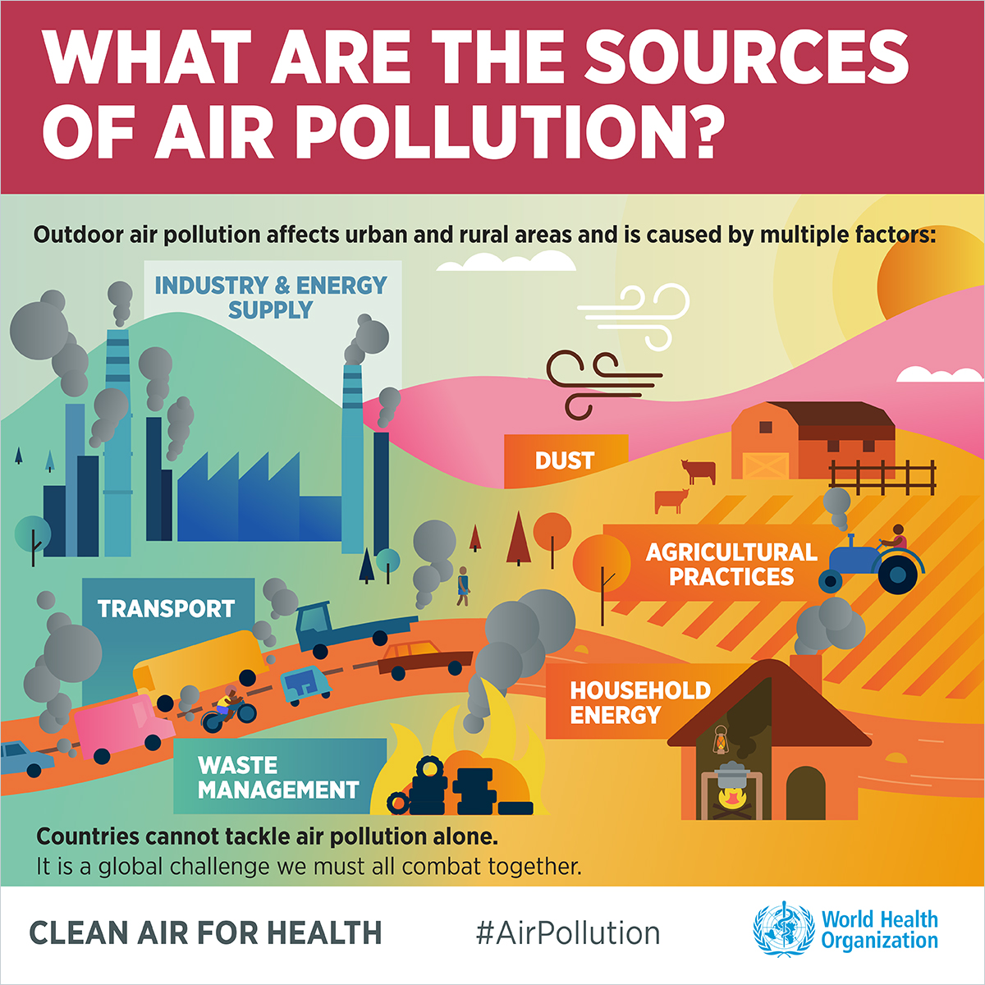
Sources of Air Pollution
On-road traffic contributes to ambient air pollution, especially in cities
In Europe (air pollution):
(>80%) of NO₂
(9-66%) of PM_{2.5}
(9-53%) of PM₁₀ (Sundvor et al., 2012)
In the United States (emissions):
(>41%) of NO_{x}
(<5%) of PM_{2.5}
(<5%) of PM₁₀ (US Environmental Protection Agency, 2014)
NO₂ and NO_{x} are good markers of traffic-related air pollution (TRAP) and track even smaller particles like ultra-fine particles extremely well
Source: World Health Organization, no date: https://www.who.int/airpollution/infographics/en/
Notes:
There are many sources of air pollution exposures
This course is focused on TRAP in particular
In urban areas, traffic is a major source of ambient air pollution

Slide 6
Short-term versus Long-term Studies
Air pollution epidemiological studies may be categorized in two broad categories of short-term and long-term studies
Short-term studies look into short-term (acute) air pollution exposures over hours, days, or weeks
Long-term studies look into long-term (chronic) air pollution exposures over months, years, decades and lifetimes
Health effects of short-term versus long-term air pollution exposures can be different
Examples of short-term health effects are cough, headache, irritation of the eyes, noise and throat, exacerbation of asthma symptoms, complications of cardiovascular diseases possibly leading to hospitalizations and deaths
Examples of long-term health effects are the development of asthma, chronic obstructive pulmonary disease, cardiovascular disease, diabetes, stroke, cancers and premature death
Notes:
Extracted from Andersen (2020): “Air pollution epidemiology is concerned with the health effects related to exposure to air pollution, and is typically divided into two large areas: 1) short-term studies - studies of health effects related to acute or short-term exposures to air pollution, lasting over several hours, days or weeks, and 2) long-term studies - studies of health effects of chronic or long-term exposures to air pollution, lasting several months, years, decades, or an entire lifetime. Short-term studies give answer to the question of whether short-term exposure to high levels of air pollution (day with high level of air pollution, several hour exposure in heavy traffic, etc.) can trigger adverse effects, such as an exacerbation of an existing disease, etc. Typical health effects from short-term or acute exposure to air pollution include cough, headache, irritation of the eyes, nose, and throat, allergic reactions, asthma symptom aggravation, wheezing, complication of symptoms in elderly subjects with chronic respiratory and cardiovascular disease, possibly leading to hospitalization or even death. Long-term air pollution studies give an answer to the question of whether every day air pollution concentrations also result in adverse effects, when accumulated over long periods of time. Typical health effects resulting from long-term or chronic exposure to air pollution are chronic diseases, such as asthma in children, and in adults, incidence of COPD, cardiovascular disease, stroke, diabetes, lung cancer, breast cancer, pneumonia, or death.”

Slide 7
Methods for Short-Term Studies
The study design used to assess health effects of short-term air pollution exposures is called a time-series study (Andersen, 2020)
The standard tool to analyze time-series data is the Poisson generalized additive model (GAM)
Detailed information on how to conduct a time-series analysis has been summarized elsewhere (Bhaskaran et al., 2013)
In this analysis, daily variations in air pollution measured at central monitors are typically associated with daily variations in health outcomes such as the daily counts of deaths or daily hospitalizations for specific health outcomes
Repeated measures for the exposure and the health outcome over time are used in the analysis
The analysis should be adjusted for confounders at the population level such as temperature, humidity, seasons, day, epidemics (e.g. influenza), holidays, pollen counts, and also importantly unmeasured confounders which are related to time such as trends in survival due to improved health care and/or changes in lifestyles (Andersen, 2010)
Days are the unites of observations
Notes:
Extracted from Andersen (2020):
“The study design used to study health effects of acute exposures to air pollution is called time-series study. Short-term or time-series air pollution study design examines time-series of day-to-day variations in air pollution over long periods of time as determinants of day-to-day variations in mortality, hospital admissions, and other public health indicators. The tool to analyze time-series data was introduced by Schwartz in 1990,13 leading to an exponential increase in studies of short-term effects of air pollution ever since. The Poisson generalized additive model (GAM) time-series model became the standard tool as it could easily utilize routinely collected data from air pollution monitors, hospital and death registries. In these types of studies, typically based in a single large city, time-series (typically several years) data of daily variations in air pollution levels (24-h mean, 8-h mean, 8-h maximum, or maximum pollutant concentrations, measured at a central monitor) are associated to daily variations in health outcomes (daily count of deaths or hospitalizations in that city), and adjusted for population level confounders that affect the health outcome of interest, such as weather (temperature, humidity), season, day of the week, influenza epidemics, public holidays, pollen counts, etc. In these models, it is important to account for other unmeasured confounders such as trends in survival due to improvements in medical care, changes in population size, trends in occurrence of major diseases, population habit changes with respect to lifestyle, drinking and smoking rates, etc. These unmeasured time trends are modelled by calendar time, which is used as a surrogate for an unmeasured variable that may have causal effects on health outcomes. The Poisson time-series model quickly became the standard tool for its many advantages, as they are relatively cheap and feasible and as they can efficiently use existing data from air pollution monitoring programs and mortality and hospitalization records. ”

Slide 8
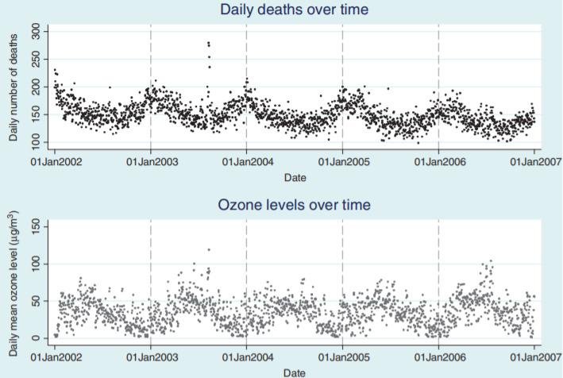
Time-Series Studies
Raw plots showing outcome (deaths) and exposure (ozone) data over time (London data), Source: Bhaskaran et al. (2013)
Notes:
An example of data which can be analyzed using a time-series study design is shown above

Slide 9
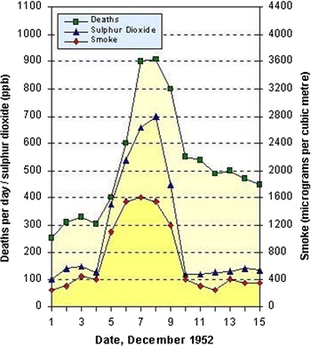
Time-Series Studies
Studying the Great London Smog of 1952 was an example of a time-series study which assessed one of the most famous air pollution episodes with a significant health toll
The figure shows estimates of mortality and average sulfur dioxide concentrations for London during the winter of 1952. Deaths in December increased approximately 3 times over comparable periods in 1947 to 1951
Death toll and pollution concentrations during the 1952 London Smog, Source: Wilkins (1954)
Notes:
Extracted from Andersen (2020): “Although this event (air pollution episode which occurred in the Meuse Valley in Belgium, in 1930) provided the first evidence of causality between air pollution and mortality, another similar episode 20 years later, became the landmark in air pollution epidemiology, because of the scale of disaster, and because it provided data to researchers for the first time to perform detailed analyses of the association between air pollution and mortality. This was 'The Great London Smog' of 1952, the most famous air pollution episode, also known as 'The Killer Fog', where unusually cold and calm weather trapped the heavy, motionless, thick layer of smoky, dusty fumes from the region's coal stoves and local factories in the London Thames basin. This severe air pollution event affected London for 4 days from the 5th to 9th of December, during which time the heavy smog caused major disruption in traffic by reducing visibility, penetrating indoor areas, and causing adverse health effects. The episode led to a fivefold increase in SO2 levels, to that of several thousands of µg/m3, and subsequently, threefold increase in the number of deaths above the expected, with an estimated excess death toll of over 4,000. Recent reanalysis of the original London Fog data acknowledged that the prolonged effects of the London air pollution episode contributed to higher death rates for several months later, resulting in a total of 12,000 deaths that can be attributed to the smog episode”

Slide 10
Methods for Short-Term Studies
Another study design which can be used to analyze time-series data is a case-crossover design
Air pollution concentration on the day a person has experienced a health outcome is compared to air pollution concentration on a day within the same month when that same person did not experience the health outcome (Andersen, 2020)
As such, each study subject serves as her/his own control
Data is analyzed using a conditional logistic regression model
The models can provide personal risk estimates
Individuals are the unit of observation
An example of such a study can be found in Iskandar et al. (2012)
Notes:
Extracted from Andersen (2020): “Another design used in analyzing time-series data is a case-crossover design where air pollution concentration on the day a person has experienced a health outcome (hospitalization) is compared to other weekdays within the same month, when the person did not experience the health outcome. The data are then analyzed by a conditional logistic regression model. This design is attractive and has gained popularity over time-series GAM approach, as it is a case-only design, where persons are used as their own control, and because it provides personal risk estimates. In an example from a study on short-term exposure to air pollution and childhood asthma in Copenhagen, a time-series of daily mean concentrations of NO2 (µg/m3) from a central background monitor in Copenhagen from 2001 until 2009, was linked to daily number of asthma hospitalizations in children aged 18 years or younger, in nine Copenhagen hospitals, during the same period. In this study, the authors found that for each 6 ppb increase in mean NO2 levels over 5 days, there was a 10% increase in risk of childhood asthma hospitalization the following day (Iskandar et al., 2012) ”

Slide 11
Methods for Long-Term Studies
The main study designs used to assess health effects of long-term air pollution exposures are:
Ecological study
Cross-sectional study
Case-control study
Cohort study (Andersen, 2020)
Early evidence in the health effects of long-term exposure to air pollution came from ecological and cross-sectional studies
However, due to their design, case-control and cohort studies are able to asses causation while cross-sectional studies are very limited in assessing cause and effect due to their typical inability of capturing the temporality between the exposure and the health outcome
Notes:
Studies concerned with long-term exposures to air pollution can tell us how much life is shortened due to air pollution exposures, how do long-term mortality rates differ because of air pollution, and whether air pollution can lead to the development of chronic diseases such as asthma or neurodegenerative diseases
These studies are often more concerned low or moderate air pollution exposure levels over longer periods of time while the studies overviewed in the short-term studies section above are often more concerned with higher air pollution episodes though more recently they also looked into lower exposures
In ecological and cross-sectional studies, the air pollution exposure and the health outcome are usually assessed at the same time
Also, ecological studies produce exposure and associated risk estimates at the population level, and not the individual level, for examples looking into health outcome rates in association to exposures at the district or county level. As such, the adjustment for confounders is also very limited as personal/individual data on risk factors and lifestyles which might act as confounders are limited

Slide 12
Ecological Studies
The unit of observation is the population or a community/groups
The health outcome rates and the exposures are measured in the population or community and their relationship examined (Coggon, 2003)
An example of an ecological study assessing the relationship between air pollution and primary liver cancer incidence in Texas can be found in Cicalese et al. (2017)
The association between county-level concentrations of 4 air pollutants known to be linked to liver cancer and hepatocellular carcinoma rates was evaluated
All data was from public databases
A non-linear association was found between 2 air pollutants and the incidence of liver cancer and hepatitis C prevalence rates
Notes:
Abstract extracted from Cicalese et al. (2017):
“Introduction: Primary liver cancer is a significant cause of cancer-related death in both the
United States and the world at large. Hepatocellular carcinoma comprises 90% of these primary liver cancers and has numerous known etiologies. Evaluation of these identified etiologies and other traditional risk factors cannot explain the high incidence rates of hepatocellular carcinoma in Texas. Texas is home to the second largest petrochemical industry and agricultural industry in the nation; industrial activity and exposure to pathogenic chemicals have never been assessed as potential links to the state’s increased incidence rate of hepatocellular carcinoma. Methods: The association between the county-level concentrations of 4 air pollutants known to be linked to liver cancer, vinyl chloride, arsenic, benzene, and 1,3-butadiene, and hepatocellular carcinoma rates was evaluated using nonparametric generalized additive logistic regression and gamma regression models. Hepatocellular carcinoma incidence rates for 2000–2013 were evaluated in comparison to 1996 and 1999 pollution concentrations and hepatocellular carcinoma rates for the subset of 2006–2013 were evaluated in comparison to 2002 and 2005 pollution concentrations, respectively. Results: The analysis indicates that the relationship between the incidence of liver cancer and air pollution and risk factors is nonlinear. There is a consistent significant positive association between the incidence of liver cancer and hepatitis C prevalence rates (gamma all years, p < 0.05) and vinyl
chloride concentrations (logistic 2002 and 2005, p < 0.0001; gamma 2002 and 2005, p < 0.05).
Conclusions: This study suggests that vinyl chloride is a significant contributor to the incidence of liver cancer in Texas. The relationship is notably nonlinear. Further, the study supports the association between incidence of liver cancer and prevalence of hepatitis B”

Slide 13
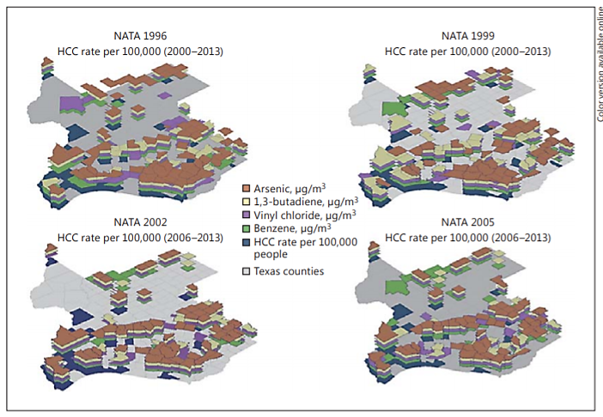
Ecological Studies
Limitations of ecological studies:
Exposure estimates are only a proxy based on the average in the population
Caution is needed when applying grouped results to the individual level (ecological fallacy, notes below)
Potential for systematic differences between areas in recording disease frequency. For example, differences in disease coding and classification, diagnosis and completeness of reporting across the analysis units
Potential for systematic differences between areas in the measurement of exposures
Lack of available data on confounding factors (Health Knowledge, 2018)
Counties in the upper quartile of hepatocellular carcinoma (HCC) incidence rate per 100,000 people (2000–2016 and 2006–2016), or air pollution levels (National Air Toxics Assessment (NATA) 1996, 1999, 2002, and 2005) for vinyl chloride, arsenic, 1,3-butadiene, or benzene, Source: Cicalese et al. (2017)
Notes:
Extracted from Health Knowledge UK, available at: https://www.healthknowledge.org.uk/public-health-textbook/research-methods/1a-epidemiology/descriptive-studies-ecological-studies
Advantages of ecological studies include:
Relatively quick, easy and cheap to conduct
Exposure data often only available at area level
Differences in exposure between areas may be bigger than at the individual level, and so are more easily examined
Utilization of geographical information systems to examine spatial framework of disease and exposure
Extracted from Health Knowledge UK, available at: https://www.healthknowledge.org.uk/public-health-textbook/research-methods/1a-epidemiology/descriptive-studies-ecological-studies
“Ecological fallacy
The ecological fallacy is an error in the interpretation of the results of an ecological study, where conclusions are inappropriately inferred about individuals from the results of aggregate data. The fallacy assumes that individual members of a group all have the average characteristics of the group as whole, when in fact any association observed between variables at the group level does not necessarily mean that the same association exists for any given individual selected from the group. For example, it has been observed that the number of televisions per capita is negatively associated with the rate of deaths from heart disease. However, it would be an ecological fallacy to infer that people who don’t own televisions die from heart disease 3. Indeed, in this scenario there are other potentially causative factors that could be common to both, such as reduced physical activity or a poorer diet associated with less affluent societies.
Reasons for the ecological fallacy include the following:
It is not possible to link exposure with disease in individuals - those with disease may not be the same people in the population who are exposed.
The data used may have originally been collected for other purposes.
Use of average exposure levels may mask more complicated relationships with the disease, such as the J-shaped relationship between alcohol consumption and heart disease.
Inability to control for confounding.”

Slide 14
Cross-Sectional Studies
Type of an observational study (Song and Chung, 2010)
Cross-sectional studies measure the prevalence of a health outcome, or determinants of health (risk factors), or both, at one point in time and over a short time period
Associations must be interpreted with caution and are hard to interpret causally, partly due to inability to establish temporality (assessments of outcome and exposure are typically contemporaneous) and lack of follow-up. Also prone to selection bias (Coggon et al., 2003)
An example of a cross-sectional study assessing the relationship between TRAP and the prevalence of asthma and COPD in Southern Sweden can be found in Lindgren et al. (2009)
Notes:
Extracted from Andersen (2020):
“Early evidence on the health effects of long-term exposure to air pollution came from ecologic, cross-sectional studies. In an example from a study from 1987, US vital statistics and available ambient air pollution data for criteria pollutants for the year 1980, were used to estimate the association between various air pollutants and total mortality. In this cross-sectional analyses, data on air pollution from 1980 were linked to data on mortality in the same year, without temporality between exposure and outcome, which raised debate about the usefulness of this approach for risk assessment. A similar cross-sectional ecological design was used in another ground-breaking study on air pollution and infant mortality in the Czech Republic in the period 1986-88 for 46 districts. Here, the mean levels of total suspended particles (TSP) and nitrogen oxide (NOx) for each district were linked to infant mortality rates for that district, adjusting for district socioeconomic characteristics, and abortion rates. In both of these types of studies, cross-sectional design implies that exposure to air pollution and health outcome are assessed at a single point of time, without temporality between exposure and outcome, precluding conclusions about causality. Furthermore, these studies are examples of ecological studies, which explore the association between disease and estimated exposures in population groups (districts, cities, etc.) and produce risk estimates at the population level, and not the individual level, as no individual level data are available on air pollution exposure, health outcome, or other personal characteristics (lifestyle, etc.). Cross-sectional studies with air pollution data at the individual level are also used for outcomes such as prevalence of a disease, with example of a study on air pollution and prevalence of diabetes, and for outcomes such as biomarkers of disease progression that are collected at a single point of time, such as blood pressure and hypertension.”

Slide 15
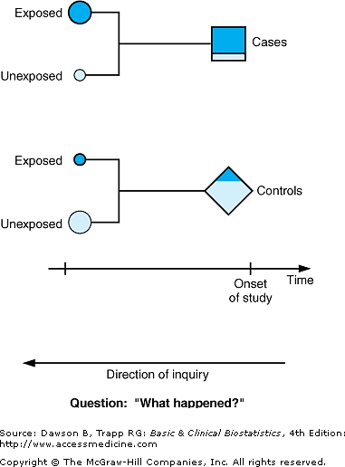
Case-Control Studies
Type of an observational study (Song and Chung, 2010)
In case-control studies, the exposure of people who have the disease (cases) is compared to the exposure of people who do not have the disease (controls)
Potential confounders are measured and adjusted for in the statistical analysis
Adjustments can also be made by matching cases to controls on basis of their confounders (for example, matching by age and sex) (Coggon et al., 2003)
Case-control studies are typically used for rare diseases, such as brain tumors or Parkinson's disease where cohort studies would not have sufficient power to detect associations (Andersen, 2020)
Notes:
Extracted from Coggon et al. (2003):
“Case-control studies
As discussed in the previous chapter, one of the drawbacks of using a longitudinal approach to investigate the causes of disease with low incidence is that large and lengthy studies may be required to give adequate statistical power. An alternative which avoids this difficulty is the case-control or case-referent design. In a case-control study patients who have developed a disease are identified and their past exposure to suspected etiological factors is compared with that of controls or referents who do not have the disease. This permits estimation of odds ratios (but not of attributable risks). Allowance is made for potential confounding factors by measuring them and making appropriate adjustments in the analysis. This statistical adjustment may be rendered more efficient by matching cases and controls for exposure to confounders, either on an individual basis (for example by pairing each case with a control of the same age and sex) or in groups (for example, choosing a control group with an overall age and sex distribution similar to that of the cases). Unlike in a cohort study, however, matching does not on its own eliminate confounding. Statistical adjustment is still required.
Selection of cases
The starting point of most case-control studies is the identification of cases. This requires a suitable case definition (see Chapter 2). In addition, care is needed that bias does not arise from the way in which cases are selected. A study of benign prostatic hypertrophy might be misleading if cases were identified from hospital admissions and admission to hospital was influenced not only by the presence and severity of disease but also by other variables, such as social class. In general it is better to use incident rather than prevalent cases. As pointed out in chapter 2, prevalence is influenced not only by the risk of developing disease but also by factors that determine the duration of illness. Furthermore, if disease has been present for a long time then premorbid exposure to risk factors may be harder to ascertain, especially if assessment depends on people's memories.
Selection of controls
Usually it is not too difficult to obtain a suitable source of cases, but selecting controls tends to be more problematic. Ideally, controls would satisfy two requirements. Within the constraints of any matching criteria, their exposure to risk factors and confounders should be representative of that in the population "at risk" of becoming cases - that is, people who do not have the disease under investigation, but who would be included in the study as cases if they had. Also, the exposures of controls should be measurable with similar accuracy to those of the cases. Often it proves impossible to satisfy both of these aims.
Two sources of controls are commonly used. Controls selected from the general population (for example, from general practice age-sex registers) have the advantage that their exposures are likely to be representative of those at risk of becoming cases. However, assessment of their exposure may not be comparable with that of cases, especially if the assessment is achieved by personal recall. Cases are keen to find out what caused their illness and are therefore better motivated to remember details of their past than controls with no special interest in the study question.
Measurement of exposure can be made more comparable by using patients with other diseases as controls, especially if subjects are not told the exact focus of the investigation. However, their exposures may be unrepresentative. To give an extreme example, a case-control study of bladder cancer and smoking could give quite erroneous findings if controls were taken from the chest clinic. If other patients are to be used as referents, it is safer to adopt a range of control diagnoses rather than a single disease group. In that way, if one of the control diseases happens to be related to a risk factor under study, the resultant bias is not too large.
Sometimes interpretation is helped by having two sets of controls with different possible sources of bias. For example, a link has been suggested between the phenoxy herbicides 2,4-D and 2,4,5-T and soft tissue sarcoma. Some case-control studies to test this have taken referents from the general population, whereas others have used patients with other types of cancer. Studies using controls from the general population will tend to overestimate risk because of differential recall, whereas studies using patients with other types of cancers as controls will underestimate risk if phenoxy herbicides cause cancers other than soft tissue sarcoma. The true risk might therefore be expected to lie somewhere between estimates obtained with the two different designs.
When cases and controls are both freely available then selecting equal numbers will make a study most efficient. However, the number of cases that can be studied is often limited by the rarity of the disease under investigation. In this circumstance statistical confidence can be increased by taking more than one control per case. There is, however, a law of diminishing returns, and it is usually not worth going beyond a ratio of four or five controls to one case.
Ascertainment of exposure
Many case-control studies ascertain exposure from personal recall, using either a self administered questionnaire or an interview. The validity of such information will depend in part on the subject matter. People may be able to remember quite well where they lived in the past or what jobs they did. On the other hand, long term recall of dietary habits is probably less reliable.
Sometimes exposure can be established from historical records. For example, in a study of the relation between sinusitis and subsequent risk of multiple sclerosis the medical histories of cases and controls were ascertained by searching their general practice notes. Provided that records are reasonably complete, this method will usually be more accurate than one that depends on memory.
Occasionally, long term biological markers of exposure can be exploited. In an African study to evaluate the efficiency of BCG immunization in preventing tuberculosis, history of inoculation was established by looking for a residual scar on the upper arm. Biological markers are only useful, however, when they are not altered by the subsequent disease process. For example, serum cholesterol concentrations measured after a myocardial infarct may not accurately reflect levels before the onset of infarction.
Analysis
The statistical techniques for analyzing case-control studies are too complex to cover in a book of this length. Readers who wish to know more should consult more advanced texts or seek advice from a medical statistician”

Slide 16
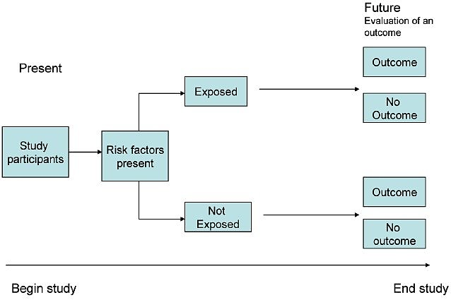
Cohort Studies
Type of an observational study – considered the gold standard
Can be prospective or retrospective in design
Definition of cohort: “group of people with defined characteristics who are followed up to determine incidence of, or mortality from, some specific disease, all causes of death, or some other outcome” (Samet, 2005)
Key advantage is that it can measure disease occurrence and its association with an exposure occurring before the outcome manifests; offering a temporal dimension important for causality assessment
Key disadvantages include the need for a large sample size and the potentially long follow-up duration resulting in high costs
Cohort studies are also susceptible to selection bias, to loss to follow-up or withdrawal over the study period (Song and Chung, 2010)
Prospective cohort study design, Source: Aslam et al. (2012)
Notes:
The below text on cohort studies is extracted from Song and Chung (2010):
“COHORT STUDY
The term “cohort” is derived from the Latin word cohors. Roman legions were composed of ten cohorts. During battle each cohort, or military unit, consisting of a specific number of warriors and commanding centurions, were traceable. The word “cohort” has been adopted into epidemiology to define a set of people followed over a period of time. W.H. Frost, an epidemiologist from the early 1900s, was the first to use the word “cohort” in his 1935 publication assessing age-specific mortality rates and tuberculosis. The modern epidemiological definition of the word now means a “group of people with defined characteristics who are followed up to determine incidence of, or mortality from, some specific disease, all causes of death, or some other outcome.”
Study Design
A well-designed cohort study can provide powerful results. In a cohort study, an outcome or disease-free study population is first identified by the exposure or event of interest and followed in time until the disease or outcome of interest occurs. Because exposure is identified before the outcome, cohort studies have a temporal framework to assess causality and thus have the potential to provide the strongest scientific evidence. Cohort studies are particularly advantageous for examining rare exposures because subjects are selected by their exposure status. Additionally, the investigator can examine multiple outcomes simultaneously. Disadvantages include the need for a large sample size and the potentially long follow-up duration of the study design resulting in a costly endeavor.
Cohort studies can be prospective or retrospective. Prospective studies are carried out from the present time into the future. Because prospective studies are designed with specific data collection methods, it has the advantage of being tailored to collect specific exposure data and may be more complete. The disadvantage of a prospective cohort study may be the long follow-up period while waiting for events or diseases to occur. Thus, this study design is inefficient for investigating diseases with long latency periods and is vulnerable to a high loss to follow-up rate. Although prospective cohort studies are invaluable as exemplified by the landmark Framingham Heart Study, started in 1948 and still ongoing,10 in the plastic surgery literature this study design is generally seen to be inefficient and impractical. Instead, retrospective cohort studies are better indicated given the timeliness and inexpensive nature of the study design.
Retrospective cohort studies, also known as historical cohort studies, are carried out at the present time and look to the past to examine medical events or outcomes. In other words, a cohort of subjects selected based on exposure status is chosen at the present time, and outcome data (i.e. disease status, event status), which was measured in the past, are reconstructed for analysis. The primary disadvantage of this study design is the limited control the investigator has over data collection. The existing data may be incomplete, inaccurate, or inconsistently measured between subjects. However, because of the immediate availability of the data, this study design is comparatively less costly and shorter than prospective cohort studies. For example, Spear and colleagues examined the effect of obesity and complication rates after undergoing the pedicled TRAM flap reconstruction by retrospectively reviewing 224 pedicled TRAM flaps in 200 patients over a 10-year period. In this example, subjects who underwent the pedicled TRAM flap reconstruction were selected and categorized into cohorts by their exposure status: normal/underweight, overweight, or obese. The outcomes of interest were various flap and donor site complications. The findings revealed that obese patients had a significantly higher incidence of donor site complications, multiple flap complications, and partial flap necrosis than normal or overweight patients. An advantage of the retrospective study design analysis is the immediate access to the data. A disadvantage is the limited control over the data collection because data was gathered retrospectively over 10-years; for example, a limitation reported by the authors is that mastectomy flap necrosis was not uniformly recorded for all subjects.
An important distinction lies between cohort studies and case-series. The distinguishing feature between these two types of studies is the presence of a control, or unexposed, group. Contrasting with epidemiological cohort studies, case-series are descriptive studies following one small group of subjects. In essence, they are extensions of case reports. Usually the cases are obtained from the authors' experiences, generally involve a small number of patients, and more importantly, lack a control group. There is often confusion in designating studies as “cohort studies” when only one group of subjects is examined. Yet, unless a second comparative group serving as a control is present, these studies are defined as case-series. The next step in strengthening an observation from a case-series is selecting appropriate control groups to conduct a cohort or case-control study, the latter which is discussed in the following section about case-control studies.
Methodological Issues
Selection of Subjects in Cohort Studies
The hallmark of a cohort study is defining the selected group of subjects by exposure status at the start of the investigation. A critical characteristic of subject selection is to have both the exposed and unexposed groups be selected from the same source population (Figure 4).9 Subjects who are not at risk for developing the outcome should be excluded from the study. The source population is determined by practical considerations, such as sampling. Subjects may be effectively sampled from the hospital, be members of a community, or from a doctor's individual practice. A subset of these subjects will be eligible for the study.
Attrition Bias (Loss to follow-up)
Because prospective cohort studies may require long follow-up periods, it is important to minimize loss to follow-up. Loss to follow-up is a situation in which the investigator loses contact with the subject, resulting in missing data. If too many subjects are loss to follow-up, the internal validity of the study is reduced. A general rule of thumb requires that the loss to follow-up rate not exceed 20% of the sample. Any systematic differences related to the outcome or exposure of risk factors between those who drop out and those who stay in the study must be examined, if possible, by comparing individuals who remain in the study and those who were loss to follow-up or dropped out. It is therefore important to select subjects who can be followed for the entire duration of the cohort study..”

Slide 17
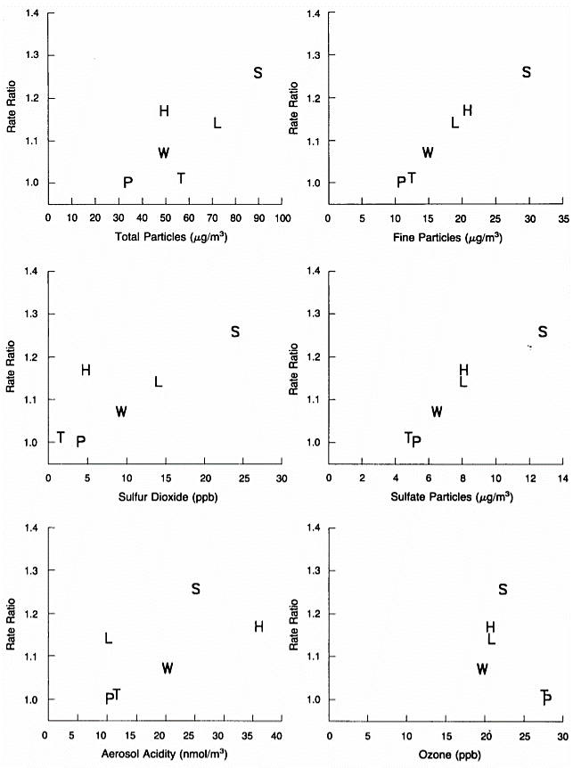
Cohort Study Example
Source: Dockery et al. (1993)
Perhaps the most famous air pollution epidemiological study is the Harvard Six Cities Study by Dockery et al. (1993)
In this paper, the authors employed a prospective cohort study design and followed up 8111 adults, since 1974, in six U.S. cities and for up to 16 years and until mortality
The six cities that were included were Watertown, Massachusetts; Harriman, Tennessee; specific census tracts of St. Louis; Steubenville, Ohio; Portage, Wisconsin; and Topeka, Kansas
Subjects were white and were 25 to 74 years of age at enrollment with data collected on their age, sex, weight, height, education, smoking history, occupational exposures, and medical history
Air pollution data was collected from ambient centrally located monitoring stations at each community
Adjusted Cox proportional hazard regression models were used for the analysis
There was a statistically significant and robust association between air pollution and mortality → The adjusted mortality-rate ratio for the most polluted of the cities as compared with the least polluted was 1.26 (a 26% increase in risk)
Notes:
The figure shown above, extracted from Dockery et al. (1993), displays city-specific mortality rates, adjusted for a variety of health risk factors, were associated with the average levels of air pollutants in the cities. The small differences in ozone levels among the cities (Table 1 in the original paper) limited the power of the study to detect associations between mortality and ozone levels. Mortality was more strongly associated with the levels of inhalable, fine, and sulfate particles than with the levels of total suspended particles, the sulfur dioxide levels, the nitrogen dioxide levels, or the acidity of the aerosol.
Abstract from Dockery et al. (1993):
“BACKGROUND
Recent studies have reported associations between particulate air pollution and daily mortality rates. Population-based, cross-sectional studies of metropolitan areas in the United States have also found associations between particulate air pollution and annual mortality rates, but these studies have been criticized, in part because they did not directly control for cigarette smoking and other health risks.
METHODS
In this prospective cohort study, we estimated the effects of air pollution on mortality, while controlling for individual risk factors. Survival analysis, including Cox proportional-hazards regression modeling, was conducted with data from a 14-to-16-year mortality follow-up of 8111 adults in six U.S. cities.
RESULTS
Mortality rates were most strongly associated with cigarette smoking. After adjusting for smoking and other risk factors, we observed statistically significant and robust associations between air pollution and mortality. The adjusted mortality-rate ratio for the most polluted of the cities as compared with the least polluted was 1.26 (95 percent confidence interval, 1.08 to 1.47). Air pollution was positively associated with death from lung cancer and cardiopulmonary disease but not with death from other causes considered together. Mortality was most strongly associated with air pollution with fine particulates, including sulfates.
CONCLUSIONS
Although the effects of other, unmeasured risk factors cannot be excluded with certainty, these results suggest that fine-particulate air pollution, or a more complex pollution mixture associated with fine particulate matter, contributes to excess mortality in certain U.S. cities.”

Slide 18
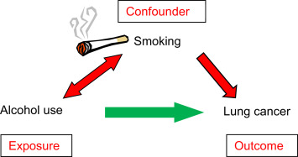
Confounding
Confounding is a distortion of the association between an exposure (e.g. air pollution) and an outcome (e.g. onset of asthma). It occurs when study groups being compared differ with respect to other factors that influence the outcome
The confounding factor is distributed unequally between the groups that are being compared
Confounders are associated with both the exposure (the risk factor of interest) and the outcome
A confounder cannot be an intermediary step in the causal pathway between the exposure and the outcome
Confounding is a kind of bias which can be adjusted for in the analysis (LaMorte and Sullivan, no date)
Illustration showing confounding and the relationship between exposure and outcome, Source: Steinke (2019)
Notes:
Extracted from LaMorte and Sullivan (no date) prepared for Boston’s University School of Public Health (https://sphweb.bumc.bu.edu/otlt/MPH-Modules/BS/BS704-EP713_Confounding-EM/BS704-EP713_Confounding-EM_print.html)
“There are three conditions that must be present for confounding to occur:
The confounding factor must be associated with both the risk factor of interest and the outcome.
The confounding factor must be distributed unequally among the groups being compared.
A confounder cannot be an intermediary step in the causal pathway from the exposure of interest to the outcome of interest.
Not surprisingly, since most diseases have multiple contributing causes (risk factors), there are many possible confounders.
A confounder can be another risk factor for the disease. For example, in the hypothetical cohort study testing the association between exercise and heart disease, age is a confounder because it is a risk factor for heart disease.
Similarly a confounder can also be a preventive factor for the disease. If those people who exercised regularly were more likely to take aspirin, and aspirin reduces the risk of heart disease, then aspirin use would be a confounding factor that would tend to exaggerate the benefit of exercise.
A confounder can also be a surrogate or a marker for some other cause of disease. For example, socioeconomic status may be a confounder in this example because lower socioeconomic status is a marker for a complex set of poorly understood factors that seem to carry a higher risk of heart disease.
Identifying Confounding
A simple, direct way to determine whether a given risk factor caused confounding is to compare the estimated measure of association before and after adjusting for confounding. In other words, compute the measure of association both before and after adjusting for a potential confounding factor. If the difference between the two measures of association is 10% or more, then confounding was present. If it is less than 10%, then there was little, if any, confounding (to see how to do in greater detail, refer to the original source).
Other investigators will determine whether a potential confounding variable is associated with the exposure of interest and whether it is associated with the outcome of interest. If there is a clinically meaningful relationship between an the variable and the risk factor and between the variable and the outcome (regardless of whether that relationship reaches statistical significance), the variable is regarded as a confounder.
Still other investigators perform formal tests of hypothesis to assess whether the variable is associated with the exposure of interest and with the outcome.
Effects of Confounding
May account for all or part of an apparent association.
May cause an overestimate of the true association (positive confounding) or an underestimate of the association (negative confounding).
The magnitude confounding can be quantified by computing the percentage difference between the crude and adjusted measures of effect. There are two slightly different methods that investigators use to compute this, as illustrated in the original source).
Percent difference is calculated by calculating the difference between the starting value and ending value and then dividing this by the starting value. Many investigators consider the crude measure of association to be the "starting value".”

Slide 19
Effect Modification
Effect modification (also referred to as interaction) is distinct from confounding; it occurs when the magnitude of the effect of the primary exposure on an outcome (i.e., the association) differs depending on the level of a third variable
Effect modification is a biological phenomenon in which the exposure has a different impact in different circumstances (Boston University School of Public Health, 2013)
When effect modification is present, computing an overall estimate for the association is misleading (LaMorte and Sullivan, no date)
A common way to deal with effect modification is to examine the association separately for each level of the third variable: i.e. stratification
Notes:
Extracted from Boston School of Public Health (2013) (https://sphweb.bumc.bu.edu/otlt/mph-modules/bs/bs704_multivariable/BS704_Multivariable4.html#:~:text=Effect%20modification%20occurs%20when%20the,level%20of%20a%20third%20variable.&text=For%20example%2C%20suppose%20a%20clinical,significant%20reduction%20in%20total%20cholesterol.)
“Effect modification occurs when the magnitude of the effect of the primary exposure on an outcome (i.e., the association) differs depending on the level of a third variable. In this situation, computing an overall estimate of association is misleading. One common way of dealing with effect modification is examine the association separately for each level of the third variable. For example, suppose a clinical trial is conducted and the drug is shown to result in a statistically significant reduction in total cholesterol. However, suppose that with closer scrutiny of the data, the investigators find that the drug is only effective in subjects with a specific genetic marker and that there is no effect in persons who do not possess the marker. The effect of the treatment is different depending on the presence or absence of the genetic marker. This is an example of effect modification or "interaction".
Unlike confounding, effect modification is a biological phenomenon in which the exposure has a different impact in different circumstances. Another good example is the effect of smoking on risk of lung cancer. Smoking and exposure to asbestos are both risk factors for lung cancer. Non-smokers exposed to asbestos have a 3-4 fold increased risk of lung cancer, and most studies suggest that smoking increases the risk of lung cancer about 20 times. However, shipyard workers who chronically inhaled asbestos fibers and also smoked had about a 64-fold increased risk of lung cancer. In other words, the effects of smoking and asbestos were not just additive – they were multiplicative. This suggests synergism or interaction, i.e., that the effect of smoking is somehow magnified in people who have also been exposed to asbestos. Multivariable methods can also be used to assess effect modification.
A stratified analysis provides a way to identify effect modification. Recall that on the previous page we used a stratified analysis to identify confounding. When there is just confounding, the measures of association in the subgroups will differ from the crude measure of association, but the measures of association across the subgroups will be similar. In contrast, when there is effect modification, the measures of association in the subgroups differ from one another.
For a more complete discussion of the phenomena of confounding and effect modification, please see the online module on these topics for the core course in epidemiology "Confounding and Effect Modification."”

Slide 20
Key Air Pollution Epidemiology Studies
The Harvard Six Cities study (Dockery et al., 1993)
The American Cancer Society Cancer Prevention Study (Krewski et al., 2005)
Air Pollution and Health: a European Approach (APHEA) (Katsouyanni et al., 1995)
National Mortality, Morbidity and Air Pollution Studies (NMMAPS) (Samet et al., 2000a; Samet et al., 2000b)
The multicenter European Study of Cohorts for Air Pollution Effects (ESCAPE) (Beelen et al., 2014)
Notes:
The above are examples of key air pollution studies which had a major influence on the field. The reader can refer to the references for a detailed description of the studies, their methods and findings.

Slide 21
Other Relevant Study Designs
The following study designs can also give insight into the health effects of air pollution, and traffic-related air pollution. For each study design, an example is given:
Experimental studies (in humans)
Chamber studies (Mills et al., 2007) → double-blind, randomized, crossover study of 20 men with prior coronary heart disease exposed to diesel exhaust in a controlled exposure facility – focus on traffic
Real-world studies (McCreanor et al., 2007) → 60 adults with mild or moderate asthma, randomized, crossover study. Each participant walked for 2 hours along Oxford Street and, on a separate occasion, through Hyde Park – focus on traffic
Intervention studies (Clancy et al., 2002) → air pollution and non-trauma, respiratory, and cardiovascular death rates compared for 72 months before and after the ban of coal sales in Dublin
Panel Studies (Vichit-Vadakan et al., 2001) → panels of schoolchildren, nurses, and adults were asked to report daily upper and lower respiratory symptoms for 3 months in association with daily PM₁₀ and PM_{2.5} from two sites
Notes:
Experimental studies investigate the health effect of controlled human exposure to individual pollutants and provides critical information on the dose-response relationships of adverse health effects. They further enable examination of the relationship of adverse effects such as symptoms and pulmonary function changes to presumed mechanisms of disease revealed through analysis of bronchoalveolar lavage fluid obtained from the lower respiratory tract for example (Rom et al., 2013). They can be chamber or real-world exposure studies.
Two key studies which are referenced above are by Mills et al. (2017) and McCreanor et al. (2007)
In Mills et al. (2007), the authors studied 20 men in a double-blinded, randomized, crossover study design. The study subjects had prior myocardial infarction and were exposed in two separate sessions to diluted diesel exhaust (300 μg per cubic meter) or filtered air for 1 hour during periods of rest and moderate exercise in a controlled-exposure facility. During the exposure, myocardial ischemia was quantified by ST-segment analysis using continuous 12-lead electrocardiography. Six hours after exposure, vasomotor and fibrinolytic function were assessed by means of intraarterial agonist infusions. It was found that during both exposure sessions, the heart rate increased with exercise and this increase was statistically significant. The increase was also similar during the two exposure scenarios: to diesel exhaust or to filtered air. Exercise-induced ST-segment depression was present in all patients, but there was a greater increase in the ischemic burden during exposure to diesel exhaust and this difference was statistically significant. Exposure to diesel exhaust did not aggravate preexisting vasomotor dysfunction, but it did reduce the acute release of endothelial tissue plasminogen activator. It is important to note that the circumstances and set-up of this experiment are different than what would occur in the real-world and therefore the results and their generalizability must be interpreted with caution.
On the other hand, the study by McCreanor et al. (2007) was conducted in a real-world setting in London and was also focused on traffic-related air pollution. 60 adults with mild or moderate asthma participated in this study and each walked for two hours along a busy London street (Oxford street) and then on another occasion, through a nearby urban park (Hyde Park). Their real-time exposure, physiological, and immunologic measurements, were collected in detail. When walking along Oxford street, participants had a significantly higher exposure to a multitude of pollutants related to traffic: PM_{2.5}, ultrafine particles, elemental carbon, and nitrogen dioxide. Walking along Oxford Street produced asymptomatic but consistent reductions in the forced expiratory volume in 1 second (FEV1) (up to 6.1%) and forced vital capacity (FVC) (up to 5.4%) that were significantly larger
than the reductions in FEV1 and FVC after exposure in Hyde Park. These effects were larger in subjects with moderate asthma and were accompanied by increases in biomarkers of neutrophilic inflammation and airway acidification. The most consistent associations were seen with exposure to ultrafine particles and elemental carbon. These findings served as a demonstration and explanation of the epidemiological evidence that associates traffic exposure with lung function in asthma patients.
Intervention studies can also confirm and lend further plausibility to the associations observed in epidemiology. For example, Clancy et al. (2002) assessed the effects of air pollution reductions resulting from the ban on coal sales in Dublin comparing rates of cardiovascular deaths for 72 months both before and after the ban of coal. The effect of the ban was assessed using an interrupted time-series analysis, adjusting for weather, respiratory epidemics, and death rates in the rest of Ireland. The authors found that black smoke concentrations declined by 70% after the ban, decreasing non-trauma death rates by 5.7%, respiratory deaths by 15.5% and cardiovascular deaths by 10.3%, all of which are statistically significant.
Finally, the study by Vichit-Vadakan et al. (2001) attempted to replicate observations found in North America and linking air pollution to respiratory symptoms in three panels of schoolchildren, nurses and adults. The study was conducted in Bangkok, Thailand, where the three panels reported daily upper and lower respiratory symptoms for 3 months, in association with PM₁₀ and PM_{2.5} concentrations collected at two sites. Generally, associations were found between these pollution metrics and the daily occurrence of both upper and lower respiratory symptoms in each of the panels. For example, an interquartile increase of 45 microg/m(³) in PM₁₀ was associated with about a 50% increase in lower respiratory symptoms in the panel of highly exposed adults, about 30% in the children, and about 15% in the nurses. These estimates were not appreciably altered by changes in the specification of weather variables, stratification by temperature, or inclusion of individual characteristics in the models; however, time trends in the data cause some uncertainty about the magnitude of the effect of PM on respiratory symptoms. These pollutants were also associated with the first day of a symptom episode in both adult panels but not in children. The estimated odds ratios were generally consistent with and slightly higher than the findings of previous studies conducted in the United States.

Slide 22
Public Health and Policy Relevance
Air pollution epidemiology studies provide many new insights that are/were especially useful to policy makers and which supported critical environmental policy decisions (Fann et al., 2011)
For example, they had an influence on the US Environmental Protection Agency’s (EPA) development of National Air Quality Standards (NAAQS) for the six ‘criteria’ pollutants and the levels of the World Health Organization (WHO) air quality guidelines in Europe
Epidemiological findings are the basis for quantitative risk assessments/burden of disease assessments and health impact assessments (see lecture #38)
Epidemiological studies from countries with low levels of air pollution have also demonstrated adverse health effects even below current limit values and guidelines and these results highlight the need to evaluate and revise air quality standards (Andersen, 2020)
Notes:
Extracted from Fann et al. (2011):
“Air pollution epidemiology plays an integral role in both identifying the hazards of air pollution to human health and informing the design and implementation of air quality policy (Greenbaum et al. 2001). A large and growing body of epidemiological studies has helped characterize for policy makers the link between ambient air pollution and the risk of an array of adverse health outcomes. In particular, those studies that have observed a relationship between both long-term exposure to particulate matter ≤ 2.5 μm in aerodynamic diameter (PM2.5) and premature death and between short-term ozone exposure and morbidity impacts have provided key empirical evidence in support of air quality standards (Ito et al. 2003; Pope et al. 2002). The findings of these and other epidemiological studies have informed critical policy decisions regarding the appropriate levels of the National Ambient Air Quality Standards for the six common “criteria pollutants” in the United States [U.S. Environmental Protection Agency (EPA) 2007b] and the levels of the World Health Organization (WHO) air quality guidelines (WHO 2005) in Europe.
No less important, but perhaps not as broadly recognized, is the role of air pollution epidemiology in supporting quantitative risk assessments—principally by providing the risk coefficients that relate air quality changes to the probability of a variety of adverse health outcomes, including premature death, hospital visits, and acute respiratory symptoms, among many others. In general, risk assessments aim to answer one of two types of policy questions. First, what is the total public health burden associated with exposure to air quality levels above some background level in terms of the number of excess cases of premature death or illness? Examples of this type of analysis include a report by Cohen et al. (2004) that quantified about 800,000 premature PM2.5-related deaths per year in urban areas globally and a global burden assessment by Anenberg et al. (2010) that estimated approximately 4.2 million premature deaths per year attributable to anthropogenic PM2.5 and ozone. A second and related question is, what would be the impact on human health of incremental changes in air quality due to a proposed policy? As an example, the U.S. EPA assessment of the benefits of the Clean Air Act Amendments of 1990 [Clean Air Act Amendments 1990; §109(b)(1)] estimated approximately 230,000 PM2.5 and ozone-related premature deaths were avoided beginning in 2020 due to the implementation of the Clean Air Act Amendments (U.S. EPA 2011). In Europe, a WHO analysis of transboundary air pollution found that a climate policy incorporating “maximally technically feasible reductions” could reduce the number of ozone-related deaths by approximately 8,000 per year (WHO 2008).
These types of quantitative risk assessments are frequently performed in a cost–benefit framework where the health impact estimates expressed as an economic value can be substantial (U.S. EPA 2010). The risk assessment accompanying a recent rule affecting coal-burning electrical-generating units used risk coefficients drawn from two long-term mortality studies based on the American Cancer Society and Harvard Six Cities cohorts (Laden et al. 2006; Pope et al. 2002) to estimate a change in PM2.5-related premature mortality of 14,000 and 36,000; the analysis estimated the economic value of these and other health and welfare benefits to be between $120 to $270 billion U.S. dollars (3% discount rate, 2006 dollars) (U.S. EPA 2010). In many cases, the findings of these risk and benefits assessments are broadly cited by the media and used by policy makers to justify significant changes in air quality policy (New York Times 2010; U.S. Congress 2010).”

Slide 23
Research Gaps and Future Directions
Need to improve the linkages between air pollution epidemiology and quantitative risk assessments/burden of disease assessments and health impact assessments (Fann et al., 2011)
Need to better investigate non-exhaust vehicular emissions from tire and road wear and their health effects, especially relevant with the expected wide adaptation of electric vehicles in the future
Rapid technological advancements in for example, the development of low-cost air quality sensors, the use of OMICS techniques, satellite data etc. present exciting future directions but also a need for more complex statistical and epidemiological approaches to handle big data
There are many remaining gaps in the exposure assessment exercise which is critical in air pollution epidemiology studies
Most frequently, the exposure assessment is conducted at the residence without accounting for time-activity patterns (Khreis and Nieuwenhuijsen, 2017)

Slide 24
Take-Home Messages
Air pollution epidemiology focuses on air pollution as a determinant of human health i.e. risk factor for multiple health effects
Air pollution has been studied in relation to many health outcomes and short or long-term air pollution exposure and has been associated with premature mortality and a wide spectrum of global diseases which has been increasing
Methods for analysis of short-term versus log-term data are different
Cohort studies are considered the gold standard in air pollution epidemiology
Analysis of epidemiological data can be biased due to many reasons notably including selection bias, confounding and effect modification which need to be adjusted/accounted for in the analysis
Air pollution epidemiology plays an integral role in both identifying hazards of air pollution to human health and informing design and implementation of air quality policy and programs including predictive modeling

Slide 25
List of Abbreviations
CO: Carbon Monoxide
BC: Black Carbon
EPA: Environmental protection Agency
GAM: Generalized Additive Model
HCC: Hepatocellular Carcinoma
NAQS: National Air Quality Standards
NATA: National Air Toxics Assessment
NO₂: Nitrogen Dioxide
NO_{x}: Nitrogen Oxides
O₃: Ozone
Pb: Lead
PM_{2.5}: Particulate Matter with diameter < 2.5µm
PM₁₀: Particulate Matter with diameter < 10µm
SO₂: Sulfur Dioxide
TRAP: Traffic-Related Air Pollution
UFP: Ultra-Fine Particles, particulate matter with diameter < 0.1µm
US: United States
WHO: World Health Organization

Slide 26
References
Andersen, Z., 2020. Air Pollution Epidemiology. Book Chapter, Traffic-Related Air Pollution: Emissions, Human Exposures, and Health. Editors: Khreis, H., Nieuwenhuijsen, M., Ramani, T., Zietsman, J. Elsevier.
Aslam, S., Georgiev, H., Mehta, K. and Kumar, A., 2012. Matching research design to clinical research questions. Indian journal of sexually transmitted diseases and AIDS, 33(1), p.49.
Beelen, R., Raaschou-Nielsen, O., Stafoggia, M., Andersen, Z.J., Weinmayr, G., Hoffmann, B., Wolf, K., Samoli, E., Fischer, P., Nieuwenhuijsen, M. and Vineis, P., 2014. Effects of long-term exposure to air pollution on natural-cause mortality: an analysis of 22 European cohorts within the multicenter ESCAPE project. The Lancet, 383(9919), pp.785-795.
Bhaskaran, K., Gasparrini, A., Hajat, S., Smeeth, L. and Armstrong, B., 2013. Time series regression studies in environmental epidemiology. International journal of epidemiology, 42(4), pp.1187-1195.
Boston University School of Public Health, 2013. Multivariable Methods. Effect Modification. Available from: https://sphweb.bumc.bu.edu/otlt/mph-modules/bs/bs704_multivariable/BS704_Multivariable4.html#:~:text=Effect%20modification%20occurs%20when%20the,level%20of%20a%20third%20variable.&text=For%20example%2C%20suppose%20a%20clinical,significant%20reduction%20in%20total%20cholesterol
Centers for Disease Control and Prevention, 2012. Principles of Epidemiology in Public Health Practice, Third Edition. An Introduction to Applied Epidemiology and Biostatistics. Section 1: Definition of Epidemiology. Available from: https://www.cdc.gov/csels/dsepd/ss1978/Lesson1/Section1.html#_ref1

Slide 27
References
Cicalese, L., Raun, L., Shirafkan, A., Campos, L., Zorzi, D., Montalbano, M., Rhoads, C., Gazis, V., Ensor, K. and Rastellini, C., 2017. An ecological study of the association between air pollution and hepatocellular carcinoma incidence in Texas. Liver Cancer, 6(4), pp.287-296.
Clancy, L., Goodman, P., Sinclair, H. and Dockery, D.W., 2002. Effect of air-pollution control on death rates in Dublin, Ireland: an intervention study. The lancet, 360(9341), pp.1210-1214.
Coggon, D., Rose, G. and Barker, D.J.P., 2003. Epidemiology for the uninitiated. London. British Medical Journal.
Dockery, D.W., Pope, C.A., Xu, X., Spengler, J.D., Ware, J.H., Fay, M.E., Ferris Jr, B.G. and Speizer, F.E., 1993. An association between air pollution and mortality in six US cities. New England journal of medicine, 329(24), pp.1753-1759.
Fann, N., Bell, M.L., Walker, K. and Hubbell, B., 2011. Improving the linkages between air pollution epidemiology and quantitative risk assessment. Environmental health perspectives, 119(12), pp.1671-1675.
Health Knowledge, 2018. The design, applications, strengths and weaknesses of descriptive studies and ecological studies. Available from: https://www.healthknowledge.org.uk/public-health-textbook/research-methods/1a-epidemiology/descriptive-studies-ecological-studies
Iskandar, A., Andersen, Z.J., Bønnelykke, K., Ellermann, T., Andersen, K.K. and Bisgaard, H., 2012. Coarse and fine particles but not ultrafine particles in urban air trigger hospital admission for asthma in children. Thorax, 67(3), pp.252-257.

Slide 28
References
Katsouyanni, K., Zmirou, D., Spix, C., Sunyer, J., Schouten, J.P., Ponka, A., Anderson, H.R., Le Moullec, Y., Wojtyniak, B. and Vigotti, M.A., 1995. Short-term effects of air pollution on health: a European approach using epidemiological time-series data. The APHEA project: background, objectives, design. European Respiratory Journal, 8(6), pp.1030-1038.
Khreis, H. and Nieuwenhuijsen, M.J., 2017. Traffic-related air pollution and childhood asthma: recent advances and remaining gaps in the exposure assessment methods. International journal of environmental research and public health, 14(3), p.312.
Krewski, D., Burnett, R., Jerrett, M., Pope, C.A., Rainham, D., Calle, E., Thurston, G. and Thun, M., 2005. Mortality and long-term exposure to ambient air pollution: ongoing analyses based on the American Cancer Society cohort. Journal of Toxicology and Environmental Health, Part A, 68(13-14), pp.1093-1109.
LaMorte, W.W. and Sullivan, L. (no date). Confounding and Effect Measure Modification. Boston University School of Public Health. Available from: https://sphweb.bumc.bu.edu/otlt/MPH-Modules/BS/BS704-EP713_Confounding-EM/BS704-EP713_Confounding-EM_print.html
Last, J.M., 2001. A Dictionary of Epidemiology. 4th.
Lindgren, A., Stroh, E., Montnémery, P., Nihlén, U., Jakobsson, K. and Axmon, A., 2009. Traffic-related air pollution associated with prevalence of asthma and COPD/chronic bronchitis. A cross-sectional study in Southern Sweden. International journal of health geographics, 8(1), p.2.

Slide 29
References
McCreanor, J., Cullinan, P., Nieuwenhuijsen, M.J., Stewart-Evans, J., Malliarou, E., Jarup, L., Harrington, R., Svartengren, M., Han, I.K., Ohman-Strickland, P. and Chung, K.F., 2007. Respiratory effects of exposure to diesel traffic in persons with asthma. New England Journal of Medicine, 357(23), pp.2348-2358.
Mills, N.L., Törnqvist, H., Gonzalez, M.C., Vink, E., Robinson, S.D., Söderberg, S., Boon, N.A., Donaldson, K., Sandström, T., Blomberg, A. and Newby, D.E., 2007. Ischemic and thrombotic effects of dilute diesel-exhaust inhalation in men with coronary heart disease. New England Journal of Medicine, 357(11), pp.1075-1082.
Rom, W.N., Boushey, H. and Caplan, A., 2013. Experimental human exposure to air pollutants is essential to understand adverse health effects. American Journal of Respiratory Cell and Molecular Biology, 49(5), pp.691-696.
Samet, J.M., Dominici, F., Zeger, S., Schwartz, J. and Dockery, D.W., 2000 (a). The National Morbidity, Mortality, and Air Pollution Study. Part I: Methods and methodologic issues. Research report (Health Effects Institute), (94 Pt 1).
Samet, J.M., Zeger, S.L., Dominici, F., Curriero, F., Coursac, I., Dockery, D.W., Schwartz, J. and Zanobetti, A., 2000 (b). The national morbidity, mortality, and air pollution study. Part II: morbidity and mortality from air pollution in the United States Res Rep Health Eff Inst, 94(pt 2), pp.5-79.
Samet, J.M., 2005. A History of Epidemiologic Methods and Concepts: Edited by Alfredo Morabia ISBN 3-7643-6818-7, Birkhäser Verlag, Basel, Switzerland (Website: www. birkhauser. ch), 2004, 405.

Slide 30
References
Song, J.W. and Chung, K.C., 2010. Observational studies: cohort and case-control studies. Plastic and reconstructive surgery, 126(6), p.2234.
Steinke, D.T., 2019. Essentials of Pharmacoepidemiology. In Clinical Pharmacy Education, Practice and Research (pp. 203-214). Elsevier.
Sundvor, I., Balaguer, N.C., Viana, M., Querol, X., Reche, C., Amato, F., Mellios, G. and Guerreiro, C., 2012. Road traffic’s contribution to air quality in European cities. ETC/ACM technical paper, 14, p.74.
US Environmental Protection Agency, 2014. 2014 National Emissions Inventory report. Available from: https://gispub.epa.gov/neireport/2014/
Vichit-Vadakan, N., Ostro, B.D., Chestnut, L.G., Mills, D.M., Aekplakorn, W., Wangwongwatana, S. and Panich, N., 2001. Air pollution and respiratory symptoms: results from three panel studies in Bangkok, Thailand. Environmental Health Perspectives, 109(suppl 3), pp.381-387.
Wilkins, E. T. (1954). Air pollution aspects of the London fog of December 1952. Quarterly Journal of the Royal Meteorological Society, 80(344), 267–271.

Slide 31
Reading List
Burnett, R., Chen, H., Szyszkowicz, M., Fann, N., Hubbell, B., Pope, C.A., Apte, J.S., Brauer, M., Cohen, A., Weichenthal, S. and Coggins, J., 2018. Global estimates of mortality associated with long-term exposure to outdoor fine particulate matter. Proceedings of the National Academy of Sciences, 115(38), pp.9592-9597.
Fedak, K.M., Bernal, A., Capshaw, Z.A. and Gross, S., 2015. Applying the Bradford Hill criteria in the 21st century: how data integration has changed causal inference in molecular epidemiology. Emerging themes in epidemiology, 12(1), p.14.
Jaakkola, J.J.K., 2003. Case-crossover design in air pollution epidemiology. European Respiratory Journal, 21(40 suppl), pp.81s-85s.
National Research Council, 1997. Environmental-Epidemiology Studies: Their Design and Conduct. In Environmental Epidemiology: Volume 2: Use of the Gray Literature and Other Data in Environmental Epidemiology. National Academies Press (US).

Slide 32
Acknowledgements
The authors acknowledge substantial materials adapted from the chapter titled “Air Pollution Epidemiology” by Zorana Andersen
The author also acknowledges critical review and feedback from Mark J. Nieuwenhuijsen, Professor at the Barcelona Institute for Global Health (ISGlobal)

