Slide 1
www.carteeh.org

Slide 2
Lecture #1: Air Quality and Air Pollution
Michael O. Rodgers, Ph.D.
Regents Researcher and Adjunct Regents Professor
School of Civil and Environmental Engineering and School of Public Policy
Georgia Institute of Technology
Atlanta, GA 30332
Michael.Rodgers@ce.gatech.edu, (404) 385-0569
In addition to his academic affiliation, Dr. Rodgers is a Principal at Avatar Environmental and Technical Services, Marietta, GA 30062
The author declares that there is no conflict of interest
Lecture Track(s): HT/TT/PPT
Notes:
Health Track (HT)—mainly targeted at urban planners, transportation planners, and engineers with limited knowledge of public health-related concepts;
Transportation Track (TT)—mainly targeted at environmental epidemiologists and public health professionals with limited knowledge of transportation-related concepts; and;
Planning and Policy Track (PPT)—mainly targeted at planners, civil servants, and policy and decision makers with particular interest in the science-policy link.

Slide 3
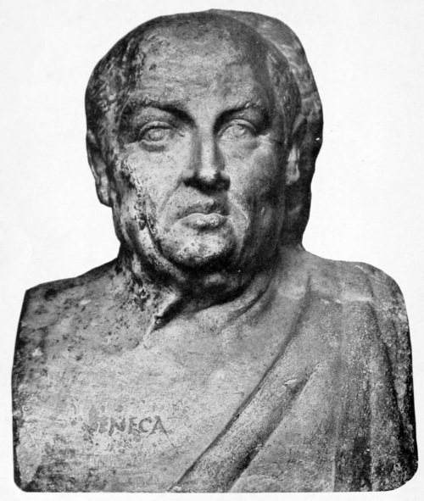
Gravioris Caeli (Air Pollution) in Ancient Rome
“But I have been consigned, so to speak, to one special ailment (asthma)… it is well enough described as "shortness of breath." Its attack is of very brief duration, like that of a squall at sea; it usually ends within an hour. Who indeed could breathe his last for long? ”
“As soon as I had escaped the heavy air of Rome and the stench of its smoky chimneys, which when stirred poured forth whatever pestilent vapors and soot they held enclosed, I felt a change in my disposition.”
Seneca the Younger, Roman Stoic Philosopher and Teacher of the Emperor Nero, excerpts from Moral Letters to Lucilius. 61 CE
Gutenberg.org
Notes:
The Latin name for air pollution was gravioris caeli (heaven is heavy)
In addition to Seneca the Youngers quotes, that come from two different letters, there are many other accounts of the impact of air pollution in the Greco-Roman world.
The Roman Poet Horace (65 BCE – 8 CE) in his Odes and Carmen Saeculare bemoaned the “smoke-grimed statues scarce divine” that were present throughout Rome.
For his part, Aristotle in his work Athenaion Politica, proposed that the city manure piles should be placed at least 2 km from city walls.
Many of the adverse health effects of air pollution were also known in ancient times. In addition to Seneca’s association of his asthmatic crises with Roman air pollution noted above, the first known direct clinical account of acute lead poisoning from mining operations was provided by Hippocrates. Pliny the Elder (23-79 CE) in his Naturalis Historia noted that slaves that mined or wove asbestos suffered from lung disorders (more information on Pliny’s accounts are provided on the next slide). Galen of Pergamon (129 CE- circa 210 CE), a physician to the gladiators and prolific writer/researcher whose views on medicine dominated western thought for more than 1000 years, recommended that gladiators be trained in the “fresh air” outside of cities to improve their performance.
The Roman Senate enacted a law near the beginning of the common era which stated “Aerem corrumpere non licet” (It is prohibited to pollute the air) and thus,
Roman cheese-making facilities were required to locate where their smoke would not pollute other homes and horse drawn wagons were prohibited within the confines of Rome itself.

Slide 4
Air Pollution
Air Pollution can be defined as: the introduction of any chemical, physical or biological agent into an atmosphere that has the potential to cause adverse impacts
Air Pollution is not a new problem
In ancient Babylon (circa 1754 BCE), one of Hammurabi’s codes (no. 232) specified compensation for another’s property damaged by your smoke.
Many ancient Egyptian mummies have evidence of smoke induced lung disease as do more recent mummified remains of Vikings.
Pliny the Elder (23-79 CE) in his Naturalis Historia noted that slaves that mined or wove asbestos suffered from lung disorders.
Edward I “Longshanks” (1239-1307 CE), King of England from 1272-1307 CE banned burning “sea coal” while parliament was in session under penalty of death.
Notes:
The definition of “air pollution” is, of necessity somewhat vague. For example, these introductions may be intentional (e.g. an exhaust emission) or unintentional (e.g. from a leak in a pipe or an industrial accident) and could be in solid (e.g. dust), liquid (e.g. a pesticide mist) or gaseous (e.g. carbon monoxide from an automobile tailpipe) form. The “atmosphere” could be either the natural atmosphere or could be some confined space (e.g. within a building or within the cab of a truck). Likewise there are a range of potential adverse impacts. These adverse impacts could range of negative impacts on humans (human health impacts) or on plants or animals (environmental impacts) but also on materials (e.g. deterioration of building materials) or on “air quality related values” (e.g. reduced visibility at a scenic vista). Similarly, these impacts can occur over the short-term (e.g. an acute toxic response) or require prolonged exposure over a long period of time (e.g. development of some types of cancers).
Hammurabi’s code 232. “If it ruin goods, he shall make compensation for all that has been ruined…”
Egyptian Mummies: Roger Montgomerie and his colleagues at the University of Manchester found evidence of air pollution induced lung disease in fifteen Egyptian mummies from Dahkleh Oasis (~800 km SSE from Cairo). They noted similar exposure levels to today impacting all social classes.
Pliny the Elder: Actual name was Gaius Plinius Scundus, a Roman army and naval commander turned author and naturalist. He was the author of Naturalis Historia, the earliest surviving encyclopedia consisting of 37 volumes covering history, art, mineralogy, geology, botany, zoology, astronomy and culinary, viticulture and mining technology.
Pliny wrote extensively on mining and noted that the air quality in underground mines had health impacts. He discussed the desirability and means to improve mine ventilation including the design of a dusk mask for miners that he believed would improve health. He specifically discussed how the slaves who mined and/or wove asbestos often suffered from lung disorders. The tablecloths and napkins used by the Roman upper classes were often made of asbestos as they could be made whiter than normal cloth simply by throwing them in fire.. Pliny also noted that smelter emissions were dangerous to animals, especially dogs.
Pliny died as a result of the eruption of Mt. Vesuvius near Pompeii where he was leading a rescue effort for some survivors. He may have died from inhalation of toxic vapors.
Edward I (Longshanks): If this name sounds familiar, it is because he is the “evil king” portrayed in the movie “Braveheart”.

Slide 5
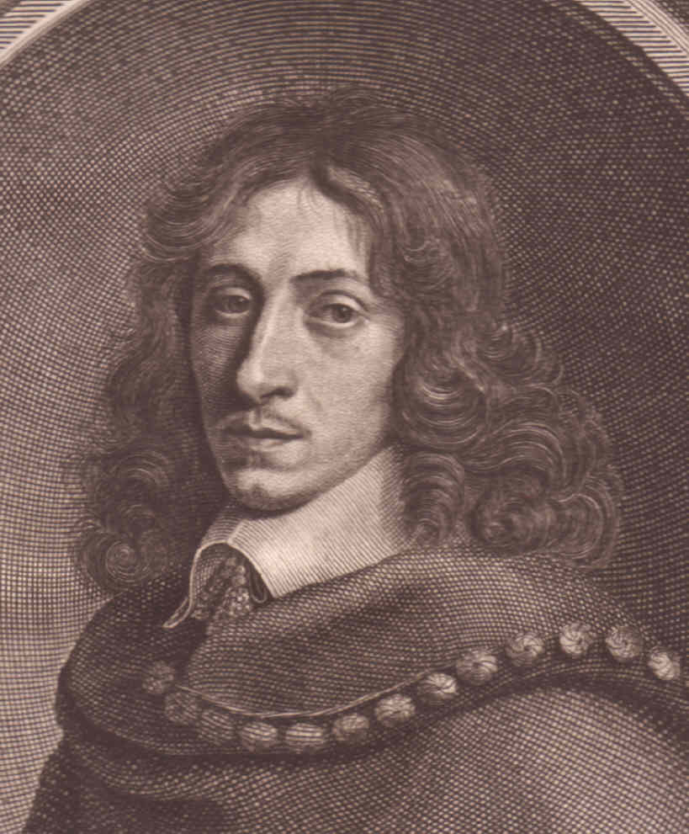
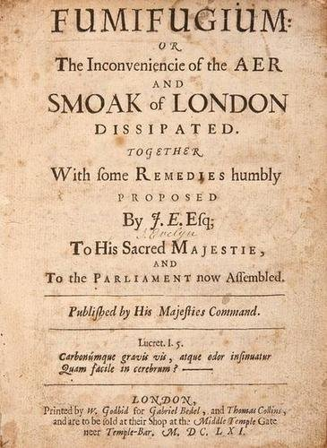
Fumifugium (1661)
John Evelyn (1620-1706 CE)
Written by John Evelyn an English aristocrat and father of the “English Garden” to King Charles II of England.
Blamed the poor air quality of London on the burning of sea coal
Proposed substitution of wood for coal for domestic heating in the environs of London
Parodied in the “Ballad of Gresham College” in 1663
Alamy.com
Theehp.com
Notes:
John Evelyn was an English “country gentleman” and expert on gardening and silviculture. He was a prolific of more than 30 books on these and other topics but is perhaps best known for his diary that spanned the years from 1640 (when he was a student at Gresham College) to his death in 1706. His diary is heavily used by scholars to understand the characteristics of everyday life (albeit for a gentleman) during the period.
As discussed in the last slide, poor air quality in London due to the burning of sea coal for domestic heating had been a problem since medieval times (e.g. Edward I’s ban on sea coal). “Sea coal” was an inexpensive sub-bituminous coal of relatively low heating value due to its high water content and was generally avoided for industrial applications (e.g. metallurgy). It was, however, relatively inexpensive and used for domestic heating purposes although it produced large quantities of smoke (also due to its high water content).
Evelyn, an expert on silviculture, proposed that sufficient quantities of wood could be produced to substitute for sea coal for heating applications and thus improve London’s air. The plans were never implemented but his efforts were the subject a comments from his fellow Gresham College alumni in their annual “Ballad of Gresham College” in 1663. The relevant passages (stanzas 22-24) are provided below and on the next (optional) slide.
Ballad of Gresham College (1663)
22.
To guesse by one everyone's meritt, A Booke call'd Fumifugium read. Its Author hath a publique spirit And doubtlesse too a subtile head He must be more than John an Oake Who writes soe learnedly of smoake.
23.
He shewes that 't is the seacoale smoake
That allways London doth Inviron, Which doth our Lungs and Spiritts choake, Our hanging spoyle, and rust our Iron. Lett none att Fumifuge be scoffing Who heard att Church our Sundaye's Coughing.
24.
For melioration of the Ayre Both for our Lungs and eke our noses, To plant the Fields he doth take care With Cedar, Juniper and Roses, Which, turn'd to trees, 't is understood, Wee shall instead of coale burne wood

Slide 6
Ballad of Gresham College (1663)
22.
To guesse by one everyone's meritt, A Booke call'd Fumifugium read. Its Author hath a publique spirit And doubtlesse too a subtile head He must be more than John an Oake Who writes soe learnedly of smoake.
24.
For melioration of the Ayre Both for our Lungs and eke our noses, To plant the Fields he doth take care With Cedar, Juniper and Roses, Which, turn'd to trees, 't is understood, Wee shall instead of coale burne wood
23.
He shewes that 't is the seacoale smoake
That allways London doth Inviron, Which doth our Lungs and Spiritts choake, Our hanging spoyle, and rust our Iron. Lett none att Fumifuge be scoffing Who heard att Church our Sundaye's Coughing
Notes:
The ballad is interesting in that the (unknown) author nots the general knowledge of the health effects of air pollution (“which doth our Lungs and Spirits choake (choke)”, our hanging (i.e. curing meats) spoyle (spoil) and rust our Iron (materials effects).

Slide 7
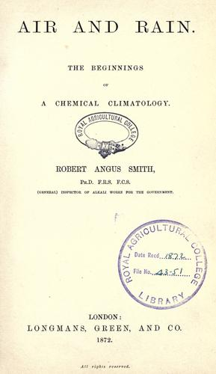
Air Pollution and the Industrial Revolution
Robert Angus Smith (1817-1884 CE)
First Alkali Inspector in England
Wrote the first modern treatise on air pollution “Air and Rain: The Beginning of a Chemical Climatology (1872)” in which he coined the term “Acid Rain”
Noted the human health impacts of air pollution:
“Medical men have objected to the argument that any evil can result from these effects (Air Pollution) , saying that man is formed so as to resist such influences…but that they are evil omens is true, or we have long been deceived.”
R.A. Smith
Air and Rain, p. 224
Longmans-Green, London (1872)
Notes:
One of the serious air pollution issues of the late nineteenth century was from the production of caustic soda (lye or sodium hydroxide) that was used in a range of industrial processes. R.A. Smith was appointed as the first “Alkali Inspector” for England to ensure that the (minimal) safety precautions associated with production of these industrial chemicals were not ignored (as they often were). Emissions from these factories often had a devastating impact on the surrounding vegetation. These results are noted in the quote on the next slide.

Slide 8
Environmental Effects of Air Pollution in Nineteenth Century England
“In many parts [of Lancashire, Dr. Cameron] found the trees and hedges utterly destroyed. He saw a crop of Wheat, the produce of 6 acres, so much injured by the exhalations of a cluster of chemical works that it was not worth threshing. On the farm on which this crop was produced, every vegetable bore the marks of acid, and on some of them it could be distinctly tasted. A plantation of Willows close to the works was utterly burnt up. All this damage was done within two years. . . . Fruit trees resisted better than most forest trees. All kinds of crops were affected by the gases, and the health of animals pastured near chemical works suffered. “
"The Influence of Exhalations from Manufactories on Agricultural Products" by Dr. Cameron reported in Gardeners' Chronicle, N.S., 1: pp. 274-275. (1874)
Notes:
Similar observations were also made by a wide range of other authors.

Slide 9
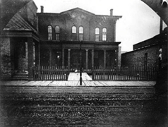
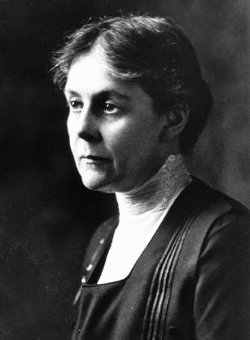
Occupational Exposure to Air Pollution
Alice Hamilton (1869-1970)
First woman appointed to the faculty of Harvard Medical School
Worked with Jane Addams at Hull House in Chicago on Occupational Medicine
Opposed the Introduction of Tetraethyl Lead into Motor Fuels in the 1920’s
Hull House 1930 (U. Chicago)
“There can be no intelligent control of the lead danger in industry unless it is based on the principle of keeping the air clear from dust and fumes. “
Alice Hamilton
Industrial Toxicology, p. 21 (1934)
Harvard University
Notes:
At this point, students often ask “If everyone knew that air pollution was bad, why didn’t they do something about it?”. The answer is, of course, complicated. However, it is not as strange as it may seem. Although our current estimates of air pollution in cities at this should have resulted in many deaths and other adverse health outcomes, the reality was that many more people were suffering adverse health impacts due to industrial and automobile accidents (the death rate on a per-mile basis was 10-30x current fatality rates for car crashes), smoking (and second hand smoke) and due to occupational exposure to toxic compounds. From the manufacture of lead-based paints to the use of asbestos in homes and shipbuilding workers, workers in numerous industries, and in some cases the general public, were exposed to range of acute toxins. In particular, Alice Hamilton’s work with Jane Addams at Hull House in Chicago on lead poisoning of workers in a variety of industries resulted in the creation of the new field of “Industrial Toxicology”. Building on this legacy in subsequent years, additional studies identified high levels of lung disease among coal miners (Black Lung Disease), cotton workers (Brown Lung Disease), and various jobs involved with silica containing materials (Silicosis) as well as others less prevalent diseases (e.g. asbestosis) (see for example: American Thoracic Society (2010) listed in the Additional Readings).
Because of the high rates of lung disease, and other maladies, associated with both smoking and industrial exposures to air pollutants the potential impacts of broader air pollution issues rarely emerged as a major public issue until the second half of the century except for particular events (described on the next slide) that highlighted a growing air pollution problem.

Slide 10
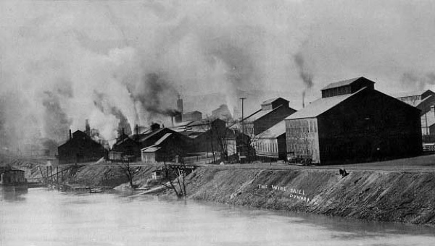
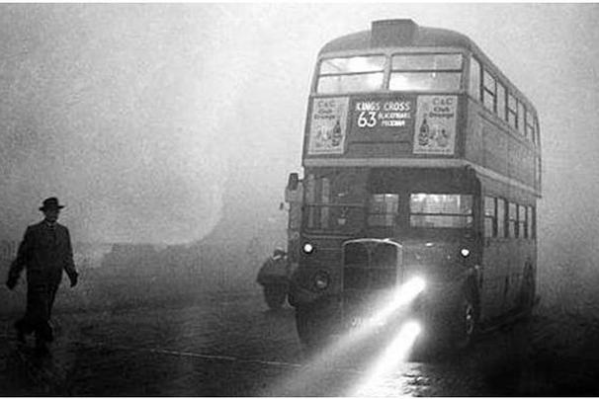
Major 20th Century Air Pollution Events
Meuse Valley, Belgium (1930)
65 deaths due to thermal inversion (flouride)
Donora, Pennsylvania (1948)
20 deaths due to thermal inversion
London, England (1952)
“Killer Fog” resulting in ~4000 deaths
Sulfur Dioxide and other compounds
Bhopal, India (1984)
~4000-22,000 deaths and ~575,000 injuries
Industrial accident (methyl isocyanate)
Meuse Valley 1930 (listserve.com)
London Killer Fog 1952 (wjla.com)
Notes:
As mentioned earlier, during the first half of the twentieth century many citizens simply viewed air pollution as one of the nuisances associated with urban living and not necessarily as a potential life-threatening condition. However, there were a number of instances in which particular circumstances, normally thermal inversions that limit vertical mixing, resulted in high concentrations of pollutants in certain locales that were sufficient to produce noticeable numbers of deaths in a short period. Often these thermal inversions were exacerbated by valley location (e.g. the Meuse Valley in Belgium and Denora, Pennsylvania) that also restricted horizonal dispersion. The London “Killer Fog” of December 1952 was similarly the result for stagnant meteorological conditions. During this episode, vehicles needed their lights at noon and much of the population was forced to remain indoors due to difficulty in breathing. At the peak of the episode (December 8, 1952) the concentration of “smoke” particles reached 1600 micrograms/cubic-meter (the U.S. Standard for Total Suspended particulate matter is currently 65 micrograms/cubic-meter) and sulfur dioxide concentrations reached a high of 700 parts-per-billion. As a result of these conditions, the number of deaths in greater London increased from its normal value of about 300/day to a high of 900/day at the peak of the episode. The 1984 industrial accident at a Union Carbide facility in Bhopal, India resulted in the release of significant quantities (the exact quantity is still in dispute) of methyl isocyanate, a toxic compound used in the manufacture of pesticides, into the city and exposing more than 600,000 people. Over 2200 died in the immediate aftermath of the incident and estimates of those who died later from gas-related diseases vary widely from about 1500 to more than 20,000.

Slide 11
Los Angeles Photochemical Smog
The word “Smog” was originally derived as a contraction of the words “smoke” and “fog” and was used to describe the wintertime conditions in London in the early twentieth century
In 1943, the Los Angeles basin had its first recognized “Smog” episode with reduced visibility, burning eyes, shortness-of-breath, and nausea.
By the late 1940’s it was clear that Los Angeles “Smog” was fundamentally different than that from London
Worse in the summer rather than the winter
Relatively little coal was burned in Los Angeles
Was not associated with coastal fogs but rather was worse on sunny days
Notes:
The first recorded instance of the use of the word “smog” was by a London physician, Harold Des Veaux, in 1905 who described the wintertime conditions in London as a mixture of Fog and Smoke from coal burning for industrial uses and domestic heating.
The Los Angeles Air Pollution Control District was created in 1947 to deal with the problems of Los Angeles Smog. It’s initial efforts to control smokestack emissions from power plants, oil refineries, and industrial facilities had little impact on the problem and the district turned to an organic chemistry professor, Arie J. Haagen-Smit, on a leave-of-absence from Caltech to establish the nature of the problem. In a remarkable series of experiments in a “smog chamber”, Haagen-Smit determined that “active ingredient” in Los Angeles Smog were oxidants (specifically ozone (O₃) and to a lesser extent another oxidant peroxy-acetyl nitrate (PAN)) that were produced from photochemical reactions involving two of the major components of automobile exhaust (volatile organic compounds and nitrogen oxides). Haagen-Smits work is described in the next slide.

Slide 12
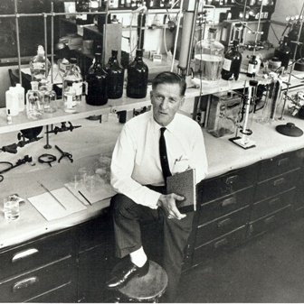
Formation of Photochemical Smog
A.J. Haagen-Smit (1900-1977)
During a one-year leave-of-absence from Caltech, Prof. Arie J. Haagen-Smit conducted a series of “smog chamber” experiments at the Los Angeles Air Pollution Control District laboratory.
Haagen-Smit (Haagen-Smit (1952)) determined that the primary constituent of the Los Angeles “Photochemical Smog” was ozone (O₃), a reactive form of oxygen, and that this ozone was produced by atmospheric chemical reactions involving volatile organic compounds (VOC) and nitrogen oxides (NO and NO₂) in the presence of sunlight.
As VOC and nitrogen oxides were two of the primary constituents of exhaust from motor vehicles and many industrial sources the link between these sources and photochemical smog was established. This discovery formed the basis for modern air pollution control regulations.
California Air Resource Board
Photochemical Smog formation
VOC + NO_{x} + hν → O₃ + products

Slide 13
Types of Air Pollution
All types of air pollution can be divided into two basic types
Primary Air Pollutants are emitted directly into the atmosphere. For example, carbon monoxide is emitted by cars and light-duty trucks.
Secondary Air Pollutants are formed within the atmosphere by chemical reactions involving precursors that are emitted into the atmosphere. Ozone a primary component of “smog” is formed by sunlight-driven reactions involving volatile organic compounds (VOC) and nitrogen oxide precursors.
For regulatory purposes, the U.S. Clean Air Act, its amendments and subsequent litigation separates air pollutants into three categories
Criteria Pollutants are common pollutants that were known to produce adverse health effects at the passage of the Clean Air Act Amendments (CAAA) of 1970. These include: ozone, particulate matter, sulfur dioxide, carbon monoxide, nitrogen dioxide, and lead. EPA was required to develop and update National Ambient Air Quality Standards (NAAQS) for each of these compounds.
Hazardous Air Pollutants or air toxics are compounds proven, or expected to be, carcinogenic, mutagenic, teratogenic or capable of producing other adverse health or environmental effects. The CAAA of 1990 specified 187 air toxics for regulation.
Greenhouse Gases or Radiatively Important Trace Substances (RITS)
Notes:
While useful conceptually for discussions of atmospheric chemistry, some of the distinction between primary and secondary air pollutants may be confusing to students. For example, nitrogen dioxide is both a primary pollutant and a precursor to the formation of ozone. Likewise, depending on the source, particulate matter can be both a primary and secondary pollutant.
Criteria Pollutants
Among the criteria pollutants, it is important to remember that at the time of the passage of the Clean Air Act Amendments of 1970 (colloquially referred to as the “Clean Air Act”) much of the public concern regarding air pollution was directed towards industrial (stationary) sources of pollution, the so called “belching smokestacks”. Much of the controls that we now associate with mobile source emissions were subsequent to the passage of the 1977 amendments that lead to the phaseout of tetraethyl lead from gasoline. Tetraethyl lead began to be added to gasoline in the 1920’s as an inexpensive octane enhancer. The addition of catalytic convertors to automobiles, mandated by the CAAA of 1977, required the removal of lead from gasoline as it could foul the catalysts being used to reduce hydrocarbon and carbon monoxide emissions from automobiles. During the 1980s, many European countries and Japan followed suit. Today only a handful of countries still allow the use of tetraethyl lead in motor fuels. The removal of tetraethyl lead from gasoline over the following years dramatically reduced atmospheric concentrations of lead and can be viewed as one of the dramatic successes of air pollution control efforts.
By the 1980s, concerns with waldsterben (forest dieback) in Germany due to “acid rain” shifted world attention regarding sulfur dioxide (and to a lesser extent nitrogen oxide) emissions from direct human health effects to concerns regarding their impact on the broader environment. During this period, European regulators made significant efforts to lower emissions, especially of sulfur dioxide. Similarly, the focus of regulating nitrogen oxide emissions increasingly focused on these emissions as ozone precursors rather than any direct health impacts of nitrogen dioxide.
In the U.S. the CAAA of 1990, mandated a 10-million ton reduction in sulfur dioxide emissions from power plants to help address concerns regarding the impacts of acid rain in parts of the U.S. but there was no corresponding effort to significantly lower the sulfur content of motor fuels even though the sulfur content of U.S. refined fuels were well above the world average.
This higher sulfur content was largely due to historical trends. At the end of the second World War with the expansion and reconstruction of refineries worldwide, there were two major approaches to refining petroleum. The first was hydrocracking (also known as steam cracking) where petroleum was passed over a catalyst in a hydrogen-rich atmosphere. The second method, fluidized-bed catalytic cracking (FBCC), involved the use of significantly more catalyst(s) (typically deposited in zeolites) in a “fluidized bed” with no added hydrogen. While both methods can refine a variety of crudes and produce a range of products, hydrocracking tends favor the production of Diesel fuel over gasoline. The hydrogen present in the hydrocracking stream also allows for the effective removal of sulfur present in the crude oil. For its part, FBCC can be configured to favor production of gasoline over Diesel fuel and the additional catalysts present allows this method to more easily refine heavier crude oils (such as those from Venezuela) than hydrocracking. As a result of local demand for fuels and availability of crudes, most European and Asian refineries were designed for hydrocracking while those in North America (with the exception of California) and the Caribbean were typically designed using FBCC. As a consequence, efforts to dramatically reduce the sulfur content of U.S. fuels (from up to 500 ppm to less than 10 ppm) did not occur until the early 2000’s (tier 2 gasoline (2000), ultra-low sulfur Diesel (2006), tier 3 gasoline (2017)).
Significant efforts to lower the Likewise, new standards for nitrogen oxide emissions (i.e. the sum of emissions of NO and NO₂) required manufactures to install improved 3-way catalysts into automobiles and light duty trucks (the original 3-way catalysts were introduced in 1981). These catalysts act to reduce nitrogen oxide emissions to molecular nitrogen as well as continuing to oxidize hydrocarbons and CO to carbon dioxide.
Over the years, the level and form (time average for the standard and compounds to be included) of the NAAQS have changed. In most cases, these have been associated with a gradual tightening of standards. In particular, two standards have undergone more significant changes. For ozone, this has meant the addition of additional averaging intervals (e.g. an eight-hour standard in addition to a one-hour standard) and a gradual lowering of the standards level. The changes in the case of particulate matter are more significant. The original standard was for Total Suspended Particulate Matter (TSP). Shortly after adoption of the standard, it was realized that TSP was dominated by the presence of large particles (dust) that had only a limited impact on human health. Thus, associated with the 1977 CAAA, the form of the particulate matter standard was changed to include a standard for particulate matter with an aerodynamic diameter of less than 10 microns (PM10). While an improvement, there were still concerns that even the PM10 standard was inadequate to protect human health. In response to these concerns, the CAAA of 1990 specified that EPA should develop a standard for “fine particulate matter”. After a series of discussions, the form of the standard was again changed to include requirements for concentrations of particulate matter less than 2.5 microns in aerodynamic diameter (PM2.5). That is where the standard remains today, although there is some effort to consider a standard based on an even lower size range (e.g. PM1) to provide greater emphasis on the very fine particles produced by Diesel engines.
Hazardous Air Pollutants
Concerns about the presence of additional toxic compounds in the atmosphere beyond the original six criteria pollutants increased significantly during the 1970s and 1980s. As a result of these concerns, the CAAA of 1990 mandated that EPA develop standards for 187 compounds (or classes of compounds) either known or suspected to cause cancer (carcinogenic), have reproductive impacts or cause other ecological or environmental harm. Teratogenic compounds have the potential to cause birth defects. Mutagenic compounds increase the rate of mutations in genetic material (typically DNA) above the natural background rate. Some compounds, mostly pesticides, were included in the list due to their potential ecological effects.
Greenhouse Gases
Unlike the other categories of pollutants that were established by legislation and subsequent regulatory actions, greenhouse gases were added as the result of litigation. In 2007, the U.S. Supreme Court ruled in the case of Massachusetts vs. EPA that the CAAA definition of “air pollutant” could include the potential adverse impacts of climate change due to greenhouse gases. (More specifically from “Radiatively Important Trace Substances (RITS) which are greenhouse gases plus particulate matter). The court further ruled that EPA must determine if potential greenhouse gas emissions from future motor vehicles would potentially endanger public heath or welfare. In 2009, EPA released its affirmative “Endangerment Finding” and these compounds were included in the list of known air pollutants. In June 2012, the D.C. circuit of the U.S. Court of appeals upheld EPA’s endangerment findings and EPA and the National Highway Traffic Safety Administration (NHSTA) now jointly coordinate the Corporate Average Fuel Economy (CAFE) standards with EPAs greenhouse gas emissions standards.

Slide 14
How are These Agents Introduced into the Atmosphere?
There are four types of sources that emit air pollutants
Stationary Sources
Mobile Sources
Area Sources
Natural Sources
There are four primary ways in which pollutants can be emitted into the atmosphere
Combustion and Thermal Processes
Evaporation
Physical (Mechanical) Processes
Biological (Metabolic) Processes
Notes:
The categorization of pollutant sources into Stationary, Mobile, Area, and Natural sources is largely derived from the regulatory mechanisms used to regulate them under the U.S. Clean Air Act and similar legislation worldwide.
Stationary Sources are large sources of emissions that are fixed in location. These types of sources include electrical power plants, large industrial facilities, sewage treatment plants, etc.. These sources are large enough (e.g. emitting more than 100 tons/year of a pollutant) to require an individual emissions permit and thus effectively be regulated individually within a type of sub-source category (e.g. electric power generation or sewage treatment).
Mobile Sources are any emission source capable of moving under its own power. These include “on road” sources such as motorcycles, cars, trucks (light to heavy-duty) and buses and “non-Road” sources. Non-road sources are mobile sources that do not routinely use the roadway infrastructure. These non-road sources include agricultural equipment (e.g. tractors, cultivators, etc.); construction equipment (e.g. bulldozers, excavators, etc.); aircraft and aircraft ground service equipment (e.g. aircraft tugs, baggage handling equipment, etc.); locomotives, marine and inland marine engines, recreational boats (including personal watercraft); landscaping equipment (e.g. lawn mowers and garden tillers); all-terrain vehicles (including snowmobiles, small all terrain vehicles and dirt bikes), and heavy-duty portable equipment (e.g. large generators, compressors and forklifts). In the U.S., these sources are regulated at a federal level.
Area Sources: are sources of pollution that are sources of pollution that, while individually too small to be regulated, nevertheless they can collectively be substantial. As these emissions tend to be associated with normal daily activities they tend to scale with population (in cities) and land area (in rural areas). There are a wide-variety of areas sources in urban areas and their relative importance may be different in various locations. Examples of population-scaled area sources include: dry cleaners, painting and other surface coating, use of home cleaning products, etc. and these sources tend to be important in cities. These sources are typically regulated by industry (e.g. dry cleaners) or at the product level (e.g. maximum concentration of organic solvents in paints). In rural locations, area sources tend to scale by land area and/or agricultural output and include emissions from livestock, crops and soils (these emissions are typically dependent on extent of fertilizer use). In some areas of the country, emissions associated with secondary recovery of oil and gas resources may also be considered an important rural area source.
Natural Sources: Are emissions from natural flora and fauna. These sources include nitrogen oxides from lightning, sulfur compounds and particulate matter from volcanic activity, as well as emissions from wildfires, soil microbes, and vegetation. Some of these emissions are episodic (e.g. volcanic eruptions or wildfires) and thus these sources can vary widely in their impact. Emissions from vegetation (e.g. emissions of isoprene from hardwood trees and monoterpenes from pine trees) may be strongly temperature dependent and depend significantly upon the local species mix and thus vary with season and locale. Note that, while these emissions are from natural sources, the emissions from many of these sources are indirectly influenced by human decision making (e.g. the selection of the type of ornamental plants, the use of prescribed burning as a silvicultural process, etc.).
Combustion and Thermal Processes. Combustion is a type of rapid oxidation of a reduced (i.e. not fully oxidized) compound by free radicals (compounds with an unpaired electron). Very often the compound being oxidized (the fuel) is an organic (carbon containing) compound. These free radical reactions are typically both rapid and highly exothermic yielding a rapid release of energy and thus high temperatures. This energy release is, of course, why petroleum-based fuels including liquid petroleum gas (LPG), motor gasoline, as well as Diesel and Jet fuel have been used to power motor vehicles for more than a century. At these high temperatures, some of the molecular nitrogen (N₂) and oxygen (O₂) in the air will be in the form of nitric oxide (NO) with this fraction increasing with temperature. This is the reason why Diesel engines, that operate a higher temperatures, tend to produce more nitrogen oxides (small molecules containing both nitrogen an oxygen, e.g. NO and NO₂) than do gasoline engines and why the high temperatures within lightning can produce natural nitrogen oxides (note that a portion of nitrogen oxide emissions also come from reduced nitrogen bound within the fuel and thus even low temperature engines will produce some nitrogen oxide emissions). However, combustion is rarely perfect and some of the carbon in the fuel is unlikely to be fully oxidized. These “unburned or partially burned” volatile organic compounds will still be present after the combustion process and thus represent potential air pollutants. These compounds can range from completely unburned motor fuels to carbon monoxide (CO) that is almost fully oxidized. Fully oxidized carbon is normally in the form of carbon dioxide (CO₂) an important greenhouse gas. Sulfur and other impurities in the fuel can also produce either fully oxidized (e.g. sulfate aerosols) or partially-oxidized (sulfur dioxide (SO₂) pollutants as well.
Evaporation. Liquid fuels, including motor fuels, can enter the atmosphere through evaporation with the rate of evaporation depending on the fuel temperature. Since most fuels are mixtures of a number of compounds the composition of the evaporated materials will be slightly different than the parent fuel (due to differences in vapor pressure. For liquid spills eventually all of the material will evaporate). While not strictly and evaporative process, leaks of natural gas which is a gas at environmental temperatures can also be thought of as an evaporative process.
Physical (Mechanical) Processes. While combustion and evaporation are the most important processes for air pollution globally, the wind can also loft particles into the atmosphere. While it is easy to see sand storms as a natural event, many dust storms are associated with poor dust control practices. Likewise, wear from tires or brakes can produce small particles that can be lofted (re-entrained) from the roadway at a later time. Similarly winds can also re-entrain some particulate matter previously collected by emissions control equipment (e.g. electrostatic precipitators in power plants).
Biological (Metabolic) Processes. In the course of their normal biological processes, plants, animals and bacteria synthesize a range of compounds. In the course of normal respiratory, photosynthetic or excretory processes a portion of these compounds can be released to the environment. For example, many ruminant animals (e.g. cattle or sheep) routinely employ symbiotic bacteria to aid in the enteric fermentation of plant fibers resulting in globally significant emissions of methane. Termites produce similar emissions in tropical climates
In plants, tissue damage due to environmental conditions, insect damage or other reasons can greatly increase the rate by which internal compounds are released into the environment. These emissions can also be significant from an atmospheric perspective as they often provide a “natural background” into which humans add additional emissions. Another major source of biogenic emissions are associated with the decay of biological materials in soil.

Slide 15
Ozone photochemistry
The chemistry of the urban atmosphere is complex. Detailed models of urban pollution consider countless sources emitting hundreds of compounds involving thousands of chemical reactions and detailed models of atmospheric transport and mixing.
Nevertheless, the basic chemistry of the atmosphere is relatively simple. Since our atmosphere is composed of 21% oxygen, atmospheric chemistry basically acts as giant low-temperature flame that oxidizes compounds entering it much like a flame consumes fuel.
In childhood we learn that we need three things to “make a fire”: a fuel (that is a chemically reduced substance); an oxidizer (air or more specifically oxygen) and heat (an energy source) and the absence of any of the elements stops combustion.
Smog chemistry works essentially the same way. You need a “fuel” (i.e. chemically-reduced volatile organic compounds) and oxidizer (in the case of smog chemistry nitrogen oxide reactions produce the oxidizing hydroxyl (OH) and peroxy-radicals) and you need an energy source (ultraviolet sunlight). The resulting oxidation of the VOC produces ozone (and other photochemical oxidants) as a byproduct.
Thus much like controlling fire, we can reduce or eliminate the formation of photochemical oxidants by reducing emissions of VOC or nitrogen oxides or both.
Notes:
This slide obviously provides a vastly over-simplified version of atmospheric fast photochemistry. If you wish to incorporate a more detailed mechanism, you can consider the following:
Initial radical formation:
O₃ + hv > O(¹D) (metastable excited state of oxygen) + O₂ (where hv is a deep ultraviolet photon this is one of the “light dependent” (photochemical) reactions)
O(¹D) + H₂O > 2OH (hydroxyl radicals)
Reaction with a hydrocarbon (RH) where “R” is some organic radical
RH + OH > H₂O + R
R + O₂ + M > RO₂ + M* (where M is some third body, most likely nitrogen or oxygen to take away the excess energy)
Ozone formation
RO₂ + NO > RO + NO₂ (in this case the nitrogen oxide is acting as a catalyst in the oxidation of the VOC)
RO ( will undergo other photochemical reactions to produce hydroperoxyl (HO₂) radicals and a smaller “R”)
HO₂ + NO > OH + NO₂ (this has replaced the OH lost in the initial reaction with RH, thus we have the opportunity to continue to react with other hydrocarbons (a “free radical chain” reaction)
NO₂ + hv > NO + O(³P) (Producing “ground state or unexcited” oxygen atom and replacing the NO used in the RO₂ reaction (that is a catalyst), note this is another photochemical reaction)
O + O₂ + M > O₃ + M* (where M is some third body, most likely nitrogen or oxygen to take away the excess energy)
Since neither the radical (OH or HO₂ nor the nitrogen oxides are consumed in making the ozone we can produce may ozone molecules for each hydrocarbon oxidized)
Chain Termination
Eventually the free radical chain process will end when two “free radicals” (compounds with an unpaired electron) react with each other or a surface.

Slide 16
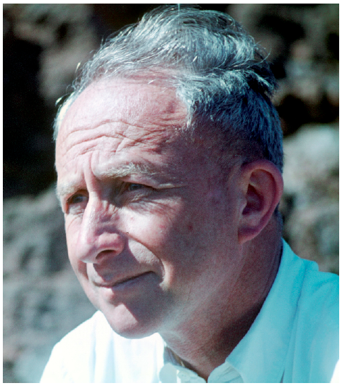
Particulate Matter
VOC, nitrogen oxides and most criteria pollutants are gases at atmospheric temperatures and pressures.
Atmospheric Particulate matter is made up of small liquid or solid particles within the air. While all particles eventually settle out of the air, very small (e.g. sub-micron) particles can stay aloft for weeks or longer.
Particulate matter can be produced by both mechanical (e.g. tire or brake wear) or chemical (e.g. smoke or soot formation) processes.
Chemical production of particles (gas-to-particle conversion) can occur both by combustion (e.g. in a Diesel engine) or through atmospheric photochemical reactions (i.e. it can be both a primary and a secondary pollutant)
Particles can also scatter light and thus impact visibility
Christian Junge (1912-1996) contributed greatly to our understanding of the formation of atmospheric particulate matter.
Notes:
Students often have difficulty understanding how particles can stay aloft for long periods of time as it seems counter to their day-to-day experience where particles that they can see settle relatively rapidly. The argument is, of course, related to surface to volume ratio. Particles are kept aloft by a balance of forces, the gravitation forces that cause a particle to settle are proportional to the mass of a particles (f= -mg). For a given density of a particle the mass is proportional to the volume that varies (for spherical particles) as the cubic power of the radius (V$=\frac{4}{3}πr3$). Much like a sail, the forces acting to keep the particle aloft depend on its area (for a spherical particle, $A=4πr^{2}$). Thus the surface to volume ratio diminishes as particles get smaller (by 3/r for spherical particles) and thus the time required for a particle to settle can become quite large for extremely small (sub-micron diameter) particles, such as those produced by Diesel engines. Larger particles, for example windborne (aeolian) dust will settle out much faster.
Since the settling velocities for very small particles are so long, these particles are often removed from the atmosphere by other processes. These processes include washout (soluble particles being incorporated into cloud or fog droplets) or rainout (being removed by incorporation into falling raindrops).

Slide 17
Health Effects of Air Pollution
Although air pollution can produce adverse impacts on humans in many ways (e.g. eye irritation or nausea due to nuisance odors) the most important health effects of air pollution are associated with the respiratory system.
These impacts can be either direct (impacting the respiratory system itself) or transmissive (the respiratory system transmits the agent to another part of the body)
Direct Effects: shortness-of-breath, reduced lung function, development of lung diseases, exacerbation of existing lung disease (e.g. initiating an asthmatic crisis), etc.
Transmissive Effects: transmission of acutely toxic substances, cardiovascular effects, transmission of carcinogenic or teratogenic compounds, etc.
These impacts can also be either short-term or long-term and can produce adverse impacts in terms of both mortality (death) and morbidity.
Notes:
The division of the impacts into direct and transmissive effects in one of several, albeit imperfect, ways of classifying health effects. There are also several other classification schemes. For example, the effects can be classified as specific (i.e. producing a particular response generally limited to a single organ) or systemic (producing effects across multiple organs/physiological-systems). Similarly, other authors have adopted a more susceptibility-based classification scheme (i.e. do these impacts manifest themselves in the general population or among specific sub-populations (e.g. asthmatic individuals)). My wife, a health-psychologist, would be unhappy if I did not include a classification based on psychological vs physiological effects.

Slide 18
Health Effects of Atmospheric Particulate Matter
Unlike gases, the human body has developed a variety of systems to exclude particles from entering the tiny air sacs (alveoli) within the lungs that allow humans to both to uptake oxygen and exchange carbon dioxide during the respiratory process.
The effectiveness of these systems depends critically on particle size and thus the health effects of exposure to particulate matter will also depend on particle size.
In the upper respiratory system, large and small nasal hair (vibrissae and cilia) as well as mucus membranes in both the nose and mouth act to trap dust, pollen and similar larger particles to prevent them from entering the lungs.
Smaller particles that can avoid these defenses may still be captured by contact with the moist bronchial tubes and smaller bronchioles that lead to the alveoli and thus the very smallest particles are of the greatest potential concern for human health.
Notes:
A consistent trend over the fifty years since the passage of the CAAA for 1970 has been the recognition as to how particle size impacts potential health effects of atmospheric particulate matter. The original form of the particulate matter standard was for total suspended particulates. The problem with any “mass based” standard (that is the mass of particles per cubic meter) is that larger particles disproportionally impact the total particulate mass (remember mass scales as the cubic power of the particle size) even though the health impacts may be proportionally greater for the smaller particles. Recognizing this problem the NAAQS for particulate matter in the US was changed in 1987 to consider only particles with an aerodynamic diameter (that is the actual particle settling velocity was the same as a spherical particle with a diameter of 10 micrometers) of less than 10 micrometers. This standard also proved insufficient as many of these particles are still effective removed by the bodies’ defenses and the CAAA of 1990 mandated that EPA develop a standard for “Fine particulate matter”. While many scientists at the time argued for a standard on submicron particles that effectively enter the alveoli, for technical reasons the standard was set to consider particles with an aerodynamic diameter of less than 2.5 microns (PM_{2.5}). This size standard was subsequently adopted by a wide range of countries. There is still, however, significant interest in a possible PM₁ standard.

Slide 19
What are Today’s Air Pollution Problems?
Photochemical Smog: While much of Europe and North America has significantly reduced levels of photochemical smog over the last few decades, much of developing world has not. For example, ozone concentrations in Delhi today are comparable to those in Los Angeles in the 1960s and 1970s.
Fine Particulate Matter: Air pollution control programs over the last decades have generally been more successful at controlling ozone precursors than fine particulate matter and its impacts have become proportionally more significant.
Hazardous Air Pollutants: Vary significantly by region but in many cases can represent significant public health risks.
Occupational Exposures: Despite advances in worker protection, there are still many occupations throughout the world where workers are exposed to unsafe levels of air pollutants.
Indoor Air Quality: In many parts of the world, exposure to pollutants in indoor environments can greatly exceed outdoor exposures. This is especially the case among women who disproportionately are impacted by exposures associated with poorly ventilated cookstoves.
Notes:
The remainder of this course will largely focus on the first two of these problems (with some discussion of mobile source air toxics). It is important to point out, however, some major public health issues that will not be covered in more detail.

Slide 20
The Role of Traffic-Related Air Pollution
The rise of both the automobile and trucks fundamentally shifted the nature of air pollution emissions from fixed (stationary) locations to mobile sources. Since these pollution sources are tied to human mobility it is much more difficult to avoid human exposure to their emissions than is the case for industrial sources.
Both spark ignition (e.g. gasoline) and compression ignition (Diesel) engines typically use hydrocarbon-based fuels and operate at high-temperatures thereby producing both VOC and nitrogen oxides (ozone precursors) in their combustion process.
Diesel engines also produce significant quantities of very fine particles with more than 90% less than one micrometer in diameter.
Although emissions control systems have been extremely effective at reducing these emissions, the shear numbers of vehicles operating still makes them an area of concern for human health.
Notes:
The is aimed at being a “framing slide” that leads into the more detailed discussions of the characteristics of traffic-related air pollution in the next lecture.

Slide 21
Discussion
Air pollution is a multi-step process
Compounds are emitted into the atmosphere by both man-made and natural sources (emissions sources)
The compounds are mixed, dispersed and transported by meteorological conditions (transport phenomena)
As these components are being mixed and transported, they are undergoing chemical reactions that can remove, transform or produce new compounds (atmospheric chemistry)
At some point this parcel of air will reach an individual who, through normal respiration, will bring a portion of this parcel into his/her lungs where the compounds will have an opportunity to interact with the lung tissues before being exhaled (respiration)
These compounds can have an influence on the individual (health effects)
Over the coming lectures we will explore each of these steps in more detail and discuss how policies and technologies can alter the overall chain-of-events.
Notes:
This lecture is intended to provide a broad overview of air pollution and its potential human health effects. While the “chain-of-events” may seem trivial, it is important to note that each one of these processes carries its own set of physical, chemical and biological principles and with it, some degree of uncertainty in estimating the evolution of each process. This is generally a good time to point out the end goal of our process (i.e. a health impact assessment) is unlikely to be strictly deterministic due to the uncertainties in estimating each step and thus such assessment are almost always statistical in nature.

Slide 22
Research Gaps and Future Directions
At present, our understanding of the impacts of ozone on human health are relatively more advanced that our understanding of the influence of particulate matter, especially very fine particles (e.g. Diesel particulate matter).
The potential impact of hazardous air pollutants (HAPs) and, in particular, mobile source air toxics (MSATs) continues to evolve and will likely remain an area of uncertainty for years to come.
The electrification of transportation, one of emerging trends in mobility, is likely to significantly impact the distribution of emissions over the coming decades.
Notes:
Motor vehicle technology continues to evolve and, as it does, the relative quantities and types of compounds emitted from these sources is likely to change significantly over the coming years. Only of fraction of known air toxics have been fully studied to date and our knowledge in this area is likely to remain a significant gap in our ability to assess long term health implications for policies for some years to come.

Slide 23
Take-Home Messages
Air pollution is not a new problem and changes in technologies are likely to continue to challenge us to anticipate how these changes are likely to impact air quality and human health.
As our understanding of emissions, atmospheric chemistry and human health impacts continue to evolve, it is likely that we will recognize that some decisions that we have made in the past, or are making now, will likely need to be revisited based on this future knowledge.
Although public policies will continue to guide our responses to air pollution issues, individual decision making will remain an important determinant of how well these policies work.
Notes:
In looking at the history of air pollution and its control, one constant is that the information available to decision makers is rarely, if ever, complete. While there has been steady progress in controlling air pollution in many countries, including the U.S., it remains a worldwide problem. Policies often prove to be largely successful but may have gaps or unforeseen effects that must be corrected by later actions. The three major amendments (1970, 1977, 1990) to the U.S. Clean Air Act and numerous policy and standard changes stand witness to that need. It is highly unlikely that this will change in the foreseeable future.

Slide 24
List of Abbreviations
BCE- Before Common Era
CAAA- Clean Air Act Amendments
CE- Common Era
EPA – Environmental Protection Agency
HAP – Hazardous Air Pollutant
kg- kilogram
MSAT – Mobile Source Air Toxic
NAAQS – National Ambient Air Quality Standards
PM – Particulate Matter
VOC – Volatile Organic Compounds

Slide 25
References
Gardeners’ Chronicle, (1874), The Influence of Exhalations from Manufactories on Agricultural Products, N.S., 1:pp. 274-275.
Haagen-Smit, A.J. (1952): Chemistry and physiology of Los Angeles smog, Industrial and Engineering Chemistry, vol. 44, p. 1342-1346.
Hamilton, A. (1934), Industrial Toxicology, Harper, London.
Seneca the Younger, (65 CE). Epistulae Morales ad Lucilium (Moral Epistles and Letters to Lucilius), English Translation by Gummere, R.M. ,1917, 1920, 1925. Loeb Classical Library. Available at: https://en.wikisource.org/wiki/Moral_letters_to_Lucilius
Smith, R.A., (1872) Air and Rain: The Beginning of a Chemical Climatology, Longman, Green and co., London

Slide 26
Reading List
American Thoracic Society, Breathing in America, American Thoracic Society, Washington (2010) available at: https://www.thoracic.org/patients/patient-resources/breathing-in-america/
HEI, Executive Summary. The Advanced Collaborative Emissions Study (ACES), Health Effects Institute, Boston, MA, (2015). Available at: https://www.healtheffects.org/publication/executive-summary-advanced-collaborative-emissions-study-aces
Rosner D and G Markowitz, A 'Gift of God'?: The Public Health Controversy over Leaded Gasoline during the 1920s, American Journal of Public Health, American Public Health Association, 75 (4) 344-352. (1985).
WHO (2016) Ambient air pollution: A global assessment of exposure and burden of disease. Available on WHO website at: http://www.who.int

