Slide 1
www.carteeh.org

Slide 2
Lecture #10: Traffic Measurement Methods and Data Sources
Michael O. Rodgers, Ph.D.
Regents Researcher and Adjunct Regents Professor
School of Civil and Environmental Engineering and School of Public Policy
Georgia Institute of Technology
Atlanta, GA 30332
Michael.Rodgers@ce.gatech.edu, (404) 385-0569
In addition to his academic affiliation, Dr. Rodgers is a Principal at Avatar Environmental and Technical Services, Marietta, GA 30062
The author declares that there is no conflict of interest
Lecture Track(s): HT/TT/PPT
Notes:
Health Track (HT)—mainly targeted at urban planners, transportation planners, and engineers with limited knowledge of public health-related concepts;
Transportation Track (TT)—mainly targeted at environmental epidemiologists and public health professionals with limited knowledge of transportation-related concepts; and;
Planning and Policy Track (PPT)—mainly targeted at planners, civil servants, and policy and decision makers with particular interest in the science-policy link.

Slide 3
Introduction to Traffic Measurements
Traffic measurements aim to understand the distribution and flow of vehicles on the transportation network by location, vehicle type, time-of-day, speed, and direction-of-travel.
These traffic measurements provide the primary data source for both managing the present transportation system as well as planning for future changes to meet future needs.
  Management uses include timing and coordination of traffic signals to minimize travel times, providing drivers with traffic/travel-time information for routing purposes, and incident management (e.g. clearance of vehicle crashes).
  Planning uses include understanding the broader societal impacts of the transportation system (e.g. vehicle emissions, energy consumption or equity issues), and identifying needs for both short and long-term changes needed to improve system performance, enhance mobility or to accommodate future growth.
Notes:
There are, of course, many other uses for traffic data but here we are focusing on those most directly related to estimating emissions and health related impacts of traffic-related air pollution. Later in this lecture, we will discuss how more advanced methods of estimating traffic volumes and fleet composition allow for improved estimates of vehicle emissions in terms of both time and space. It is also worthwhile to note the contrast between the management uses of traffic data that tend to require higher time resolutions (often on times scales of seconds to minutes) and near real-time data availability (i.e. what is happening right now). In contrast, many of the planning uses of data are often concerned with how conditions have, or will, change over periods of months to years.

Slide 4
Types of Traffic Data
Traffic Volume
Traffic Flow Characteristics: Vehicle Speeds, Smooth vs. Stop-and-Go Flow (free vs. congested flow), Traffic Density, Turning Movements, Weaving and Merging Behaviors
Vehicle Occupancy
Fleet Composition
  Vehicle Types
  Vehicle Weights
  Vehicle Age Distribution and Class
Individual Vehicle Trajectories
Notes:
Many students consider that traffic data is just about the number (and perhaps the speed) of vehicles using a facility. This slide seeks to broaden their understanding to include more specific information as to the composition and characteristics of this vehicle traffic flow. “Real world” traffic data goes well beyond the average annual daily traffic (AADT) or peak-hour volume on a facility. For example, vehicle emissions estimates require a knowledge of the number and types of vehicles present on a facility, the types of fuel that they use as well as their weights, speeds and accelerations. For this purpose individual vehicle trajectories are ideal, but a great deal of information can be obtained by measurements of the overall traffic flow (traffic flow characteristics) and either measurements or assumptions concerning the fleet composition. Generally, the range of traffic data that will be collected on a facility will scale with its importance to the overall transportation system. That is, higher functional class facilities (e.g. interstate highways and major arterial roads) will have more traffic data collected on them than on local roads.

Slide 5
Traffic Data for Vehicle Emissions Estimates
Emissions are estimated by a simple relationship:
(Total Emissions) = (Emissions/unit activity)) x (Units of Activity) or
(Total Emissions) = (Emissions Factor) x (Activity Factor)
For traffic-related emissions how to we calculate these factors?
Emission Factors: are dependent on a variety of characteristics that are both dependent and non-dependent on traffic. These include:
  Vehicle Characteristics include vehicle type, aerodynamic coefficients (degree of streamlining), fuel type, vehicle age, emissions control equipment, and level of maintenance. (non-traffic dependent)
  Environmental Characteristics include temperature, humidity and barometric pressure (non-traffic dependent)
  Operational Characteristics include vehicle mass, as well as speed and acceleration on a second-by-second basis (traffic-dependent)
Activity Factors:
  How much time (or distance) each type of vehicle operates on a facility with a particular combination of speed, acceleration and weight. Thus emissions estimates are highly dependent on accurate traffic data.
Notes:
This slide is designed to introduce the dependence of emissions (and emissions estimates) on specific vehicle activity and, by extension, traffic data. In actual emissions estimates, “real world” traffic observations are most typically used to calibrate traffic flow and/or travel demand models that will be used to estimate what traffic volumes, speeds and congestion are likely to be over a protracted period. This is because most impacts of traffic-related air pollution are associated with long term exposure to pollutants, rather than a single event.

Slide 6
Hierarchy of Traffic Data
Traffic (screen line) Counts: The number of vehicles passing a location on the transportation system. Can be directional or bi-directional, by lane or total.
Classified Vehicle Counts: expands on screen-line counts to include vehicle speeds and the count of vehicles by classification (e.g. passenger cars vs. single-unit trucks vs. tractor-trailers).
Traffic Flow Measurements: expands on classified vehicle counts by including broader information on the flow of traffic (e.g. lane changing, turning movements, traffic density, etc.)
Full Vehicle Trajectories: collects second-by-second data on the position, speed and acceleration on all, or selected, vehicles on the facility
Increasing Complexity
Notes:
Screen line counts are what we think of as classical “traffic volumes”. For uncongested roadway links, these traffic volumes can be easily interpreted. However for facilities that can undergo congestion the same traffic flow can arise in multiple ways. For example we could either have a significant number of vehicles on the roadway moving at low speeds (congested flow) or a much smaller number of vehicles operating at higher speeds (free flow). Thus effective traffic management typically requires more complex methods of obtaining traffic data. Modern methods have vastly reduced the cost of collecting classified vehicle counts and semi-automatic procedures for collecting traffic flow measurements have made these richer data much more prevalent than they were even a decade ago. Similarly, the ubiquitous presence of GPS in vehicles and cell phones have greatly increased the quantity of vehicle trajectory data available for management and analysis purposes. In particular, high-resolution vehicle trajectory data has found widespread application as a method for improving fuel economy and evaluating driver behavior for insurance purposes.

Slide 7
Traffic Data Collection Methods
Manual Methods
  Live (at site) Observations
  High-resolution video
Automatic Methods
  Pneumatic Tubes
  Inductive Loops
  Weigh-in-Motion Systems
  Micro/Millimeter Wave Radar Systems
  Video Detection Systems
Notes:
Traffic data collection methods can be broadly classified into those methods that require direct human involvement in the collection of the data (manual methods) and those that do not (automatic methods). While the presence of human analyst “in the loop” for data collection significantly increases the range of possible observations (e.g. the number of vehicles from different trucking companies present) compared to automatic methods, these manual methods cost significantly more on “per use” basis than do automatic methods. For this reason, manual methods are normally used either when: 1) the observations are going to be done a very limited number of times (e.g. counting turning movements to evaluate the need for a turn lane or conditions in a temporary work zone), or 2) there is a need for highly specialized observations that are costly or difficult to automate (e.g. contrasting the driving behavior of in-service and out-of-service taxicabs). While the use of manual methods is common in research and design applications, most traffic data used for system planning and/or management purposes are currently collected through automated methods. These automated methods differ principally in the type of data to be collected (e.g. vehicle speed vs. vehicle weight), the conditions to be evaluated (e.g. day/night, interstate highway/arterial road, etc.), the application of the data (e.g. vehicle presence at a traffic signal vs. traffic flow along a highway), as well as the required duration of traffic data collection (i.e. short-term vs. long-term). Traditional pneumatic tubes use the pressure of a vehicle passing over the tube stretched across a lane (or multiple lanes) to count the number of axles (i.e. the number of tires/axle is typically not measured) passing over the tube. With a reasonable estimate of the average number of axles per vehicle (typically slightly more than two to account for the presence of a small percentage of larger trucks) this approach provides a reasonably accurate estimate of traffic volumes and, in some cases, vehicle speed (if we assume an axle separation). The use of multiple tubes in parallel across a lane call allows a direct measurement of vehicle speed and can classify vehicles by number of axles and axle separation (this will be discussed later in the lecture). Pneumatic tubes are used almost exclusively for short-term traffic counts (typically less than one week). Inductive loops placed in the pavement allow for both long term traffic counts on roadways as well as measuring vehicle presence at a traffic signal to allow actuated and semi-actuated signal operation. Weigh-in-motion systems use a variety of physical processes to measure vehicle weights as they pass over a detector, while microwave and millimeter wave radar systems enable measurements of vehicle speeds. In recent years, traffic management in urban areas have increasingly turned to the use of video camera systems and large urban areas can have literally thousands of cameras deployed across their jurisdictions. The cameras are of two general types. Variable cameras allow system operators to see traffic conditions at selected locations and to remotely adjust the camera view though pan, tilt and zoom (PTZ) features. In contrast, fixed cameras have a pre-established field-of-view that can be calibrated to work with machine vision software to measure traffic volumes and speeds. These systems are shown in the next slide.

Slide 8
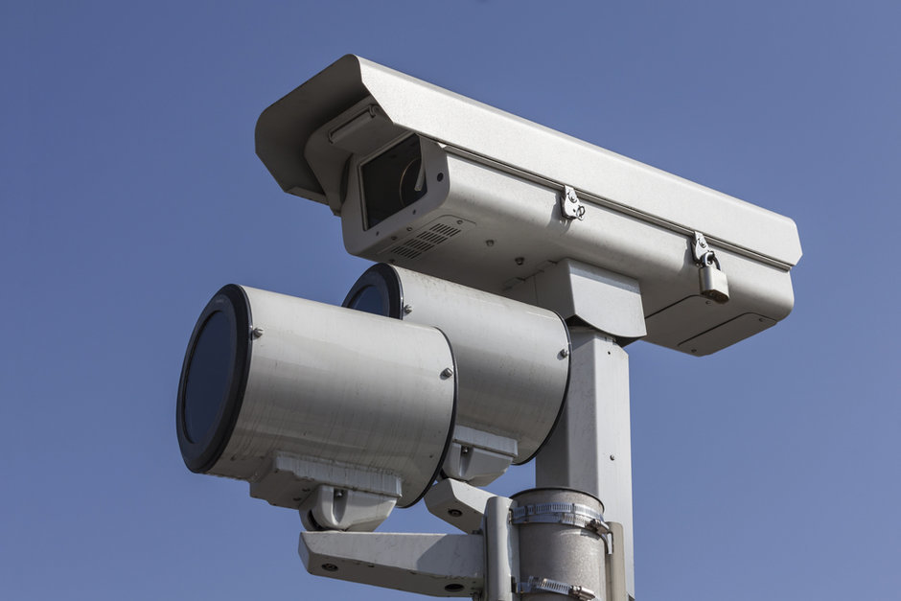
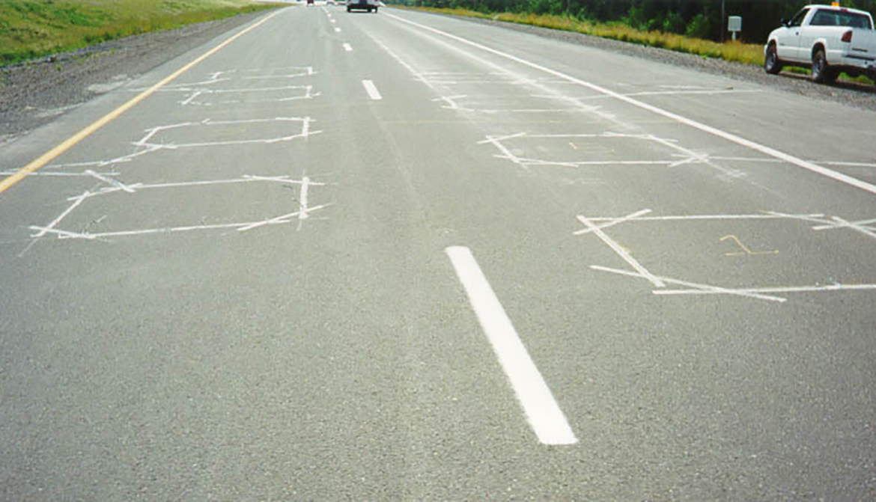
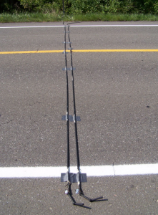
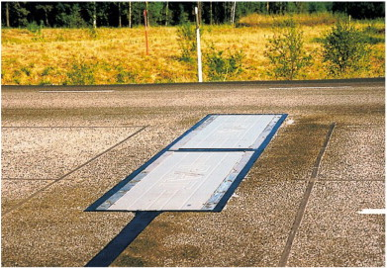
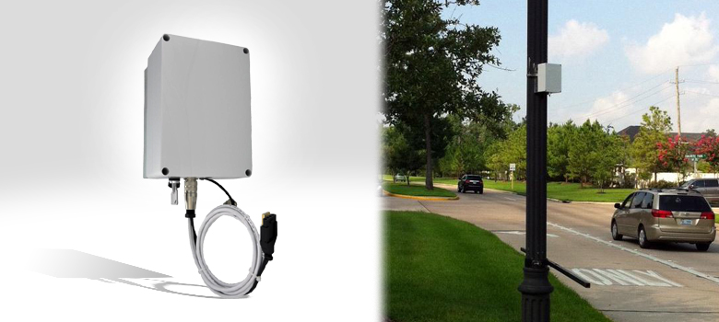
Types of Traffic Data Collection Devices
Inductive Loop Detectors (International Road Dynamics, inc.)
Automated Traffic Camera (govtech.com)
Pneumatic Tube Detectors
(readcivil.com)
Radar Traffic Counter (Houston Radar, inc.)
Weigh-in-Motion (Jacob & Beaumelle, 2010)
Notes:
Slide shows a variety of devices used for collection of automated traffic data. Clockwise from upper left, a high-definition video camera in a weather-proof housing (camera on top with infrared illuminators for nighttime images below) . Unlike traditional traffic monitoring cameras these cameras typically operate with a fixed field-of-view to facilitate calibration of the images. The second image shows inductive loop detectors installed within the pavement. Note that the multiple loops allow for determination of speed and classification (number of axles and spacing) and vehicle presence (over the loop). The vehicle presence indication allows system operators to determine queue lengths at traffic signals and can provide a signal for an actuated traffic signal that a vehicle is present on a lower volume approach. Inductive loop detectors are the most common method of traffic data collection within the U.S. and for most of the developed world. Also note presence of loops in each lane to allow independent determination of vehicle flows. The third image is of a two-tube pneumatic tube counter. Despite its rather crude appearance, the pneumatic tube technology is very portable and cost-effective, making it ideal for periodic monitoring of lower volume roads where permanent counters would not be justified. The fourth image shows a “plate-type” weigh-in-motion system. Unlike other systems, weigh-in-motion systems give information on current vehicle weights that are important in estimating emissions from medium and heavy-duty trucks whose weight can vary significantly between loaded and unloaded conditions. The last image is for a micro/millimeter wave traffic radar systems. These systems can operate of a range of frequencies from about 100 megahertz to 100 gigahertz with advantages and disadvantages for each frequency range. An important characteristic of these systems is that most will provide both bi-directional speed and count information and many systems can be configured to provide some classification data.

Slide 9
Traffic-Data for Emissions Estimates
Traffic Volume by Time and Roadway Segment
Fleet Composition by Time and Roadway Segment
  Vehicle Types
  Vehicle Weights
  Vehicle Age Distribution and Class
Traffic Parameters by Time and Roadway Segment
  Joint Distribution of Vehicle Speeds and Accelerations by Vehicle Type
  Roadway Grade
Notes:
As discussed in an earlier slide, emissions scale directly by vehicle activity and thus it is essential to establish how many vehicles are operating across a transportation network as a function of time and to identify where these vehicles are operating. Likewise, roadways have limited capacity and management of congestion is strongly linked to traffic volumes. Since roadways are linked and traffic tends to vary in patterns (e.g. morning vs. evening directionality of flow, weekday vs weekend travel patterns, variation in traffic volumes across the day, etc.) it is generally necessary to collect data from only a sample of locations in order to make reasonable estimates of how traffic is distributed across a network. Identification of these “strategic locations” is generally accomplished by evaluating historical relationships between observed traffic conditions across different portion of a network. Highly correlated segments in general require fewer measurement locations than those whose conditions are more independent of each other. The need to independently estimate emissions from trucks generally require at least some classified traffic counts and weigh-in-motion data.

Slide 10
Determining Vehicle Fleet Composition
Vehicle Mix (% trucks)
Average Vehicle Mix (registration data + assumed VMT)
Classified Vehicle Counts (by FHWA or EPA methods)
Actual Fleet Observations (license plate survey)
Notes:
Knowing the types of vehicles present on a roadway is essential to accurate estimates as to the quantity and type of emissions. In the US, most light-duty vehicles (Cars and trucks with a Gross Vehicle Weight Rating of <8500 pounds) are powered by gasoline, while most medium and heavy-duty trucks a powered by Diesel fuel each of which has a distinctive emissions profile. So, at a minimum, we need to know the number of trucks present on a facility. This is normally accomplished by “classified vehicle counts”. The U.S. FHWA has developed a vehicle classification scheme based on the number and distance between axles of a vehicle. This scheme is illustrated in the next slide. The scheme was adopted because this approach could be used with pneumatic counting tubes that were, and are, prevalent in traffic counting applications. This remains the most common method of identifying the presence and types of medium and heavy-duty trucks operating on U.S. roadways. Unfortunately, this classification scheme does not directly translate into the medium and heavy-duty vehicle classifications used by U.S. EPA for its emissions estimates and thus some type of “mapping” is required. For light duty vehicles, the distribution of types and ages of vehicles can either be inferred from vehicle registration data or directly measured. These light-duty type (e.g. SUV vs. Van vs. Car) and age distributions are commonly estimated from local vehicle registration data along with an assumed reduction in vehicle miles travelled with vehicle age (i.e. older vehicles are typically driven less than newer vehicles and thus are less likely to be seen on the road relative to their prevalence in the registration data). This estimation approach works reasonably well for larger areas (e.g. county level emissions) but has limitations when trying to estimate emissions from a particular roadway as the distribution of vehicle types and ages are dependent on demographic factors that vary spatially. In these cases, investigators will typically directly measure the type and age distribution using license plate surveys in conjunction with vehicle registration data. While more accurate, this latter method tends to be labor-intensive and costly.

Slide 11
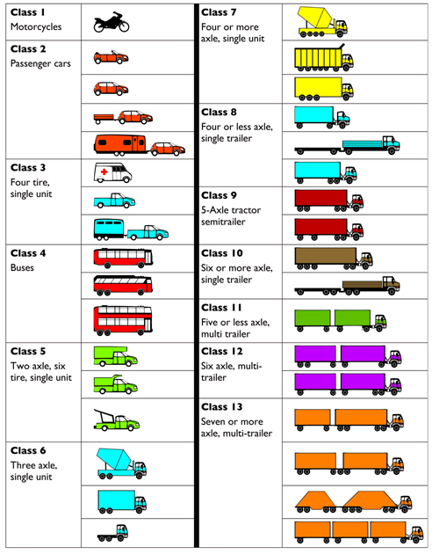
U.S. FHWA Vehicle Classification Scheme
Vehicle classification scheme developed by the U.S. Federal Highway Administration
Vehicles are categorized by the number of axles and the axle spacing and, in some cases the number of tires per axle.
This classification scheme can be used with simple pneumatic-tube counters and long-term historical data are available
Scheme is, however, not consistent with the U.S. EPA classification scheme for emissions estimates and thus some form of conversion is required (Liu, et al. (2015))
Fhwa.dot.gov
Notes:
Pneumatic tube counters (the ubiquitous “traffic counting tube”) have existed in some form or other for nearly a century. While inexpensive and relatively easy to deploy, the counter only records the passage of a wheel over the tube. Using two tubes in parallel with a known spacing the time interval between the initial passage of a vehicle over the first tube and the second can be used to measure vehicle speed. Knowing this speed, subsequent passages of the vehicle over the tubes can be used both to count the number of axles and estimate their physical separation. This ability forms the basis of the FHWA classification system. Some pneumatic systems can also differentiate between the passage of two or four tires over the tube at the same time and thus can separate Class 3 and Class 5 vehicles. Systems that do not have this capability will classify into a combined Class3/Class 5 category.
For emissions, EPA has established vehicle emissions standards based on Gross Vehicle Weight Ratings (GVWR) for light and medium duty trucks or on engine power (for heavy-duty trucks). For the lightest and heaviest vehicles the mapping between the EPA and FHWA classifications are relatively straightforward but for Medium Duty and Light-Heavy Duty vehicles (approximately 13,000 to 30,000 pounds) the correlation is less robust and statistical methods must be used in the absence of visual identification (see for example, Liu, et al. (2015)).

Slide 12
Determining Vehicle Speeds and Accelerations
Point Measurement Speed Detection (e.g. inductive loop counters and pneumatic tube classifiers)
Microwave- or Millimeter-wave Radar Systems
Video Detection Systems
Bluetooth™
Cell Phone Data
  Tower connection
  User data
GPS data loggers (dedicated or cell phone based)
Vehicle driving cycles
Notes:
There is perhaps no form of traffic data for which there is as much variety in techniques as for vehicle speeds and/or travel times. In general, these systems measure a physical process related to vehicle speed (e.g. the Doppler shift of electromagnetic radiation between a fixed Radar unit and a moving vehicle) or by observing the time required for a vehicle to move a specific distance. These techniques are described in the following slides

Slide 13
Point Measurement Speed Detection
Measure Speed of Vehicles by Measuring the Time Difference Between a Vehicle Crossing Two Closely Separated Points
Inductive Loop Detectors (International Road Dynamics, inc.)
Pneumatic Tube Detectors
(readcivil.com)
Notes:
These systems, or similar optical systems that involve breaking a beam of light across a road, measure the time interval required for the vehicle to pass between two or more adjacent detectors. If two detectors are employed, the system can measure vehicle speed. If three are employed, then the system can also measure instantaneous acceleration of the vehicles. The advantage of the approach is that short spacing allows relatively little variation in vehicle speed between the detectors. Alternatively, such systems simulate “point measurements” and thus do not necessarily reflect average vehicle speeds along a roadway segment.

Slide 14
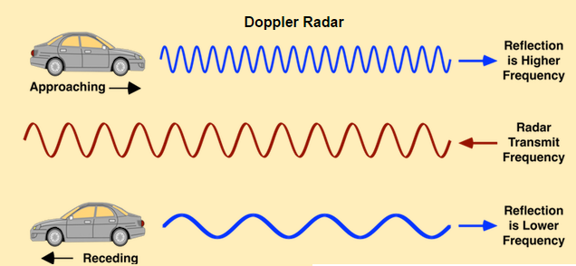
Microwave and Millimeter-Wave Radar Systems
Operate with Frequencies Ranging from about 100 MHz to 100 GHz
  There are Advantages and Disadvantages to Various Frequencies
  Many Systems Operate at a 10.525 GHz Frequency Dedicated to Traffic Radars
  Most Systems Detect Vehicle Speeds Using the Doppler Shift in Frequency Between the Fixed Radar and the Moving Vehicle
  While Most Sensors Operate in the Micro/Millimeter-Wave Frequency Range Some Sensors Operate at Higher (Infrared) Frequencies
  Some Sensors Transmit Acoustical (Ultrasonic) Energy Instead
Physicsopenlab.org
Notes:
Recent advances in microelectronics have drastically reduced the price and complexity of Radar systems, making them available for widespread deployment in traffic management and monitoring applications. More sophisticated systems can handle monitoring of up to 20+ lanes of traffic and include vehicle classification as well as vehicle counts and speeds.

Slide 15
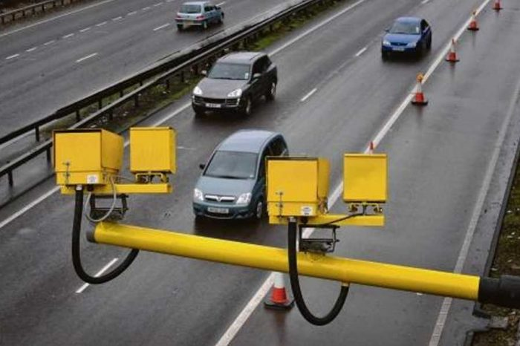
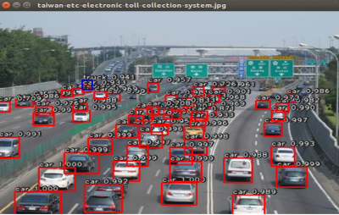
Video Detection Systems
Video Detection Systems Determine Vehicle Speeds and Classification by Observing Vehicle Dimensions and Position as a Function of Time Against a Calibrated Background Image
Single Lane Speed Setup (Highwaysindustry.com)
Multilane Camera Setup for Traffic Monitoring (Acti.com)
Notes:
Video based detection systems depend upon a detailed knowledge of the field of view of the camera including the cameras relative to known positions in the image. By analyzing the movements of vehicles against this background the positions and speeds of vehicles can be determined. The principal drawback of video detection systems is the need to maintain a consistent field of view for the camera and thus the camera positions must be fixed. The accuracy of these systems also varies as a function of distance from the camera as the relative size of camera image pixels changes with distance and camera angle. Likewise, video detection is sensitive to conditions of reduced visibility (e.g. rain or fog) and glare. These disadvantages are offset in many cases by the ability of these systems to cover multiple lanes and to provide a direct video feed for human observation as well as providing traffic data. The image on the left show a typical setup for single lane speed measurements (in London). The larger of the two boxes, aimed at each lane, is the weatherproof enclosure for the camera, while the smaller box houses an infrared illuminator to enable nighttime operations. This type of single lane setups limits the range of angles present in the image and maximizes the accuracy of the speed measurements. The image on the right (from Taiwan) is for typical “wide” field of view. This type of configuration trades of accuracy of speed observations in exchange for allowing multi-lane operations.

Slide 16
“In Vehicle” Technologies for Traffic Data
Not All Traffic Measurement Methods are Infrastructure-Based
“In Vehicle” Traffic Systems are Typically Based on Identifying the Location of the Vehicle at Various Times During a Trip to Determine Travel Times Between Locations
Obtaining this Location Data Normally Requires that an Electronic Device on the Vehicle is Connected to One or More External Networks
  Short-Range: Bluetooth™, WiFi, DSRC, etc.
  Medium-Long Range: Cellular Network, Private Networks
  Satellite: Telematic Systems (e.g. OnStar™), GPS, Satellite Internet
Position Data Can Either be Directly Reported by the Device or Inferred from Its Network Connection Points.
Notes:
The traffic monitoring technologies discussed so far have been located external to the vehicles operating on the network, typically on transportation infrastructure. It is also possible to monitor vehicle speeds and travel times based on the position of a vehicle at various times. In principle, any electronic device located within a vehicle that is connected to an external network can be used monitor a vehicles location at a particular time. These devices can be located on the vehicle itself, for example, the GPS data systems used by trucking companies to monitor the location of their vehicles, or vehicle telematic systems (e.g. OnStar™) or they can be hand-held devices carried in the vehicle including cellular telephones or tablet computers. There are three common approaches to identifying the location of vehicle. The first approach is localization. This approach is based on the use of “short range” technologies that can only connect to a nearby receiver. If the location of the receiver is known, then the device (or the vehicle carrying it) is localized to be near the receiver location. Common “short range” technologies include Bluetooth™ devices, designed specifically for short range communications or DSRC (Dedicated Short-Range Communications) originally developed for vehicle-to-vehicle or vehicle-to-infrastructure communications. The second approach is triangulation. For longer-range communication technologies (e.g. cellular telephone communication) that can simultaneously connect to many receivers, the signal direction and strength from each receiver (cell tower) can be used to locate the transmitter (cell phone) to a small geographic area. In both approaches the location of the vehicle as a function of time along the network can be used to determine vehicle travel times and thus average speeds along the network. The third approach is direct reporting. In this case, the electronic device is equipped to determine its own position (typically using the satellite-based Global Positioning System (GPS)) which it then reports back, either periodically or on request, back to a data repository. Each of these approaches are discussed in subsequent slides.

Slide 17
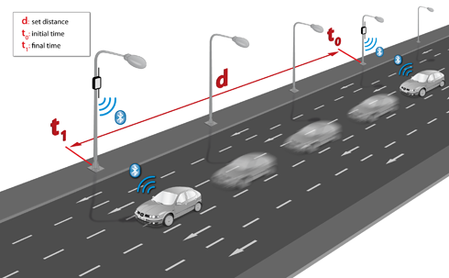
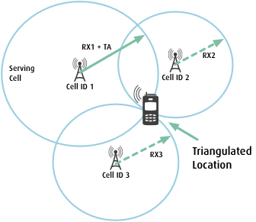
Bluetooth™ and Cell Tower Data
The Location of Networkable Electronic Devices can be Determined by Knowledge of the Nature of Its Network Connection(s)
For Short-Range Networks (e.g. Bluetooth™) the Device Will Sequentially Connect to Nearby Access Points Along its Route Identifying its Location. The Device Media Access Control (MAC) Address is Used to Uniquely Identify the Vehicle
For Longer-Range Networks (e.g. Cellular Network) the Direction and Strength of the Device Signal and its MAC Address can be used to Triangulate the Location of the Device.
Bluetooth™ Travel Time Monitoring (Libelium.com)
Cell Tower Triangulation (Unlockbase.com)
Notes:
Being Short Range Devices, Bluetooth™ and Similar Technologies (e.g. WiFi) cannot generally be affordably deployed to cover an entire transportation network. Much like Radars and Inductive Loop Detectors, these devices are normally deployed along “strategic” corridors that can provide important information regarding overall network conditions. Conversely, cell phone triangulation data can cover large portions of the network but are constrained by the density of the cell towers present. That is, areas with high density of cell tower coverage will tend to have higher data volumes. In addition, if data are not collected with sufficient frequency, sequential position data from the vehicle may not be able to identify the exact route taken.

Slide 18
GPS Position Data
Increasingly, Vehicles are “Self-Reporting” Their Position Data via WiFi or Cellular Networks.
  Dedicated Wayfinding Applications (e.g. WAZE™, INRIX™, Google Maps™, etc.) on Portable Electronic Devices
  In Vehicle Navigation and Telematic Systems (e.g. OnStar™, TomTom™, etc.)
  Ancillary Position Data from other Applications
In Most Cases These Data are Proprietary to the Software Developer but are often Resold for Particular Applications
  Many Departments of Transportation Enter Into Data Sharing Agreements to Obtain Access to Some or All of These Data
  Some Data Aggregators (e.g. the Regional Integrated Transportation Information System (RITIS) at the University of Maryland) Collect Data from Multiple Sources and Create New Traffic Data Products
Notes:
The uses of cell phone position data have greatly expanded in the last several years. The full implications of this trend are still being revealed. It is clear, however, that high resolution data from users will likely revolutionize the way that travel data are collected and analyzed over the coming years. A significant implication of these trends is that the primary repositories for transportation data are likely to move from the public sector (e.g. Departments of Transportation or Metropolitan Planning Organizations) to private firms. It is, at yet, unclear what the implication of these trends are for equity in terms of both access and affordability of transportation. It is not difficult to posit both highly positive and profoundly negative outcomes from these developments.

Slide 19
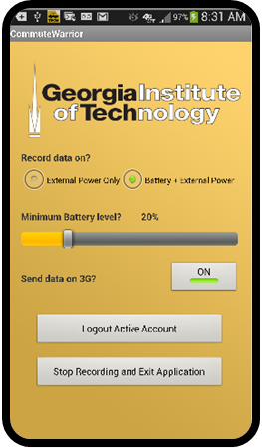
Full Vehicle Trajectory Data
The Ultimate Data for Emissions Estimation is to Obtain a Second-by-Second Estimation of the Power Required to be Supplied by the Engine.
These Second-by-Second Power Requirements can be Closely Approximated with a Knowledge of the Full Vehicle Trajectory (Speed vs. Time and Grade)
From the Earliest Days of Emissions Modeling Special Efforts have been Undertaken to Obtain these Data but GPS-Enabled Smart Devices have Drastically Reduced its Cost.
These Trajectory Data are Normally Obtained from Volunteers as Part of Larger Research or Transportation Planning Studies (e.g. Electronic Travel Diaries)
Trajectory Data are Normally Securely Transmitted to a Dedicated Centralized Server for Later Analysis
Georgia Tech Vehicle Trajectory Data App (Commute Warrior™)
Notes:
The ubiquity of cell phones and other portable electronic devices has had a profound impact on our ability to investigate “deeper layers” of the transportation process. While full vehicle trajectory data is still relatively rare, it is not hard to imagine that it will be commonplace within the next few years. These data have the potential to profoundly alter our ability to study the interactions between transportation and human health by being able to evaluate emissions at the individual street level and to track individual exposures throughout the day.

Slide 20
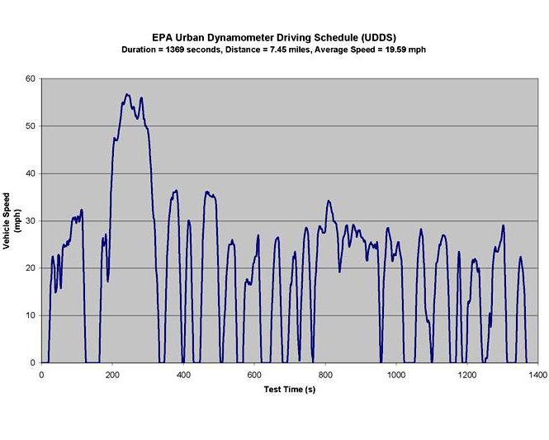
“City Driving” Driving Cycle for Light Duty Vehicles
Figure to the right shows the vehicle speed-vs-time trace for arterial-based “city driving” that forms the basis for U.S. emissions testing.
In the absence of specific vehicle speed/acceleration distributions this distribution is corrected by average speed to produce emissions estimates in the EPA MOVES model
Epa.gov
Notes:
The U.S. EPA Urban Dynamometer Driving Schedule (UDDS) forms the basis for regulatory-based emissions testing in the United States. Originally developed by the California Air Resources Board, this driving cycle (i.e. speed trace) was based on what was assumed to be a typical home-to-work trip in Los Angeles, California in 1966 and provides a good example of a complete vehicle trajectory. The U.S. Federal Test Procedure (FTP) for light-duty vehicles (passenger cars and light-duty trucks/Sports Utility Vehicles) collects emissions data on a dynamometer from vehicles after a “cold start” driving according to the UDDS at which time the vehicle is shut off. After a brief “rest” the vehicle is restarted (warm start) and additional emissions data are collected based upon a repeat of the first 505 seconds of the UDDS. For emissions estimates, the U.S. EPA regulatory emissions model (MOVES) allows the user to either input information for vehicle fleet composition and speed distributions collected on a facility (traffic data) or to input only average speed. If the latter option is selected (average speed) the distribution of emissions is assumed to follow the speed/acceleration distribution of the UDDS (except on freeways) corrected by specified “speed correction factors”.

Slide 21
Research Gaps and Future Directions
The Trends Towards Increased Use of “On Vehicle” Data Sources is Likely to Continue and Even Accelerate.
The Resulting Quantity of Data Available to System Managers, Researchers and Users is Rapidly Increasing and it will be a Significant Challenge to Develop the Infrastructure and Tools to Both Manage this Data and to Convert it into Usable Products
While these new Data Products will Provide and Opportunity to Examine a Variety of new Areas it is, at yet, Unclear as to how These Data can be Examined in a Historical Context
Increased Use of These New Data are Likely to Produce a More Robust and Efficient Transportation System

Slide 22
Take-Home Messages
Traffic Data Consists of much more than just how many Vehicles Use a Roadway in a Day
Understanding the Environmental and Health Impacts of Transportation Requires Knowledge of many more things than is Required to Manage the System Itself
Advances in Technology are Making These Data Available to the Public and to Researchers Outside the Field of Transportation
Higher Resolution Traffic Data will likely have a Profound Effect on our Ability to Understand the Relationship Between Transportation and Human Health

Slide 23
List of Abbreviations
DSRC: Dedicated Short Range Communications
EPA: (US) Environmental Protection Agency
FHWA: (US) Federal Highway Administration
GPS: Global Positioning System
MAC: Media Access Control
MOVES: The U.S. EPA Motor Vehicle Emissions Simulator model.
RITIS: Regional Integrated Transportation Information System
UDDS: U.S. EPA Urban Dynamometer Driving Schedule
VMT: Vehicle Miles Travelled

Slide 24
References
Federal Highway Administration, Office of Highway Policy Information, 2013. Traffic Monitoring Guide, U.S. Department of Transportation, Washington, DC. available at: https://www.fhwa.dot.gov/policyinformation/tmguide/tmg_2013/vehicle-types.cfm
Jacob, Bernard & Beaumelle, Véronique. (2010). Improving truck safety: Potential of weigh-in-motion technology. Iatss Research. 34. 9-15. 10.1016/j.iatssr.2010.06.003.
Liu, H., Xu, Y., Guensler, R., and Rodgers, M.O., 2015, Developing Vehicle Classification Inputs for MOVES Project Level Analysis. Transportation Research Record, 2503, pp. 81-90.

Slide 25
Reading List
For Information on methods of determining travel time consider reading:
The Travel Time Data Collection Handbook available at: https://www.fhwa.dot.gov/ohim/timedata.htm
For more technical information on how various technologies operate consider examining:
FHWA Traffic Monitoring Guide available at: https://www.fhwa.dot.gov/policyinformation/tmguide/tmg_fhwa_pl_17_003.pdf

