Slide 1
www.carteeh.org

Slide 2
Lecture #17: Air Pollution Exposure
Misti Levy Zamora
Environmental Health & Engineering
Johns Hopkins School of Public Health
The author declares that there is no conflict of interest
Lecture Track(s): HT/TT
Notes:
Health Track (HT)—mainly targeted at urban planners, transportation planners, and engineers with limited knowledge of public health-related concepts;
Transportation Track (TT)—mainly targeted at environmental epidemiologists and public health professionals with limited knowledge of transportation-related concepts; and;
Planning and Policy Track (PPT)—mainly targeted at planners, civil servants, and policy and decision makers with particular interest in the science-policy link.

Slide 3
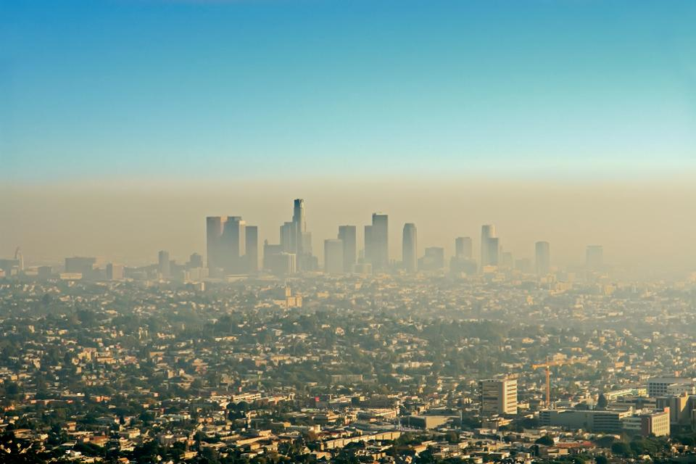
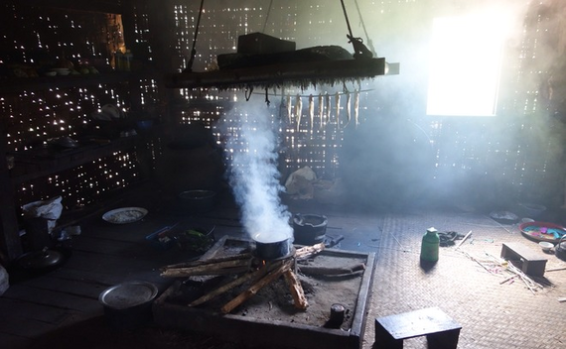
Introduction
Air pollution consists of gasses, liquids, or particles in the air that can have serious effects on human health, wildlife, vegetation, lakes, streams, soils, and visibility
It is a mixture of natural and man-made substances in the air we breathe.
It is typically separated into two categories: ambient (outdoor) air pollution and indoor (household) air pollution.
Air pollution is now considered to be the world’s largest environmental health threat.
The latest air quality estimates from WHO show that 92% of the world's population breathes air which does not meet minimum standards.
Wide shot of the downtown Los Angeles skyline bathed in smog. View from Griffith Park GETTY
https://www.huffpost.com/entry/better-stoves-can-reduce-_b_7705186
https://www.who.int/health-topics/air-pollution
Notes:
The combined effects of outdoor and indoor air pollution cause about seven million premature deaths every year, largely as a result of increased mortality from stroke, heart disease, chronic obstructive pulmonary disease, lung cancer and acute respiratory infections.
Nearly 90% of air-pollution-related deaths occur in low- and middle-income countries, with nearly 2 out of 3 occurring in WHO’s South-East Asia and Western Pacific regions.
WHO World Health Organization
https://www.who.int/news-room/detail/27-09-2016-who-releases-country-estimates-on-air-pollution-exposure-and-health-impact

Slide 4
Air Pollution Exposures
Human exposure to air pollution is determined by the amount and types of air pollution, human activity, and the exposure duration.
People breathe air in several indoor and outdoor environments throughout a typical day.
Many exposure assessments are based on outdoor air concentrations, but Americans spend most of their time indoors.
According to The National Human Activity Pattern Survey (NHAPS), Americans spend 87% of the time indoors, 6% of the time in automobiles, and only 7% of the time outdoors.
The US Environmental Protection Agency (EPA) has set National Ambient Air Quality Standards (NAAQS) to limit exposures to major outdoor pollutants
https://www.nature.com/articles/7500165
Notes:
Whether people are harmed by poor air quality depends on the level and mixture of pollutants in the air, exposure doses and durations, individuals' susceptibilities to diseases, and other factors. Similarly, air pollutants' interactions with ecosystems determine whether air pollution causes harmful environmental effects.
https://www.epa.gov/report-environment/outdoor-air-quality
https://indoor.lbl.gov/sites/all/files/lbnl-47713.pdf

Slide 5
National Ambient Air Quality Standards (NAAQS)
The Clean Air Act requires EPA to set National Ambient Air Quality Standards for pollutants considered harmful to public health and the environment.
Ambient air concentration standards are set for seven criteria air pollutants.
1. Carbon Monoxide (CO)
2. Sulfur Dioxide (SO2)
3. Nitrogen Dioxide (NO2)
4. Ozone (O3)
5. PM10 (particulates < 10 µm diameter)
6. PM2.5 (particulates < 2.5 µm diameter)
7. Lead (Pb)
Notes:
The primary NAAQS are set to protect public health. EPA also sets secondary NAAQS to protect public welfare from adverse effects of criteria pollutants, including protection against visibility impairment, or damage to animals, crops, vegetation, or buildings.
The primary standards are set at a level intended to protect public health, including the health of at-risk populations, with an adequate margin of safety. In selecting a margin of safety, EPA considers such factors as the strengths and limitations of the evidence and related uncertainties, the nature and severity of the health effects, the size of the at-risk populations, and whether discernible thresholds have been identified below which health effects do not occur. In general, for the criteria air pollutants, there is no evidence of discernible thresholds.2-7
For regulatory purposes, EPA distinguishes between categories of particles based on size, and has established standards for fine and coarse particles. PM10, in general terms, is an abbreviation for particles with an aerodynamic diameter less than or equal to 10 micrometers (µm), and represents inhalable particles small enough to penetrate deeply into the lungs (i.e., thoracic particles).
• Different NAAQS for different averaging times
➢ 1-hr, 3-hr, 8-hr, 24-hr and annual averages.
➢ Averaging times of standards depend on pollutants
Some of the air quality standards are designed to protect the public from adverse health effects that can occur after being exposed for a short time, such as hours to days. Other standards are designed to protect people from adverse health effects that are associated with long-term
exposures (months to years). For example, the standard for ozone is based on pollutant concentrations measured over a short-term period of eight hours. By contrast, the standard for lead considers average concentrations measured over a rolling three-month period. For fine particulate matter (PM2.5), annual and 24-hour standards work together to provide protection against effects associated with long- and short-term exposures.
. The EPA identifies ground-level ozone (O3), particulate matter (PM), carbon monoxide (CO), sulfur dioxide (SO2), and nitrogen dioxide (NO2) as five common air pollutants and use them to calculate the air quality index (AQ

Slide 6
There are four main types of air pollution sources:
Mobile Sources
Stationary (point) sources
Natural Sources
Area Sources
https://www.nps.gov/subjects/air/pollutants.htm
Notes:
Mobile Sources – such as cars, buses, planes, trucks, and trains
Mobile sources account for more than half of all the air pollution in the United States and the primary mobile source of air pollution is the automobile,
Stationary (point) sources – such as power plants, oil refineries, industrial facilities, and factories
Stationary sources, like power plants, emit large amounts of pollution from a single location, these are also known as point sources of pollution.
Natural Sources – such as wind-blown dust, wildfires, and volcanoes
Natural sources can sometimes be significant but do not usually create ongoing air pollution problems like the other source types can.
Area Sources – such as agricultural areas, cities, and wood burning fireplaces
Area sources are made up of lots of smaller pollution sources that aren't a big deal by themselves but when considered as a group can be.
https://www.nps.gov/subjects/air/pollutants.htm

Slide 7
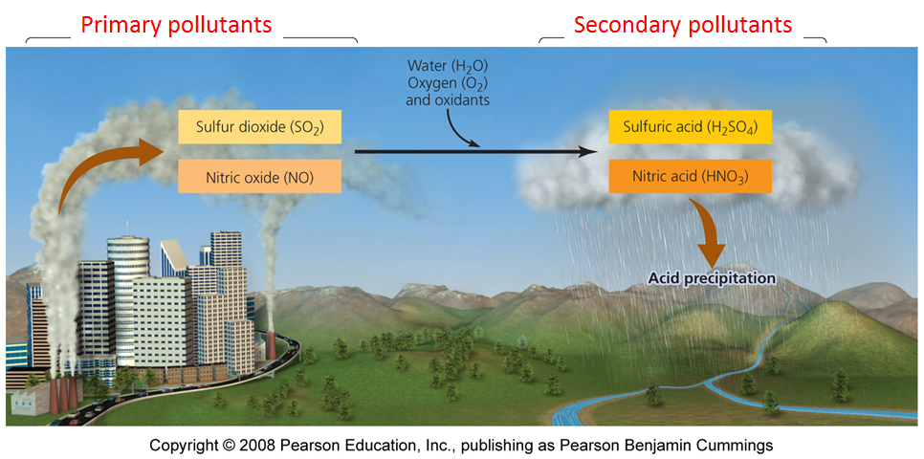
Primary and Secondary Air Pollutants
Notes:
Two categories
Primary Air Pollutant
Harmful substance that is emitted directly into the atmosphere
Secondary Air Pollutant
Harmful substance formed in the atmosphere when a primary air pollutant reacts with substances normally found in the atmosphere or with other air pollutants
Pollution from human-generated and natural sources is often created in one place and transported through the air. Sometimes chemical reactions in the atmosphere change pollutants before they are deposited. Pollutants in the air can create haze, making it harder to see, and pollutant deposition can have biological effects. Location and even the time of year can determine which pollution sources are most important to each park.
https://www.nps.gov/subjects/air/pollutants.htm

Slide 8
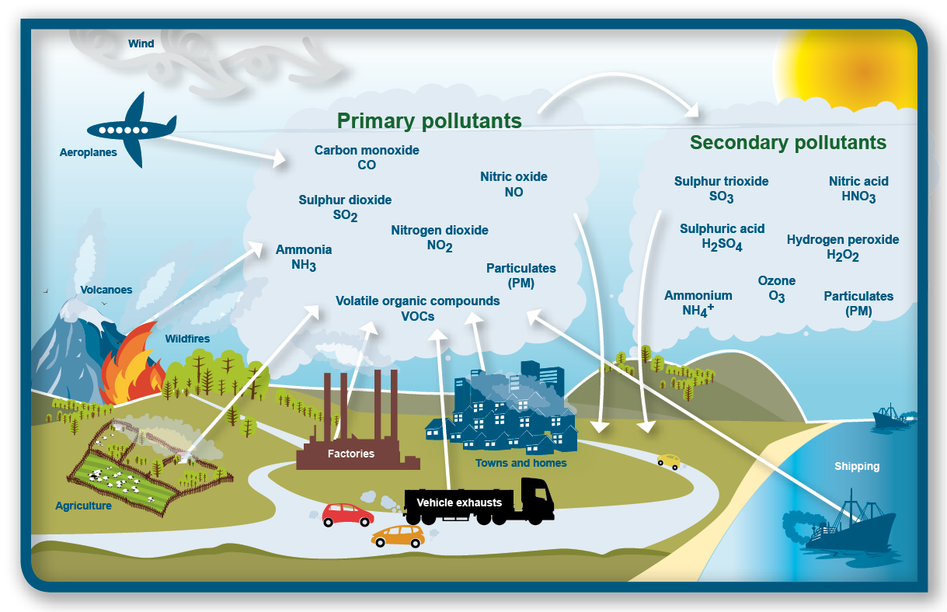
Examples of Primary and Secondary Air Pollutant
https://mhsibess.weebly.com/day-3-48.html
Notes:
Two categories
Primary Air Pollutant
Harmful substance that is emitted directly into the atmosphere
Secondary Air Pollutant
Harmful substance formed in the atmosphere when a primary air pollutant reacts with substances normally found in the atmosphere or with other air pollutants

Slide 9
Exposure Pathways
Pollutants enter the human body in three main different ways:
inhalation
ingestion
skin absorption (dermal)
https://www.learner.org/courses/envsci/visual/visual.php?shortname=exposure_pathways
Notes:
In many cases, exposure may occur simultaneously from many sources and through multiple routes. Pathways of exposures to lead, for example, include air pollution from traffic and industrial emissions, drinking water, food, tobacco smoking, dusts, paints and other industrially produced commodities and soil.
https://www.learner.org/courses/envsci/visual/visual.php?shortname=exposure_pathways
https://www.epa.gov/expobox/exposure-assessment-tools-routes
Inhalation exposure can result from breathing air that is contaminated with particulate matter (e.g., dust), vapors (e.g., volatile or semivolatile contaminants), or aerosols. Individuals can be exposed via the inhalation route during a variety of activities outdoors and indoors. Indoor receptors could also be exposed to outdoor air contaminants that infiltrate the indoor environment.
Ingestion exposure can occur via consumption of contaminated food, water and other liquids. Food can contain chemical residues as a result.
Dermal exposure can result from skin contact with contaminated environmental media, including:
water (e.g., during bathing, washing, swimming);
sediment (e.g., while wading, fishing);
outdoor soil or dust (e.g., during recreational, gardening, or construction-related activities); and
indoor dust that has settled on carpets, floors, clothing, counter tops, or other surfaces.

Slide 10
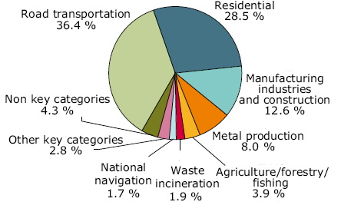
Routes of Exposure to the Criteria Pollutants: CO
Inhalation is the only exposure route for carbon monoxide (CO).
Sources of CO
Anthropogenic emissions are responsible for about two thirds of the carbon monoxide in the atmosphere.
The majority of CO emissions to ambient air come from mobile sources, especially in urban areas
In cities, as much as 95% is from motor vehicles
Popescu and Ionel (2010). Anthropogenic Air Pollution Sources, Air Quality, Ashok Kumar (Ed.), ISBN: 978-953-307-131-2
Available from: http://www.intechopen.com/books/air-quality/anthropogenic-air-pollution-sources
Notes:
Colorless, odorless gas
Levels below poisoning are associated with cardiovascular and neurological outcomes, particularly among people with pre-existing heart disease

Slide 11
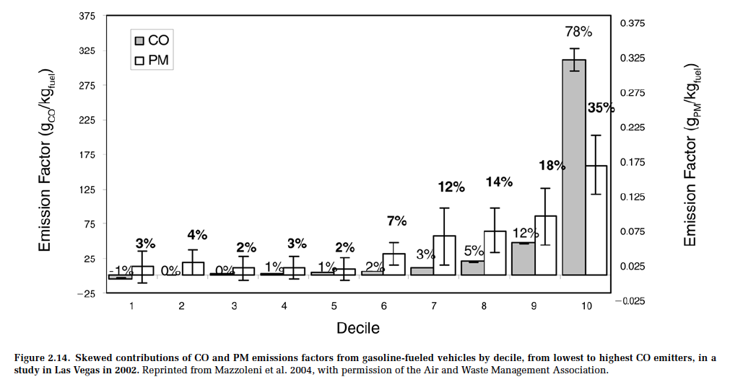
A Small Number of Cars can be Responsible for a LOT of the Pollution
Notes:
Notice that the top 10% contribute most of the CO
Mazzoleni C, Kuhns HD, Moosmüller H, Keislar RE, Barber PW, Robinson NF, Watson JG, Nikolic D. 2004. On-road vehicle particulate matter and gaseous emission distributions in Las Vegas, Nevada, compared with other areas. J Air Waste Manage Assoc 54:711–726.

Slide 12
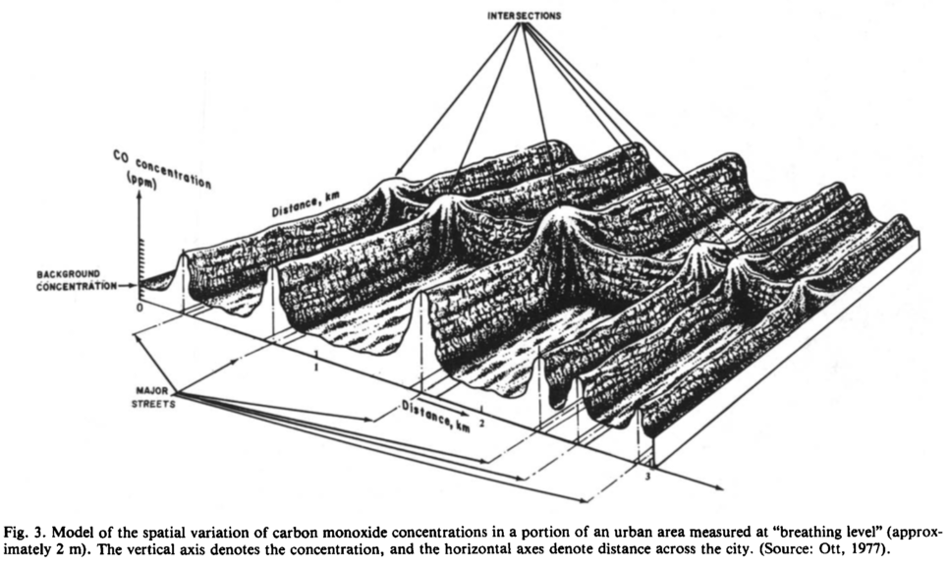
Example: CO Spatial Variability
Ott, Env. Int. (1982) 7:179-196
Notes:
Note the high levels near the intersections

Slide 13
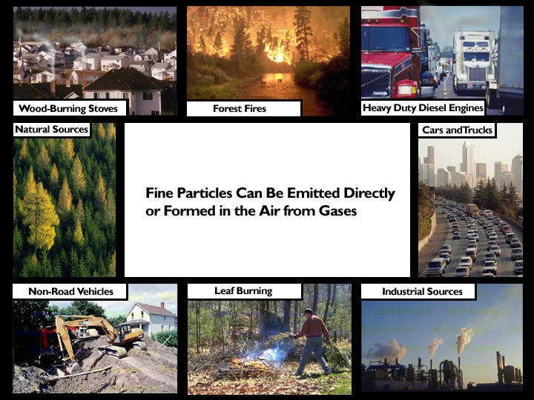
Routes of Exposure to the Criteria Pollutants: PM
Particulate matter (PM) contains microscopic solids or liquid droplets that can be inhaled and cause serious health problems.
These particles come in many sizes and shapes and can be made up of hundreds of different chemicals.
Some are emitted directly from a source, such as construction sites or fires.
Most form in the atmosphere as a result of chemical reactions from pollutants emitted by power plants, industries and automobiles.
PM is emitted by
many different sources
Notes:
https://www.epa.gov/pm-pollution/particulate-matter-pm-basics

Slide 14
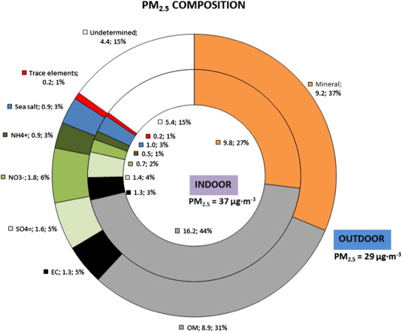
Routes of Exposure to the Criteria Pollutants: PM
PM is also found in all indoor environments. Indoor PM levels have the potential to exceed outdoor PM levels and the NAAQS.
However, less is known about the specific impacts of indoor PM on health.
Indoor PM can be generated through cooking, combustion activities (including burning of candles, use of fireplaces, use of unvented space heaters or kerosene heaters, cigarette smoking) and some hobbies.
Average indoor and outdoor PM2.5 chemical composition in BREATHE schools. - Child exposure to indoor and outdoor air pollutants in schools in Barcelona, Spain
Notes:
Child exposure to indoor and outdoor air pollutants in schools in Barcelona, Spain
https://www.epa.gov/indoor-air-quality-iaq/indoor-particulate-matter
Rivas, I., Viana, M., Moreno, T., Pandolfi, M., Amato, F., Reche, C., Bouso, L., Àlvarez-Pedrerol, M., Alastuey, A., Sunyer, J. and Querol, X., 2014. Child exposure to indoor and outdoor air pollutants in schools in Barcelona, Spain. Environment international, 69, pp.200-212.

Slide 15
Routes of Exposure to the Criteria Pollutants: Nitrogen Oxides
Outdoors: Primarily from mobile sources leading to high in-vehicle and near-road concentrations
The primary sources indoors are combustion processes, such as, unvented e.g. gas stoves, tobacco smoke, kerosene heaters.
NO₂ exposures linked with increased respiratory symptoms, asthma exacerbation.
2014 EPA National Emissions Inventory

Slide 16
Routes of Exposure to the Criteria Pollutants: Sulfur Dioxide
The largest source of sulfur dioxide (SO₂) in the atmosphere is the burning of fossil fuels by power plants and other industrial facilities.
Short-term exposures to SO₂ can harm the human respiratory system and make breathing difficult.
Children, the elderly, and those who suffer from asthma are particularly sensitive to effects of SO₂.
2014 EPA National Emissions Inventory
Notes:
Sulfur dioxide is a colorless gas with a pungent, irritating odor characteristic of burning sulfur.
The average atmospheric residence time for SO2 is 1-5 days. Ambient air concentrations of SO2 range from 1-5 ug/m3 in remote areas to 400 ug/m3 in polluted urban areas.

Slide 17
Routes of Exposure to the Criteria Pollutants: Ozone
Ozone (O₃) is not emitted directly. It is created by chemical reactions between NOx and volatile organic compounds (VOCs) in the presence of sunlight.
Ozone at ground level is a harmful air pollutant, good ozone occurs naturally in the upper atmosphere, where it forms a protective layer that shields us from the sun's harmful ultraviolet rays.
Concentrations are highest on hot, sunny days
Photochemical Smog (ex: Los Angeles)
Brownish-orange haze formed by chemical reactions involving sunlight, nitrogen oxide, and hydrocarbons
Notes:
Called stratospheric ozone, good ozone occurs naturally in the upper atmosphere, where it forms a protective layer that shields us from the sun's harmful ultraviolet rays.
https://www.epa.gov/ground-level-ozone-pollution/ground-level-ozone-basics#formation

Slide 18
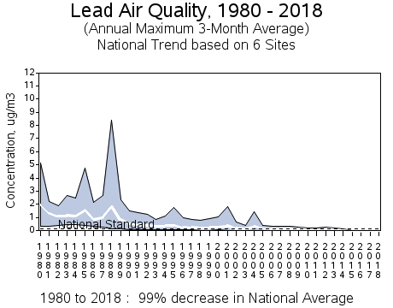
Routes of Exposure to the Criteria Pollutants: Lead
Lead (Pb) is an elemental heavy metal found naturally in the environment as well as in manufactured products.
Lead can be released directly into the air, as suspended particles.
Humans may be exposed to lead from air pollution directly, through inhalation, or through the incidental ingestion of lead that has settled out from the air onto soil or dust.
Ingestion of lead settled onto surfaces is the main route of human exposure to lead originally released into the air.
The average lead concentrations decreased dramatically after EPA's regulations reduced the lead content in on-road motor vehicle gasoline. https://www.epa.gov/air-trends/lead-trends
Notes:
https://www.tceq.texas.gov/airquality/sip/criteria-pollutants/sip-lead
https://www.epa.gov/air-trends/lead-trends

Slide 19
Research Gaps and Future Directions
Studies using complex mixtures rather than individual components are needed to expand our knowledge in this field.
Residential ambient air pollution exposure assessment can be enhanced by integrating with personal sampling with regional/ambient measurements.
Overall emissions of air toxics have declined significantly since the Clean Air Act, but new toxic pollutants continue to be released into the air. More work needs to be done to assess the toxicity of such compounds.

Slide 20
Take-Home Messages
Air pollution refers to the release of chemicals into the air that are detrimental to human health and the ecosystem.
Air pollution comes from many primary vs secondary sources. People are exposed to both indoor and outdoor air pollutants everyday.
The complexity of air pollution is partially due to its Spatial and temporal heterogeneity, which means that air pollution varies across different locations and time.
Pollutants enter the human body in three main different ways: inhalation, ingestion, and skin absorption.
Inhalation is the dominant pathway for most air pollutants.
Notes:
https://www.epa.gov/clean-air-act-overview/air-pollution-current-and-future-challenges

Slide 21
List of Abbreviations
1. Carbon Monoxide (CO)
2. Sulfur Dioxide (SO₂)
3. Nitrogen Dioxide (NO₂)
4. Ozone (O₃)
5. PM10 (particulates < 10 µm diameter)
6. PM2.5 (particulates < 2.5 µm diameter)
7. Lead (Pb)
World Health Organization (WHO)
National Ambient Air Quality Standards (NAAQS)
Volatile Organic Compounds (VOCs)
US Environmental Protection Agency (EPA)
The National Human Activity Pattern Survey (NHAPS)

Slide 22
Reading List
https://www.nps.gov/subjects/air/pollutants.htm
https://www.niehs.nih.gov/health/topics/agents/air-pollution/index.cfm
https://www.unece.org/environmental-policy/conventions/envlrtapwelcome/cross-sectoral-linkages/air-pollution-and-health.html
https://www.epa.gov/expobox/exposure-assessment-tools-routes
https://www.who.int/health-topics/air-pollution
https://www.epa.gov/report-environment/outdoor-air-quality
https://indoor.lbl.gov/sites/all/files/lbnl-47713.pdf

Slide 23
Articles Cited
Klepeis, N.E., Nelson, W.C., Ott, W.R., Robinson, J.P., Tsang, A.M., Switzer, P., Behar, J.V., Hern, S.C. and Engelmann, W.H., 2001. The National Human Activity Pattern Survey (NHAPS): a resource for assessing exposure to environmental pollutants. Journal of Exposure Science & Environmental Epidemiology, 11(3), pp.231-252.
Popescu, F. and Ionel, I., 2010. Anthropogenic air pollution sources. Air quality, pp.1-22.
Rivas, I., Viana, M., Moreno, T., Pandolfi, M., Amato, F., Reche, C., Bouso, L., Àlvarez-Pedrerol, M., Alastuey, A., Sunyer, J. and Querol, X., 2014. Child exposure to indoor and outdoor air pollutants in schools in Barcelona, Spain. Environment international, 69, pp.200-212.
Dallmann, T.R. and Harley, R.A., 2010. Evaluation of mobile source emission trends in the United States. Journal of Geophysical Research: Atmospheres, 115(D14).

