Slide 1
www.carteeh.org

Slide 2
Lecture #3: Other Transportation-Related Emissions and Air Pollution
Wen-Whai Li, Ph.D., P.E.
The University of Texas at El Paso
wli@utep.edu; (915) 747-8755
Materials used in the presentation are for education and discussion purposes only. Do not use or cite the materials without the permission of the author
The author declares that there is no conflict of interest
Lecture Track(s): HT/TT/PPT
Notes:
Health Track (HT)—mainly targeted at urban planners, transportation planners, and engineers with limited knowledge of public health-related concepts;
Transportation Track (TT)—mainly targeted at environmental epidemiologists and public health professionals with limited knowledge of transportation-related concepts; and;
Planning and Policy Track (PPT)—mainly targeted at planners, civil servants, and policy and decision makers with particular interest in the science-policy link.

Slide 3
Introduction
Sources of Air Pollution
Transportation-related Air Emissions in the U.S.
Health Impacts of Transportation Air Emissions
Transportation-related Air Regulations
Other Non-road Transportation-related Air Emissions
Discussion
Summary

Slide 4
Sources of Air Pollution
Natural Sources
  Volcanic emissions, lightning strike induced forest fires, wind erosion, animal wastes, etc.
Anthropogenic Sources
  Air pollution is a situation in which substances that result from anthropogenic activities are present at concentrations sufficiently high above their normal ambient levels to produce a measurable effect on humans, animals, vegetation, or materials.
  Primary Pollutants and Secondary Pollutants
  Point Sources
  Area Sources
  Mobile Sources
Notes:
Air pollution may be the consequence of natural processes that include volcanic eruptions, plant and animal decomposition, hydrocarbon emissions from vegetation, pollen, mold and spore releases, background ozone formation, wind-blown dust, dust storms, among many other mechanisms. Some of these events such as volcanic eruption, forest fires, or dust storms may generate enormous amount of pollutants; however, the occurrences of these events are considered rare to low, the locations of the events and the areas to be impacted are likely to be removed from major population centers, or the amounts generated by the processes such as background ozone formation and hydrocarbon emissions from vegetation are relatively insignificant when compared to the same substances that are generated by anthropogenic sources. Therefore, control and impact of these processes are typically not discussed by air pollution professionals.
Anthropogenic air pollution is a main concern of the modern society. Anthropogenic air pollution is generally more persistent and toxic, with profound effects. It could cause significant adverse health effects to human beings and irreversible damage to the environment. Anthropogenic air pollution can be easily observed as smokestack emissions from industrial facilities, trapped emissions in routinely occurring urban temperature inversion layers, and hazes in national parks. Anthropogenic air pollutants can be emitted directly from a source or formed indirectly among airborne substances in the atmosphere chemically through chemical and/or photochemical reactions or physically through nucleation, accumulation, agglomeration, phase change, or decomposition. Air pollutants emitted directly from a source are called primary pollutants whereas those formed indirectly in the atmosphere are called secondary pollutants. The sources of air pollution are also classified into three categories according to the nature of the emissions’ source. A “point source” refers to a source that emits from a stationary, identifiable location such as a smokestack or a leak point in a container vessel. A “mobile source” refers to sources that are powered by combustion engines and can move on-road or off-road. Any other source that cannot be classified as point source or mobile source is called an “area source”, which in general represents sources with multiple unidentifiable locations or groups of sources with small amounts and/or unsteady-state emissions. Fugitive emissions from industrial related operations, small businesses, household activities (heating, cooking, cleaning, gardening) that are difficult to quantify and locate fall into the category of area sources. In the United States, for regulatory compliance enforcement, those point sources which emit or have the potential to emit 10 tons per year or more of a hazardous air pollutant or 25 tons per year or more of a combination of hazardous air pollutants are called “major sources”, as defined in Section 112 of the 1997 Clean Air Act Amendments (CAAA). Likewise, an “area source" is defined as any stationary source that is not a major source, i.e., emitting less than 10 tons per year or more of a hazardous air pollutant or 25 tons per year or more of a combination of hazardous air pollutants.

Slide 5
Transportation Emissions in The U.S.
On-road Emissions
emissions from vehicles travelling on roadways including freeways, arterial, secondary, and surface roads
Off-road Emissions
emissions from vehicle or machinery/equipment powered by internal combustion engines such as equipment used for construction, agriculture, recreation, and many other purposes
Notes:
Among the many sources of pollution, pollution caused by transportation related activities is of particular importance to human due to its ubiquity, close proximity to humans, increased usage, less controlled emissions, and toxic effects to human health and the environment. Transportation-related emission sources include vehicles, engines, and motorized equipment that produce exhaust and evaporative emissions on-road or off-road. "On-road" emissions refer to emissions from vehicles travelling on roadways including freeways, arterial, secondary, and surface roads. These sources are primarily associated with discussions on traffic-related air pollution (TRAP). Off-road emissions refer to emissions from vehicle or machinery/equipment powered by internal combustion engines such as equipment used for construction, agriculture, recreation, and many other purposes. Within these two broad categories, on-road and off-road sources can be further distinguished by size, weight, use, and/or horsepower.

Slide 6
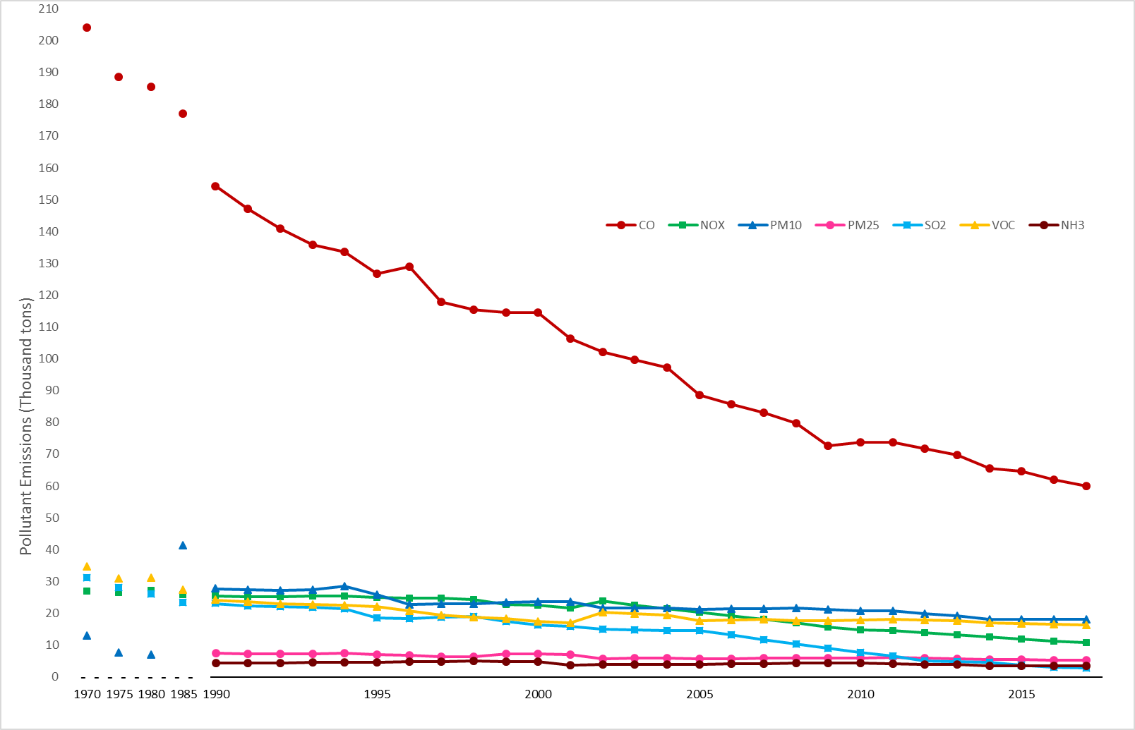
Emission Trends in the U.S.
National emission trends in the U.S., 1970 – 2107
(Data sources: U.S. EPA, https://www.epa.gov/air-emissions-inventories/air-pollutant-emissions-trends-data
Notes:
While the trends of all emissions (except PM₁₀) in the U.S. have decreased since 1970, transportation related emissions have not decreased in the same pace as other pollutants due to the increases in the total number of vehicles and the total number of vehicle miles travelled. Roadway infrastructures and on-road vehicles in the U.S. increased dramatically in the early 20th century. The public road and street mileage in the U.S. has reached 3.5 million in 1960 but slowly grown to 4.1 million in 2017 while the number of registered vehicles grew rapidly from 74 million in 1960 to 269 million in 2016 [12]. Nationwide, energy efficient, low-emission vehicles (including gasoline hybrid-electric, plug-in hybrid-electric and electric vehicles) have steadily increased from a sale of merely 17 vehicles in 1999 to 370,000 in 2017 while the average age of household vehicles has increased from 8.4 years in 1995 to 11.6 years in 2016, and from 11.6 to 17.3 years for trucks. It is worth noting that while the growth of total number of roads has been slow and steady, the vehicle miles travelled in the U.S. has grown significantly from 858 million in 1960 to 6.2 billion in 2016, an increase of 7.2 fold compared to only a fraction of 17% increase in the total miles of roads [12]. Air pollutant emissions from the activities associated with the operations of these vehicles have been considered a source of major pollution. In 2017, the CO₂ emissions from transportation exceeded all other major sources and became the largest source in the country (Figure 2.2).

Slide 7
Transportation Emissions and Health
Globally, more than 90% of air pollution-related deaths occur in low- and middle-income countries, mainly in Asia and Africa.
Low-income, underserved neighborhoods are likely to be exposed to more severe air pollution in the same city
In the U.S., 68 % of African Americans live within 30 miles of a coal-fired power plant and 66 % of Latinos live in areas that do not meet the federal government’s air quality standards.
16.9 million households (or 43.5 million of people) in the United States lived within ½ block from a four-or-more-lane highway, railroad, or airport in 2011. (AHS 2013)
Notes:
Air pollution is a complex issue which affects every living being in the world. New data from the WHO shows that 9 out of 10 people breathe air containing high levels of pollutants. The WHO estimates that around 7 million people die every year from exposure to PM_{2.5} in polluted air that penetrate deep into the lungs and cardiovascular system, causing diseases including stroke, heart disease, lung cancer, chronic obstructive pulmonary diseases and respiratory infections, including pneumonia [30]. Ambient air pollution alone caused some 4.2 million deaths in 2016, while household air pollution from cooking with polluting fuels caused an estimated 3.8 million deaths in the same period. In the U.S., approximately 20% of mortality could be attributed to air pollution exposure [31, 32]. Air pollution deaths cost global economy US $225 billion in lost labor income in 2013 [33]. It costs the global economy more than $5 trillion annually in welfare costs, with the most devastating damage occurring in the developing world.
Air pollution is not only a public health but also a social and economic inequality issue. Globally, more than 90% of air pollution-related deaths occur in low- and middle-income countries, mainly in Asia and Africa. In the developed countries, people living in underserved, low-income neighborhoods are likely to be exposed to more severe air pollution in the same city. Residents of underserved communities (low-income minority communities, in particular) are more likely to be exposed to excessive levels of air pollution. The U.S. demographics have shown that 68 % of African Americans live within 30 miles of a coal-fired power plant and 66 % of Latinos live in areas that do not meet the federal government’s air quality standards. Highly polluting industries are likely to locate their facilities in less affluent and less regulated areas. Individuals with higher education and income are likely to be more aware or better informed of the causes and impacts of air pollution and have the financial means to move away from poor air quality areas than people who don’t. As we all know, public policy is heavily influenced by interested parties and industries are said to be willing to invest more fund to support less restrictive environmental regulations than that to be invested on pollution control equipment. All these result in a “pollution inequality”, as concluded in a recently published study that non-Hispanic whites experience a “pollution advantage” verse Blacks and Hispanics [34]. On average, non-Hispanic whites experience ∼17% less PM_{2.5} exposures than Black and Hispanics. This disparity reflects a “pollution burden” of 56% and 63% excess exposure by Black and Hispanics, respectively, relative to the exposure caused by their consumption (or economic affluence).

Slide 8
Transportation Emissions and Health
Schoolchildren living 30-300 meters from a major roadway had
    increased arterial stiffness (Iannuzi et al., 2010)
    increased carotid intima-media thickness (Armijos et al., 2015)
    decreased academic performance (Gilliland et al., 2001)
    increased absenteeism (Chen et al., 2000)
    increased clinical asthma symptoms (Wendt el al, 2014).
Near-road elementary school children spend approximately 6-8 hours per day in various school microenvironments (classrooms, and playgrounds) and almost the rest of the day in their local community while elderly people are, either voluntarily or involuntarily, likely to spend 90% of their time in the community
Notes:
Schoolchildren living 30-300 meters from a major roadway had increased arterial stiffness (Iannuzi et al., 2010), increased carotid intima-media thickness (Armijos et al., 2015), decreased academic performance (Gilliland et al., 2001), increased absenteeism (Chen et al., 2000), and increased clinical asthma symptoms (Wendt el al, 2014). Elementary school children spend approximately 6-8 hours per day in various school microenvironments (classrooms, and playgrounds) and almost the rest of the day in their local community while elderly people are, either voluntarily or involuntarily, likely to spend 90% of their time in the community.

Slide 9
Transportation Emissions and Health
Approximately 4.2 million deaths worldwide are attributed to air pollution. 91% of people in the world today live in areas where the levels of air pollution exceed the WHO pollutant guidelines (WHO, 2018a).
17 % of deaths from acute lower respiratory infection and 43% of all deaths and disease from chronic obstructive pulmonary disease (COPD) could be attributed to ambient air pollution (WHO, 2016).
Studies have documented that acute exposure to air pollutants can result in the exacerbation of various health conditions such as wheezing, coughing, reduced lung function, tightness of chest and onset of asthma attacks, especially in sensitive populations such as young children, pregnant women, and the elderly.
Of the various sources of air pollution, traffic-related air pollution is considered to have caused substantial impacts on ambient and indoor exposures in urban areas (Janssen et al., 2001; Spira-Cohen et al., 2011).
Notes:
Urban air pollution is a major health concern. As per the World Health Organization (WHO) estimates, approximately 4.2 million deaths worldwide are attributed to air pollution. 91% of people in the world today live in areas where the levels of air pollution exceed the WHO pollutant guidelines (WHO, 2018a). 17 % of deaths from acute lower respiratory infection and 43% of all deaths and disease from chronic obstructive pulmonary disease (COPD) could be attributed to ambient air pollution (WHO, 2016). Air quality in the developed countries has improved in the last few decades due to stricter air pollution guidelines, improvement in fuel efficiency, cleaner car technology, and greening of the urban landscape. Nevertheless, a plethora of studies have documented that acute exposure to air pollutants can result in the exacerbation of various health conditions such as wheezing, coughing, reduced lung function, tightness of chest and onset of asthma attacks, especially in sensitive populations such as young children, pregnant women, and the elderly. The United Nations and its sister agencies have recognized air pollution as a grave risk and established the 2030 Agenda for Sustainable Development, which are a set of 17 goals formulated to achieve sustainable development by the year 2030.
Of the various sources of air pollution, traffic-related air pollution is considered to have caused substantial impacts on ambient and indoor exposures in urban areas (Janssen et al., 2001; Spira-Cohen et al., 2011). A cross-sectional study conducted in Barcelona, Spain investigated the impact of traffic-related air pollution (TRAP) and noise, and associated behavioral problems (Forns et al., 2016) reported that increases in both indoor and outdoor EC, BC, and NO₂ were positively associated with children’s frequent behavioral problems.

Slide 10
Transportation Air Quality Regulations in The U.S.
Transportation Air Quality Regulations in the U.S
Transportation Conformity
Transportation Regulations Enforcement
Notes:
Transportation emissions have been regulated since the enactment of the 1970 Clean Air Act when EPA was authorized to regulation air pollution from transportation facilities. As a result, the new passenger vehicles are 98-99% cleaner by comparing the current tailpipe emissions to that of the 1960s [22]. A major achievement of the transportation regulation is the implementation of a complete ban of leaded gas in 1995. EPA started a "phasedown" program in 1973 to bring the levels of lead down at all refineries to an average of leaded and unleaded gasoline of 0.5 g/gallon by 1982. EPA first changed the standard to 1.10 g/gallon in 1982 for leaded gallon and eliminated the “average” provision between unleaded and leaded gasoline. EPA later, in 1985, revised the standard to 0.1 g/gallon, a 90 percent reduction from the 1982 standard of 1.10 g/gallon, beginning on January 1, 1986. Lead was completed banned as a fuel additive in the U.S. in 1996 [23]. Figure 2.2 shows a significant reduction of blood lead level in children aged 1-5 years from 1976 to 2008 since EPA started to regulated lead concentration in gasoline and other consumer lead-containing products such as lead paints, plumbing, food cans, etc.
The U.S. EPA continues to regulate transportation emissions throughout the years. The timeline of EPA’s major accomplishments in regulating transportation air quality and vehicle emissions can be found at EPA’s webpage [22]. Most noticeably, the final national emission standards for hazardous air pollutants (NESHAP) for engine test cells/stands were promulgated in May of 2003 and new fuel and vehicle standards (Tier 3 standards) which require the oil companies to produce gasoline of lower sulfur content of gasoline and vehicle manufacturers improved emission control technologies to reduce harmful tailpipe pollution were enacted in 2014 (40CFR Part79). EPA began to regulate greenhouse gas emissions from vehicles in 2009 when it concluded that the current and projected concentrations of the six key well-mixed greenhouse gases in the atmosphere threaten the public health and welfare of current and future generations. In 2011, EPA and the Department of Transportation’s National Highway Traffic Safety Administration (NHTSA) announced the first-ever regulations to reduce greenhouse gas emissions and improve fuel efficiency of heavy-duty trucks and buses. In 2015, EPA and NHTSA proposed model years 2018 to 2027 greenhouse gas emissions and fuel economy standards for medium and heavy duty vehicles. A graphic timeline of the U.S. federal vehicle emission regulatory compliance and control program was prepared by the International Council on Clean Transportation [24] and reproduced in Figure 2.3.
Transportation conformity is defined in Section 176(c)(4) of the 1990 CAAA as conformity for new or existing highway or transit projects to a state implementation plan’s (SIP’s) purpose of eliminating or reducing the severity and number of violations of the NAAQS and achieving expeditious attainment of such standards. The intent is to prevent the air quality impacts of federal actions from causing or contributing to a violation of the NAAQS or interfering with the purpose of a SIP. The EPA has established criteria and procedures for determining if transportation activities conform to the SIP. In general, transportation conformity regulations in the United States act as a means to ensure that metropolitan planning organizations and state departments of transportation consider transportation emissions as part of their transportation planning activities in air quality nonattainment areas, i.e. areas that do not meet the NAAQS.
Transportation conformity is implemented in three phases: i) Applicability Analysis; ii) Conformity Determination; and iii) Review Process. Basically, the applicability analysis requires actions for those activities that cause emissions in designated nonattainment and maintenance areas. If an application analysis shows a need for the action, then a conformity determination must be performed. In the conformity determination, it must i) identify the total direct and indirect emissions associated with the activity; ii) demonstrate these emissions would not exceed the SIP emissions; iii) obtain statements from state and local metropolitan planning organization (MPO) that the emissions are included in the SIP and the area’s transportation plan; iv) fully offset the emissions in the same nonattainment or maintenance area; and v) demonstrate, by conducting air quality modeling, that the emissions will not cause or contribute to new violations of the standards, or increase the frequency or severity of any existing violations of the standards. Final revisions to the General Conformity Regulations were published on March 24, 2010 (40 CFR Parts 51 and 93)
The EPA regulates transportation emissions through regulating not only fuel sulfur contents but also individual passenger, commercial, and nonroad vehicles. The regulations and programs affecting individual vehicle are standards for exhaust and evaporative emissions, control of hazardous air pollutants and air toxics, national low emission vehicle program, CAP 2000 (Compliance Assurance Program), onboard refueling vapor recovery, and inspection and maintenance programs. Compliance of these regulations is a major challenge to gasoline refiners, automobile manufactures, and the public. Refiners and fuel importers have the primary responsibility of compliance with the motor vehicle fuels standards. Parties in the fuel distribution system are responsible for ensuring that motor vehicle fuel is not contaminated and is used in the proper locations and times. Vehicle or engine manufacturers are responsible for compliance with the vehicle and engine emissions standards. Private vehicle owners are responsible for compliance of vehicle emission standards through state-implemented inspection and maintenance programs.
Tempering of emissions tests is not limited to private citizens, especially with people who do not abide by the law, but also to major auto manufacturers. In 2018, the German auto manufacturers Volkswagen and Audi [25] was charged in the U.S. for defrauding the U.S. by working collaboratively in designing, testing, implementing, and improving software they knew to cheat the U.S. testing process by making it appear as if the emissions standards were met (referred to as the Diesel Gate scandal). Whether it’s intentional or due to serious technology deficiencies, violation of emission standards by auto manufacturers is not unique to Volkswagen. Emission control devices on automobiles were found to shut off completely while vehicles were driving with certain passenger vehicles manufactured by Fiat Chrysler [26], Daimler [27], and GM [28]. In other cases, vehicles may be recalled for excessive emissions in violation of EPA’s emission standards (e.g., Chrysler 2019 [29]). These companies failed to comply with the emissions standards have since agreed to pay up to $25 billion in fine to settle the charges.

Slide 11
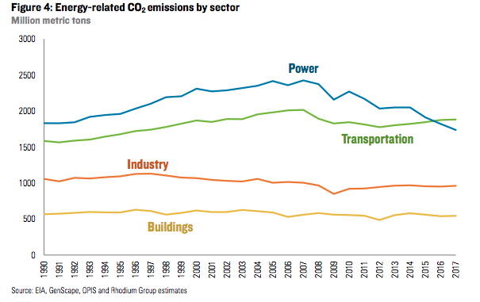
Transportation-Related Emissions
Transportation emissions have become the major source of air pollution emissions in the U.S. CO₂ emissions from transportation section has surpassed emissions from other source categories
Notes:
Mobile sources emit both criteria and other hazardous air pollutants and account for more than half of all the air pollution in the U.S.
Most of the automobiles are powered by gasoline fuel, other vehicles such as trucks, buses, trains, airplanes, off-road agricultural machinery are powered by diesel or other types of high octane fuels.

Slide 12
Transportation-Related Emissions
Evaporative Emissions:
  Fuel losses during engine resting and running
  diurnal emissions (or tank breathing loss) due to venting of vapors from the fuel tank as ambient temperature rises over the course of the day,
  hot soak emissions that occur due to residual engine heat at the end of a trip after the engine has been shut down.
  30% of gasoline-related VOCs emissions are fuel vapor, that is, non-tailpipe emissions account for around 30% of gasoline-related emissions in urban regions.
Tailpipe Emissions
Complete and incomplete combustion products such as CO, CO₂, VOCs or HCs, NO_{x}, and PM.
The speciation of VOC emitted from motor vehicles reflects the chemical composition of the fuel consumed, with additional species formed and emitted as products of incomplete combustion.
These compounds are responsible for the majority of ozone formation due to organic emissions from on-road motor vehicles.
Notes:
Characterization of Transportation Related Emissions
Air pollutants emanated from traffic-related activities associated with the operations of transportation vessels (or the traffic-related air pollutants) have the most profound impact on human health because of i) the toxicities associated with a vast number of chemicals; ii) the quantity of pollutants emitted, and iii) the relatively close proximity between the source and the population. While the health impacts and burdens of disease associated with exposures to traffic-related air pollutants are discussed in other chapters of this book, this section characterizes the various transportation emissions by their activities. Emissions from transportation related activities are generally classified into evaporative emissions, tailpipe emissions, and nonroad emissions. Emissions from other transportation vessels such as aircraft, locomotives, waterborne vessels, and military equipment are not the focus of this chapter and therefore are briefly discussed under the non-roadway emissions in this section.
· Evaporative Emissions
Volatile organic compounds (VOCs) can be evaporated from multiple points under the hood and during engine operations. Fuel losses during engine resting and running include liquid and vapor leaks in the fuel system, diurnal emissions (or tank breathing loss) due to venting of vapors from the fuel tank as ambient temperature rises over the course of the day, and hot soak emissions that occur due to residual engine heat at the end of a trip after the engine has been shut down. Analyses of gasoline samples from California for both summer and winter indicated significant differences in liquid fuel and vapor chemical composition due to intentional seasonal adjustments [13]. The California Emissions Factor Model estimates 30% of gasoline-related VOCs emissions are fuel vapor, that is, non-tailpipe emissions account for around 30% of gasoline-related emissions in urban regions. Similar weight % for the most abundant VOCs in the motor vehicle emissions were reported during a Houston tunnel air pollution study in Texas [14]. Table 2.5 lists the chemical composition of gasoline and diesel along with the calculated composition of non-tailpipe, i.e., headspace vapor, gasoline emissions [15]. Besides gasoline fuel, many vehicles are powered by diesel fuel. Diesel fuel contains low volatility hydrocarbons and as a result evaporative contributions of diesel fuel were found to be negligible compared to exhaust emissions [16].
‘TABLE 2.5 HERE’
· Tailpipe Emissions
Vehicle exhaust (or tail pipe) emissions is a major concern of air pollution. Tail pipe emissions are dominated by complete and incomplete combustion products such as CO, CO₂, VOCs or HCs, NO_{x}, and PM. CO, CO₂, NO_{x}, and PM emissions are well reported in the literature and strictly regulated by federal and state air pollution control agencies whereas VOCs are less reviewed in the literature, even though they are generally more toxic than the criteria pollutants. The speciation of VOC emitted from motor vehicles reflects the chemical composition of the fuel consumed, with additional species formed and emitted as products of incomplete combustion. Isopentane, methane, MTBE, ethylene, toluene, 2,2,4-trimethylpentane, acetylene, 2-methylpentane, m-and p-xylene, isobutylene are the primary compounds in the motor vehicle exhausts that account for approximately 50% of the emissions [14, 17]. In urban areas where gasoline accounts for a range of 73−90% of total on-road fuel use, gasoline sources are responsible for 69−96% of reactive organic carbon emissions and 79−97% of organic precursors to ozone from motor vehicles in the U.S. Isopentane is a major constituent of the headspace vapors accounting for about 40% of the VOC while it accounts for about 10% of the composition of the base gasoline [13]. These compounds are responsible for the majority of ozone formation due to organic emissions from on-road motor vehicles.
· Non-fuel Related Emissions
Non-fuel related emissions associated with transportation activities refer to PM emissions of resuspended road dust, tire and brake pad wear, clutch wear, road surface deterioration, entrainment of roadside materials due to vehicle-induced turbulence. Among non-fuel sources, brake wear can be a significant PM contributor, particularly within areas with high traffic density and braking frequency. In urban environments, brake wear can contribute up to 55 % by mass to total non-exhaust traffic-related PM₁₀ emissions and up to 21% by mass to total traffic-related PM₁₀ emissions; the respective contribution is lower on freeway due to lower braking frequency [18]. The composition of non-fuel related emissions depends strongly on the activities and materials involved in the emission processes. Road dust are likely to contain naturally occurring elements such as silicon, aluminum, potassium, calcium, and iron whereas brake and clutch wears are likely to emit titanium, iron, copper, barium, magnesium, antimony, zinc, and other metals. Organic compounds could be part of the non-fuel emissions. Polyalkylene glycol ethers (56.9 %) and n-alkanoic acids (34.3 %) are the most abundant species while n-alkanes, PAHs, and substituted PAHs are also detected in trace concentrations.
· Non-roadway Emissions
Non-roadway emissions are those emissions resulting from use of non-road engines. Non-road engines are used in an extremely wide range of applications, each involving great differences in operating characteristics, engine technology, and market dynamics. EPA has adopted emission standards for all types of non-road engines, equipment, and vehicles including emissions from aircraft, locomotives, waterborne vessels, and heavy equipment. For instance, marine diesel engine at various load conditions emits significant amounts of elemental carbon (EC), organic carbon (OC) and hydrated sulfate (HS), ash, and sulfate [19]. Aircraft emits a wide range in size of PM and heavy metals [20]. Soot from jet engines operating at low and high power levels may contain varied percentages of elements associated with lube oil—namely the metals from the organo-metallic additives [21].

Slide 13
Transportation-Related Emissions (Continued)
Non-fuel Related Emissions
  PM emissions of resuspended road dust, tire and brake pad wear, clutch wear, road surface deterioration, entrainment of roadside materials due to vehicle-induced turbulence.
  Brake wear can be a significant PM contributor, particularly within areas with high traffic density and braking frequency.
  The composition of non-fuel related emissions depends strongly on the activities and materials involved in the emission processes.
Non-roadway Emissions
  Emissions are those emissions resulting from use of non-road engines.
  Non-road engines are used in an extremely wide range of applications
  Marine diesel engine at various load conditions emits significant amounts of elemental carbon (EC), organic carbon (OC) and hydrated sulfate (HS), ash, and sulfate.
  Aircraft emits a wide range in size of PM and heavy metals.
Notes:
Characterization of Transportation Related Emissions
Air pollutants emanated from traffic-related activities associated with the operations of transportation vessels (or the traffic-related air pollutants) have the most profound impact on human health because of i) the toxicities associated with a vast number of chemicals; ii) the quantity of pollutants emitted, and iii) the relatively close proximity between the source and the population. While the health impacts and burdens of disease associated with exposures to traffic-related air pollutants are discussed in other chapters of this book, this section characterizes the various transportation emissions by their activities. Emissions from transportation related activities are generally classified into evaporative emissions, tailpipe emissions, and nonroad emissions. Emissions from other transportation vessels such as aircraft, locomotives, waterborne vessels, and military equipment are not the focus of this chapter and therefore are briefly discussed under the non-roadway emissions in this section.
· Evaporative Emissions
Volatile organic compounds (VOCs) can be evaporated from multiple points under the hood and during engine operations. Fuel losses during engine resting and running include liquid and vapor leaks in the fuel system, diurnal emissions (or tank breathing loss) due to venting of vapors from the fuel tank as ambient temperature rises over the course of the day, and hot soak emissions that occur due to residual engine heat at the end of a trip after the engine has been shut down. Analyses of gasoline samples from California for both summer and winter indicated significant differences in liquid fuel and vapor chemical composition due to intentional seasonal adjustments [13]. The California Emissions Factor Model estimates 30% of gasoline-related VOCs emissions are fuel vapor, that is, non-tailpipe emissions account for around 30% of gasoline-related emissions in urban regions. Similar weight % for the most abundant VOCs in the motor vehicle emissions were reported during a Houston tunnel air pollution study in Texas [14]. Table 2.5 lists the chemical composition of gasoline and diesel along with the calculated composition of non-tailpipe, i.e., headspace vapor, gasoline emissions [15]. Besides gasoline fuel, many vehicles are powered by diesel fuel. Diesel fuel contains low volatility hydrocarbons and as a result evaporative contributions of diesel fuel were found to be negligible compared to exhaust emissions [16].
‘TABLE 2.5 HERE’
· Tailpipe Emissions
Vehicle exhaust (or tail pipe) emissions is a major concern of air pollution. Tail pipe emissions are dominated by complete and incomplete combustion products such as CO, CO₂, VOCs or HCs, NO_{x}, and PM. CO, CO₂, NO_{x}, and PM emissions are well reported in the literature and strictly regulated by federal and state air pollution control agencies whereas VOCs are less reviewed in the literature, even though they are generally more toxic than the criteria pollutants. The speciation of VOC emitted from motor vehicles reflects the chemical composition of the fuel consumed, with additional species formed and emitted as products of incomplete combustion. Isopentane, methane, MTBE, ethylene, toluene, 2,2,4-trimethylpentane, acetylene, 2-methylpentane, m-and p-xylene, isobutylene are the primary compounds in the motor vehicle exhausts that account for approximately 50% of the emissions [14, 17]. In urban areas where gasoline accounts for a range of 73−90% of total on-road fuel use, gasoline sources are responsible for 69−96% of reactive organic carbon emissions and 79−97% of organic precursors to ozone from motor vehicles in the U.S. Isopentane is a major constituent of the headspace vapors accounting for about 40% of the VOC while it accounts for about 10% of the composition of the base gasoline [13]. These compounds are responsible for the majority of ozone formation due to organic emissions from on-road motor vehicles.
· Non-fuel Related Emissions
Non-fuel related emissions associated with transportation activities refer to PM emissions of resuspended road dust, tire and brake pad wear, clutch wear, road surface deterioration, entrainment of roadside materials due to vehicle-induced turbulence. Among non-fuel sources, brake wear can be a significant PM contributor, particularly within areas with high traffic density and braking frequency. In urban environments, brake wear can contribute up to 55 % by mass to total non-exhaust traffic-related PM₁₀ emissions and up to 21% by mass to total traffic-related PM₁₀ emissions; the respective contribution is lower on freeway due to lower braking frequency [18]. The composition of non-fuel related emissions depends strongly on the activities and materials involved in the emission processes. Road dust are likely to contain naturally occurring elements such as silicon, aluminum, potassium, calcium, and iron whereas brake and clutch wears are likely to emit titanium, iron, copper, barium, magnesium, antimony, zinc, and other metals. Organic compounds could be part of the non-fuel emissions. Polyalkylene glycol ethers (56.9 %) and n-alkanoic acids (34.3 %) are the most abundant species while n-alkanes, PAHs, and substituted PAHs are also detected in trace concentrations.
· Non-roadway Emissions
Non-roadway emissions are those emissions resulting from use of non-road engines. Non-road engines are used in an extremely wide range of applications, each involving great differences in operating characteristics, engine technology, and market dynamics. EPA has adopted emission standards for all types of non-road engines, equipment, and vehicles including emissions from aircraft, locomotives, waterborne vessels, and heavy equipment. For instance, marine diesel engine at various load conditions emits significant amounts of elemental carbon (EC), organic carbon (OC) and hydrated sulfate (HS), ash, and sulfate [19]. Aircraft emits a wide range in size of PM and heavy metals [20]. Soot from jet engines operating at low and high power levels may contain varied percentages of elements associated with lube oil—namely the metals from the organo-metallic additives [21].

Slide 14
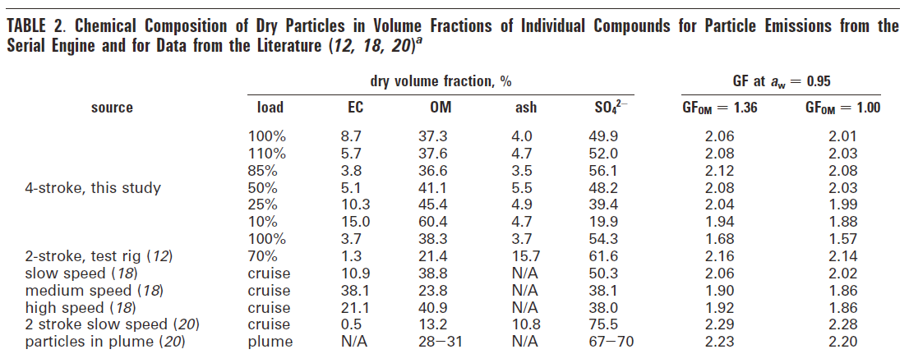
Characterization of Transportation Emissions
Off-road Emissions
emissions resulting from use of non-road engines. Non-road engines are used in an extremely wide range of applications, each involving great differences in operating characteristics, engine technology, and market dynamics. EPA has adopted emission standards for all types of non-road engines, equipment, and vehicles (U.S. EPA, 2018).
Notes:
Off-roadway emissions are those emissions resulting from use of non-road engines. Non-road engines are used in an extremely wide range of applications, each involving great differences in operating characteristics, engine technology, and market dynamics. EPA has adopted emission standards for all types of non-road engines, equipment, and vehicles (U.S. EPA, 2018).
A literature review on the physical properties, chemical composition, and cloud forming potential of particulate emissions from a marine diesel engine at various load conditions and compares the fraction of elemental carbon (EC), organic carbon and hydrated sulfate (OM), ash, and sulfate (Petzold, 2010).
Studies on aircraft emissions suggest that the range of size of particulate emissions from some jet engines clusters below 1.5 µm and that the emissions contain heavy metals (Boyle, 1996).
Wal et al, in a study sponsored by NASA, found that soot from jet engines operating at low and high power levels may contain varied percentages of elements associated with lube oil—namely the metals from the organo-metallic additives. The impact to air quality surrounding airports can be assessed based on measured emission indices and jet operations, motivated by its chemically active nature (Wal et al, 2016).

Slide 15
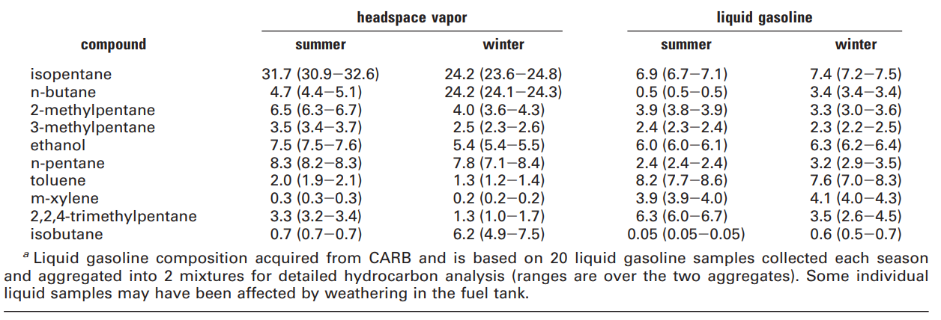
Characterization of Transportation Emissions
VOCs in the Gasoline Vapors
Table copied from Genter et al (2009)
Notes:
A follow up study in 2013 (Genter et al, 2013) concluded that gasoline emissions (both exhaust and non-tailpipe) are responsible for the majority of ozone formation due to organic emissions from on-road motor vehicles. In urban areas where gasoline accounts for a range of 73−90% of total on-road fuel use, gasoline sources are responsible for 69−96% of reactive organic carbon emissions and 79−97% of organic precursors to ozone from motor vehicles in the U.S. Isopentane is a major constituent of the headspace vapors accounting for about 40% of the VOC while it accounts for about 10% of the composition of the base gasoline.

Slide 16
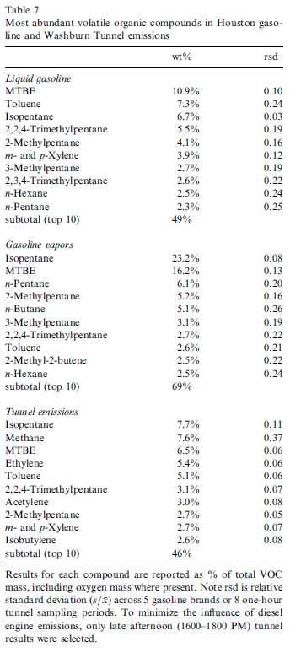
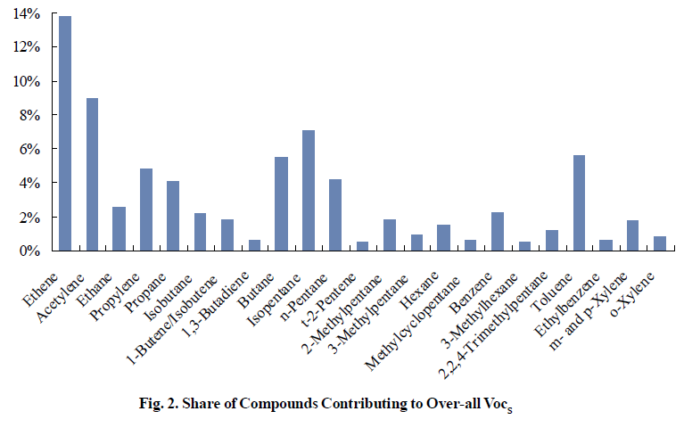
Characterization of Transportation Emissions
Vehicle Emissions in the a Tunnel (McGauhey et al 2004)
Araizaga et al (2013) Volatile Organic Compound Emissions from Light-Duty Vehicles in Monterrey, Mexico: A Tunnel Study
Notes:
The speciation of VOC emitted from motor vehicles reflects the chemical composition of the fuel consumed, with additional species formed and emitted as products of incomplete combustion. These products of incomplete combustion depend on fuel composition. Tunnel studies are often used to measure emissions from diesel and gasoline powered vehicles; these are often reported as emissions factors for different pollutants
Measurements from a Houston Tunnel study report also reported wt% for VOC tunnel emissions (McGauhey et al, 2004). Products of incomplete combustion such as ethylene and acetylene are present in tunnel emissions, but are not found in unburned gasoline.

Slide 17
Characterization of Transportation Emissions
VOCs in the Gasoline Vapors
Table copied from Genter et al (2009)

Slide 18
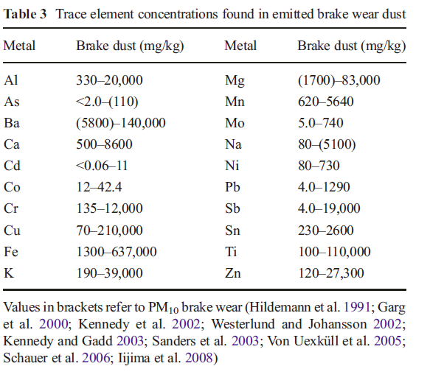
Characterization of Transportation Emissions
Non-fuel Related Emissions
Non-fuel particles can be generated either from non-exhaust sources such as brake, tire, clutch and road surface wear or already exist in the form of deposited material at the roadside and become re-suspended due to traffic-induced turbulence.
Notes:
Non-fuel particles can be generated either from non-exhaust sources such as brake, tire, clutch and road surface wear or already exist in the form of deposited material at the roadside and become re-suspended due to traffic-induced turbulence. Among non-fuel sources, brake wear can be a significant PM contributor, particularly within areas with high traffic density and braking frequency. Studies mention that in urban environments, brake wear can contribute up to 55 % by mass to total non-exhaust traffic-related PM10 emissions and up to 21% by mass to total traffic-related PM10 emissions, while in freeways, this contribution is lower due to lower braking frequency (Grigoratos and Martini, 2014).

Slide 19
Other Non-Road Transportation-related Emission Sources
Fugitive Dust Emissions
Truck and Buses
Trains
Aircraft
Off-road trackers and machineries
Boats and marine vessels
Military equipment

Slide 20
Other Non-Road Transportation-related Emission Sources
Fugitive Dust Emissions from transportation-related activities
  Paved Roads
  Unpaved roads
  Heavy Construction
  Material Handling
  Wind Erosion
  Blasting/Explosion
Notes:
AP 42, Fifth Edition, Volume I, Chapter 13: Miscellaneous Sources
“A number of fugitive dust studies have indicated that the PM2.5 / PM10 ratios measured by US EPA federal reference method (FRM) samplers are significantly lower than predicted by AP-42 emission factors. As a result, the PM2.5 emission estimates are biased high. The controlled exposure study described in this report was conducted to compare fine fraction ratios derived from FRM samplers to those derived from the cyclone/impactor method that had been used to develop AP-42 emission factors for fugitive dust sources. The study was conducted by the Midwest Research Institute using the same cyclone/impactor samplers and operating method that generated the original AP-42 emission factors and associated PM2.5 / PM10 ratios. This study was sponsored by the Western Regional Air Partnership”

Slide 21
Other Non-road Transportation-related Emission Sources
Emissions from Locomotives
  Regulations for Emissions from Locomotives
  In June 2008, EPA finalized a three-part program that dramatically reduces emissions from diesel locomotives of all types -- line-haul, switch, and passenger rail. The rule cuts particulate matter (PM) emissions from these engines by as much as 90 percent and oxides of nitrogen (NO_{x}) emissions by as much as 80 percent when fully implemented. The standards are based on the application of high-efficiency catalytic aftertreatment technology for freshly manufactured engines built in 2015 and later.
  Federal Exhaust Emission Standards for Locomotives
  Emission Factors for Locomotives
  Emission Inventories
  Reduction of Locomotive Emissions
Notes:
Control of Emissions from Idling Locomotives, https://nepis.epa.gov/Exe/ZyPdf.cgi?Dockey=P100HP4Q.pdf
Locomotive Emission Inventories for the United States from ERTAC Rail by Bergin, Harrell, and Janssen
Federal Exhaust Emissions Standards for Locomotives, https://www.bts.gov/content/federal-exhaust-emissions-standards-locomotives
“Three nationwide locomotive emission inventories have been developed in collaboration with twenty-seven state air protection agencies, coordinated through the Eastern Regional Technical Advisory Committee, with support from railroads and industry associations. The inventories are for Class I line-haul locomotives which travel long distances, Class I switcher locomotives which largely operate within railyards, and for Shortline and Regional locomotives which generally serve specific industries and complex railyards and intermodal terminals. This paper presents the data and methodologies used to develop the inventories, the results, and potential improvements. Locomotives generally utilize very large diesel combustion engines, resulting in emissions of NOx, PM, hydrocarbons, and greenhouse gases. Emissions are regionally distributed from long-distance hauling as well as sometimes being highly concentrated in railyards. Along with contributing to secondary pollutants such as ozone and PM2.5, which can exceed National Ambient Air Quality Standards, locomotive emissions can directly impact sensitive populations near railroad tracks and railyards (e.g. schools, hospitals, ‘Environmental Justice’ communities). Locomotive emission inventory development tools often vary dramatically between states. Except for a few notable exceptions, the resulting inventories generally lack the resolution needed to support air quality modeling or ‘hotspot’ evaluation and are difficult to combine for cohesive systematic analysis. Freight transportation is projected to increase, dramatically in some areas near the East Coast due to the 2014 Panama Canal expansion, and technologies and techniques for reducing emissions and/or population exposure are available, making these inventories timely and useful to support the safe, efficient advancement of the United States railroad system.”
Emission Factors, https://nepis.epa.gov/Exe/ZyNET.exe/P1001Z8C.TXT?ZyActionD=ZyDocument&Client=EPA&Index=1995+Thru+1999&Docs=&Query=&Time=&EndTime=&SearchMethod=1&TocRestrict=n&Toc=&TocEntry=&QField=&QFieldYear=&QFieldMonth=&QFieldDay=&IntQFieldOp=0&ExtQFieldOp=0&XmlQuery=&File=D%3A%5Czyfiles%5CIndex%20Data%5C95thru99%5CTxt%5C00000022%5CP1001Z8C.txt&User=ANONYMOUS&Password=anonymous&SortMethod=h%7C-&MaximumDocuments=1&FuzzyDegree=0&ImageQuality=r75g8/r75g8/x150y150g16/i425&Display=hpfr&DefSeekPage=x&SearchBack=ZyActionL&Back=ZyActionS&BackDesc=Results%20page&MaximumPages=1&ZyEntry=1&SeekPage=x&ZyPURL

Slide 22
Other Non-road Transportation-related Emission Sources
Emissions from Aircraft and Aircraft Engines
  Regulations for Emissions from Aircraft
  Federal Emission Standards for Aircraft
  Emission Factors for Aircraft
    GHG
    Criteria Pollutants
    HAPs
  Emission Inventories
  The National Emissions Inventory (NEI) is a comprehensive and detailed estimate of air emissions of criteria pollutants, criteria precursors, and hazardous air pollutants from air emissions sources. The NEI is released every three years based primarily upon data provided by State, Local, and Tribal air agencies for sources in their jurisdictions and supplemented by data developed by the US EPA.
  Reduction of Aircraft Emissions
Notes:
Regulations for Emissions from Aircraft, https://www.epa.gov/regulations-emissions-vehicles-and-engines/regulations-emissions-aircraft
Final Rule for Control of Air Pollution from Aircraft and Aircraft Engines: Emission Standards and Test Procedures, https://www.epa.gov/regulations-emissions-vehicles-and-engines/final-rule-control-air-pollution-aircraft-and-aircraft-0
ENVIRONMENTAL PROTECTION AGENCY 40 CFR Part 87 [OAR–2002–0030; FRL–7997–3] RIN 2060–AK01 Control of Air Pollution From Aircraft and Aircraft Engines; Emission Standards and Test Procedures
Aircraft produce the same types of emissions as your automobile. Aircraft jet engines, like many other vehicle engines, produce carbon dioxide (CO2), water vapor (H2O), nitrogen oxides (NOx), carbon monoxide (CO), oxides of sulfur (SOx), unburned or partially combusted hydrocarbons (also known as volatile organic compounds (VOCs)), particulates, and other trace compounds. A small subset of the VOCs and particulates are considered hazardous air pollutants (HAPs). Aircraft engine emissions are roughly composed of about 70 percent CO2, a little less than 30 percent H2O, and less than 1 percent each of NOx, CO, SOx, VOC, particulates, and other trace components including HAPs. Aircraft emissions, depending on whether they occur near the ground or at altitude, are primarily considered local air quality pollutants or greenhouse gases, respectively. Water in the aircraft exhaust at altitude may have a greenhouse effect, and occasionally this water produces contrails, which also may have a greenhouse effect. About 10 percent of aircraft emissions of all types, except hydrocarbons and CO, are produced during airport ground level operations and during landing and takeoff. The bulk of aircraft emissions (90 percent) occur at higher altitudes. For hydrocarbons and CO, the split is closer to 30 percent ground level emissions and 70 percent at higher altitudes.
National Emissions Inventory for aircraft, https://www.epa.gov/air-emissions-inventories/national-emissions-inventory-nei

Slide 23
Other Non-road Transportation-related Emission Sources
Emissions from Maritime shipping and Transportation
  Regulations for Ship Emissions
  Federal Emission Standards
  Emission Factors
    GHG
    Criteria Pollutants
    HAPs
  Emission Inventories for maritime shipping and transportation
  Emissions Inventory at Port of Entry
  Reduction of Emissions from Ocean-going Vessels
Notes:
The Development of a Global Maritime Emissions Inventory Using Electronic Monitoring and Reporting Techniques by D. Neef “Emissions from maritime shipping are a significant source of airborne pollution. Recent studies have estimated that ocean-going ships produce at least 15% of the world's NOx, between 3%-6% of greenhouse gasses, and between 3%-7% of global SOx output. Many partial maritime emissions inventories have been compiled in the last decade using both fuel-based and energy-based survey methods, but without accurate data on load factor, engine speed, and fuel type – data that must be taken directly from the ship’s onboard systems – these surveys remain as high-level estimates; not precise enough to use as a basis for assigning emissions credits in an emissions cap-and-trade mechanism. “
Emission inventories for ocean-going vessels, https://nepis.epa.gov/Exe/ZyNET.exe/P100LKVH.TXT?ZyActionD=ZyDocument&Client=EPA&Index=2006+Thru+2010&Docs=&Query=&Time=&EndTime=&SearchMethod=1&TocRestrict=n&Toc=&TocEntry=&QField=&QFieldYear=&QFieldMonth=&QFieldDay=&IntQFieldOp=0&ExtQFieldOp=0&XmlQuery=&File=D%3A%5Czyfiles%5CIndex%20Data%5C06thru10%5CTxt%5C00000036%5CP100LKVH.txt&User=ANONYMOUS&Password=anonymous&SortMethod=h%7C-&MaximumDocuments=1&FuzzyDegree=0&ImageQuality=r75g8/r75g8/x150y150g16/i425&Display=hpfr&DefSeekPage=x&SearchBack=ZyActionL&Back=ZyActionS&BackDesc=Results%20page&MaximumPages=1&ZyEntry=1&SeekPage=x&ZyPURL

Slide 24
Discussion
Multipollutant exposure to non-road traffic-related air pollution
Implementation of emission control on oceans is an international issue. Regulations will be difficult to enforce.
Notes:
To be developed later

Slide 25
Research Gaps and Future Directions
Total exposure assessment on transportation emissions, exposure, and Health Effects for transportation facility users
Characterization of air emissions and associated health effects from exposures to maritime vessels and diesel engines, aircraft, military equipment, or other non-conventional vessels

Slide 26
Take-Home Messages
Transportation emissions have exceeded emissions from other source categories and became the primary emission source for air pollution
The impacts of transportation emissions other than onroad automobile emissions on health are not well understood and characterization of these emissions is needed.
Emission models for automobile as well as other sources are readily available in the literature and applications of these model require knowledge in air pollution as well as transportation modeling

Slide 27
References
Araizaga, A.E., Mancilla, Y. and Mendoza, A. 2013. Volatile Organic Compound Emissions from Light-Duty Vehicles in Monterrey, Mexico: A Tunnel Study
Gentner, D.R., Harley, R.A, Miller, A.A., Goldstein, A.H. 2009. Diurnal and Seasonal Variability of Gasoline-Related Volatile Organic Compound Emissions in Riverside, California. Environmental Science & Technology 43 (12), 4247-4252. DOI: 10.1021/es9006228
Gentner D.R., Isaacman, G., Worton, D.R., Chan, A.W.H., Dallmann, T.R, Goldstein, A.H. 2012. Elucidating secondary organic aerosol from diesel and gasoline vehicles through detailed characterization of organic carbon emissions. Proceedings of the National Academy of Sciences Nov 2012, 109 (45) 18318-18323; DOI: 10.1073/pnas.1212272109
Gentner, D. R., Worton, D. R., Isaacman, G., Davis, L. C., Dallmann, T. R., Wood, E. C., Harley, R. A. 2013. Chemical Composition of Gas-Phase Organic Carbon Emissions from Motor Vehicles and Implications for Ozone Production. Environmental Science & Technology,47(20), 11837-11848. doi:10.1021/es401470e
McGaughey, G. R., N. R. Desai, D. Allen, R L. Seila, W A. Lonneman, M. P. Fraser, R. A. Harley, A. K. Pollack, J. M. Ivey, J. H. Price. Analysis of Motor Vehicle Emissions in A Houston Tunnel During the Texas Air Quality Study 2000. Presented at NARSTO Workshop on Innovative Methods for Emission-Inventory Development and Evaluation, Austin, TX, October 14-17, 2003.
U.S. EPA. 2018. Regulations for Emissions from Nonroad Vehicles and Engines. https://www.epa.gov/regulations-emissions-vehicles-and-engines/regulations-emissions-nonroad-vehicles-and-engines
Wal, R. L., Bryg, V. M., & Huang, C. (2016). Chemistry characterization of jet aircraft engine particulate matter by XPS: Results from APEX III. Atmospheric Environment, 140, 623-629. doi:10.1016/j.atmosenv.2016.05.039
Li, W-W, 2020. Chapter 2: Air pollution, air quality, vehicle emissions and environmental regulations, in Traffic-Related Air Pollution: Emissions, Human Exposures, and Health, edited by Khreis H. et al, Elsevier S&T Books.
De Nevers, Noel. 2017. Air Pollution Control Engineering, Waveland Press, Inc., ISBN 1-4786-2905-3.
Li, W.W. et al 2019. Healthy Living, Children’s Respiratory Health, and Traffic-Related Air Pollution in an Underserved Community, a CARTEEH Report.

Slide 28
Reading List
Khreis H. et al, 2020. Traffic-Related Air Pollution: Emissions, Human Exposures, and Health, Elsevier S&T Books.

Slide 29
Acknowledgements
This presentation is adapted from the class notes used in the class CE 5326: Air Pollution Control Engineering at UTEP and refers to many published documents. The information provided in this presentation is designed solely for discussion only and should not be cited or reproduced for any other uses without the consent of the author.

