Slide 1
www.carteeh.org

Slide 2
Lecture #31: Effects of Traffic-Related Air Pollution on Human Health—Well-Established Evidence
Kirsten Koehler
Johns Hopkins Bloomberg School of Public Health
Kirsten.Koehler@jhu.edu (410) 955-7706
The author declares that there is no conflict of interest
Lecture Track(s): HT/TT
Notes:
Health Track (HT)—mainly targeted at urban planners, transportation planners, and engineers with limited knowledge of public health-related concepts;
Transportation Track (TT)—mainly targeted at environmental epidemiologists and public health professionals with limited knowledge of transportation-related concepts.

Slide 3
Introduction
Traffic-related air pollution (TRAP) is a strong contributor to the global burden of disease due to air pollution.
However, it can be challenging to assess the associations between traffic-related air pollution and health because there is no perfect measure of exposure.
Because of these challenges, many researchers use different metrics of exposure to look at the impact of TRAP on health.
This lecture will consider the well-known impacts of traffic-related air pollution or TRAP on health.

Slide 4
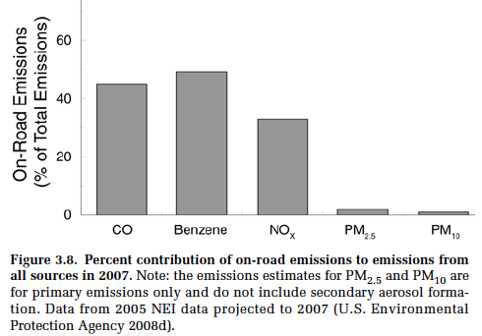
The Contribution of Traffic to Concentration Depends on the Pollutant
TRAP includes a variety of pollutants, and most of those pollutants can also come from other sources (non-traffic fossil fuel consumption primarily).
It can also be challenging to quantify exposures because concentrations decrease rapidly as you move away from roadways.
PM is known to be strongly related with health.
However, PM comes from many different sources, and only a small proportion is due to traffic.
Other pollutants like CO are more strongly related to traffic emissions.
HEI Report, pg. 3-15
Notes:
HEI Special Report 17
https://www.healtheffects.org/system/files/SR17TrafficReview.pdf

Slide 5
All-Cause Mortality
Some early evidence was related to all-cause mortality.
A 2007 study showed a 2.3% increase in all-cause mortality per IQR increase in traffic particle exposure from a GIS-based exposure model. (Maynard et al. 2007)
Traffic intensity on the nearest roadway was associated with mortality in a Dutch cohort in a 2008 study. (Beelen et al. 2008)
The Health Effects Institute (HEI) has classified TRAP as suggestive of a causal relationship with all-cause mortality. (HEI Special Report 17, hereafter “HEI Report”)
Notes:
HEI Special Report 17
https://www.healtheffects.org/system/files/SR17TrafficReview.pdf

Slide 6
Long-term Exposure to TRAP and All-Cause Mortality
Relative Risk for all-cause mortality with long-term exposure.
Even small relative risks are very important because everyone is exposed to TRAP.
HEI Report, pg. 4-63
Notes:
Note that many different exposure metrics are considered

Slide 7
Cardiovascular Morbidity
A large number of studies have focused on cardiovascular morbidity.
Associations have been shown with:
  increased blood pressure (Fuks et al. 2014; Defino et al. 2010; Cosselman et al. 2012; Alexeeff et al. 2018)
  cardiovascular events (Alexeeff et al. 2018)
  coronary heart disease (Gan et al. 2011; Kan et al. 2008; Hoffmann et al. 2009)
  heart rate variability (Weichenthal et al. 2011; Baja et al. 2010)
  cardiac autonomic function (Wu et al. 2011)
Notes:
HEI Special Report 17
https://www.healtheffects.org/system/files/SR17TrafficReview.pdf

Slide 8
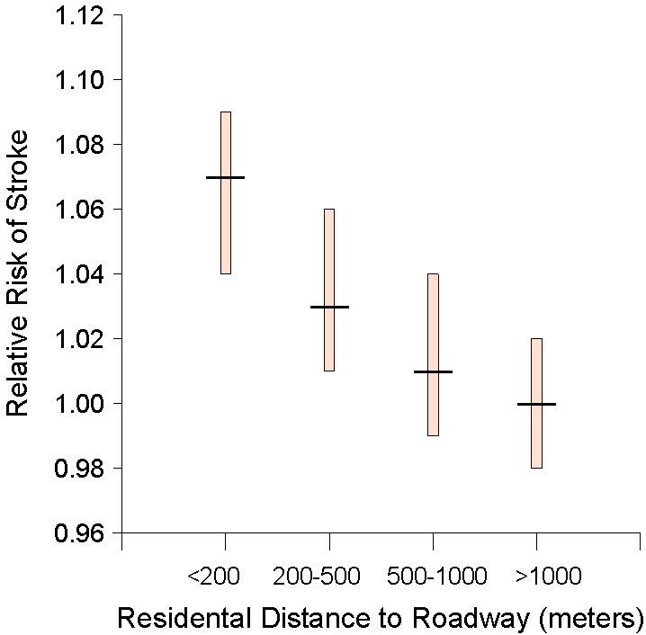
Stroke Risk vs. Distance to Major Roadway
Stroke kills almost 130,000 Americans each year—that's 1 out of every 19 deaths.
Even simple exposure metrics like distance to roadway were sufficient to show an association between traffic exposure and stroke.
Adapted from Maheswaran and Elliott, Stroke (2003)
Notes:
CDC: On average, one American dies from stroke every 4 minutes. Every year, more than 795,000 people in the United States have a stroke.

Slide 9
Respiratory Disease
Many studies have investigation relationships between TRAP and respiratory symptoms, asthma and chronic obstructive pulmonary disease (COPD).
Different studies have considered both prevalence and incidence of disease.
The HEI Report concluded the evidence was “sufficient” to infer a causal association between exposure to TRAP and exacerbation of asthma symptoms in children with asthma but the evidence was “inadequate and insufficient” to infer a causal association between exposure and symptoms in children without asthma. The evidence for adult onset asthma was also considered inadequate.

Slide 10
Changes in Lung Function Among Asthmatic Children
Clear reductions in FEV1 – the forced expiratory volume in 1 second - was observed in asthmatic children after exposure to a busy street traffic.
HEI Report, pg. 5-16

Slide 11

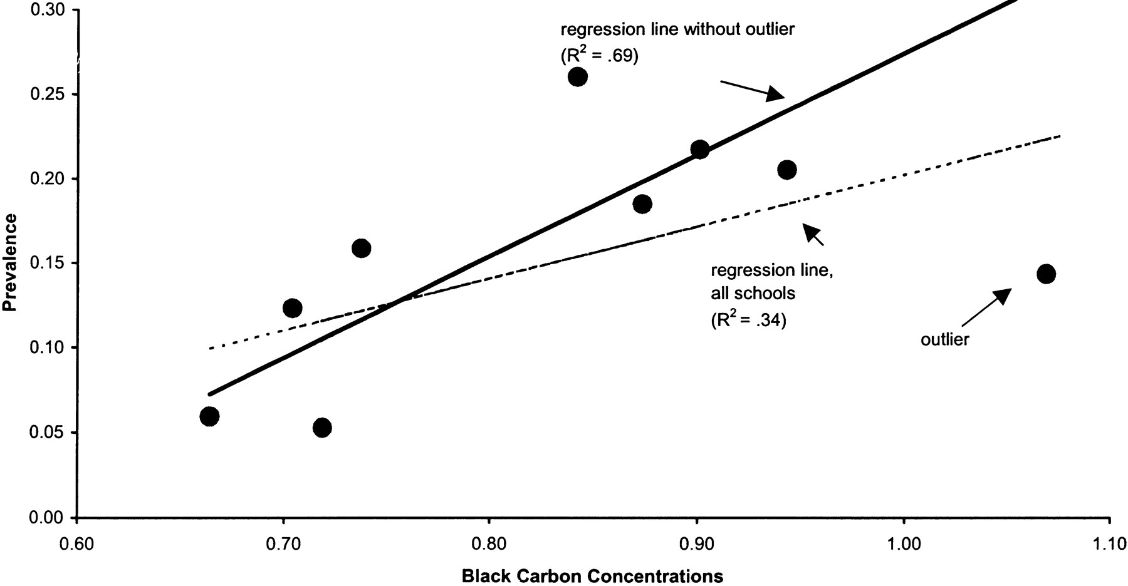
Asthma prevalence at schools in the bay area was related to black carbon concentrations, the component of PM often associated with traffic.
The study also showed associations with bronchitis.
Asthma Prevalence
Notes:
Kim et al. 2004 doi: 10.1164/rccm.200403-281OC
https://www.ncbi.nlm.nih.gov/pubmed/15184208

Slide 12
TRAP and Asthma in Children
HEI Report, pp. 4-23
Substantial variability in odds ratios, but most are greater than 1, indicating exposure is associated with increased prevalence of asthma in children.
HEI Report, pg. 4-23

Slide 13
TRAP and Respiratory symptoms among Adults
HEI Report, pg. 4-38
Notes:
Note that some of these studies show that those living closest to major roadways have the strongest effects.

Slide 14
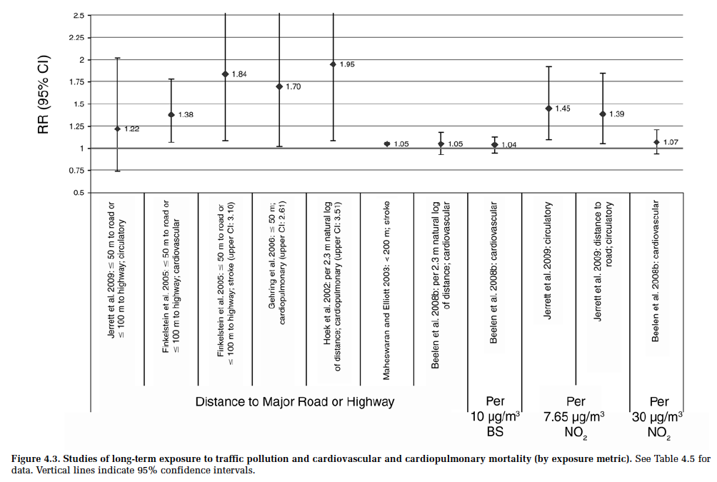
Cardiovascular and cardiopulmonary mortality
Even simple metrics like distance to roadway, requiring little measurement cost, show strong associations with cardiopulmonary mortality.
From HEI Report, pg. 4-13

Slide 15
Cancer
Exposure to TRAP (NO₂, in particular) was associated with a 4% increase in lung cancer per 10 µg/m³ increase in NO₂ in a systematic review and meta-analysis (Hamra et al. 2015).
A meta-analysis of childhood cancer studies found a positive association between pre- and post-natal TRAP exposure and childhood leukemia (Boothe et al. 2014; Filippini et al. 2015).
Associations suggestive of a link between traffic-related hazardous air pollutants (i.e., 1,3-butadiene and diesel exhaust particulate matter) and the incidence of childhood central nervous system tumors (Danysh et al. 2001-2009).

Slide 16
Possible Mechanistic Pathway
Particles and some other TRAP constituents are known to cause inflammation and oxidative stress, associated with many health outcomes.
These constituents may also cause DNA damage leading to carcinogenesis.
From HEI Report, pg. 5-21

Slide 17
TRAP and Childhood Cancer
Large variability in effect estimates depending on the exposure metric.
Figure from the HEI Report, pg. 4-58

Slide 18
Susceptible and Vulnerable Populations (1)
Some groups may be particularly susceptible to the effects of TRAP.
For cardiovascular outcomes, groups at greater risk were those with
  Obesity (Baja et al. 2010)
  pre-existing heart disease (Dragano et al. 2008)
  Diabetes (Baja et al. 2010)
  lower socioeconomic status (Dragano et al. 2008)
There may also be differences by sex.
  wheeze, night cough, and rhinitis symptoms were reported in boys, but not in girls (Ranciere et al. 2017).
  Stronger effects were observed among boys for pneumonia (Chang et al. 2018), attention measures (Chiu et al. 2013), and asthma symptoms (Gonzalez-Barcala et al. 2013).

Slide 19
Susceptible and Vulnerable Populations (2)
Certain worker populations may also be vulnerable given their higher exposures to TRAP. These can include:
traffic police and conductors, taxi drivers, professional motorcyclists, gas station attendants, and street vendors
Notes:
Sources: Bucker et al. 2013; Huang et al. 2012; Carvalho et al. 2018; Garshick et al. 2008; Choudhary et al. 2014

Slide 20
Discussion
Distinguishing the impact of TRAP on health is challenging from an exposure and an outcome perspective. TRAP exposures can be estimated in many ways because many constituents likely contribute to health effects. Health outcomes are also assessed in many ways, which can make it challenging to compare results across studies.
Even relatively simple exposure assessments based on proximity have been helpful to understand the relationship between TRAP exposure and health.
There is growing evidence for an association between TRAP and all-cause mortality, asthma exacerbation, cardiovascular disease, and cancer.

Slide 21
Research Gaps and Future Directions
Future research should continue to prioritize improving exposure assessment for health effects research.
Epidemiologists and biostatisticians should continue to develop methods to better consider mixtures of pollutants, which is especially important for TRAP.
Toxicological studies may help us determine which constituents of TRAP are most responsible for observed health effects.
Studies should also focus on determining which groups are particularly susceptible to the effects of TRAP so that they can be prioritized for exposure reduction.

Slide 22
Take-Home Messages
Nearly everyone is exposed to TRAP worldwide. Thus, even seemingly small increases in risks to myriad diseases due to exposure to TRAP can have a very large impact on the burden of disease globally.
A large proportion of the population live within 300 m of a major roadway and may be particularly at risk due to the rapid decay of pollutants away from roadways.
Even in 2010, the Health Effects Institute found sufficient or suggestive evident showing a causal relationship between TRAP and some health effects, and the literature is rapidly growing in this area.

Slide 23
List of Abbreviations
Abbreviation | Definition
TRAP | Traffic Related Air Pollution
PM | Particulate Matter
CO | Carbon Monoxide
NO₂ | Nitrogen Dioxide
COPD | chronic obstructive pulmonary disease

Slide 24
References
Alexeeff, S.E., Roy, A., Shan, J., et al., 2018. High-resolution mapping of traffic related air pollution with google street view cars and incidence of cardiovascular events within neighborhoods in Oakland, CA. Environmental Health : A Global Access Science Source, 17(1), pp.38-13.
Baja, E.S., Schwartz, J.D., Wellenius, G.A., et al., 2010. Traffic-related air pollution and QT interval: Modification by diabetes, obesity, and oxidative stress gene polymorphisms in the normative aging study. Environmental Health Perspectives, 118(6), pp.840-846.
Beelen, R., Raaschou-Nielsen, O., Stafoggia, M., Andersen, Z. J., Weinmayr, G., Hoffmann, B., and Vineis, P., 2014. Effects of long-term exposure to air pollution on natural-cause mortality: an analysis of 22 European cohorts within the multicentre ESCAPE project. The Lancet, 383(9919), pp.785-795.
Boothe, V.L., Boehmer, T.K., Wendel, A.M., Yip, FY., 2014. Residential traffic exposure and childhood leukemia. American Journal of Preventive Medicine, 46(4), pp.413-422.

Slide 25
References
Brucker, N., Moro, A.M., Charão, M.F., et al., 2013. Biomarkers of occupational exposure to air pollution, inflammation and oxidative damage in taxi drivers. Science of the Total Environment, 463-464, pp.884-893.
Carvalho, R., Carneiro, M., Barbosa, Jr. F., et al., 2018. The impact of occupational exposure to traffic-related air pollution among professional motorcyclists from Porto Alegre, Brazil, and its association with genetic and oxidative damage. Environmental Science and Pollution Reseseach, 25(19), pp.18620-18631.
Chang, J., Liu, W., Huang, C., 2018. Residential ambient traffic in relation to childhood pneumonia among urban children in Shandong, China: A cross-sectional study. International Journal of Environmental Research in Public Health, 15(6), pp.1076.
Cosselman, K.E., Krishnan, R., Oron, A., et al., 2012. Blood pressure response to controlled diesel exhaust exposure in human subjects. Hypertension, 59(5), pp.943-948.

Slide 26
References Continued
Chiu, Y.M., Bellinger, D.C., Coull, B.A., et al., 2013. Associations between traffic-related black carbon exposure and attention in a prospective birth cohort of urban children. Environmental Health Perspectives, 121(7), pp.859-864.
Choudhary, H., Tarlo, S., 2014. Airway effects of traffic-related air pollution on outdoor workers. Current Opinion in Allergy and Clinical Immunology, 14(2), pp.106-112.
Danysh, H.E., Mitchell, L.E., Zhang, K., Scheurer, M.E., Lupo, P.J., 2015. Traffic-related air pollution and the incidence of childhood central nervous system tumors: Texas, 2001-2009. Pediatric Blood Cancer, 62(9), pp.572-1578.
Delfino, R.J., Tjoa, T., Gillen, D.L., et al., 2010. Traffic-related air pollution and blood pressure in elderly subjects with coronary artery disease. Epidemiology, 21(3), pp.396-404.
Dragano, N., Hoffmann, B., Moebus, S., et al., 2009. Traffic exposure and subclinical cardiovascular disease: Is the association modified by socioeconomic characteristics of individuals and neighbourhoods? Results from a multilevel study in an urban region. Occupational and Environmental Medicine, 66(9), pp.628-635.

Slide 27
References Continued
Filippini, T., Heck, J.E., Malagoli, C., Del Giovane, C., Vinceti, M., 2015. A review and meta-analysis of outdoor air pollution and risk of childhood leukemia. Journal of Environmental Science and Health Part C, Environmental Carcinogenesis Ecotoxicology Reviews, 33(1), pp.36-66.
Fuks, K.B., Weinmayr, G., Foraster, M., et al., 2014. Arterial blood pressure and long-term exposure to traffic-related air pollution : An analysis in the European study of cohorts for air pollution effects (ESCAPE). Environmental Health Perspectives, 122(9), pp.896-905.
Gan, W.Q., Koehoorn, M., Davies, H.W., Demers, P.A., Tamburic, L., Brauer, M., 2011. Long-term exposure to traffic-related air pollution and the risk of coronary heart disease hospitalization and mortality. Environmental Health Perspectives, 119(4), pp.501-507.
Garshick, E., Laden, F., Hart, J.E., et al., 2008. Lung cancer and vehicle exhaust in trucking industry workers. Environmental Health Perspectives, 116(10), pp.1327-1332.

Slide 28
References Continued
Gonzalez-Barcala, FJ., Pertega, S., Garnelo, L., et al., 2013. Truck traffic related air pollution associated with asthma symptoms in young boys: A cross-sectional study. Public Health, 127(3), pp.275-281.
Hamra, G.B., Laden, F., Cohen, A.J., Raaschou-Nielsen, O., Brauer, M., Loomis, D., 2015. Lung cancer and exposure to nitrogen dioxide and traffic: A systematic review and meta-analysis. Environmental Health Perspectives, 123(11), pp.1107-1112
Health Effects Institute (HEI), 2010. Traffic-Related Air Pollution: A Critical Review of the Literature on Emissions, Exposure, and Health Effects. HEI Special Report 17.
Hoffmann, B., Moebus, S., Dragano, N., et al., 2009. Residential traffic exposure and coronary heart disease: Results from the Heinz Nixdorf recall study. Biomarkers, 14 Suppl 1, pp.74-78.
Huang, H.B., Lai, C.H., Chen, G.W., et al., 2012. Traffic-related air pollution and DNA damage: A longitudinal study in Taiwanese traffic conductors. PLoS One, 7(5), pp.e37412.

Slide 29
References Continued
Kan, H., Heiss, G., Rose, K.M., et al., 2008. Prospective analysis of traffic exposure as a risk factor for incident coronary heart disease: The atherosclerosis risk in communities (ARIC) study. Environmental Health Perspectives, 116(11), pp.1463-1468.
Kim, J.J., Smorodinsky, S., Lipsett, M., Singer, B.C., Hodgson, A.T., Ostro, B., 2004. Traffic-related air pollution near busy roads: the East Bay Children's Respiratory Health Study. American Journal of Respiratory Critical Care Medicine, 170(5), pp.520-526.
Maheswaran, R., Elliott, P., 2003. Stroke mortality associated with living near main roads in England and wales: a geographical study. Stroke, 34(12), pp.2776-80.
Maynard, D., Coull, B. A., Gryparis, A., and Schwartz, J., 2007. Mortality risk associated with short-term exposure to traffic particles and sulfates. Environmental Health Perspectives, 115(5), pp.751–755.

Slide 30
References Continued
Rancière, F., Bougas, N., Viola, M., Momas, I., 2017. Early exposure to traffic-related air pollution, respiratory symptoms at 4 years of age, and potential effect modification by parental allergy, stressful family events, and sex: A prospective follow-up study of the PARIS birth cohort. Environmental Health Perspectives, 125(4), pp.737-745.
Weichenthal, S., Kulka, R., Dubeau, A., et al. 2011. Traffic-related air pollution and acute changes in heart rate variability and respiratory function in urban cyclists. Environmental Health Perspectives, 119(10), pp.1373-1378.
Wu, S., Deng, F., Niu, J., Huang, Q., Liu, Y., Guo, X., 2011. The relationship between traffic-related air pollutants and cardiac autonomic function in a panel of healthy adults: A further analysis with existing data. Inhalation Toxicology, 23(5), pp.289-303.

Slide 31
Reading List
Nothing additional

Slide 32
Acknowledgements
Not applicable

