Slide 1
Lecture #37: Health Impact Assessment
Keshia M. Pollack Porter, PhD, MPH
Associate Dean for Faculty and Professor
Department of Health Policy and Management
Johns Hopkins Bloomberg School of Public Health
kpollac1@jhu.edu, 410-502-6272, @DR_KMP
The author declares that there is no conflict of interest
Lecture Track(s): HT/TT/PPT
Notes:
Health Track (HT)—mainly targeted at urban planners, transportation planners, and engineers with limited knowledge of public health-related concepts;
Transportation Track (TT)—mainly targeted at environmental epidemiologists and public health professionals with limited knowledge of transportation-related concepts; and;
Planning and Policy Track (PPT)—mainly targeted at planners, civil servants, and policy and decision makers with particular interest in the science-policy link.

Slide 2
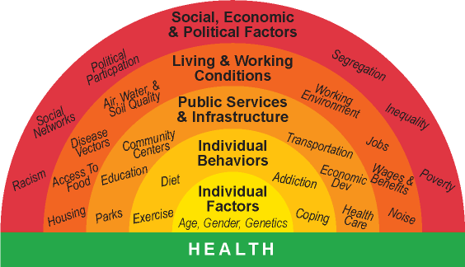
Introduction: Determinants of Health
World Health Organization, Commission on the Social Determinants of Health (2008)
Notes:
Health is a state of complete physical, mental and social well-being and not merely the absence of disease or infirmity.
Many factors contribute to a person’s health.
only 10% is actually related to healthcare, 5% genetics,
physical environment, health behaviors, social and economic factors = estimated up to 85% - https://www.countyhealthrankings.org/what-is-health
So many daily policy decisions made outside of the health sector have significant health implications that sometimes go unrecognized.
resulting in missed opportunities for health benefits or increased costs down the road.

Slide 3
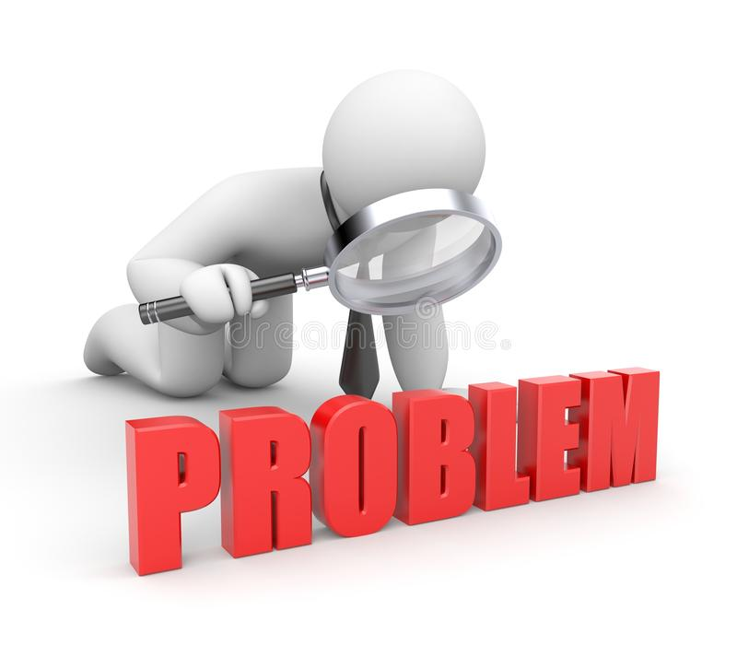
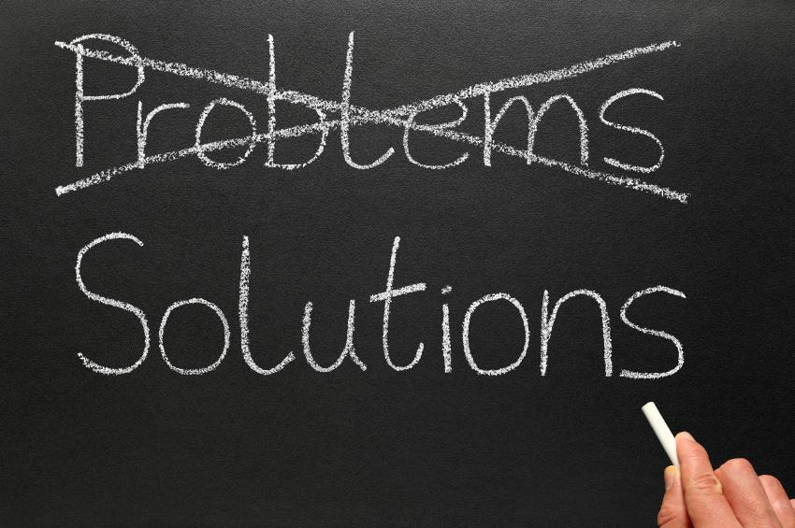
Determinants of Health
Problem: Many daily policy decisions made outside of the health sector have significant health implications that go unrecognized, often resulting in unintended consequences for health
Solution? Tools exist that try to bridge the gap
Notes:
The challenge is that many decisions about the design and planning of where we live and work are made without health concerns in mind. Tools exist to bridge that gap.

Slide 4
Health in All Policies (HiAP)
HiAP is a collaborative approach that integrates and articulates health considerations into policymaking and programming across sectors, and at all levels, to improve the health of all communities and people
Systems level change
HiAP requires public health practitioners to collaborate with other sectors to define and achieve mutually beneficial goals
Source: NAACHO, WHO
Notes:
An Introduction to Health in All Policies: A Guide for State and Local Governments. http://www.phi.org/uploads/application/files/udt4vq0y712qpb1o4p62dexjlgxlnogpq15gr8pti3y7ckzysi.pdf
(Brief) https://www.phi.org/uploads/files/Four_Pager_Health_in_All_Policies-A_Guide_for_State_and_Local_Governments.pdf

Slide 5
Tools and Tactics to Achieve HiAP
There is no one single way to “do” health in all policies
Some Examples:
Creating cross-sector government structures
Integrating health into planning processes including zoning updates and General Plans*
Integrating health language into RFPs
Developing health-related grant scoring criteria
Workforce development
Health Impact Assessment (HIA)
Notes:
Collins J, Koplan JP. Health impact assessment: a step toward health in all policies. Journal of the American Medical Association 2009; 302(3):315-17.

Slide 6
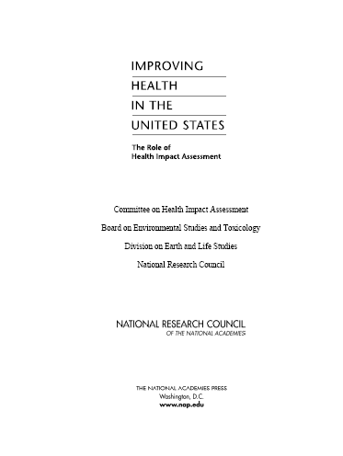
Defining Health Impact Assessment
A structured process that uses scientific data, professional expertise, and stakeholder input to identify and evaluate public health consequences of proposals and suggests pragmatic actions that could be taken to minimize adverse health impacts and optimize beneficial ones.
Notes:
This definition of health impact assessment comes from the National Research Council, which developed guidance for HIAs in 2010.
I will emphasize a few things about this definition:
An HIA is a defined process (not just a study). It is defined by 6 steps.
The assessment of impacts may take quantitative data, gray literature, stakeholder input, and expert judgment into consideration. HIA is intended to be pragmatic: It is not about elegant quantitative models as much as providing timely, useful judgments based on available knowledge and public health expertise.
HIA focuses on equity: looks not just at effects, but also the distribution of those effects within a population.
Stakeholders are engaged at every step of the process—including those in the community that will be affected by a decision, policymakers, and others with an interest in the outcome
HIA is focused on solutions: offers feasible recommendations that can help minimize risks and maximize benefits.
Predicts anticipated health (equity) impacts of a proposed decision/project
Translates science and community voice into recommendations for balance, well-informed policies
Helps impacted populations and decision makers weigh trade-offs and understand the direct and indirect health impacts of your work
Increases community capacity and addresses community concerns
Improving Health in the United States: The role of health impact assessment. Report in Brief. National Academy of Sciences, 2011.
http://www.nap.edu/catalog/13229/improving-health-in-the-united-states-the-role-of-health
Minimum Elements and Practice Standards for Health Impact Assessment, Version 3, September 2014.

Slide 7
HIA Addresses Determinants of Health
Affect
How does the proposed
project, plan, policy
Housing
Air quality
Noise
Safety
Social networks
Nutrition
Parks and natural space
Private goods and services
Public services
Transportation
Livelihood
Water quality
Education
Inequities
and lead to
health outcomes
Notes:
HIAs view health from a broad perspective. It looks systematically across the entire spectrum of factors that drive community health and
Takes into account a wide range of environmental factors, such as housing conditions, roadway safety, employment, environmental conditions, and social factors that lead to health outcomes.

Slide 8
HIA…
Provides a framework for community capacity-building and empowerment
Involves a broad-range of impacted people
Is an effective tool for meaningful cross-sector collaboration
Addresses health inequities
Increases transparency, support inclusiveness, democracy, and community engagement in the policy decision-making process
Adapted from Human Impact Partners, HIA Toolkit, 3rd Edition
Notes:
https://humanimpact.org/wp-content/uploads/2018/10/A-HIA-Toolkit_February-2011_Rev.pdf

Slide 9
HIA is not the same as…
Evaluation
Risk assessment
Cost-benefit or cost-effectiveness analysis
Community Health Assessment
However, these methods can be used as part of the HIA assessment step

Slide 10

Key Values of HIA
  Democracy (and transparency)
  Equity
  Sustainable Development
  Ethical Use of Evidence
  Holistic Approach to Health
Source: The International Association of Impact Assessment (Quigley 2006)
Notes:
Democracy -- allowing people to participate in the development and implementation of policies, programs or projects that may impact on their lives
Equity -- HIA assesses the distribution of impacts from a proposal on the whole population, with a particular reference to how the proposal will affect vulnerable people
Sustainable Development -- that both short and long term impacts are considered, along with the obvious, and less obvious impacts
Ethical Use of Evidence -- the best available quantitative and qualitative evidence must be identified and used in the assessment. A wide variety of evidence should be collected using the best possible methods

Slide 11
Scope of HIA
Differences based on assessment and decision-making stages of HIA; also level of stakeholder engagement
Rapid/desktop (sometimes separate categories)
Intermediate
Comprehensive
Notes:
While the rapid HIA was less resource intensive than the intermediate HIA, there are several factors that affect the feasibility of conducting this type of HIA within a short time period.
https://humanimpact.org/wp-content/uploads/2018/10/A-HIA-Toolkit_February-2011_Rev.pdf

Slide 12
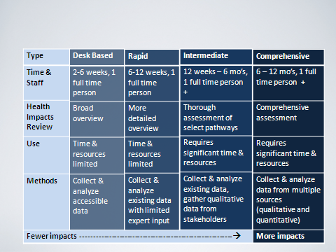
Scope of HIA

Slide 13
HIA Examples
HIA can be applied to a wide range of sectors
  Energy: state legislature’s decision on funding for the Low Income Housing Energy Assistance Program
  Agriculture: statewide farm-to-school legislation
  Built environment: HIA of the city’s proposed zoning changes
HIA can be applied to policy, project, program
  Policy: proposed changes to SNAP
  Project: senior housing redevelopment in California
  Program: zero tolerance program
Notes:
https://www.pewtrusts.org/en/research-and-analysis/data-visualizations/2015/hia-map?sortBy=relevance&sortOrder=asc&page=1
The Health Impact Project’s cross-sector toolkit for health contains resources that help communities, agencies, and other organizations take action to improve public health. The toolkit offers a collection of health impact assessments, guides, and other research to support policymakers’ efforts to consider health when making decisions across sectors, such as housing, planning, and education.

Slide 14
How to do HIA
“There exists considerable diversity in the practice and products of HIA due to the variety of policies, plans, programs, and projects assessed; the diverse settings in which decisions take place; and the evolution of the field. A number of available guidance documents for HIA…This document, in contrast, is intended to provide guidance on what is required for a study to be considered an HIA (Minimum Elements) and some benchmarks for effective practice (Practice Standards).”
Notes:
Bhatia R, Farhang L, Heller J, Lee M, Orenstein M, Richardson M and Wernham A. Minimum Elements and Practice Standards for Health Impact Assessment, Version 3, September 2014.
https://pdfs.semanticscholar.org/040d/8ff2749f8ef2ec8b8233b7bffae9f7a38a12.pdf

Slide 15
The HIA Process
Screening - do we need to conduct a HIA
Scoping - determine the important health effects, affected populations, available evidence, etc.
Assessment - analyze baseline conditions and likely health effects
Recommendations - develop health-based recommendation and a feasible plan for implementing them
Reporting - disseminate the report to the public, stakeholders, solicit input
Monitoring - track outcomes of a decision and its implementation
Evaluation - of the process and impacts; note: evaluation is not always included in the HIA process
EQUITY
Stakeholder Engagement
Notes:
https://humanimpact.org/wp-content/uploads/2018/10/A-HIA-Toolkit_February-2011_Rev.pdf

Slide 16
Transportation HIAs
From 2004-2013, 73 HIAs completed
Decisions being made by local and state transportation agencies, county and city councils and planning agencies, parks departments, other state agencies
Projects: addressed bridge replacement, new transit stations, bus rapid transit, bicycle and pedestrian facilities, corridor redevelopment, greenways and walking trails, and port expansions
Policies: road pricing, speed limits, complete streets, etc.
Health impacts examined: Physical activity, transportation-related injury, air and water quality, noise, social capital, mental health, social cohesion, crime, access to goods and services, affordable housing, discretionary time, etc.
Dannenberg et al 2014

Slide 17
Transportation HIAs: Lessons Learned
Collaboration is key. Need to consider:
  Political and technical sensitivities
  Differences in agency culture, practices, and authority
  Studies have different timelines and demands
  Differences in language and terminology
Determine synergies, identify the added value of the collaborations (not just bureaucratic requirement)
Determine the right tool (HIA?)
Dannenberg et al 2014

Slide 18
Methods
Methods question is most relevant for the Assessment step and how stakeholders are engaged
Two steps:
  First: describe the baseline (existing conditions) and factors that influence health
  Second: impact assessment – predict the future consequences of possible decisions for health (both positive and negative)
Involves multiple methods (selection of methods mainly depends on the scope):
  Literature review
  Secondary data analysis
  Primary data collection via focus groups and interviews
  Participatory approaches for stakeholder engagement
Notes:
HIA Assessment step
What are your goals in assessing health impacts?
To accurately predict specific health outcomes?
To help decide whether the overall the project is good or bad for health?
To recognize potential linkages between the project and health, so that measures can be taken to minimize harm and maximize benefit to health. In other words, to inform policy decisions and project design with a public health perspective.
Important considerations:
What sources of information/evidence exist to find the information that you need?
Baseline health of “the population”
Potential health affects to “the population”; who is the “the population?”

Slide 19
HIA: Strengths and Challenges
Strengths
  Emphasizes equity
  When done well, can support stakeholder engagement and democracy
  Address determinants of health
  Supports multi-sector/cross-sector collaboration (especially between health, transportation, and planning)
  Advances HiAP
Challenges
  Balancing the need to provide timely, valid information with the realities of varied data quality
  Determining how best to evaluate evidence quality
  Deciding how to characterize and manage uncertainty
  Ensuring that stakeholder participation is valued and done well
  Lack of data for certain issues; must determine if we can still reasonably and validly evaluate health impacts?

Slide 20
Discussion
HIAs are a great tool and approach for identifying potential health impacts of transportation proposals
Key points:
  Conducted to inform a specific decision
  Uses a broad analytic framework
  Involves collaboration with stakeholders, especially communities who will be impacted by the proposed program, project, or policy
  Addresses health equity
  Pragmatic and focused on solutions
  Not intended to stop a proposal; provides an objectives analysis intended to maximize health benefits and minimize harms when the decision is made

Slide 21
List of Abbreviations
HiAP: Health in All Policies
HIA: Health Impact Assessment

Slide 22







HIA Resources
Health Impact Project www.healthimpactproject.org
Centers for Disease Control and Prevention (CDC) Healthy Places http://www.cdc.gov/healthyplaces/hia.html
Human Impact Partners http://www.humanimpact.org
Health Impact Assessment Clearinghouse Learning and Information Center (HIA-CLIC) http://www.hiaguide.org
American Planning Association: Online HIA Training http://professional.captus.com/Planning/hia/default.aspx
World Health Organization (WHO) Health Impact Assessment http://www.who.int/hia/en
HIA Gateway http://www.apho.org.uk/default.aspx?QN=P_HIA

Slide 23
References
National Research Council (US) Committee on Health Impact Assessment. 2011. Improving Health in the United States: The Role of Health Impact Assessments. National Academies Press: Washington, DC. Available at: https://www.ncbi.nlm.nih.gov/books/NBK83546/
Collins, J., Koplan, J.P., 2009. Health impact assessment: a step toward health in all policies. Journal of the American Medical Association, 302, 3,pp.315-17.
Rudolph, L., Caplan, J., Ben-Moshe, K., & Dillon, L. (2013). Health in All Policies: A Guide for State and Local Governments. Washington, DC and Oakland, CA: American Public Health Association and Public Health Institute. Available at: http://www.phi.org/uploads/application/files/udt4vq0y712qpb1o4p62dexjlgxlnogpq15gr8pti3y7ckzysi.pdf

Slide 24
Reading List
Additional Resources
Health Impact Project. http://www.healthimpactproject.org/
Human Impact Partners. http://www.humanimpact.org/
Centers for Disease Control and Prevention. Health Impact Assessment. http://www.cdc.gov/healthyplaces/hia.htm
Society of Practitioners of HIA (SOPHIA). http://www.hiasociety.org
World Health Organization. http://www.who.int/hia/en/

Slide 25
Reading List
Books about HIA:
National Research Council. Improving Health in the United States: The Role of Health Impact Assessment. National Academies Press, 2011.
Martin Birley. Health Impact Assessment: Principles and Practice. Earthscan, 2011.
John Kemm, editor. Health Impact Assessment: Past Achievement, Current Understanding, and Future Progress. Oxford University Press, 2012.
Monica O’Mullane, editor. Integrating Health Impact Assessment with the Policy Process: Lessons and Experiences from around the World. Oxford University Press, 2013.
Catherine Ross, Marla Orenstein, Nisha Botchwey. Health Impact Assessments in the USA. Springer, 2014.

