Slide 1
www.carteeh.org

Slide 2
Lecture #4: Air Quality Standards and Health
Juan Aguilera MD, PhD, MPH
University of Texas at El Paso
jaaguilera2@utep.edu +1 (915) 274-3475
The author declares that there is no conflict of interest
Lecture Track(s): HT/TT
Notes:
Health Track (HT)—mainly targeted at urban planners, transportation planners, and engineers with limited knowledge of public health-related concepts;
Transportation Track (TT)—mainly targeted at environmental epidemiologists and public health professionals with limited knowledge of transportation-related concepts; and;
Planning and Policy Track (PPT)—mainly targeted at planners, civil servants, and policy and decision makers with particular interest in the science-policy link.

Slide 3
Introduction
Research | US Public Policy
1930s – 1950s: Studies of early episodes of air pollution | 1955, 1963: Early national legislation
 | 1967, 1970, 1971: Clean Air Act, National Ambient Air Quality Standards
1960s – 1980s: Scattered ecologic and other studies; inhalation toxicologic studies | 1987: PM10 standards for particulate matter air pollution established replacing previous standards for total suspended particulate matter
1989 – 1995: Reports of several key, loosely connected research efforts | 1997: Promulgation of PM2.5 standards
1995 – 2004: Controversy regarding health effects of low-level air pollution, reanalysis of key studies; rapid growth in epidemiologic, toxicologic an other studies | 1998 – 2001: PM2.5 standard challenged, blocked in federal appeals court, but ultimately upheld by Supreme Court
 | 2002 – 2004: Additional review of PM2.5 standards; cost-benefit analysis
Health-related concerns of air pollution originated from events in¹
Belgium (1930)
Pennsylvania (1948)
London (1952) https://www.youtube.com/watch?v=SXGakIQSOn0
The Clean Air Act (CAA) of 1970 mandates the U.S. Environmental Protection Agency (EPA) to set health-based National Ambient Air Quality Standards (NAAQS) for certain (criteria) pollutants that are known hazards to human health¹⁻⁵
Adapted from Pope (2004)
Notes:
Early concerns regarding the health-related effects of air pollution originated from severe episodes in Meuse Valley, Belgium, in 1930; Donora, Pennsylvania, in 1948; and London, in 1952. Although the overall effects of these episodes continue to be debated, well-documented, episode-related increases in morbidity and mortality from cardiopulmonary causes provided dramatic evidence that extremely high concentrations of air pollution can have serious adverse effects on health (Pope, 2000).
Play video for London event at: https://www.youtube.com/watch?v=SXGakIQSOn0 (created by the Environmental Research Group at King's College London)
From the 1960s through the 1980s, a few scattered studies continued to suggest that air pollution had adverse effects on health (Pope, 2000; Lave 1970)
The Clean Air Act of 1970 mandates the U.S. Environmental Protection Agency (EPA) to set health-based National Ambient Air Quality Standards (NAAQS) for certain pollutants that are known hazards to human health. During the relatively short period of 1989 through 1995, several loosely connected epidemiologic studies reported adverse effects of unexpectedly low levels of particulate-matter air pollution (Pope, 1989, Schwartz, 1992, Dockery, 1993)

Slide 4
Definitions and rationale of air quality standards
Air quality standards are set to protect public health to avoid unacceptable risks
The NAAQS requires the protection of both general and sensitive populations⁶
Health impact assessments rely on prospectively modeled air quality predictions under broadly-defined hypothetical scenarios⁷⁻⁸
Notes:
The National Ambient Air Quality Standards (NAAQS) require the U.S. EPA to establish standards in order to protect public health with an adequate margin of safety level to avoid unacceptable risks.
Legislative history has interpreted the NAAQS margin of safety provision as requiring the protection of both general populations and sensitive subpopulations, or those subgroups potentially at increased risk for ambient particle health effects (National Air Quality Standards Act, 1970)
Existing regulatory health impact assessments such as those carried out by the US Environmental Protection Agency (EPA) typically rely on prospectively modeled air quality predictions under broadly-defined hypothetical scenarios (e.g., assuming full compliance with the 1990 CAA amendments). Direct evaluation of specific strategies using observed data in a manner that is reproducible and less reliant on prospectively-modeled hypothetical air quality scenarios is necessary to strengthen the evidence available to support current policies (Bennear, 2005, Zigler, 2014).

Slide 5
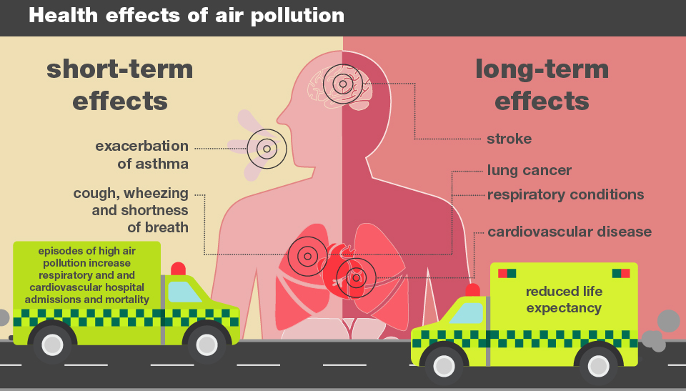
Respiratory and cardiovascular health effects
Air pollution is an important risk factor for various adverse health effects in humans
Many studies have focused on respiratory disease, but substantial evidence indicates air pollution is also a risk for cardiovascular disease ^{1,9-14}
https://publichealthmatters.blog.gov.uk/2018/11/14/health-matters-air-pollution-sources-impacts-and-actions/
Notes:
Research has continued to suggest that a level of air pollution that is common in many urban and industrial environments is an important risk factor for various adverse health effects in humans. Although many such studies have focused on respiratory disease, substantial and growing evidence indicates that fine particulate air pollution is also a risk factor for cardiovascular disease (Pope, 1995; Brook, 2004)
Short-term exposure exacerbates existing pulmonary and cardiovascular disease and increases the risk of symptoms, the need for medical attention, and death while long-term, repeated exposure increases the cumulative risk of chronic pulmonary and cardiovascular disease and death (Pope, 1995; Brook, 2004; Clancy, 2002; Hoek, 2002)
Mortality studies suggest that the exposure– response relationships for particulate-matter pollution in the case of both short-term and long-term exposures are nearly linear, with no discernible safe thresholds within relevant ranges of exposure (Pope, 2000).
One evaluation of the literature suggests that the proportion of a given population that is at risk for death, hospitalization, or life-threatening conditions owing to short-term exposure to air pollution is very small and limited to the elderly, infants, and persons with chronic cardiopulmonary disease, influenza, or asthma. There appears to be a much broader susceptibility to small, transient changes in lung function, low-grade pulmonary inflammation, or other subclinical physiological changes in response to short-term exposure (Pope, 2002)
With regard to the cumulative effects of long-term, repeated exposure, there is little evidence of a unique, well-defined, susceptible subgroup. The Children’s Health Study reports pollution-related deficits in the development of lung function in boys and girls, children with asthma and those without asthma, and smokers and nonsmokers — results “suggesting that most children are susceptible to the chronic respiratory effects of breathing polluted air (Gauderman, 2004).

Slide 6
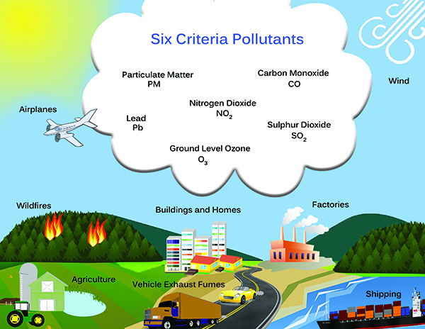
Criteria pollutants
NAAQS criteria pollutants¹⁵
particulate matter
ozone
sulfur dioxide
nitrogen dioxide
carbon monoxide
lead
Defined as those widespread & originated from multiple sources that endanger human health
Pollutants should go under scientific review every five years
http://www.alamoareampo.org/AirQuality/standards.html
Notes:
PM stands for particulate matter (also called particle pollution): the term for a mixture of solid particles and liquid droplets found in the air. Some particles, such as dust, dirt, soot, or smoke, are large or dark enough to be seen with the naked eye. Others are so small they can only be detected using an electron microscope.
Ozone is a gas composed of three atoms of oxygen (O3). Ozone occurs both in the Earth's upper atmosphere and at ground level. Ozone at ground level is a harmful air pollutant, because of its effects on people and the environment, and it is the main ingredient in “smog.“
Sulphur dioxide (SO₂ )is the component of greatest concern and is used as the indicator for the larger group of gaseous sulfur oxides (SO_{x}). This may have the important co-benefit of reducing the formation of particulate sulfur pollutants, such as fine sulfate particles. The largest source of SO₂ in the atmosphere is the burning of fossil fuels by power plants and other industrial facilities. Smaller sources of SO₂ emissions include: industrial processes such as extracting metal from ore; natural sources such as volcanoes; and locomotives, ships and other vehicles and heavy equipment that burn fuel with a high sulfur content.
Nitrogen Dioxide (NO₂) is one of a group of highly reactive gases known as oxides of nitrogen or nitrogen oxides (NO_{x}). NO₂ primarily gets in the air from the burning of fuel. NO₂ forms from emissions from cars, trucks and buses, power plants, and off-road equipment. Breathing air with a high concentration of NO₂ can irritate airways in the human respiratory system.
Carbon monoxide (CO) is a colorless, odorless gas that can be harmful when inhaled in large amounts. CO is released when something is burned. The greatest sources of CO to outdoor air are cars, trucks and other vehicles or machinery that burn fossil fuels.
Lead can also get into the air, major sources of lead in the air are ore and metals processing and piston-engine aircraft operating on leaded aviation fuel. Other sources are waste incinerators, utilities, and lead-acid battery manufacturers. The highest air concentrations of lead are usually found near lead smelters. Once taken into the body, lead distributes throughout the body in the blood and is accumulated in the bones. Depending on the level of exposure, lead can adversely affect the nervous system, kidney function, immune system, reproductive and developmental systems and the cardiovascular system. Lead exposure also affects the oxygen carrying capacity of the blood.
(Environmental Protection Agency, 2018)

Slide 7
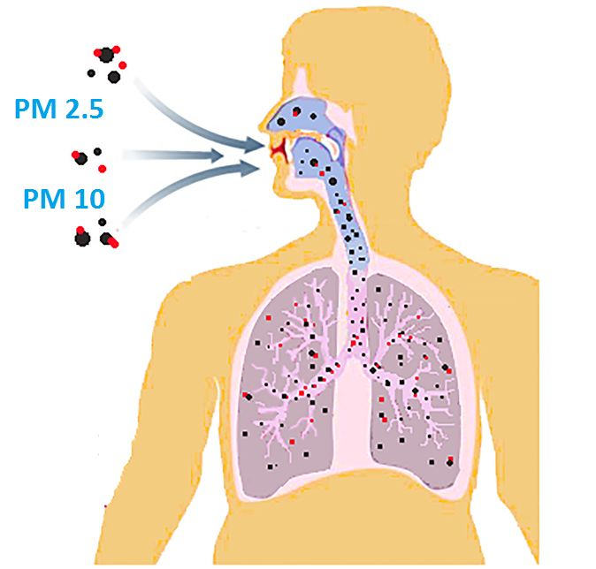
Particulate Matter
Particle pollution includes
PM₁₀ : diameters 10 micrometers and smaller
PM_{2.5} : diameters that are 2.5 micrometers and smaller
Health effects¹⁶
Respiratory symptoms
irritation of the airways
coughing
difficulty breathing
aggravated asthma
Cardiovascular symptoms
Increased blood pressure
irregular heartbeat
nonfatal heart attacks
https://www.jagranjosh.com/general-knowledge/what-is-pm-25-and-pm10-and-how-they-affect-health-1528711006-1
Notes:
PM is also called Particulate Matter or particle pollution, which is a mixture of solid particles and liquid droplets present in the atmosphere. The particles present in the air are so minute that you cannot even view through naked eyes. Some particles are so small that they can only be detected by using electron microscope. Particle pollution consists of PM2.5 and PM10 which are very dangerous.
PM2.5 refers to the atmospheric particulate matter that has a diameter of less than 2.5 micrometres, which is about 3% of the diameter of human hair.
The particles in PM2.5 category are so small that they can only be detected with the help of the electron microscope. These are smaller than PM10 particles. PM10 are the particles with a diameter of 10 micrometers and they are also called fine particles. An environmental expert says that PM10 is also known as respirable particulate matter.
Particulate matter is a complex mixture of soot, smoke, metals, nitrates, sulphates, dust water and rubber
Sources of Particulate Matter
Particulate Matter is of different sizes and it can be due to both human and natural sources. Primary sources includes automobile emissions, dust and cooking smoke and secondary sources of pollution can be due to complex reactions of chemicals like sulphur dioxide and nitrogen oxide. These particles are mixed in air and pollute it.
Apart from these, forest fires, wood burning stoves, agricultural burning, smoke of the industry, dust occur from various construction sites also causes air pollution.
Due to small in size both PM2.5 and PM10 particles act as gas. When you breathe, these particles they penetrate into the lungs, which can lead to cough and asthma attacks. High blood pressure, heart attack, and stroke.
Which could lead to problem in breathing with irritation in eyes, nose and throat.
Also, particulate matter contains microscopic solids or liquid droplets that are so small that they can be inhaled and cause serious health problems. Some particles less than 10 micrometers in diameter can get deep into your lungs and some may even get into your bloodstream. Of these, particles less than 2.5 micrometers in diameter, also known as fine particles or PM_{2.5}, pose the greatest risk to health.
Health Effects
The size of particles is directly linked to their potential for causing health problems. Small particles less than 10 micrometers in diameter pose the greatest problems, because they can get deep into your lungs, and some may even get into your bloodstream.
Exposure to such particles can affect both your lungs and your heart. Numerous scientific studies have linked particle pollution exposure to a variety of problems, including:
premature death in people with heart or lung disease
nonfatal heart attacks
irregular heartbeat
aggravated asthma
decreased lung function
increased respiratory symptoms, such as irritation of the airways, coughing or difficulty breathing.
People with heart or lung diseases, children, and older adults are the most likely to be affected by particle pollution exposure.
(Environmental Protection Agency, 2018)

Slide 8
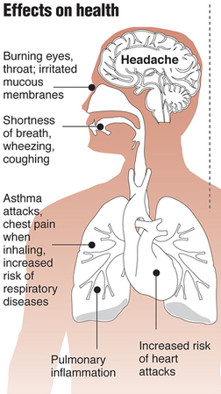
Ozone
Ground-level ozone is created by chemical reactions between oxides of nitrogen (NOx) and volatile organic compounds (VOC)¹⁷
Health effects¹⁷
Irritated mucous membranes
throat irritation
coughing, wheezing
chest pain
airway inflammation
http://apesairpollution.weebly.com/ground-level-vs-stratospheric-ozone.html
Notes:
Ground level ozone, is not emitted directly into the air, but is created by chemical reactions between oxides of nitrogen (NOx) and volatile organic compounds (VOC). This happens when pollutants emitted by cars, power plants, industrial boilers, refineries, chemical plants, and other sources chemically react in the presence of sunlight.
Ozone is most likely to reach unhealthy levels on hot sunny days in urban environments but can still reach high levels during colder months. Ozone can also be transported long distances by wind, so even rural areas can experience high ozone levels(Environmental Protection Agency, 2018).
Health effects
Ozone in the air we breathe can harm our health. People most at risk from breathing air containing ozone include people with asthma, children, older adults, and people who are active outdoors, especially outdoor workers. In addition, people with certain genetic characteristics, and people with reduced intake of certain nutrients, such as vitamins C and E, are at greater risk from ozone exposure. Breathing ozone can trigger a variety of health problems including chest pain, coughing, throat irritation, and airway inflammation. It also can reduce lung function and harm lung tissue. Ozone can worsen bronchitis, emphysema, and asthma, leading to increased medical care. Learn more about health effects.
Ozone affects sensitive vegetation and ecosystems, including forests, parks, wildlife refuges and wilderness areas. In particular, ozone harms sensitive vegetation during the growing season.
(Environmental Protection Agency, 2018)

Slide 9
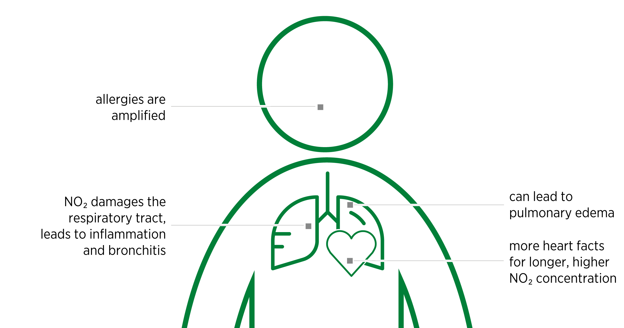
Nitrogen Dioxide
Primarily gets in the air from the burning of fuels
Health effects¹⁸
Short exposure periods
aggravate respiratory diseases (asthma)
coughing, wheezing or difficulty breathing
hospital admissions
Long term exposure
increase susceptibility to respiratory and cardiovascular infections
https://www.mann-hummel.com/en/research-and-development/future-trends/nitrogen-oxides-harmful-gases-in-the-air/
Notes:
Nitrogen Dioxide (NO₂) is one of a group of highly reactive gases known as oxides of nitrogen or nitrogen oxides (NO_{x}). NO₂ primarily gets in the air from the burning of fuel. NO₂ forms from emissions from cars, trucks and buses, power plants, and off-road equipment. Breathing air with a high concentration of NO₂ can irritate airways in the human respiratory system (Environmental Protection Agency, 2018).
Health effects
Breathing air with a high concentration of NO₂ can irritate airways in the human respiratory system. Such exposures over short periods can aggravate respiratory diseases, particularly asthma, leading to respiratory symptoms (such as coughing, wheezing or difficulty breathing), hospital admissions and visits to emergency rooms. Longer exposures to elevated concentrations of NO₂ may contribute to the development of asthma and potentially increase susceptibility to respiratory infections. People with asthma, as well as children and the elderly are generally at greater risk for the health effects of NO₂.
NO₂ along with other NO_{x} reacts with other chemicals in the air to form both particulate matter and ozone. Both of these are also harmful when inhaled due to effects on the respiratory system.
Environmental effects
NO₂ and other NO_{x} interact with water, oxygen and other chemicals in the atmosphere to form acid rain. Acid rain harms sensitive ecosystems such as lakes and forests.
The nitrate particles that result from NO_{x} make the air hazy and difficult to see though. This affects the many national parks that we visit for the view.
NO_{x} in the atmosphere contributes to nutrient pollution in coastal waters.
(Environmental Protection Agency, 2018)

Slide 10
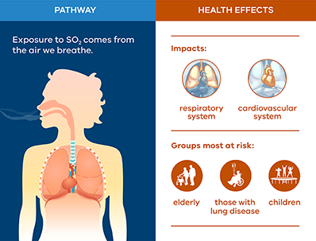
Sulphur dioxide
Largest sources of SO₂ emissions are from fossil fuels at industrial facilities¹⁹
Health effects¹⁹
Difficulty breathing (specially in people with asthma)
Other vulnerable groups include¹⁹
Elderly
Those with lung disease
Children
https://www.epa.vic.gov.au/for-community/environmental-information/air-quality/sulfur-dioxide-in-the-air
Notes:
Sulphur dioxide (SO₂) is the component of greatest concern and is used as the indicator for the larger group of gaseous sulfur oxides (SO_{x}). The largest sources of SO₂ emissions are from fossil fuel combustion at power plants and other industrial facilities. Smaller sources of SO₂ emissions include: industrial processes such as extracting metal from ore; natural sources such as volcanoes; and locomotives, ships and other vehicles and heavy equipment that burn fuel with a high sulfur content (SO₂ and other sulfur oxides can contribute to acid rain which can harm sensitive ecosystems (Environmental Protection Agency, 2019).
Health effects
Short-term exposures to SO₂ can harm the human respiratory system and make breathing difficult. People with asthma, particularly children, are sensitive to these effects of SO₂.
SO₂ emissions that lead to high concentrations of SO₂ in the air generally also lead to the formation of other sulfur oxides (SO_{x}). SO_{x} can react with other compounds in the atmosphere to form small particles. Small particles may penetrate deeply into the lungs and in sufficient quantity can contribute to health problems.
Environmental effects
At high concentrations, gaseous SOx can harm trees and plants by damaging foliage and decreasing growth.
SO₂ and other sulfur oxides can contribute to acid rain which can harm sensitive ecosystems.
(Environmental Protection Agency, 2019)

Slide 11
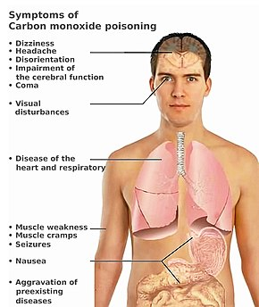
Carbon Monoxide
Harmful when inhaled in large amounts
Health effects²⁰
Reduces the amount of oxygen that can be transported in the blood
Headache, dizziness
Visual problems
Muscle weakness and cramps
More concerning in people with preexisting respiratory or cardiovascular disease
http://www.alamoareampo.org/AirQuality/standards.html
Notes:
Carbon monoxide (CO) is a colorless, odorless gas that can be harmful when inhaled in large amounts. The greatest sources of CO to outdoor air are cars, trucks and other vehicles or machinery that burn fossil fuels. A variety of items in your home such as unvented kerosene and gas space heaters, leaking chimneys and furnaces, and gas stoves also release CO and can affect air quality indoors (Environmental Protection Agency, 2016).
Health Effects
Breathing air with a high concentration of CO reduces the amount of oxygen that can be transported in the blood stream to critical organs like the heart and brain.
At very high levels, CO can cause dizziness, confusion, unconsciousness and death. Very high levels of CO are of particular concern for people with heart disease. These people already have a reduced ability for getting oxygenated blood to their hearts in situations where the heart needs more oxygen than usual. They are especially vulnerable to the effects of CO when exercising or under increased stress. In these situations, short-term exposure to elevated CO may result in reduced oxygen to the heart accompanied by chest pain also known as angina.
(Environmental Protection Agency, 2016)

Slide 12
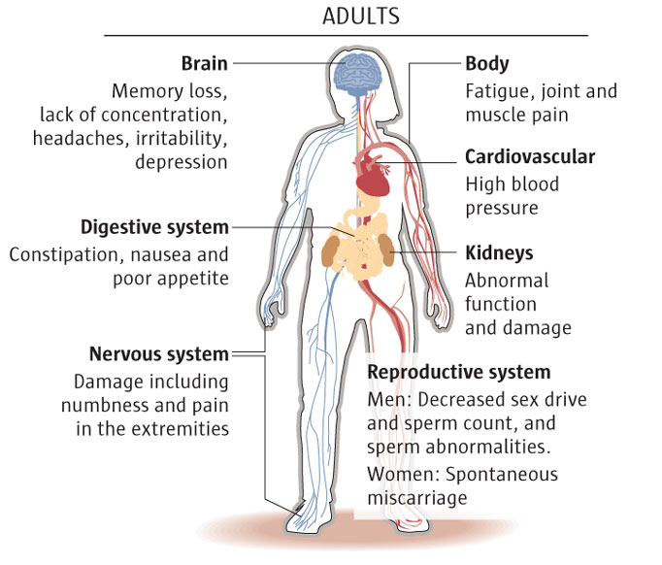
Lead
Lead distributes throughout the body in the blood and is accumulated in the bones²¹
Health effects²¹
affects nervous system
reduced kidney function
compromised immune system
Developmental and reproductive problems
Long term effects in children and pregnant women
https://greenkidsdoc.files.wordpress.com/2015/03/blog-health-effects1.jpg
Notes:
Lead can be found in all parts of our environment. Much of it comes from human activities including burning fossil fuels, mining, and manufacturing. Sources of lead emissions vary from one area to another. Other sources are waste incinerators, utilities, and lead-acid battery manufacturers. The highest air concentrations of lead are usually found near lead smelters (Environmental Protection Agency, 2017)
.
Health effects
Once taken into the body, lead distributes throughout the body in the blood and is accumulated in the bones. Depending on the level of exposure, lead can adversely affect the nervous system, kidney function, immune system, reproductive and developmental systems and the cardiovascular system. Lead exposure also affects the oxygen carrying capacity of the blood. The lead effects most commonly encountered in current populations are neurological effects in children and cardiovascular effects in adults.
Children six years old and younger are most susceptible to the effects of lead.
Even low levels of lead in the blood of children can result in:
Behavior and learning problems
Lower IQ and Hyperactivity
Slowed growth
Hearing Problems
Anemia
In rare cases, ingestion of lead can cause seizures, coma and even death.
Pregnant Women
Lead can accumulate in our bodies over time, where it is stored in bones along with calcium. During pregnancy, lead is released from the mother's bones along with calcium and can pass from the mother exposing the fetus or the breastfeeding infant to lead. This can result in serious effects to the developing fetus and infant, including:
Cause the baby to be born too early or too small;
Hurt the baby’s brain, kidney’s, and nervous system;
Increase the likelihood of learning or behavioral problems; and
Put the mother at risk for miscarriage.
(Environmental Protection Agency, 2017)

Slide 13
Non-criteria pollutants
Hazardous air pollutants are known or suspected to cause cancer or other serious health effects²²
EPA is working with state, local, and tribal governments to reduce air emissions of 187 toxic air pollutants to the environment²²
Examples of toxic air pollutants include
benzene
perchloroethylene
methylene chloride
Notes:
Hazardous air pollutants, also known as toxic air pollutants or air toxics, are those pollutants that are known or suspected to cause cancer or other serious health effects, such as reproductive effects or birth defects, or adverse environmental effects. EPA is working with state, local, and tribal governments to reduce air emissions of 187 toxic air pollutants to the environment (Environmental Protection Agency, 2018).
Examples of toxic air pollutants include
benzene, which is found in gasoline;
perchloroethylene, which is emitted from some dry-cleaning facilities; and
methylene chloride, which is used as a solvent and paint stripper by a number of industries.
Examples of other listed air toxics include dioxin, asbestos, toluene, and metals such as cadmium, mercury, chromium, and lead compounds (Environmental Protection Agency, 2018)

Slide 14
Air quality standards
Pollutant |  | Primary/ Secondary | Averaging Time | Level | Form
Carbon Monoxide (CO) |  | primary | 8 hours | 9 ppm | Not to be exceeded more than once per year
 |  |  | 1 hour | 35 ppm
Lead (Pb) |  | primary and secondary | Rolling 3 month average | 0.15 μg/m³ | Not to be exceeded
Nitrogen Dioxide (NO₂) |  | primary | 1 hour | 100 ppb | 98th percentile of 1-hour daily maximum concentrations, averaged over 3 years
 |  | primary and secondary | 1 year | 53 ppb | Annual Mean
Ozone (O₃) |  | primary and secondary | 8 hours | 0.070 ppm | Annual fourth-highest daily maximum 8-hour concentration, averaged over 3 years
Particle Pollution (PM) | PM_{2.5} | primary | 1 year | 12.0 μg/m³ | annual mean, averaged over 3 years
 |  | secondary | 1 year | 15.0 μg/m³ | annual mean, averaged over 3 years
 |  | primary and secondary | 24 hours | 35 μg/m³ | 98th percentile, averaged over 3 years
 | PM₁₀ | primary and secondary | 24 hours | 150 μg/m³ | Not to be exceeded more than once per year on average over 3 years
Sulfur Dioxide (SO₂) |  | primary | 1 hour | 75 ppb | 99th percentile of 1-hour daily maximum concentrations, averaged over 3 years
 |  | secondary | 3 hours | 0.5 ppm | Not to be exceeded more than once per year
The Clean Air Act identifies two types of national ambient air quality standards²³
Primary standards provide public health protection, including vulnerable populations
Secondary standards provide public welfare protection
Notes:
The Clean Air Act requires EPA to set National Ambient Air Quality Standards for pollutants considered harmful to public health and the environment. The Clean Air Act identifies two types of national ambient air quality standards. Primary standards provide public health protection, including protecting the health of "sensitive" populations such as asthmatics, children, and the elderly. Secondary standards provide public welfare protection, including protection against decreased visibility and damage to animals, crops, vegetation, and buildings.
The EPA has set National Ambient Air Quality Standards for six principal pollutants, which are called "criteria" air pollutants. Periodically, the standards are reviewed and may be revised. The current standards are listed. Units of measure for the standards are parts per million (ppm) by volume, parts per billion (ppb) by volume, and micrograms per cubic meter of air (µg/m³) (Environmental Protection Agency, 2017).

Slide 15
Air quality standards across the world
Country | Pollutants Considered | AQI Scale | Description
United States: Air Quality Index | Ozone (O3) Particulate matter (PM10) Carbon monoxide (CO) Sulfur dioxide (SO2) Nitrogen dioxide (NO2) | 0 to 500 | 0-50 Good 51-100 Moderate 101-150 Unhealthy for Sensitive Groups 151-200 Unhealthy 201-300 Very Unhealthy 301-500 Hazardous
Canada: Air Quality Health Index | Nitrogen dioxide (NO2) Ground-level Ozone (O3) Total particulate (PM2.5 / PM10) | 0 to 10+ | 1-3 Low Risk 4-6 Moderate Risk 7-10 High Risk 10+ Very High Risk
European Union: Common Air Quality Index | Particulate matter (PM10) Nitrogen dioxide (NO2) Ozone (O3) | 0 to 100+ | 0-25 Very low 25-50 Low 50-75 Medium 75-100 High 100+ Very High
China: Air Quality Index | Sulfur dioxide (SO2) Nitrogen dioxide (NO2) Coarse Particulate Matter (PM10) Fine Particulate Matter (PM2.5) Carbon monoxide (CO) Ozone (O3) | 0 to 300+ | 0-50 Excellent 51-100 Good 101-150 Lightly Polluted 151-200 Moderately Polluted 201-300 Heavily Polluted 300+ Severely Polluted
India: National Air Quality Index | Coarse Particulate Matter (PM10) Fine Particulate Matter (PM2.5) Nitrogen dioxide (NO2) Sulphur dioxide (SO2) Carbon monoxide (CO) Ozone (O3) Ammonia (NH3) Lead (Pb) | 0 to 500 | 0-50 Good 51-100 Satisfactory 101-200 Moderately Polluted 201-300 Poor 301-400 Very poor 401-500 Severe
Mexico: Metropolitan Index of Air Quality | Ozone (O3) Sulphur dioxide (SO2) Nitrogen dioxide (NO2) Carbon monoxide (CO) Total particulate (PM2.5 / PM10) | 0 to 200+ | 0-50 Good 51-100 Regular 101-150 Bad 151-200 Very Bad 200+ Extremely Bad
Each country defines its own Air Quality Index (AQI) and its calculation procedure²⁴⁻²⁵
The following table summarizes some of the AQIs used around the world²⁴
Notes:
There is a wide variety of air pollutants and each government establishes its own air quality indexes. As a consequence, there is no international air quality standard that allows countries to benchmark their performance and address the topic in collaboration. Global companies subject to air quality regulations must learn the rules for each country, increasing the cost of compliance. Although the World Health Organization provides a list of guideline values for each pollutant, these are only guidelines and not legally enforced standards. At the end of the day, each country is free to establish its own Air Quality Index (AQI). The most evident difference between the AQIs of different countries is the numerical scale used, and you can’t apply a conversion factor because each index is calculated differently. For instance, the USA, India and Singapore all use a scale that ranges from 0 to 500, but the calculation procedure is different, and values are not comparable as a result (Dominici, 2010).
You will notice that pollutant concentrations are reported as 8-hour values, 24-hour values and other similar time periods. When you come upon these values, consider that the following:
The pollutant concentration of interest is measured each hour.
The value is averaged along with the measured values of the most recent hours. For example, if a pollutant concentration measurement is taken at 3 PM, the 8-hour value would be the result of calculating an average with the most recent measurement (3PM) and the seven previous ones (8AM through 2PM).
Since the procedure can be repeated every hour, there are 24 possible 8-hour concentration values each day. Following the example above, a new 8-hour value can be calculated at 4PM considering the values from 9AM through 3PM.
(Watson, 1988)

Slide 16
Health effects at exposure levels below current air quality standards
Even at relatively low concentrations, the health effects of air pollution are of great concern²⁶
Air pollutants contribute to heart or lung disease, irregular heartbeat, aggravated asthma, decreased lung function, and increased respiratory symptoms²⁷⁻²⁸
Several reviews summarize the associations of air pollution with diabetes, asthma, emergency room visits, blood pressure and cardiovascular disease²⁹⁻³²
Notes:
Even at relatively low concentrations, the health effects of air pollution are of great concern (Kim, Kabir, & Kabir, 2015). Air pollutants contribute to various health problems including heart or lung disease, irregular heartbeat, aggravated asthma, decreased lung function, and increased respiratory symptoms (Atkinson, Fuller, Anderson, Harrison, & Armstrong, 2010; Cadelis, Tourres, & Molinie, 2014). Furthermore, several reviews summarize the associations of ambient (outdoor) air pollution with diabetes (Eze et al., 2015), asthma emergency room visits (Zheng et al., 2015), blood pressure (Giorgini et al., 2016), and cardiovascular disease (Franklin, Brook, & Pope III, 2015).

Slide 17
Underlying evidence base
Outdoor air pollution leads to 3.3 million premature deaths per year worldwide with important contributions in the U.S from power generation and traffic³³
In an urban environment, trafﬁc air pollutants originate from the emissions of motor vehicles, wear of vehicle components such as brakes and tires, and suspension of road dust³⁴
Those who are more likely to be affected by excessive levels of air pollutants include people with asthma, lower income, and those living close to heavy traffic roads³⁵⁻³⁶
Notes:
Outdoor air pollution leads to 3.3 million premature deaths per year worldwide with important contributions in the U.S from power generation and traffic (Lelieveld, Evans, Fnais, Giannadaki, & Pozzer, 2015). In an urban environment, trafﬁc air pollutants originate from the emissions of motor vehicles, wear of vehicle components such as brakes and tires, and suspension of road dust (Kok, Driece, Hogervorst, & Briedé, 2006). Those who are more likely to be affected by excessive levels of air pollutants include people with asthma, lower income, and those living close to heavy traffic roads (Alexis et al., 2014; Makri & Stilianakis, 2008).

Slide 18
Development and revision of air quality standards
The CAA requires periodic review of the science upon which the standards are based and the standards themselves²³
Planning
Integrated Science Assessment (ISA)
Risk/Exposure Assessment (REA)
Policy Assessment (PA)
Rulemaking
Scientific review during the development of these documents is thorough and extensive. Drafts of all documents are reviewed, and the public has an opportunity to comment on them²³
Notes:
The Clean Air Act (CAA) governs the establishment, review, and revision, as appropriate, of the National Ambient Air Quality Standards (NAAQS) for each criteria air pollutant to provide protection for the nation’s public health and the environment. The CAA requires periodic review of the science upon which the standards are based and the standards themselves (Environmental Protection Agency, 2017).
Planning: The planning phase of the NAAQS review process begins with a science policy workshop, which is intended to gather input from the scientific community and the public regarding policy-relevant issues and questions that will frame the review. Drawing from the workshop discussions, EPA prepares an Integrated Review Plan (IRP) that presents the schedule for the entire review, the process for conducting the review, and the key policy-relevant science issues that will guide the review.
Integrated Science Assessment (ISA): This assessment is a comprehensive review, synthesis, and evaluation of the most policy-relevant science, including key science judgments that are important to inform the development of the risk and exposure assessments, as well as other aspects of the NAAQS review.
Risk/Exposure Assessment (REA): This assessment draws upon information and conclusions presented in the ISA to develop quantitative characterizations of exposures and associated risks to human health or the environment associated with recent air quality conditions and with air quality estimated to just meet the current or alternative standard(s) under consideration. This assessment includes a characterization of the uncertainties associated with such estimates.
Policy Assessment (PA): This assessment provides a transparent staff analysis of the scientific basis for alternative policy options for consideration by senior EPA management prior to rulemaking. Such an evaluation of policy implications is intended to help ‘‘bridge the gap’’ between the Agency’s scientific assessments, presented in the ISA and REA(s), and the judgments required of the EPA Administrator in determining whether it is appropriate to retain or revise the NAAQS. In so doing, the PA is also intended to facilitate the Clean Air Scientific Advisory Committee’s (CASAC’s) advice to the Agency and recommendations to the Administrator, as provided for in the CAA, on the adequacy of the existing standards or revisions that may be appropriate to consider. The PA focuses on the information that is most pertinent to evaluating the basic elements of the NAAQS: indicator, averaging time, form, and level. Drafts of all documents are reviewed by CASAC and the public has an opportunity to comment on them.
Rulemaking: Taking into consideration the information in the ISA, REA(s), and PA and the advice of CASAC, EPA develops and publishes a notice of proposed rulemaking that communicates the Administrator’s proposed decisions regarding the review of the NAAQS. A public comment period, during which public hearings are generally held, follows publication of the notice of proposed rulemaking. Taking into account comments received on the proposed rule, EPA issues a final rule.
(Environmental Protection Agency, 2017).

Slide 19
Compliance monitoring
Compliance monitoring is one of the key components EPA uses to ensure that the regulated community obeys environmental laws and regulations and include³⁷
formulation and implementation of compliance monitoring strategies
on-site compliance monitoring
inspections, evaluations, and investigations
off-site compliance monitoring
data collection, review, reporting, program coordination, oversight, and support
inspector training, credentialing, and support
Notes:
Compliance monitoring is one of the key components EPA uses to ensure that the regulated community obeys environmental laws and regulations. It encompasses all regulatory agency activities performed to determine whether a facility (or group of facilities, such as plants related geographically, by sector, or corporate structure) is in compliance with applicable law (Environmental Protection Agency, 2019).
Compliance monitoring includes:
formulation and implementation of compliance monitoring strategies
on-site compliance monitoring: compliance inspections, evaluations, and investigations (including review of permits, data, and other documentation)
off-site compliance monitoring: data collection, review, reporting, program coordination, oversight, and support
inspector training, credentialing and support
EPA provides compliance incentives and auditing to encourage facilities to find and disclose violations to the Agency. Violations may also be discovered from tips/complaints received by the Agency from the public. Violations discovered as a result of any of these activities may lead to civil or criminal enforcement (Environmental Protection Agency, 2019).
Clean Air Act Evaluations can be either a Full Compliance Evaluation (FCE) or a Partial Compliance Evaluation (PCE).
An FCE is a comprehensive evaluation of the compliance status of the facility. It looks for all regulated pollutants at all regulated emission units, and it addresses the compliance status of each unit, as well as the facility’s continuing ability to maintain compliance at each emission unit. An FCE includes:
a review of all required reports and the underlying records;
an assessment of air pollution control devices and operating conditions;
observing visible emissions; a review of facility records and operating logs;
an assessment of process parameters, such as feed rates, raw material compositions, and process rates; and
a stack test if there is no other way to determine compliance with the emission limits.
(Environmental Protection Agency, 2019).

Slide 20
Non-compliance
The noncompliance penalty provision requires EPA to assess and collect a noncompliance penalty against three stationary source categories³⁷
Major sources
Sources not in compliance with an emission limitation or standard
Sources subject to a nonferrous smelter order, or other order of consent decree
Noncompliance penalty³⁷
Within 45 days of receipt of a notice, a source must do one of two things:
calculate the amount of the noncompliance and submit to EPA the calculation, a proposed payment schedule, and necessary information for independent verification of the penalty calculation
Or file a petition for reconsideration challenging the finding of a violation
Notes:
How does the noncompliance penalty work? Once a violation has been identified, EPA issues a Notice of Noncompliance to the violating source. Penalty accrual commences from the date of the notice. The total amount of the penalty is calculated on the number of days that elapse before final compliance is achieved. As required by the Act, EPA has developed an economic model, predicated upon well-accepted principles of financial theory, which the source must use to calculate its own penalty. The model generally utilizes data specific to the individual noncomplying source but, in some instances, where appropriate, it uses industry-wide or national averages. Within 45 days of receipt of a notice, a source must do one of two things: (1) calculate the amount of the noncompliance levy owed and submit to EPA the calculation, a proposed payment schedule, and necessary information for independent verification of the penalty calculation; or (2) file a petition for reconsideration challenging the finding of a violation by the Agency or claiming entitlement to an exemption.
(Environmental Protection Agency, 2019)

Slide 21
Discussion
Many studies have focused on respiratory diseases, however substantial evidence indicates air pollution as a risk factor for cardiovascular disease³⁸
Criteria air pollutants are monitored under the under NAAQS. However, there are other air pollutants which are known or suspected to cause serious health effects²²
Air quality standards and compliance monitoring are crucial to decrease the exposure to air pollution³⁷
Notes:
Many studies have focused on respiratory diseases, however substantial evidence indicates air pollution as a risk factor for cardiovascular disease (Han, 2006).
Criteria air pollutants are monitored under the under NAAQS. However, there are other air pollutants which are known or suspected to cause serious health effects
Air quality standards and compliance monitoring are crucial to decrease the exposure to air pollution

Slide 22
Research Gaps and Future Directions
Additional research is required to understand the biologic mechanisms that link exposure to air pollutants with increases in morbidity and mortality from cardiopulmonary causes
Recent studies suggest mechanistic pathways probably include³⁹⁻⁴¹
pulmonary and systemic oxidative stress and inflammation
enhanced initiation and progression of atherosclerosis
altered cardiac autonomic function
Notes:
Much additional research is required to understand the biologic mechanisms that link exposure to air pollutants with increases in morbidity and mortality from cardiopulmonary causes. However, several recent studies suggest that general mechanistic pathways probably include pulmonary and systemic oxidative stress and inflammation, enhanced initiation and progression of atherosclerosis, and altered cardiac autonomic function (Lawal, 2017; Kelly & Fussell, 2017; Al-Kindi, 2020).

Slide 23
Take-Home Messages
The control of air pollution represents an important opportunity to prevent disease
Air pollution is a risk factor for pulmonary and cardiovascular disease
Decreasing air pollution offers substantial opportunities for disease prevention
Continued efforts to improve our air quality are likely to provide additional health benefits
Notes:
The control of air pollution represents an important opportunity to prevent disease. Air pollution is just one of many risk factors for pulmonary and cardiovascular disease, but it is one that can be modified. In the United States and elsewhere, commendable progress has been made on improving air quality and, with regard to fine particulate pollution, new standards have been implemented. Extremely high concentrations of air pollution remain in many areas of the world, and decreasing these concentrations offers substantial opportunities for disease prevention.
As efforts to reduce air pollution progress, debates over the relative benefits and costs associated with additional marginal improvements are inevitable. Nevertheless, continued efforts to improve our air quality are likely to provide additional health benefits.

Slide 24
List of Abbreviations
CAA: Clean Air Act
CASAC: Clean Air Scientific Advisory Committee
CO: Carbon Monoxide
EPA: Environmental Protection Agency
NAAQS: National Ambient Air Quality Standards
NO₂: Nitrogen Dioxide
O₃: Ozone
PM: Particulate Matter
PM₁₀: inhalable particles, with diameters that are generally 10 micrometers and smaller
PM_{2.5}: fine inhalable particles, with diameters that are generally 2.5 micrometers and smaller
SO₂: Sulfur Dioxide

Slide 25
References
1. Pope CA III, 2000. Epidemiology of fine particulate air pollution and human health: biologic mechanisms and who’s at risk? Environ Health Perspect, 108:Suppl 4, pp.713-23.
2. Lave LB, Seskin EP, 1970. Air pollution and human health. Science, 169, pp.723-33.
3. Pope CA III, 1989. Respiratory disease associated with community air pollution and a steel mill, Utah Valley. Am J Public Health, 79, pp.623-8.
4. Schwartz J, Dockery DW, 1992. Increased mortality in Philadelphia associated with daily air pollution concentrations. Am Rev Respir Dis, 145, pp.600-4.
5. Dockery DW, Pope CA III, Xu X, et al, 1993. An association between air pollution and mortality in six U.S. cities. N Engl J Med, 329, pp.1753-9.
6. National Air Quality Standards Act, 1970)
7. Bennear Lori Snyder, Coglianese Cary, 2005. Measuring Progress: Program Evaluation of Environmental Policies. Environment: Science and Policy for Sustainable Development, 47, pp. 22–39.
8. Zigler Corwin Matthew, Dominici Francesca, 2014. Point: Clarifying Policy Evidence With Potential-Outcomes Thinking Beyond Exposure-Response Estimation in Air Pollution Epidemiology. American Journal of Epidemiology, 180, pp.1133–1140.
9. Pope CA III, Thun MJ, Namboodiri MM, et al, 1995. Particulate air pollution as a predictor of mortality in a prospective study of US adults. Am J Respir Crit Care Med,151, pp.669-74.
10. Brook RD, Franklin B, Cascio W, et al, 2004. Air pollution and cardiovascular disease: a statement for healthcare professionals from the Expert Panel on Population and Prevention Science of the American Heart Association. Circulation, 109, pp.2655-71.
11. Clancy L, Goodman P, Sinclair H, Dockery DW, 2002. Effect of air-pollution control on death rates in Dublin, Ireland: an intervention study. Lancet, 360, pp.1210-4.
12. Hoek G, Brunekreef B, Goldbohm S, Fischer P, van den Brandt PA, 2002. Association between mortality and indicators of traffic-related air pollution in the Netherlands: a cohort study. Lancet, 360, pp.1203-9.
13. Pope CA III, Burnett RT, Thun MJ, et al, 2002. Lung cancer, cardiopulmonary mortality, and long-term exposure to fine particulate air pollution. JAMA, 287, pp.1132-41.
14. Gauderman WJ, Avol E, Gilliland F, et al, 2004. The effect of air pollution on lung development from 10 to 18 years of age. N Engl J Med, 351, pp.1057-67.
15. Environmental Protection Agency, 2018. Criteria Air Pollutants. Retrieved August 13, 2020, from https://www.epa.gov/criteria-air-pollutants
16. Environmental Protection Agency, 2018. Particulate Matter (PM) Basics. Retrieved August 13, 2020, from https://www.epa.gov/pm-pollution/particulate-matter-pm-basics
17. Environmental Protection Agency, 2020. Ground-level Ozone Basics. Retrieved August 13, 2020, from https://www.epa.gov/ground-level-ozone-pollution/ground-level-ozone-basics
18. Environmental Protection Agency, 2016. Basic Information about NO2. Retrieved August 13, 2020, from https://www.epa.gov/no2-pollution/basic-information-about-no2
19. Environmental Protection Agency, 2019. Sulfur Dioxide Basics. Retrieved August 14, 2020, from https://www.epa.gov/so2-pollution/sulfur-dioxide-basics
20. Environmental Protection Agency, 2016. Basic Information about Carbon Monoxide (CO) Outdoor Air Pollution. Retrieved August 14, 2020, from https://www.epa.gov/co-pollution/basic-information-about-carbon-monoxide-co-outdoor-air-pollution
21.Environmental Protection Agency, 2017. Basic Information about Lead Air Pollution. Retrieved August 14, 2020, from https://www.epa.gov/lead-air-pollution/basic-information-about-lead-air-pollution

Slide 26
References
22. Environmental Protection Agency, 2018. Hazardous Air Pollutants. Retrieved August 13, 2020, from https://www.epa.gov/haps
23. Environmental Protection Agency, 2017. Clean Air Act Text. Retrieved August 14, 2020, from https://www.epa.gov/clean-air-act-overview/clean-air-act-text
24. Dominici, 2010)
25. Watson, A. Y., Bates, R. R., & Kennedy, D. (1988). Assessment of human exposure to air pollution: methods, measurements, and models. In Air pollution, the automobile, and public health. National Academies Press (US).
26. Kim, K.-H., Kabir, E. & Kabir, S. 2015. A review on the human health impact of airborne particulate matter. Environment international, 74, 136–143.
27. Atkinson, R. W., Fuller, G. W., Anderson, H. R., Harrison, R. M. & Armstrong, B. 2010. Urban ambient particle metrics and health: a time-series analysis. Epidemiology, 21, 501-511.
28. Cadelis, G., Tourres, R. & Molinie, J. 2014. Short-term effects of the particulate pollutants contained in Saharan dust on the visits of children to the emergency department due to asthmatic conditions in Guadeloupe (French Archipelago of the Caribbean). PloS one, 9, e91136.
29. Eze, I. C., Hemkens, L. G., Bucher, H. C., Hoffmann, B., Schindler, C., Künzli, N., Schikowski, T. & Probst-Hensch, N. M. 2015. Association between ambient air pollution and diabetes mellitus in Europe and North America: systematic review and meta-analysis. Environmental health perspectives, 123, 381-389.
30. Zheng, X.-Y., Ding, H., Jiang, L.-N., Chen, S.-W., Zheng, J.-P., Qiu, M., Zhou, Y.-X., Chen, Q. & Guan, W.-J. 2015. Association between air pollutants and asthma emergency room visits and hospital admissions in time series studies: a systematic review and meta-analysis. PloS one, 10, e0138146.
31. Giorgini, P., Di Giosia, P., Grassi, D., Rubenfire, M., D Brook, R. & Ferri, C. 2016. Air pollution exposure and blood pressure: an updated review of the literature. Current pharmaceutical design, 22, 28-51.
32. Franklin, B. A., Brook, R. & Pope III, C. A. 2015. Air pollution and cardiovascular disease. Current problems in cardiology, 40, 207-238.
33. Lelieveld, J., Evans, J. S., Fnais, M., Giannadaki, D. & Pozzer, A. 2015. The contribution of outdoor air pollution sources to premature mortality on a global scale. Nature, 525, 367-371.
34. Kok, T. M. C. M. D., Driece, H. A. L., Hogervorst, J. G. F. & Briedé, J. J. 2006. Toxicological assessment of ambient and traffic-related particulate matter: A review of recent studies. Mutation research, 613, 103–122.
35. Alexis, N. E., Huang, Y. C. T., Rappold, A. G., Kehrl, H., Devlin, R. & Peden, A. D. B. 2014. Patients with Asthma Demonstrate Airway Inflammation after Exposure to Concentrated Ambient Particulate Matter.
36. Makri, A. & Stilianakis, N. I. 2008. Vulnerability to air pollution health effects. International journal of hygiene and environmental health, 211, 326-336.
37. Environmental Protection Agency, 2019. National Emission Standards for Hazardous Air Pollutants Compliance Monitoring. Retrieved August 14, 2020, from https://www.epa.gov/compliance/national-emission-standards-hazardous-air-pollutants-compliance-monitoring
38. Han, X. & Naeher, L. P. 2006. A review of traffic-related air pollution exposure assessment studies in the developing world. Environment international, 32, 106–120.
39. Lawal, A. O. (2017). Air particulate matter induced oxidative stress and inflammation in cardiovascular disease and atherosclerosis: The role of Nrf2 and AhR-mediated pathways. Toxicology letters, 270, 88-95.
40. Kelly, F. J., & Fussell, J. C. (2017). Role of oxidative stress in cardiovascular disease outcomes following exposure to ambient air pollution. Free Radical Biology and Medicine, 110, 345-367.
41. Al-Kindi, S. G., Brook, R. D., Biswal, S., & Rajagopalan, S. (2020). Environmental determinants of cardiovascular disease: lessons learned from air pollution. Nature Reviews Cardiology, 1-17.

Slide 27
Reading List
Air Topics - Environmental Protection Agency
https://www.epa.gov/environmental-topics/air-topics
Air Quality - Centers for Disease Control and Prevention
https://www.cdc.gov/air/default.htm
Air Pollution - World Health Organization
https://www.who.int/health-topics/air-pollution

Slide 28
Acknowledgements
“The author acknowledges Dr. Wen-Whai Li from the University of Texas at El Paso for his guidance and contributions to this presentation”
“The author acknowledges materials adapted from several published documents available on the EPA website. The information provided in this presentation is designed solely for discussion and should not be cited or reproduced for any other uses”
“The author acknowledges that all images in this presentation are the property of their respective authors and are used for educational purposes”

