Slide 1
www.carteeh.org

Slide 2
Lecture #41: Reducing The Impacts of Traffic-Related Air Pollution : Including Health in Policy and Decision Making
Thomas A. Burke, PhD, MPH
Johns Hopkins University
Bloomberg School of Public Health
tburke1@jhu.edu
The author declares that there is no conflict of interest
Lecture Tracks: HT/TT/PPT
Notes:
Health Track (HT)—mainly targeted at urban planners, transportation planners, and engineers with limited knowledge of public health-related concepts;
Transportation Track (TT)—mainly targeted at environmental epidemiologists and public health professionals with limited knowledge of transportation-related concepts; and;
Planning and Policy Track (PPT)—mainly targeted at planners, civil servants, and policy and decision makers with particular interest in the science-policy link.

Slide 3
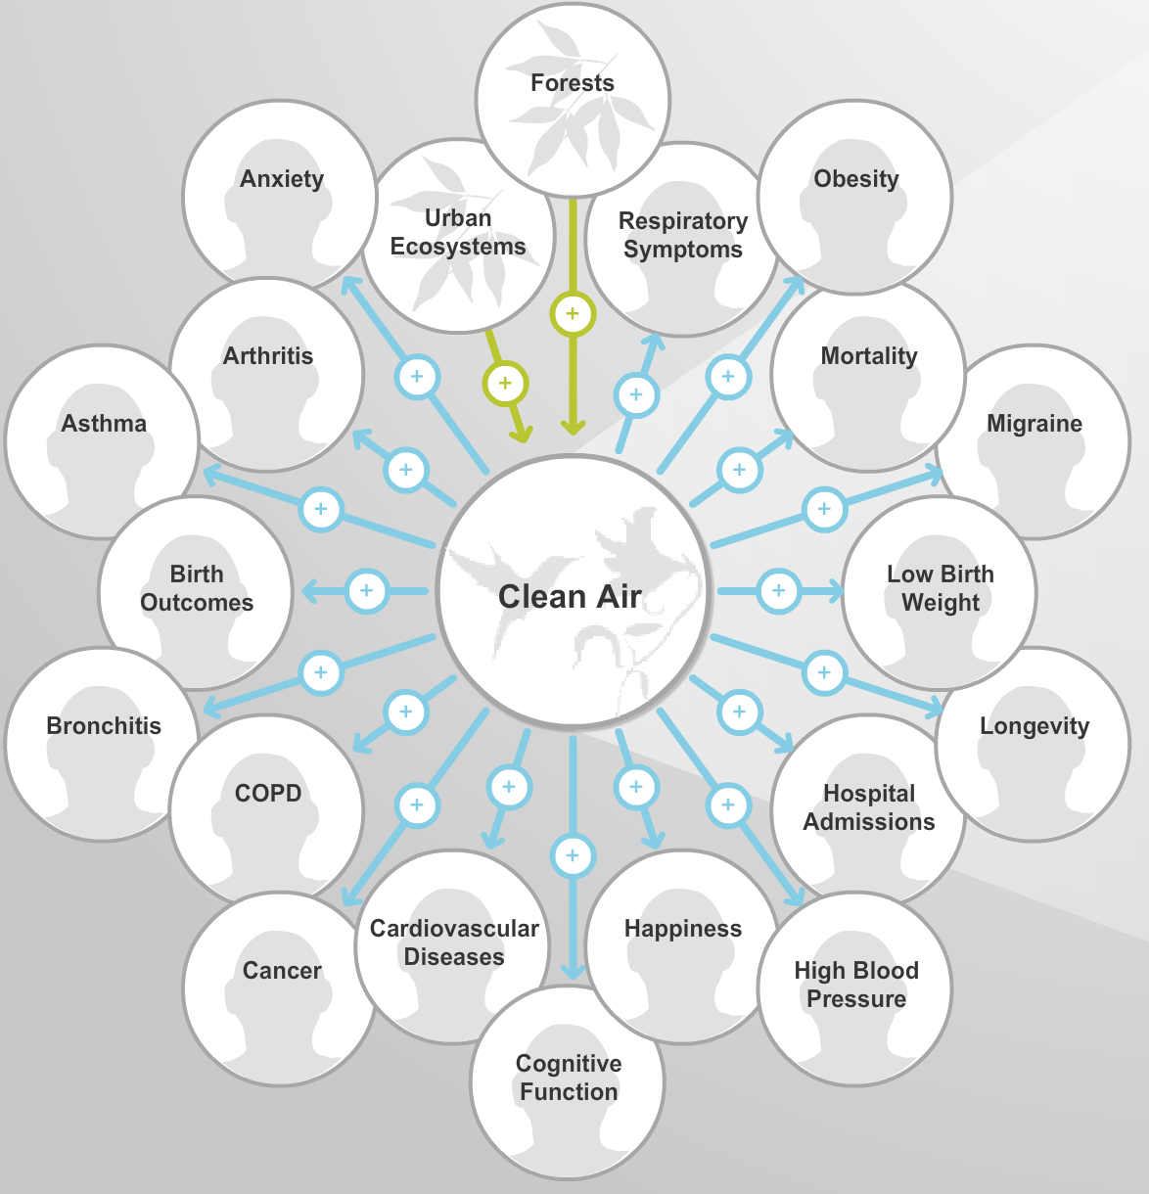
Introduction
Transportation has a profound effect on our environment, health, and the burden of disease.
Policy decisions affecting transportation and health transcend the authorities and often exclude traditional health agencies.
Healthy decisions for the future of transportation will require inclusive collaborative efforts.
Notes:
http://enviroatlas.epa.gov/enviroatlas/Tools/EcoHealth_RelationshipBrowser/index.html
The quality of the environment is a powerful determinant of human health. The World Health Organization (WHO) estimated that 22% of the total global burden of disease in 2012, including 12.6 million deaths each year, was due to environmental risks, including exposure to air pollution.

Slide 4
Two Different Worlds
Let’s face it, the world of public health and transportation are closely linked, but we really have not worked together that much.
CARTEEH – bringing public health and transportation science together

Slide 5
Air Pollution and the Burden of Disease
The environmental burden of disease is an estimate of the proportion of the global burden of disease that could be prevented by changes to the environment. The United States has the highest environmental burden of disease among comparably high-income countries.
Air pollution is the largest environmental health risk in the United States. Exposure to particulate matter air pollution was the sixth-leading risk factor for death in the United States in 2015, contributing to approximately 88 000 deaths per year. Ozone exposure contributes to an additional 9000 deaths per year.
Notes:
Sawyer B. The U.S. has the highest environmental burden of disease compared to other high-income countries. Peterson-Kaiser Health System Tracker. May 4, 2017. https://www.healthsystemtracker.org/chart/u-s-highest-environmental-burden-disease-compared-high-income-countries/#item-start. 2017.
World Health Organization. Global Health Observatory Data Repository: burden of disease attributable to the environment; data by country. 2016. http://apps.who.int/gho/data/node.main-emro.ENVDALYSBYCOUNTRY?lang=en.

Slide 6
Environmental Health Disparities
Not all populations are affected equally by transportation related environmental risks.
The environmental justice movement has increased the public’s awareness of the combination of increased exposures to environmental risks and social inequities that result in more disease related to such exposures in disadvantaged communities
The increased environmental exposures faced by disadvantaged communities are due, in large part, to decisions made around the built environment, including industrial siting, roadway locations, and resulting traffic; pollution and toxic emissions.

Slide 7
Transportation Policies and Public Health
Automobile centered development adopted since the 1950s required more roads, highways, and parking lots, leading to less greenspace, less availability of public transit or walkable/bikable transport, more traffic-related air pollution, and more injuries.
Transportation policy choices and their impact on the built environment affect many aspects of individual heath and well-being including obesity, physical activity, and mental health. This contributes to risks of respiratory and cardiovascular disease, and diabetes.
Now, COVID 19 mortality rates are higher in those with these comorbidities. Traffic related air pollutants are also associated with higher risk of death from COVID 19
Notes:
Exposure to air pollution and COVID-19 mortality in the United States: A nationwide cross-sectional study Xiao Wu, Rachel C Nethery, M Benjamin Sabath, Danielle Braun, Francesca Dominici
Preprint MedRxiv April 2020
https://www.medrxiv.org/content/10.1101/2020.04.05.20054502v2

Slide 8
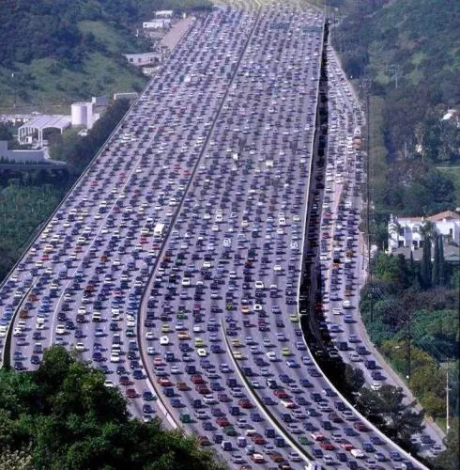
Traffic and Health - A Wicked Problem
Complex Affected by many interacting factors Various spatial scales and long temporal scales May have global implications Difficult to define Unstable and socially complex Have no clear solution or end point Extend beyond the understanding of one discipline
Notes:
The National Academies of Science has defined many environmental challenges as “wicked problems” See the NASEM report Science for Environmental Protection http://dels.nationalacademies.org/Report/Science-Environmental-Protection-Road/13510

Slide 9
Wicked Problems: NASEM Findings and Recommendations
Finding: Environmental problems are increasingly interconnected. EPA can no longer address just one environmental hazard at a time without considering how that problem interacts with, is influenced by, and influences other aspects of the environment.
Recommendation: The committee recommends that EPA substantially enhance the integration of systems thinking into its work and enhance its capacity to apply systems thinking to all aspects of how it approaches complex decisions.

Slide 10
Systems Approach
Leischow and Milstein define the systems approach as “a paradigm or perspective that considers connections among different components, plans for the implications of their interaction, and requires transdisciplinary thinking as well as active engagement of those who have a stake in the outcome to govern the course of change.”

Slide 11
Developing a Systems Approach
Two major Initiatives have developed new tools to examine the complex interaction of health and environment to improve the science basis for environmental Policies and Decisions
The National Academies of Science Environmental Health Matters Initiative
The Johns Hopkins Bloomberg American Health Initiative

Slide 12

Feb. 15, 2018
WASHINGTON – The National Academies of Sciences, Engineering, and Medicine are launching an Academies-wide initiative to transform how the nation addresses the complex issues associated with environmental health—a field that examines how the environment affects human health.
The initiative will bring together expertise across the institution, including environmental, medical, and social science, energy, and engineering, and involve leaders from government, corporate, and academic entities to explore the latest science, identify promising solutions, and create innovative pathways toward improving environmental health.
Notes:
https://www.nationalacademies.org/our-work/environmental-health-matters-initiative

Slide 13
The NASEM Environmental Health Matters Initiative
Catalyze cross-sector and multidisciplinary work and provide leadership on the big challenges in environmental health by combining forces of all seven program divisions. In particular:
Provide a focal point for dialog across disciplines and sectors
Identify priority topics for ad hoc studies and workshops
Enable nimble response to scientific questions that arise
Facilitate consideration of environmental health in broader contexts
Engage and broaden involvement of stakeholders

Slide 14
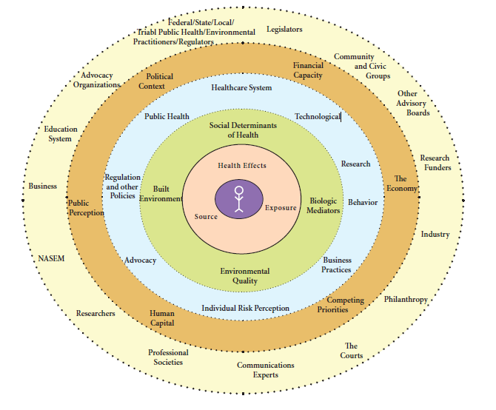
Develop Opportunity Landscapes by Mapping the Environmental Health System for Each Issue
People – population(s) of concern.
Environmental Health Assessment - drivers of the environmental health continuum from source to exposure to health outcome
Mediators of Health
Action Steps - specific actions (established actions and gaps)
External Drivers that can facilitate action and key barriers
Actors - key actors and their role in relation to key action steps or external drivers
Notes:
Steps in Mapping the Environmental Health System for a Specific Problem
First, state or name the EH issue of interest; it could be a single chemical, a mixture, a broader topic such as roadway traffic exposure or industrial agriculture, or something else. It could be emerging, developing, or mature (already well examined) issue.
1. People
Name the population of concern to you. If you have reason to believe that you are dealing with an “equal opportunity” issue that affects all people equally, then you list the general population. BUT if you have reason to know or believe that the issue affects populations differently or that the solutions might need to be tailored to different populations, then list multiple populations. The preliminary list of potentially relevant distinct or sub-populations includes infants and chidren; pregnant woman; elderly; medically-compromised; gender-specific; geographically-defined (e.g. rural, urban, costal, pacific NW, Gulf Coast); occupation; other.
Next follow the steps below, which mirror the circles of the System Diagram. Focus on delineating what is known, but also what is not known but important for action. Not everything that is interesting to know is important at this time for moving the issue forward to identify interventions/actions, the barriers to those steps, and the stakeholders involved.
2. Environmental Health Assessment
The first ring addresses drivers of the EH continuum from source to dose and exposure to health outcome.
Distinguish for each what is fairly well established and what are key knowledge gaps. If these likely differ for key populations, identify separately.
3. Mediators of Health
The next set of issues identifies key mediators of health that are known or, in your best estimation, might be related to the likelihood of exposure, as well as a person’s response to the exposure of interest.
These mediators include social determinants of health, the built environment, biologic mediators (e.g. microbiome, nutrition, genetics, disease state), and the natural environment.
As above, if you have reason to identify different elements in this category for different populations or for different routes of exposure or for different health effects, please do. This is important to address, because interventions/actions as well as stakeholder involvement, might differ if a mediator appears to be significant or different for different populations.
4. Action Steps
Moving outward in the Figure, identify specific actions (known/established or a gap) for each of the broader categories (Healthcare System; Public Health; Research; Technology; Business Practices; Regulation/Policy; Advocacy; Individual Behavior; Individual Risk Perception; others?).
5. External Drivers
Continuing on, identify external drivers (be as specific as you can) that can facilitate action. Identify key barriers.
6. Actors
Finally, identify key actors and their role in relation key action step or external drivers.

Slide 15
EHMI Workshop on Transportation and Health
The workshop's objectives:
Provide a forum for the environmental health and transportation sectors, along with experts in consumer behavior, to gather and apply environmental health perspectives to the consideration of new mobility options as part of the transportation system.
Identify research, policy, and communication needs related to the environmental health impacts of emerging transportation services and mobility options.
Stimulate potential collaborations to address environmental health benefits and challenges of transportation services and new mobility options.

Slide 16
The Bloomberg American Health Initiative
The Public Health Approach
Today, the increasing proportion of disease burden caused by chronic diseases, coupled with a recognition of the role of the environment in these diseases, requires an inclusive, cross-sector approach to improving the built environment for healthier communities. The public health approach to solving environmental health problems is a stepwise process that includes:
Defining the public health problem (identifying health risks of concern)
Measuring the magnitude of the problem (understanding measures of disease or exposure in the population)
Identifying key determinants of risk (including epidemiologic, social, and political factors)
Developing and recommending policies (ways to reduce risk and promote health)
Assessing health effects of policy options (eg, Health Impact Assessment [HIA])
Implementing and evaluating policy choices (tracking changes in community health)

Slide 17
The New Tools
Numerous emerging tools and information resources are helping to advance the public health approach and offering new ways to inform environmental decision making.
Health Impact Assessment
Mapping and Spatial Analysis - CDC National Environmental Health Tracking Program and EPA EnviroAtlas
Cumulative Risk Assessment
EJSCREEN – EPA Environmental Justice Screening and Mapping Tool
Notes:
Health Impact Assessment
2011 report of the NRC committee on HIA “Improving Health in the United States: The Role of Health Impact Assessment.”
2014 EPA’s “Review of Health Impact Assessments in the U.S.: Current State-of-Science, Best Practices, and Areas for Improvement”
Integrates data on proposed policy, stakeholder views, vulnerable populations, baseline health status, health impacts, and recommendations
Evaluation of health consequences of policies, programs, or plans
CDC National Environmental Public Health Tracking Program
Interactive mapping of environment, exposures, health effects, and population characteristics
Spatial presentation of disease incidence and environmental risk factors
Cumulative Risk Assessment
2009 NASEM report “Science and Decisions: Advancing Risk Assessment”
EPA Framework for Human Health Risk Assessment to Inform Decision Making
Data on multiple chemical and non-chemical stressors that interact to contribute to health impacts
Characterization of incremental risks to health from multiple agents or stressors
US Environmental Protection Agency EnviroAtlas
National data for mapping of pollution sources, environmental concentrations, exposures and risks, and demographic and community characteristics
Community maps for screening and prioritizing environmental health risk factors
EJSCREEN: EPA’s Environmental Justice Screening and Mapping Tool Demographic information including data on low-income, non–English-speaking, and minority populations; and environmental indicators of risk, including traffic, lead paint, air, water, and waste Mapping and screening results to identify environmental health risks, vulnerable populations, and environmental health disparities

Slide 18
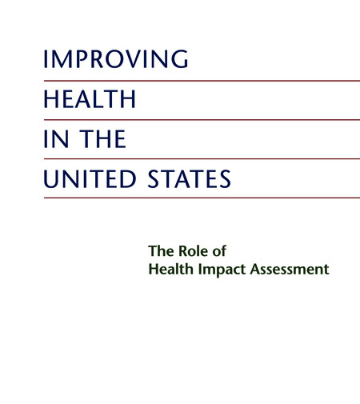
Health Impact Assessment
HIA uses a systems approach to array data sources and analytic methods and considers input from stakeholders to determine potential effects of a proposed action or decision on the health of a population, and the distribution of those effects within the population.

Slide 19
A Framework for Improving Health – Systems Thinking
Notes:
This framework was developed with the support of the Bloomberg American Health Initiative. A multi-disciplinary and cross agency symposium was held to develop recommendations for redefining our siloed approaches to built environment, community development and transportation policies. This framework is built upon the inclusive methods of health impact assessment, public health tracking, geographic analysis and cumulative risk assessment. The ultimate goal is to build healthier communities through a systems approach.

Slide 20
Discussion
Traffic related health impacts present a “wicked problem” for transportation and public health decision makers.
This lecture has examined the connection between public health and transportation decisions
A systems approach is needed to integrate the many scientific, social, economic and health considerations that drive transportation policies.
Two major initiatives and their related tools and approaches are presented: the National Academies of Science Environmental Health Initiative and the Johns Hopkins Bloomberg American Health Initiative.

Slide 21
Research Gaps and Future Directions
Researchers should develop partnerships with communities across multiple disciplines, agencies, and sectors so that their research aligns with community needs.
Cross-disciplinary research teams should aim to fill critical gaps in data to assess the links between transportation and health, improve the quantitative measures of HIAs, advance exposure science, identify vulnerable populations, and integrate social and behavioral influences transportation choices.
Research should document the economic effects of transportation policies ion health to provide a sound basis for balancing costs and benefits of policy choices
Researchers should integrate citizen science, whereby the public participates voluntarily in the scientific process to address community health concerns.

Slide 22
Take-Home Messages
Transportation policies have a profound impact on public health.
This is a time of great change for our transportation infrastructure and we have an opportunity to bridge the chasm between public health and transportation
Transportation infrastructure is key to the both the economic health and public health of communities.
We have a great opportunity to rethink our approach to transportation and public health – a systems approach
New tools and inclusive systems approaches to transportation and health can improve the scientific basis for policies and the health and well-being of our communities

Slide 23
References
World Health Organization. Global Health Observatory Data Repository: burden of disease attributable to the environment; data by country. 2016. http://apps.who.int/gho/data/node.main-emro.ENVDALYSBYCOUNTRY?lang=en.
Koehler K, Latshaw M, Matte T, Kass D, Frumkin H, Fox M, Hobbs BF, Wills-Karp M, Burke TA. Building Healthy Community Environments: A Public Health Approach. Public Health Rep. 2018 Nov/Dec;133(1_suppl):35S-43S. doi: 10.1177/0033354918798809. PMID: 30426875; PMCID: PMC6243448.
Leischow SJ, Milstein B. Systems thinking and modeling for public health practice. Am J Public Health. 2006;96(3):403-405.
National Research Council. Improving Health in the United States: The Role of Health Impact Assessment. Washington, DC: National Academies Press; 2011.

Slide 24
Reading List
Burke et al. 2017 Rethinking Environmental Protection: Meeting the Challenges of a Changing World. Env Health Perspect http://dx.doi.org/10.1289/EHP1465
Fox MA, Brewer LE, Martin L. An Overview of Literature Topics Related to Current Concepts, Methods, Tools, and Applications for Cumulative Risk Assessment (2007-2016). Int J Environ Res Public Health. 2017;14(4):389. doi:10.3390/ijerph14040389

