Slide 1
www.carteeh.org

Slide 2
Lecture #43: Transportation Decision Making—Overview and Process
Dr. Carlos Chang
UNIVERSITY OF TEXAS AT EL PASO
Phone Number: 915-747-8301
The author declares that there is no conflict of interest
The author reserves the rights to use this lecture for education purposes
E-mail: cchangalbitres2@utep.edu
Lecture Track(s): HT/TT/PPT
Notes:
Health Track (HT)—mainly targeted at urban planners, transportation planners, and engineers with limited knowledge of public health-related concepts;
Transportation Track (TT)—mainly targeted at environmental epidemiologists and public health professionals with limited knowledge of transportation-related concepts; and;
Planning and Policy Track (PPT)—mainly targeted at planners, civil servants, and policy and decision makers with particular interest in the science-policy link.

Slide 3
Introduction
The Transportation Decision Making process is performed at different interactive levels: strategic, network, project selection, and project level.
This lecture focusses on Transportation Asset Management (TAM) concepts and applications to make cost-effective strategic decisions to achieve environmental, social, and economic goals for sustainable healthy communities.
Notes:
Notes: The entire lecture is oriented to Transportation Asset Management (TAM) concepts, elements and recommendations.

Slide 4
What is Transportation Asset Management (TAM) ?
“ Transportation Asset Management is a strategic and systematic process of operating, maintaining, upgrading and expanding physical assets effectively throughout their lifecycle. It focuses on business and engineering practices for resource allocation and utilization, with the objective of better decision making based upon quality information and well defined objectives.”
(NCHRP, 2009)
Notes:
Note: TAM formal definition

Slide 5
Responsibilities: Management Levels
Strategic (Asset) – Planning, Programming & Allocation for all Systems
Network - Planning & Programming for Entire Set of Type Facility Managed
Project Selection - Programming a Subset
Project - Designing a Specific Section
Notes:
Note: Distinction of the management levels

Slide 6
Overview of the TAM Decision Making Process
Goals and Objectives
Overview
Inventory and condition assessment
Analysis of Options
and Tradeoffs
(Example: Preservation vs.
Capacity Expansion)
Policies
Budgets
Decision-Making &
Resource Allocation
Expectations
Implementation
Monitoring and Performance Measures
Notes:
This flow chart shows a typical Transportation Asset Management process (Asset Management is important and this is what it means in practice):
· Policy Goals and Objectives - Policies in Asset Management have to be realistic, they have to be clear, and have to have the “buy-in” from all who are responsible for implementing them. They are supported by quantifiable performance measures and service levels used to guide the overall resource allocation and program delivery processes.
· Analysis of Options and Tradeoffs - This includes examination of options within each investment area, as well as tradeoffs across different investment areas which support the agency’s policies, goals and objectives. The definition of investment areas is flexible and needs to be tailored to how an individual agency does business. Option analysis and tradeoff analysis are often facilitated by economic analysis methods.
· Decision Making and Resource Allocation - These decisions are the critical allocations of dollars, staff, equipment, materials, and other resources to different strategies, programs, projects, or asset classes within the organization. They are always based on the results of the proactive analysis of the options and tradeoffs and cover all investment areas and focus directly on performance goals and service levels with life-cycle performance considerations. Customer expectations can not be forgotten.
· Implementation and Program Delivery - The critical issue here is that programs need to be accomplished in the most cost-effective manner that can meet the performance targets. It may involve consideration of different delivery options, such as using contractors, interagency agreements, or design-build projects. Program delivery also means having a systematic way to monitor actions taken, costs, efficiency, and lessons learned to guide future decisions and analyses. (On time and within budget.)
· Monitoring System Conditions and Performance Measures - This is the monitoring and the all important feedback portion of Asset Management that measures the extent to which established performance objectives are being addressed. This information has to be objective, current, and targeted toward the goals, objectives, and priorities set by the agency. Analysis is needed to Optimize Operation and Maintenance and Optimize Capital Investment. As a result Funding Strategy needs to be developed as part of an Asset Management Plan.

Slide 7
Step-by-Step TAM Decision-Making Process
Setting program goals and objectives
Establishing program performance measures
Assessing needs and identifying projects (Needs Analysis, Gap Analysis)
Project evaluations
Priority setting and program development
Analyze trade-offs
Budgeting
Program implementation and monitoring
Notes:
Notes: The previous slide show the overview of the TAM Decision Making Process. This slide list the steps for the TAM process.

Slide 8
Key Stakeholders for Successful TAM Programs
Stakeholders are organized in groups who has influence in the transportation decision-making process:
Legislators, Commissioners
Government public officers, Steering Committee, Senior Management
Planners, Economist, Engineers and other professionals involved in the trade-off impact analysis of transportation alternatives
Public (Customers)
Stakeholders need for a strong leadership support – “ A Champion” in each group
Stakeholders require a clear vision supported by performance measures that guide investment decisions

Slide 9
Asset Management Basics Five Core Questions
What is the current state of my assets?
What is the required level of service/ performance?
Which assets are critical to sustained target performance?
What are my best “Operations and Maintenance” and “Capital Improvement” investment strategies?
What is my best long-term funding strategy?
Notes:
Note: Essential questions to define Asset Management with focus on implementation.

Slide 10
Network Management Level Elements
Inventory
Condition Assessment
Determination of Needed Work and Funds
Identification of Candidate Projects
Determination of Impacts of Funding Alternatives
Feedback

Slide 11
How to Develop and Implement a Transportation Asset Management Program?
Management Technical Aspects
Set Target Level of Service /Performance Goals (Economics, Social, Environment)
Develop Asset Inventory
Condition Assessment, Failure Modes
Determine Remaining Service Life
Determine Life Cycle and Replacement Costs (Example: LCCA)
Business (Financial) Analysis
Determine Business Risk (Example: B/C Analysis)
Optimize Operation and Maintenance
Optimize Capital Investment
Determine Funding Strategy
Notes:
Note: key aspects to implement TAM

Slide 12
Checklist for the Implementation of Asset Management
What are the necessary attributes of each of the assets and how to register and maintain the data?
What assets in the infrastructure network require immediate attention based on needs analysis?
What are cost effective data collection procedures and what accuracy and frequency of data collection is recommended?
What is the impact of short and log term asset management plans in the network condition?
Notes:
Note: Questions to ask by the agency to prepare a program to implement TAM.

Slide 13
Checklist for the Implementation of Asset Management Cont…
How to allocate limited funds among assets based on location and priorities set by the agency?
What are the results of trade off analysis in the different types of assets managed by the agency?
How performance metrics will evolve due to the implementation of an asset management strategy?
How to better communicate funding need using tools to visualize the results of gap analysis?

Slide 14
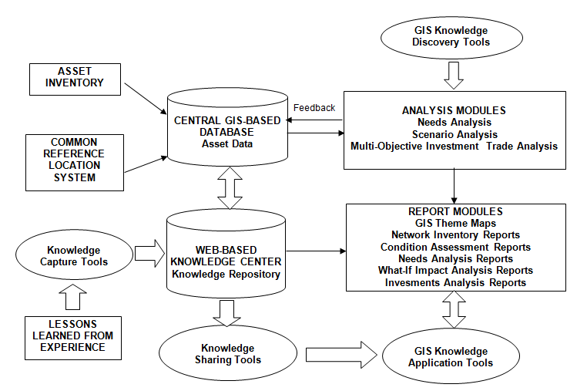
Asset Management Decision Support Systems (DSS)
Chang, 2007
Notes:
Note: To implement TAM there is a need of DSS with GIS and a Knowledge Database

Slide 15
Benefits of Implementing Asset Management Practices
To improve communication across departments when working in multidisciplinary team projects with different types of assets.
To enhance the decision making process when developing management plans through better communication and analysis tools.
To maximize cost savings resulting from greater efficiency in management operations.
Notes:
Note: To foster communication, TAM benefits must be highlighted.

Slide 16
Role of the Environment and Human Health in Transportation Decision Making
TAM focusses on the strategic goals of the agency, performance measures, and system performance, and those should considered metrics for the environment and human health.
Asses the performance of the transportation system with desired performance measures as targets and demonstrate how transportation decisions affect the environment and human health.
Monetary impact of the decisions and whole life performance/investment analysis to optimize investments on a long term basis used to support decision making
Need to model in the transportation decision making process “sustainability performance measures toward reaching agency goals in safety, mobility and the environment.” (Chang, 2017)
Notes:
Note: The need to have performance measures to connect TAM with environment and human health. Also modeling TAM decision making process to reach agency goals.

Slide 17
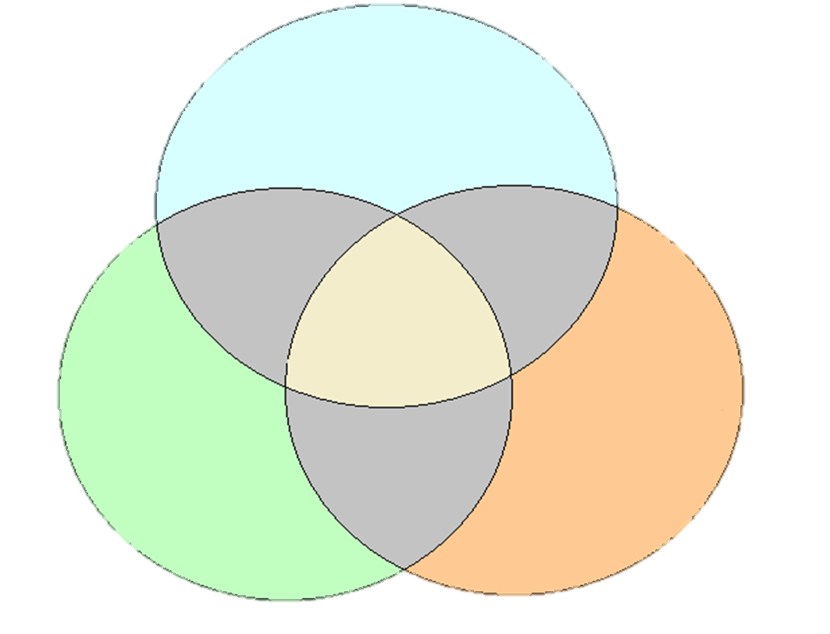
Role of the Environment and Human Health
A Better World to Live…
Healthy Society
Acceptable
Equity
SUSTAINABILITY
Natural
Environment
Economic
Vitality
Viable
Notes:
Note: Look for the equilibrium of a “Healthy Society” , “Natural Environment” and “Economic Vitality”. Major focus should be on the people with “people oriented” management approach.

Slide 18
Topics for Discussion
How to manage effectively along the whole-life cycle of the transportation assets?
What performance measures related to the environment and human health can be used for investment decisions?
How to implement an investment strategy that are based on life cycle cost and benefit/cost ratio analysis incorporating environment and human health?
How to prepare transportation decision making champions in an organization?
Notes:
Notes: Key topics for TAM successful implementation.

Slide 19
Framework of an Integrated Asset Management System
Discussion: How to Implement an Integrated Transportation Asset Management System ?
Chang, 2007
Notes:
NOTES: Diagram that emphasizes the need to have an integrated approach across transportation assets.

Slide 20
Research Gaps and Future Directions
How to integrate new data collection techniques combined with artificial intelligence to enhance the transportation decision-making process?
How to deal with the uncertainty of social, economical, changes in future decision-making scenarios?
What performance models and metrics can be used to quantify the impact of transportation decisions in the environmental, social, and economic aspects of sustainability?
What methods to apply to minimize the risk of the investments over the whole life cycle of the transportation assets?
Notes:
Notes: Key topics that require further attention for TAM future development.

Slide 21
Take-Home Messages
1. TAM emphasizes the strategic view of the decision-making process
Policy driven
Investment analysis
Data supported
Performance-based Oriented
2. TAM decision-making cross impacts through all types of infrastructure assets
3. People making transportation decisions at different level about:
Goals/Policies
Funding Levels
Alternative Solutions and Project Selection
Funding Allocation and Prioritization
Notes:
Notes: Summary of important TAM topics described before in the slides.

Slide 22
List of Abbreviations
B/C : Benefit / Cost Ratio
DSS : Decision-support Systems
LCCA: Life Cycle Cost Analysis
TAM : Transportation Asset Management
Notes:
Notes: Acronyms mentioned in the slides

Slide 23
References
AASHTO. 2002. Transportation Asset Management Guide. American Association of State Highway and Transportation Officials (AASHTO), Washington, D.C..
Cambridge Systematics Inc. 2009. An Asset-Management Framework for the Interstate Highway System. National Cooperative Highway Research Program Report 632. The National Academies of Science. Washington, D.C.
Chang C., Nazarian, S., Vavrova, M., Yapp, M., Pierce, L., Robert, W., Smith, R. 2017. Consequences of Delayed Maintenance of Highway Assets. National Cooperative Highway Research Program Report 859. The National Academies of Science. Washington, D.C.

Slide 24
References
Chang-Albitres, C. 2007. Development of a Multi-Objective Strategic Management Approach to Improve Decisions for Pavement Management Practices in Local Agencies. Dissertation. Texas A&M, College Station, Texas.

Slide 25
Reading List
AASHTO TAM Portal ( http://www.tam-portal.com/ )
Chang, C. 2020. CE 6301 Infrastructure Management, Class Notes. University of Texas at El Paso. El Paso, Texas.
FHWA. 1999. Asset Management Primer. Federal Highway Administration (FHWA). U.S. Department of Transportation. Washington, D.C.
FHWA Asset Management website ( http://www.fhwa.dot.gov/asset/)
Notes:
Notes: Addition recommended sources of information for TAM

Slide 26
Acknowledgements
A deep sense of gratitude is owed to Dr. Roger E. Smith who introduced me to Asset Management and for his mentoring throughout my academic career.

