Slide 1
www.carteeh.org

Slide 2
Lecture #54: Alternative and Emerging Technologies—Connected and Automated Vehicles
Peng Hao
Center for Environmental Research & Technology
University of California, Riverside
Contact information: haop@cert.ucr.edu, 951-781-5777
The author declares that there is no conflict of interest
Lecture Track(s): TT
Notes:
Health Track (HT)—mainly targeted at urban planners, transportation planners, and engineers with limited knowledge of public health-related concepts;
Transportation Track (TT)—mainly targeted at environmental epidemiologists and public health professionals with limited knowledge of transportation-related concepts; and;
Planning and Policy Track (PPT)—mainly targeted at planners, civil servants, and policy and decision makers with particular interest in the science-policy link.

Slide 3
Introduction
Taking advantage of both vehicle-to-everything (V2X) and autonomous driving technology, connected and automated vehicle (CAV) emerges as one of the transformative solutions to the current challenges for traffic-related emissions.
Connected vehicles has shown the capability to improve traffic efficiency and reduce emissions via vehicle-to-vehicle (V2V) or vehicle-to- infrastructure (V2I) communication.
Automated vehicles equipped with sensing technology (e.g. camera, Lidar, radar, etc.) and artificial intelligent technology would recognize the environment and subsequently perform proper eco-actions precisely by fully or partial automation.
In the long term, the expanded and inexpensive mobility provided by CAVs may cause increased trip frequency and higher VMT.
Notes:
Transportation activities, including both goods and people movement, have been playing a crucial role in fossil fuel consumption and air pollutant emissions. In 2015, the United States consumed approximately 97.5 quadrillion BTUs (Quads) of energy, and 28.4% of this was used for transportation purposes. According to the estimation from U.S. Environmental Protection Agency (USEPA), transportation activities were responsible for about 26% of the total U.S. greenhouse gas (GHG) emissions in 2014. Meanwhile, in many areas, vehicle emissions have become the dominant source of air pollutants, including greenhouse gas (GHG), carbon monoxide (CO), volatile organic compound (VOCs), nitrogen oxides (NOx), particulate matter (PM), and polycyclic aromatic hydrocarbons (PAH).
To save energy and reduce air pollutant emissions, more and more rigorous standards and regulations have been established as a strong driving force to promote motor vehicles’ fuel economy and reduce their tail-pipe emissions. On the other hand, the rapid development in vehicle automation and communication technologies promotes the prototype applications on eco-driving which improves the transportation energy efficiency by conducting smarter driving styles.

Slide 4
Connected Vehicles
Connected Vehicles establishes communication among vehicles, the infrastructure, and other transportation participants.
In 1999, Federal Communications Commission allocated 75 MHz of spectrum in the 5.9 GHz band for ITS applications.
Dedicated Short Range Communications (DSRC) and Cellular-V2X
Connected Vehicle deployment
  Safety Pilot Model Deployment project
  - City of Ann Arbor, MI
  Connected Vehicle Pilot Deployment
  - Wyoming, New York City and Tampa
  Signal Phase and Timing (SPaT) Challenge
  - 26 states, 216 signals, 2000+ planned
  SPaT challenge Deployment (Source: NOCoE)
Notes:
U. S. Department of Transportation (USDOT) leads the effort on investigating the efficiency and safety benefits by augmenting automated vehicle capabilities with connected vehicle technologies to enable cooperative automation. With wireless communications between vehicles and infrastructure or among vehicles, cooperative automation allows automated vehicles to share information and coordinate movements to enhance the safety, mobility and energy efficiency.
Connected Vehicles establishes communication among vehicles, the infrastructure, and other transportation participants. As an important complementary technology to support automation, vehicle-to-vehicle communication (V2V), vehicle-to-infrastructures communication (V2I), and communication with the surrounding environment (V2X) is expected to enhance the benefits of automation at all levels in safety, mobility and environmental sustainability.

Slide 5
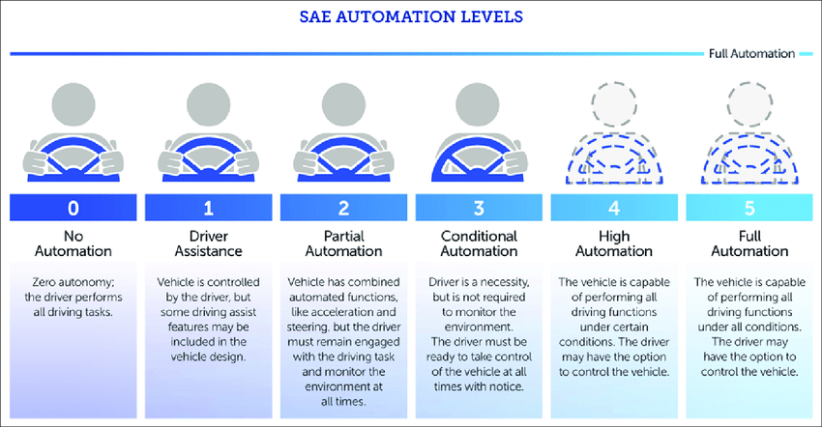
Automated Vehicles
Rapid development thanks to advanced sensing, AI technologies. Two paths:
  Fully-autonomous driving system in small-scale deployment: Waymo, Lyft
  Semi-autonomous driving system which enabled hands-free control for selected scenarios have been market-ready, e.g. Tesla’s Autopilot and GM’s Super Cruise.
Organization | 2016/2017 Predictions | 2018 Predictions | Automation Level
BMW | 2021 | Predictions | Levels 4 and 5
Daimler | 2020-2025 | Unchanged | Levels 4 and 5
Fiat-Chrysler Automotive | 2021 | 2023 | Level 4
Ford Motor Company | 2021 (Ridehailing) | Unchanged | Level 4
General Motors/Cruise | 2019 (Ridehailing) | Unchanged | Unspecified
Tesla | 2017 | 2019 | Level 4
Toyota | 2020 (Highways) | Unchanged | Level 4
Volvo | 2020 | 2021 | Level 4
Zoox | 2020 | 2020 | Levels 4 and 5
Google/Waymo | 2020 | Unchanged | Level 4
Uber | 2019 (Ridehailing) | 2021 | Unspecified
ABI Research | 2021 | Unchanged | Levels 4 and 5
his Markit | 2020 | 2021 | Levels 4 and 5
Levels of automation (source: SAE J3016 standard)
Expectation Availability of AVs (source: Lewis and Grossman, 2019 )
Notes:
With the rapid development of vehicle automation technology, the state and municipal governments and government agencies play a significant role in facilitating and regulating automated vehicle industry. Nevada was the first state to authorize the operation of autonomous vehicles in 2011. Since then, 29 states and Washington D. C. have enacted legislation related to autonomous vehicles, and Governors in 11 states have issued executive orders related to autonomous vehicles. California allows autonomous vehicle testing on public roads but asks the entities to report disengagements when the system hands back control to a safety driver proactively or passively. In the Autonomous Vehicle Disengagement Reports 2018, 28 companies reported 496 vehicles with over 2 million miles of autonomous driving and 143,720 disengagements encounters. The top five companies including Waymo, GM Cruise, Zoox, Nuro and Pony.AI reached more than 1,000 miles before a disengagement happened.
Based on the forecast from car manufactures, transportation network and information companies and market research firms, the expected rollout dates for Society of Automotive Engineers (SAE) Levels 4 and 5 automated vehicles ranged from late 2019 to 2023, as shown in the table.

Slide 6
CAV Applications for the Environment
With wireless communications between vehicles and infrastructure or among vehicles, more eco-friendly vehicular maneuvers have been achieved through information sharing and better cooperation.
Autonomous driving precisely follows the designed eco-friendly strategies while guaranteeing safety.
In 2009, the Applications for the Environment: Real-Time Information Synthesis (AERIS) program was initialized to investigate the eco-friendly transportation operations in Connected Vehicle (CV) environment.
AERIS program defined 5 Operational Scenarios and 18 unique connected vehicle applications with potential on fuel consumption and vehicle emissions reduction
  Eco-Signal Operations, Eco-Lanes, Low Emissions Zones, Eco-Traveler Information, and Eco-Integrated Corridor Management (Eco-ICM)
Notes:
AERIS - Five years US DOT project
Vision: Cleaner air through smarter transportation
Research objectives
Identify connected vehicle applications that could provide environmental impact reduction benefits via reduced fuel use and efficiency impacts on emissions.
Facilitate and incentivize “green choices” by transportation service consumers (i.e., system users, system operators, policy decision makers, etc.).
Identify vehicle-to-vehicle (V2V), vehicle-to-infrastructure (V2I), and vehicle-to-grid (V2G) data (and other) exchanges via wireless technologies of various types.
Model and analyze connected vehicle applications to estimate the potential environmental impact reduction benefits.
Develop a prototype for one of the applications to test its efficacy and usefulness

Slide 7
AERIS Operational Scenarios & Applications
Eco-Signal Operations
Low Emissions Zones
Eco-Integrated Corridor Management (E-ICM)
Arterial Data Environments
Performance Measures
Performance Measures
Eco-
Approach & Departure at Signalized
Int.
Low
Emissions
Zone
Mgmt.
Performance Measures
Freeway Data Environments
Connected
Eco-Driving
Eco-ICM Decision Support System
Eco-Traffic Signal
Priority
Regulatory / Policy Tools
Regulatory / Policy Tools
Eco-Traffic Signal
Timing
Eco-
Traveler Information
Apps
Eco-Signal Operations
Apps
Corridor (Control) Data Environments
Regulatory / Policy Tools
Connected
Eco-Driving
Educational Tools
Educational Tools
Eco-Lanes
Apps
Wireless Inductive Charging
Regional (Info) Data Environments
Incident Management
Educational Tools
Eco-
Traveler Information Apps
Eco-Traveler Information
Low
Emissions Zones Apps
Eco-Lanes
Performance Measures
Performance Measures
AFV
Charging/ Fueling Information
Connected
Eco-Driving
Eco-Lanes
Mgmt.
Dynamic
Eco-Routing
Regulatory / Policy Tools
Eco-Cooperative Adaptive Cruise
Control
Eco-Speed Harmonization
Regulatory / Policy Tools
Dynamic
Eco-Freight
Routing
Multi-modal Traveler Information
LEGEND
Multi-Modal Traveler Information
AERIS Application
Eco-Ramp Metering
Eco-
Traveler Information
Apps
Dynamic
Eco-Transit
Routing
Performance Measures
Educational Tools
Applications Supported with AERIS Data (R&D by Others)
Regulatory / Policy Tool
Educational
Tool
Wireless Inductive Charging
Educational Tools
Eco-Smart Parking
Connected
Eco-Driving
Source: USDOT
Notes:
Eco-Signal Operations focused on the connected vehicle technologies to reduce fuel consumption and emissions at signalized intersections, such as Eco-Approach and Departure at Signalized Intersections, Eco-Traffic Signal Timing, Eco-Traffic Signal Priority and Connected Eco-Driving. Eco-Lanes evaluates the feasibility and utility to design dedicated freeway lanes that encourage use from vehicles operating in connected eco-friendly ways, e.g. Eco-Cooperative Adaptive Cruise Control (Eco-CACC) and Eco-Speed Harmonization.

Slide 8
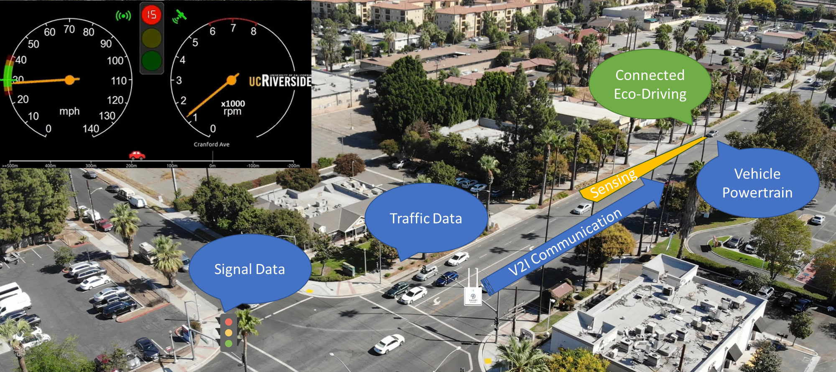
Eco-Approach and Departure (EAD)
Utilizing traffic signal phase and timing (SPaT) data to provide driver recommendations that encourage “green” approaches to signalized intersections
Notes:
Among all the programs, Eco-Approach and Departure (EAD) at Signalized Intersections is particularly promising for fuel saving and emission reduction in urban area, as drivers would effectively reduce stops and idling and avoid unnecessary acceleration and deceleration by receiving SPaT information in advance. Connected eco-driving is also one of the most feasible pilot applications in the early stage of the CAV era, as it could show significant effect on fuel economy improvement under low penetration rate, even for a single vehicle that is communicable with the signal controller.

Slide 9
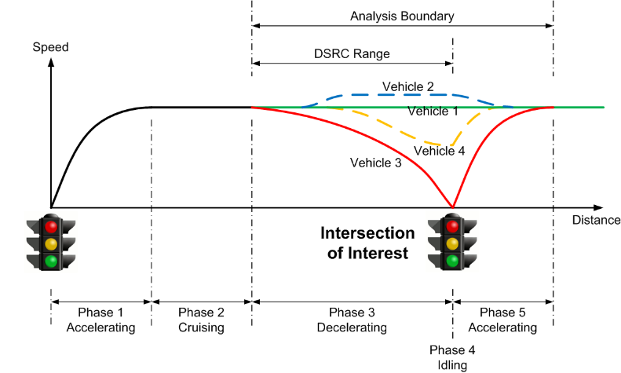
EAD Algorithms
EAD algorithms aim to find the most environmental-friendly strategy to pass the intersection without any unnecessary idling or speed fluctuation.
Multiple data sources, such as SPaT information, GPS location, vehicle dynamics and preceding vehicle information from radar, are integrated in this system.
Scenarios in EAD algorithm (Source: Xia, 2014)
System Framework of EAD (Source: Hao et al., 2018)
Notes:
The maximum/minimum time-to-change for the current phase is extracted from SPaT message broadcasted by Road-side DSRC Unit (RSU). The distance to the intersection is calculated after map matching based on the current GPS location. Vehicle dynamics from the vehicle’s on-board diagnostics (OBD) port, and activity data of the preceding vehicle from a forward looking automotive radar are also collected by the EAD system. A vehicle trajectory planning algorithm is developed to provide speed recommendation based on the state of the subject vehicle, preceding vehicle, and upcoming traffic signal. To avoid distraction when the subject vehicle follows preceding vehicles, a state machine is introduced for governing the display of the recommended speed based on detection from radar.
The following objectives are considered when developing the EAD algorithm:
1) Safety is the primary goal and basic requirement for any CV applications. In EAD algorithm, we set up multiple rules to guarantee that the vehicle can keep safe distance with preceding vehicles while obeying traffic rules, e.g. not speeding and not crossing on red;
2) The second objective is to avoid or minimize idling at the intersection; and
3) The third is to avoid unnecessary acceleration and deceleration.

Slide 10
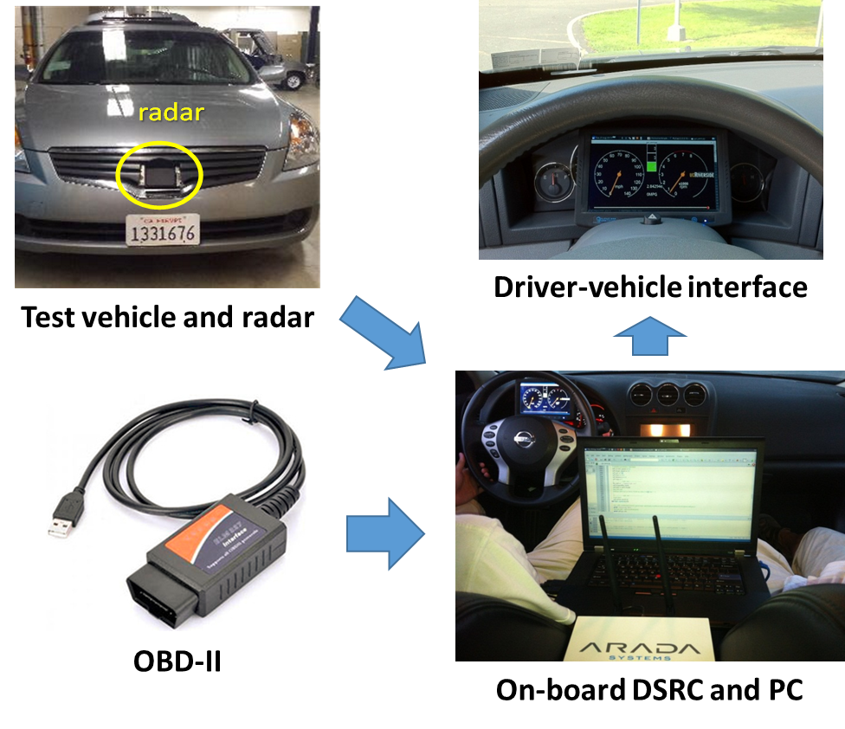
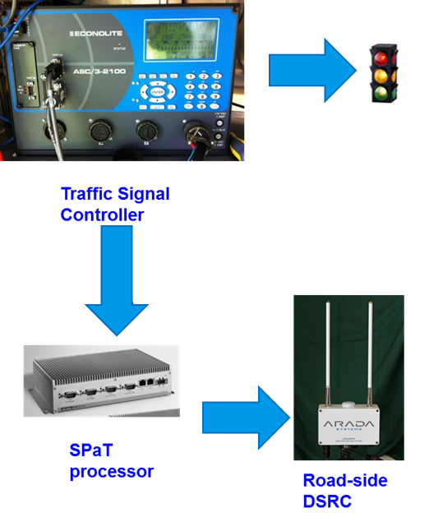
Field Implementation of EAD
Vehicle-side setup
Road-side setup
Source: Hao et al, 2018
Notes:
A research test vehicle has been set up for the field test. As shown in the figure, a real-time automotive radar system was installed in front to detect the relative distance and relative speed of the preceding vehicle. The on-board system receives position information via GPS, and vehicle dynamics information through on-board diagnostics (OBD). This vehicle was also equipped with a Dedicated Short Range Communication (DSRC) modem, an on-board computer, and a 7-inch automotive-grade display to serve as an artificial dashboard. The on-board computer acquired high-resolution vehicle dynamics data (e.g., instantaneous speed and RPM) from the CAN BUS via an OBD-II interface and parsed the SPaT and GID messages received from the DSRC modem at 10 Hz. Based on the GPS location and a developed map-matching algorithm, the vehicle’s distance-to- intersection is estimated. The radar detection data were also processed to estimate several key parameters related to the preceding vehicle along the same lane. The EAD algorithm integrated data from multiple sources to calculate the recommended vehicle trajectory. Key information for EAD was then delivered to the driver through the artificial dashboard display, and archived in the database every second. Another vehicle with similar size and engine condition (2.5 L 4-cylinder) was selected as baseline vehicle for uninformed drivers. A GPS-enabled tablet was linked with that vehicle by Bluetooth to receive OBD information.

Slide 11
Experiment Results
EAD smooths the trajectories and reduces the frequency of high acceleration and decertation. EAD also reduces the number of stops.
Comprehensive Modal Emissions Model (CMEM) is applied to estimate fuel consumption and air pollutant emissions based on second-by-second trajectory collected from both vehicles.
Significant emission reduction can be observed from road segment with EAD activated.
Driver | Fuel (g/mile) | CO2 (g/mile) | CO (g/mile) | HC (g/mile) | NOx (g/mile)
Informed | 101.3 | 317.0 | 2.48 | 0.13 | 0.27
Uninformed | 107.9 | 335.8 | 3.66 | 0.18 | 0.35
Saving in % | 6.1 | 5.6 | 32.4 | 29.7 | 24.3
Source: Hao et al, 2018
Notes:
To activate the display of EAD speed, the vehicle has to be travelling within the DSRC communication range of the downstream intersection, and without the detection of preceding vehicles by the forward facing radar. Therefore, we first applied a range filter based on Table I to exclude trips out of the DSRC communication range. We then searched for the trip segments that are not significantly impacted by preceding vehicles. As the test corridor is a busy arterial even in the off-peak hour, it is difficult to find an approaching process without any preceding traffic or queues. We relax the criterion for EAD activated segments. When the vehicle approached a certain intersection within the DSRC coverage, if the EAD algorithm was activated and the target speed was displayed for more than 50% of that range (i.e. ), we considered this trip segment as an EAD activated segments. EAD was applied to about 22% of the entire mileage during the test. The corresponding trip segments for uninformed driver were also collected for comparison. As shown in Table III, EAD system reduced fuel consumption by 6%, and reduced 6% of CO2, 32% of CO, 30% of HC and 24% of NOx. For the uninformed driver, the fuel consumption per mile near the intersection is higher than that of the entire trip, due to frequent stop-and-go maneuvers and/or speed oscillation. With the help of EAD system, the fuel consumption and emissions per mile were slightly reduced below the average level of overall trips.

Slide 12
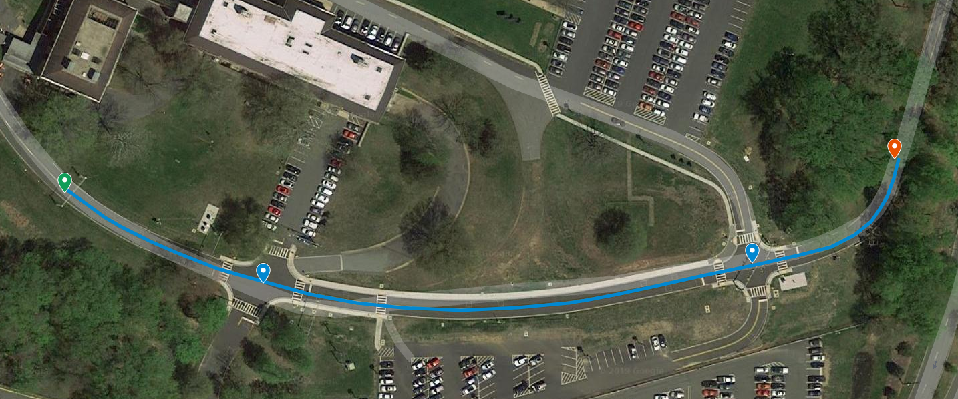
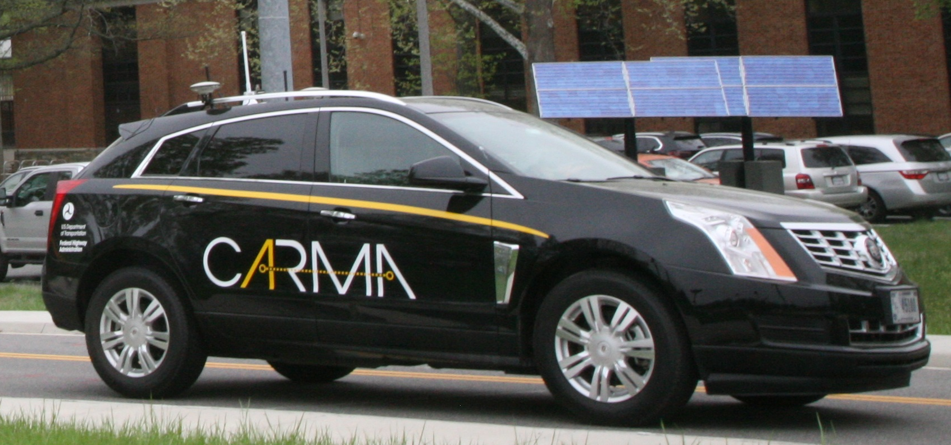
GlidePath - Partially Automated EAD system
GlidePath Test Route
System Diagram of Cooperative Automation Research Mobility Applications (CARMA) platform
GlidePath Test Vehicle
Source: USDOT
Notes:
A field implementation with a real passenger-vehicle is also conducted to validate the effectiveness of the proposed EAD system. The field testbed is located at the Federal Highway Administration’s (FHWA) Turner-Fairbank Highway Research Center (TFHRC) in McLean, Virginia using the Saxton Transportation Operations Laboratory (STOL) Intelligent Intersections. This testbed offers a sheltered traffic environment where the field test can be conducted with minimal safety risk and without disrupting live traffic operations.
The test vehicle is a production Cadillac SRX 2013, which is outfitted for automated throttle and brake control using hardware developed by the STOL and TORC Robotics. It is additionally equipped with a TORC PinPoint GPS unit, which integrates IMU and Dual Phase GPS solution for accurate localization.

Slide 13
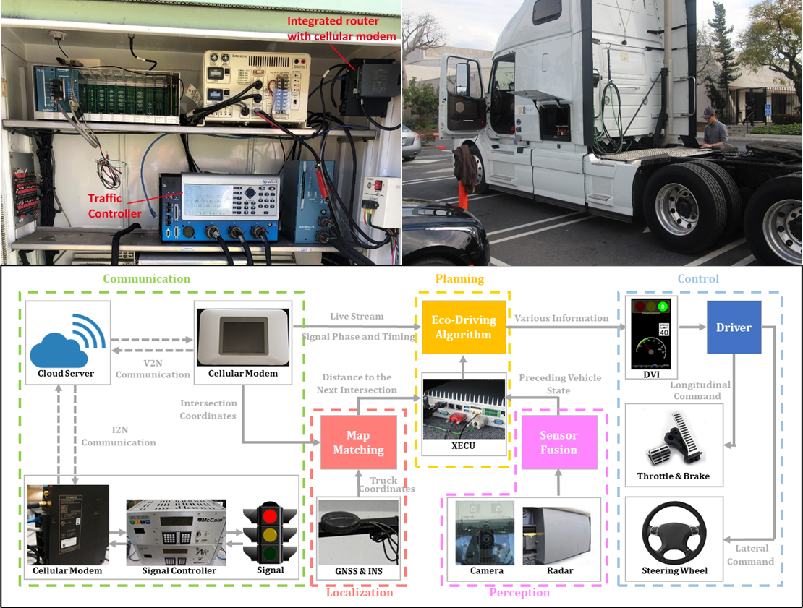
Truck Eco-Drive
Emissions from on-road trucks play as a major contributor to the deteriorating air quality.
EAD is particularly beneficial to heavy-duty trucks as:
  Greater level of energy and emission benefits due to lower power-to-weight ratio and high emission rate when accelerating from a stop.
  Drayage trucks operate mostly on surface streets with many signals
Figures on the right show the system architecture and setup of truck eco-drive system.
Source: Wang et al, 2019
Notes:
The Truck Eco-Drive project has multiple innovative features which are adaptive to the large-scale deployment of connected vehicles. 1) Communication over 4G network. We developed a server to receive and parse the SPAT information from signal controllers. This server also hosts the Truck Eco-Drive Planner which sends real time EAD speed recommendations to the DVI in the onboard tablet for display. We also considered the communication latency issue for 4G network and developed compensation algorithms to correct that. 2) Tablet-based onboard system. As we use 4G instead of DSRC signal for SPAT transmission and move the major computation load to the server, only a tablet is mounted in the truck for GPS acquirement, data transmission and Eco-Drive information display. The tablet-based system is more cost-effective and user-friendly when comparing with the EAD systems installed in previous tests. 3) Mobileye-based preceding vehicle warning system. We connected the onboard tablet with the Mobileye system equipped in the truck to provide collision avoidance notification to the drivers.

Slide 14
Microsimulation results
We create VISSIM freight network with varying speed limit, traffic volume, truck ratio and CAV penetration rate to test Truck Eco-Drive algorithms
EAD application is more effective in the light or mild traffic, in term of CO₂ reduction and NOx reduction.
There is no significant trend on emission reduction per vehicle in term of the truck ratio or CAV penetration rate but increasing the percentage of eco-drive trucks will reduce the system-wide emissions.
CO₂ emission reduction from Truck Eco-Drive
Truck % Volume | 5% | 10% | 15% | 20%
300 vphpl | 10% | 10% | 12% | 10%
600 vphpl | 9% | 9% | 9% | 8%
900 vphpl | 9% | 8% | 7% | 7%
1200 vphpl | 7% | 6% | 6% | 6%
NO_{x} emission reduction from Truck Eco-Drive
Truck % Volume | 5% | 10% | 15% | 20%
300 vphpl | 12% | 12% | 13% | 12%
600 vphpl | 10% | 10% | 10% | 10%
900 vphpl | 11% | 10% | 9% | 8%
1200 vphpl | 9% | 8% | 7% | 7%
Notes:
For Truck Eco-Drive study, we create Vissim freight network with varying speed limit, traffic volume, truck ratio and CAV penetration rate. The tables show the emission reduction of equipped trucks from Truck Eco-Drive when the speed limit is 45mph. This study shows that EAD application is more effective in the light or mild traffic. There is no significant trend on energy savings per vehicle in term of the truck ratio or CAV penetration rate, but increasing the percentage of eco-drive trucks will reduce the system-wide energy consumption.

Slide 15
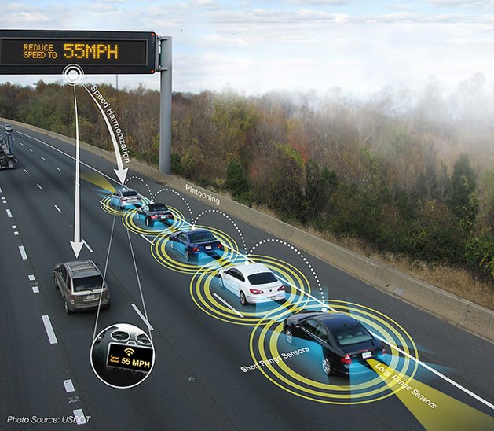
Cooperative Adaptive Cruise Control (CACC)
CACC investigates the extension of ACC systems for longitudinal control using V2V/V2I communication to coordinate a string of vehicles to improve traffic flow.
CACC allow the mean following time gap to be reduced from about 1.4s to 0.7s. (Nowakowski et al., 2010)
Resulting in an increase in highway lane capacity and traffic efficiency.
By designing Eco-CACC algorithm over the conventional CACC algorithm, emissions of CO₂, CO, HC, and NO_{x}, could be further reduced by 2.2%, 17.0% 6.7%, and 3.0%. (Wang et al., 2017)
Source: USDOT
Notes:
CACC takes advantage of V2V communications to allow CAVs to form platoons and be driven at harmonized speeds with shorter time headways between them. By sharing vehicle information such as acceleration, speed, and position in a distributed manner, CAVs in a certain communication range can cooperate with others to obtain the following benefits: 1) driving safety is increased since actuation time is shortened compared to manually driven, and downstream traffic can be broadcasted to following vehicles in advance; 2) roadway capacity is increased due to the reduction of time/distance headways between vehicles; and 3) energy consumption and pollutant emissions are reduced due to the reduction of unnecessary velocity changes and aerodynamic drag on following vehicles

Slide 16
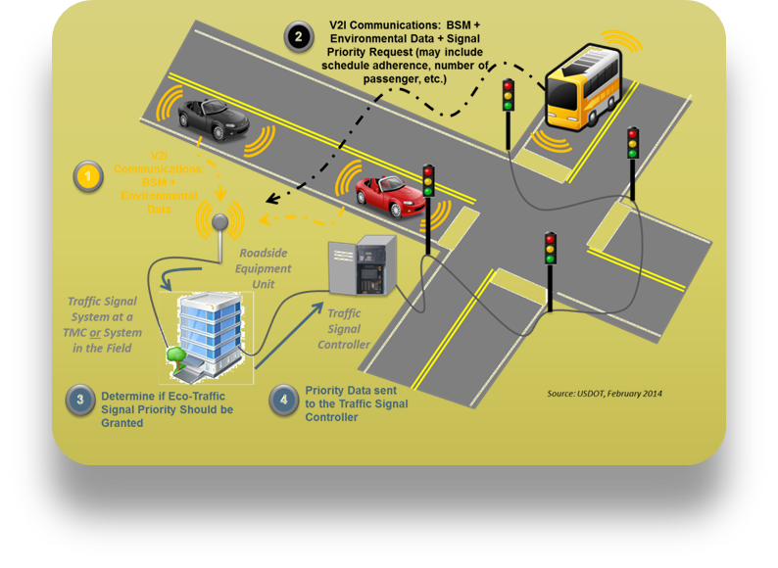
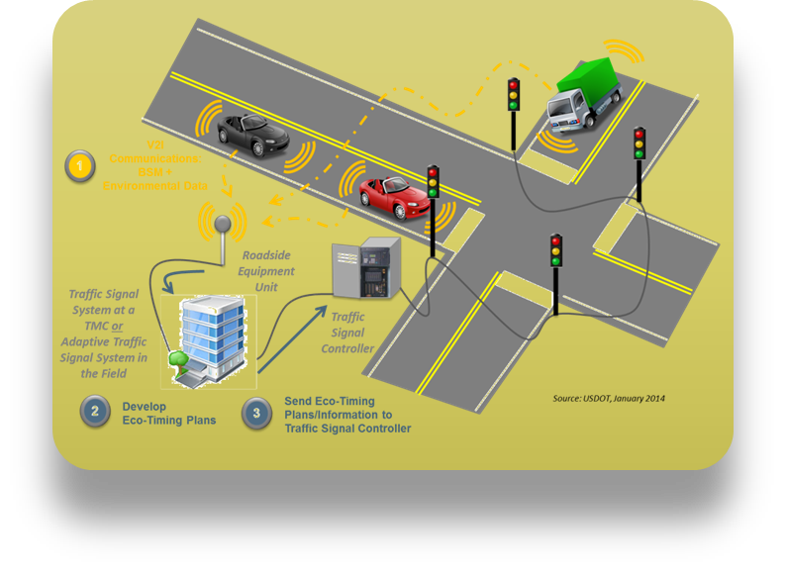
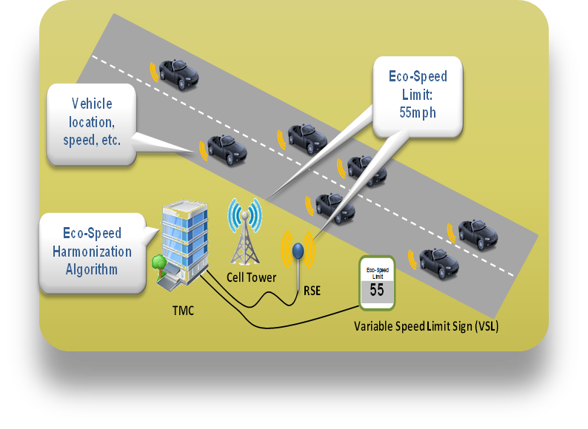
Other CAV applications
Eco-Traffic Signal Priority
Eco-Traffic Signal Timing
Eco-Speed Harmonization
Source: USDOT
Notes:
Eco-Traffic Signal Timing
Similar to current traffic signal systems; however the application’s objective is to optimize the performance of traffic signals for the environment
Collects data from vehicles, such as vehicle location, speed, vehicle type, and emissions data using connected vehicle technologies
Processes these data to develop signal timing strategies focused on reducing fuel consumption and overall emissions at the intersection, along a corridor, or for a region
Eco-Traffic Signal Priority
Allows either transit or freight vehicles approaching a signalized intersection to request signal priority
Considers the vehicle’s location, speed, vehicle type (e.g., alternative fuel vehicles), and associated emissions to determine whether priority should be granted
Information from vehicles approaching the intersection, such as a transit vehicle’s adherence to its schedule, the passenger number on the transit vehicle, or weight of a truck is also considered in granting priority
Eco-Speed Harmonization
Collects traffic information and pollutant information using connected vehicle-to-infrastructure (V2I) communications
The application assists in maintaining flow, reducing unnecessary stops and starts, and maintaining consistent speeds near bottleneck and other disturbance areas
Receives V2I messages, the application calculates the optimal speed for the segment of freeway where the bottleneck, lane drop, or disturbance is occurring

Slide 17
VMT increase due to CAVs
Provide a new form of mobility to certain population groups that have largely been travel-restricted
  Children, the elderly, and people with a medical condition
  Those population groups could increase the total VMT by 14%. (Harper, 2016)
The long-term impacts of CAV technologies on traffic emissions are uncertain as there is no real-world evidence at this time
  VMT increase of 4%–60% due to the reduced cost of drivers’ time (Wadud et al., 2016)
  Increased accessibility in suburban areas by 10%–14%, result in urban sprawl and increased trip length. (Meyer at al., 2017)
Source: USDOT
Notes:
While the real-world testing and demonstration of CAVs to date has shown potential for emissions reduction in the near term, primarily as a result of improved vehicle and traffic operational efficiency, the long-term impacts of these technologies on traffic emissions are unclear as there is no real-world evidence at this time. One speculative long-term impact is that the expanded and inexpensive mobility provided by CAVs may cause increased trip frequency and, consequently, higher VMT. Wadud et al. (2016) estimated VMT increase of 4%–60% due to the reduced cost of drivers’ time. Meyer, Becker, Bösch, and Axhausen (2017) suggested that autonomous vehicles could increase accessibility in suburban areas by 10%–14%. Such an increase in accessibility may translate to urban sprawl and result in increased trip length. These uncertain yet potentially significant impacts of CAVs may result in an overall increase in emissions in the long run.
In addition, CAVs are expected to provide a new form of mobility to certain population groups that have largely been travel-restricted. These include, for example, children, the elderly, and people with a medical condition. Harper, Hendrickson, Mangones, and Samaras (2016) estimated that those population groups could increase the total VMT in the United States by 14%. Such an increase in travel activity could also mean an increase in the amount of time that these vulnerable population groups are exposed to traffic-related air pollution.

Slide 18
Discussion
What type of CAV technology will be first deployed in a large-scale in the future?
What is the most likely operation/business model for automated vehicles in the future?
What policy can lead the development of CAVs to an environmental-friendly direction?
Source: USDOT
Notes:
Effective under low CAV penetration rate, low average automation level
Shared or private autonomous fleet
Parking? Occupancy? Restriction of use?

Slide 19
Research Gaps and Future Directions
Connected eco-driving technology
  More realistic traffic scenarios
  Measure emissions directly from
  field to validate
  Integrate with Computer
  Vision and AI technology
  Collect more data
Solve long-term issues
  Travel behavior studies
  Policy studies
  Agent-based simulation
Signal Timing
Fixed timed signal
Actuated signal
Coordinated signal
Facility information
Road Grade
Bus stop
Bus Schedule
Traffic Sensing
Radar
CAV
Queue length data
Computer Vision
Vehicle/Powertrain
ICEV, EV, PHEV
Passenger car, Truck, Bus
Connected
Eco-Driving
Computation efficiency
Shortest-path
Master graph
Solution graph
Regression model
Planning Scale
Single intersection
Signalized corridor
Route-based planning

Slide 20
Take-Home Messages
Cooperative automated driving would reduce emissions via information sharing and vehicle-vehicle or vehicle-infrastructure collaboration.
Eco-Approach and Departure (EAD) at signalized intersections and Cooperative Adaptive Cruise Control (CACC) are two promising eco-friendly applications.
Both light-duty vehicles and heavy-duty vehicles can receive emission reduction benefit from CAV technology
CAVs may cause increased trip frequency and higher VMT due to expanded and inexpensive mobility.

Slide 21
List of Abbreviations
AERIS: applications for the environment: real-time information synthesis
EV: electric vehicle
CACC: cooperative adaptive cruise control
CAV: connected and automated vehicle
CO: carbon monoxide
CO2: carbon dioxide
V2X: vehicle-to-everything
DSRC: dedicated short-range communications
EAD: eco-approach and departure
SPaT: signal phase and timing
VMT: vehicle miles traveled
GPS: Global Positioning System

Slide 22
References
Altan, O. D., Wu, G., Barth, M. J., Boriboonsomsin, K. and Stark, J. A. GlidePath: Eco-Friendly Automated Approach and Departure at Signalized Intersections. IEEE Transactions on Intelligent Vehicles, vol. 2, no. 4, 2017, pp. 266-277.
Hao P., Wu G., Boriboonsomsin K. and Barth M., Eco-approach and departure (EAD) application for actuated signals in real-world traffic, IEEE Transactions on Intelligent Transportation Systems 20 (1), 2018, 30–40.
Harper C.D., Hendrickson C.T., Mangones S. and Samaras C., Estimating potential increases in travel with autonomous vehicles for the non-driving, elderly and people with travel-restrictive medical conditions, Transportation Research Part C: Emerging Technologies 72, 2016, 1–9.
Lewis, P., Grossman, A. Beyond Speculation 2.0: Automated Vehicles and Public Policy, Research Report. https://www.enotrans.org/wp-content/uploads/2019/04/4-1-AV-Paper-FINAL-with-Cover.pdf, 2019.
National Operations Center of Excellence. SPaT Challenge Overview. https://transportationops.org/spatchallenge, 2020.
Meyer J., Becker H., Bösch P.M. and Axhausen K.W., Autonomous vehicles: The next jump in accessibilities?, Research in Transportation Economics 62, 2017, 80–91.
Nowakowski, C., O'Connell, J., Shladover, S., and Cody, D. Cooperative Adaptive Cruise Control: Driver Acceptance of Following Gap Settings Less Than One Second. Proceedings of the Human Factors and Ergonomics Society 54th Annual Meeting. Santa Monica, CA: The Human Factors and Ergonomics Society. 2010.
SAE international, Taxonomy and definitions for terms related to driving automation systems for on-road motor vehicles, 2016, SAE International, (J3016).
U.S. Department of Transportation, Applications for the environment: Real-time information synthesis (AERIS), http://www.its.dot.gov/aeris/, 2016.
Wadud Z., MacKenzie D. and Leiby P., Help or hindrance? The travel, energy and carbon impacts of highly automated vehicles, Transportation Research Part A: Policy and Practice 86, 2016, 1–18.
Wang Z., Wu G., Hao P., Boriboonsomsin K. and Barth M., Developing a platoon-wide eco-cooperative adaptive cruise control (CACC) system, In: 2017 IEEE intelligent vehicles symposium (IV), 2017, June, IEEE, 1256–1261.
Xia H., Eco-approach and departure techniques for connected vehicles at signalized traffic intersections, Doctoral Dissertation. 2014, University of California, Riverside.

Slide 23
Further Readings
Anair D., Capturing the climate benefits of autonomous vehicles, 2017, UC Davis Institute of Transportation Studies.
Fulton L., Mason J. and Meroux D., Three revolutions in urban transportation, 2017, Institute for Transportation & Development Policy, Davis, CA.
U. S. Department of Transportation. Preparing for the Future of Transportation: Automated Vehicles 3.0, https://www.transportation.gov/av/3, 2018
U. S. Department of Transportation. Ensuring American Leadership in Automated Vehicle Technologies: Automated Vehicles 4.0, https://www.transportation.gov/av/4, 2020
Walker J. and Johnson C., Peak car ownership: The market opportunity of electric automated mobility services, 2016, Rocky Mountain Institute.
Wenzel T., Rames C., Kontou E. and Henao A., Travel and energy implications of ridesourcing service in Austin, Texas, Transportation Research Part D: Transport and Environment 70, 2019, 18–34.

