Slide 1
www.carteeh.org

Slide 2
Lecture #56: Alternative and Emerging Technologies—Zero and Near-Zero Emission Vehicles
Kanok Boriboonsomsin
College of Engineering – Center for Environmental Research and Technology
University of California at Riverside
kanok@cert.ucr.edu, 951-781-5792
The author declares that there is no conflict of interest.
Lecture Track(s): TT/PPT
Notes:
Health Track (HT)—mainly targeted at urban planners, transportation planners, and engineers with limited knowledge of public health-related concepts;
Transportation Track (TT)—mainly targeted at environmental epidemiologists and public health professionals with limited knowledge of transportation-related concepts; and;
Planning and Policy Track (PPT)—mainly targeted at planners, civil servants, and policy and decision makers with particular interest in the science-policy link.

Slide 3
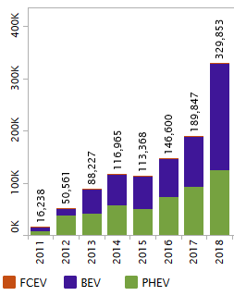
Introduction
Zero emission vehicles (ZEVs) and near-zero emission vehicles (NZEVs) have been advancing at a rapid pace.
  Technology maturity
  Lower costs
  Population growth
Many countries promote ZEVs and NZEVs as a key element in reducing greenhouse gas and pollutant emissions from transportation.
The majority of ZEVs and NZEVs on the roads today are battery electric vehicles (BEVs) and plug-in hybrid electric vehicles (PHEVs).
ZEV and NZEV sales in the U.S.
Source: Auto Alliance (2020)
Notes:
ZEVs and NZEVs have been advancing at a rapid pace over the last decade. Technology has matured enough to result in several vehicle products. Costs, especially that of battery, have come down considerably. These have then led to significant growth in ZEV population, especially electric vehicles (EVs).
The majority of ZEVs and NZEVs on the roads today are BEVs and PHEVs. Fuel cell electric vehicles (FCEVs), while commercially available, haven’t been adopted as widely as BEVs and PHEVs.

Slide 4
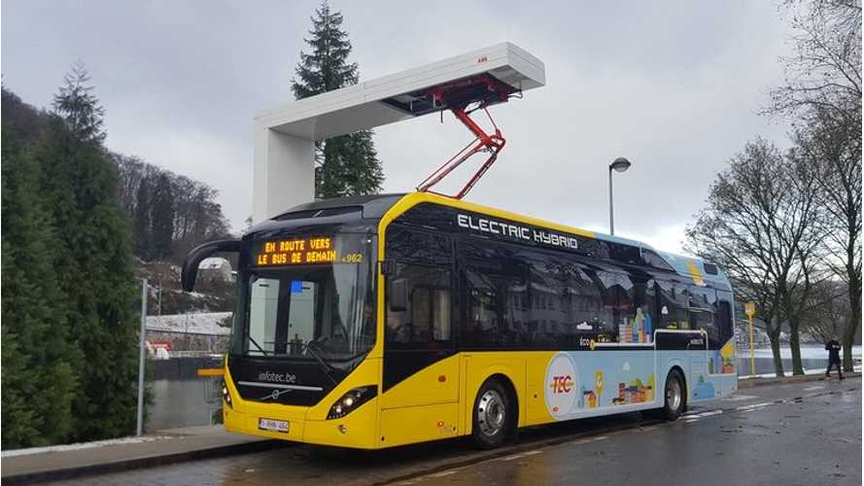

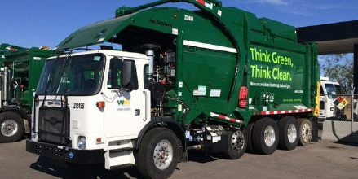
Zero and Near-Zero Emission Vehicles
 | Light-Duty Sector | Medium- and Heavy-Duty Sector
Zero emission vehicles | BEV FCEV | BEV FCEV
Near-zero emission vehicles | PHEV | PHEV NGV LPG vehicle
Plug-in hybrid electric bus
BEV - Battery electric vehicle
FCEV - Hydrogen fuel cell electric vehicle
PHEV - Plug-in hybrid electric vehicle
NGV - Natural gas vehicle
LPG - Propane
Propane school bus
Natural gas refuse truck
Notes:
There are multiple types of ZEVs and NZEVs. Most of them are EVs including BEV, FCEV, and PHEV.
People are more familiar with EVs, especially in the light-duty sector (e.g., Tesla Model 3, Nissan LEAF, Chevy Volt). It may be less known that non-EVs and have near-zero emission as well. These include NGV and LPG vehicles which, to date, have been used primarily in heavy-duty sector such as refuse trucks, transit buses, and school buses.
Nevertheless, this lecture is focused on EVs, especially BEVs, as they are widely available and commonly found on the roads today.

Slide 5
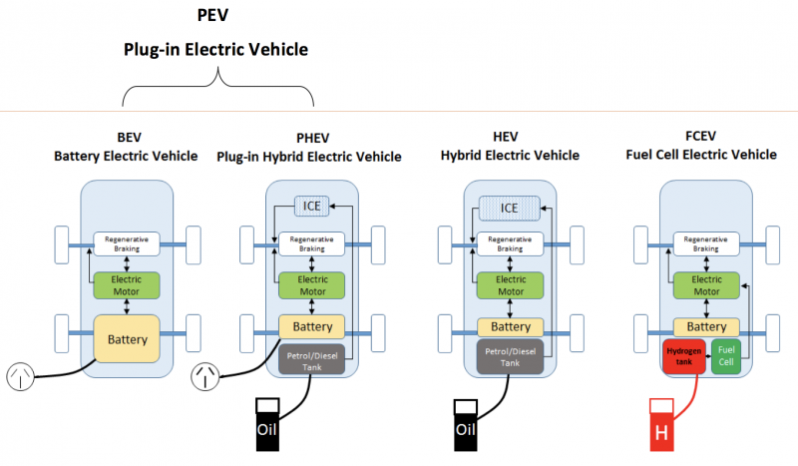
Different Types of EVs
Source: Adapted from Gaton (2018)
Notes:
BEV runs on electricity stored in the battery on the vehicle where the battery is charged by the electrical grid.
PHEV is similar to BEV, but it also has the traditional internal combustion engine (ICE). So, PHEV can run on the ICE like a regular vehicle when the battery runs out, but that means it will produce emissions during that time.
FCEV also runs on electricity, but the electricity comes from hydrogen stored on the vehicle that is converted by the fuel cell.

Slide 6
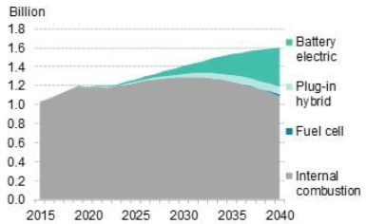
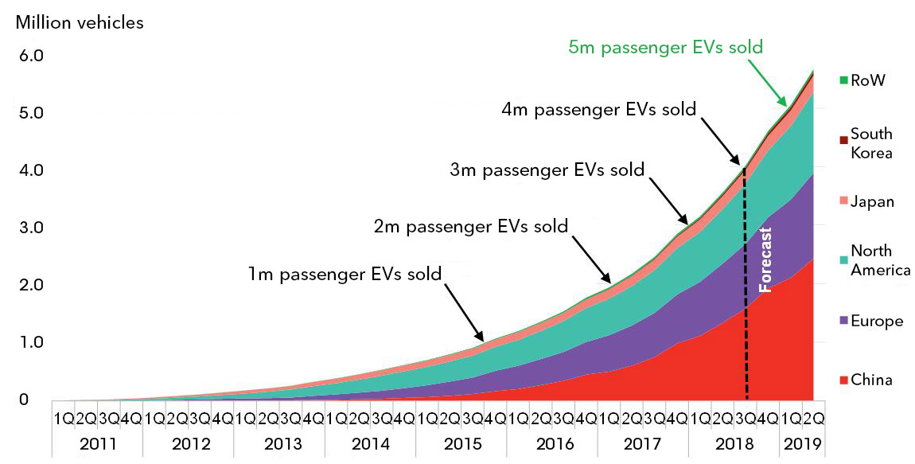
Trends of EV Population
Cumulative passenger EV sales globally have grown exponentially, surpassing 4 million in fall 2018.
Source: Bloomberg NEF (2020)
Global passenger EV fleet is forecast to reach 500 million by 2040, about 31% of the world’s passenger cars.
Source: Bloomberg NEF (2018)
Notes:
Cumulative passenger EV sales globally have grown exponentially, surpassing 4 million in fall 2018. While it took 60 months to reach the first million EV sales (in late 2015), it took the fourth million just six months. China is driving this trend where it accounts for 37% of all passenger EV sales in the world since 2011, and around 99% of e-buses.
Global passenger EV fleet is forecast to reach 500 million by 2040, accounting for about 31% of the world’s passenger cars. The increase in EV sales will be a result of a drop in purchasing price driven primarily by the lower costs of battery.

Slide 7
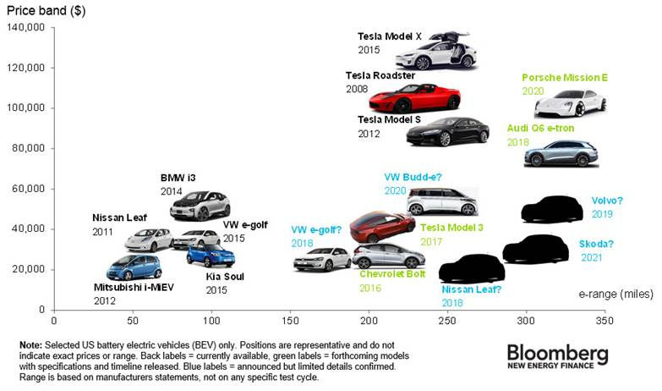
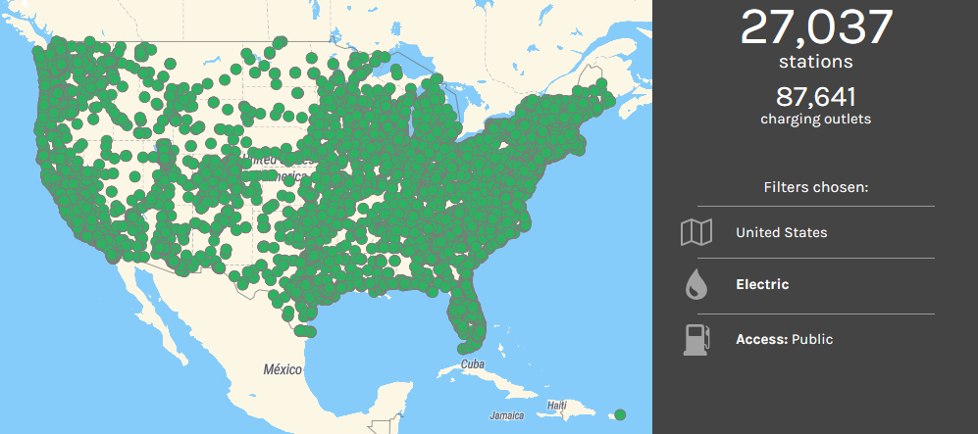
Key Barriers for EV Market Penetration
Cost
Driving range
Charging infrastructure
Charging time
Source: Roberts (2016)
These barriers for the light-duty sector have been gradually overcome over the last decade.
Source: U.S. Department of Energy (2020a)
Notes:
Key barriers for EV market penetration include:
High cost or price as compared to ICE counterpart
Short driving range, not sufficient for all types of trip
Limited availability of public charging infrastructure, preventing trips far away from home
Long charging time, requiring pre-planning of trips
However, these barriers for the light-duty sector have been gradually overcome over the last decade.
Now, there are multiple passenger EV models that have the range of 200+ miles and yet affordable.
Also, there are more than 27,000 public EV charging stations throughout the U.S.

Slide 8
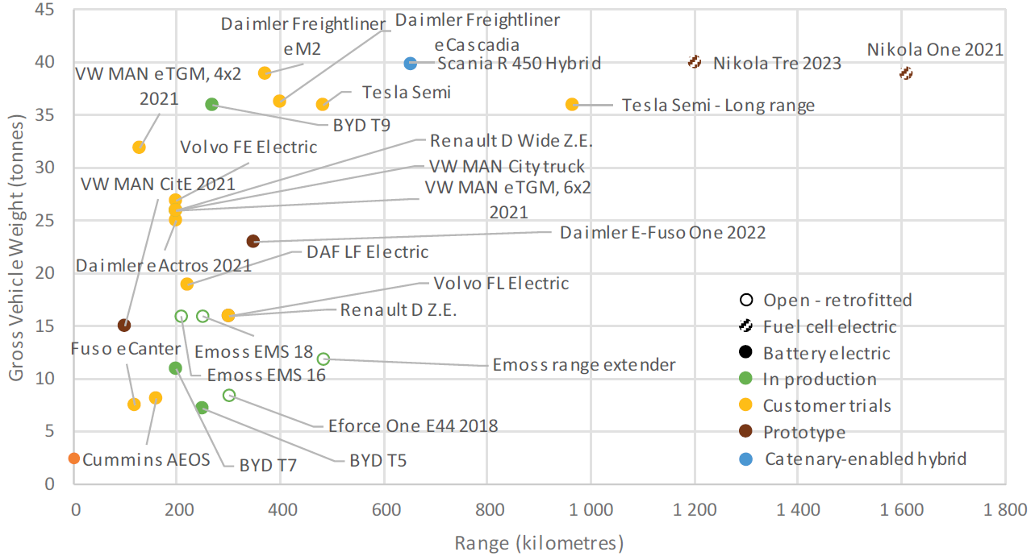
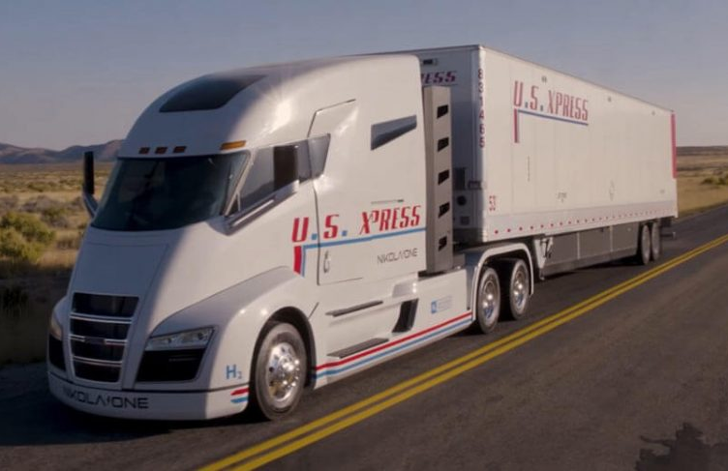
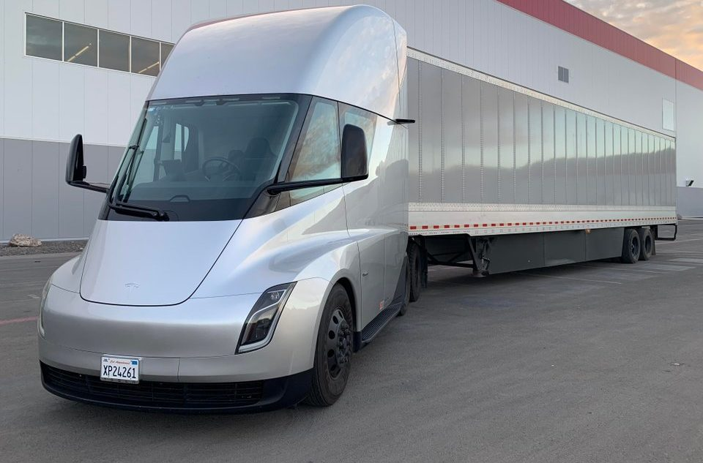
How about EV trucks?
Source: International Energy Agency (2019)
Notes:
EV trucks are in the early phase of overcoming the same barriers as what EV cars have gone through.

Slide 9
EV Adoption
EV cars
  Early adopters of EVs tend to be predominantly male, young, wealthy, and college-educated (Langbroek et al. 2017, Plotz et al., 2014).
  A survey of 1,094 people in San Francisco found that people with household income more than $200,000 are 7% and 13% more likely to adopt BEV and PHEV, respectively, compared to people with household income less than $75,000 (Spurlock et al., 2019).
EV trucks
  Early adopters are large fleets utilizing medium-duty EVs in applications such as package delivery, fixed route transit, school bus, and utility.
  There have also been demonstrations of heavy-duty EVs in short haul applications such as drayage and regional distribution.
Notes:
Adoption of passenger EVs has been increasing. There have been studies on the demographic characteristics of EV adopters. Some findings include:
Early adopters of EVs, at least in Sweden and Germany where the studied were conducted, tend to be predominantly male, young, wealthy, and college-educated.
And due to the higher prices of EVs as compared to their ICE counterparts, it’s not surprising that people with high household income are more likely to adopt EVs than people with lower household income.
For EV trucks:
Early adopters tend to be large fleets that have financial capacity to purchase and try new technologies. Examples include the use of medium-duty (Classes 3-6) EVs in applications such as package delivery, fixed route transit, school bus, and utility.
There have also been demonstrations of the use of heavy-duty (Classes 7-8) EVs in short haul applications such as drayage and regional distribution, which usually have limited daily mileage.

Slide 10
Examples of EV-related Policies and Programs
There are many EV-related policies and programs that can accelerate the adoption of EVs and the transition towards ZEVs.
Targets
  Global warming limits
  GHG emission targets
Regulations
  EV sales mandates for vehicle manufacturers
  EV purchase requirements for fleets
  Low emission zones
Incentives
  EV purchase incentives for individuals and fleets
  Carpool lane eligibility for EVs
Notes:
Targets
Global warming limits, e.g., the Paris agreement that limits global warming to well below 2°C
GHG emission targets, e.g., California’s SB 32 that requires the state to reduce its GHG emissions to 40% below 1990 levels by 2030
Regulations
EV sales mandates for vehicle manufacturers, e.g., California’s Advanced Clean Trucks regulation, requiring truck manufacturers to sell zero-emission trucks as an increasing percentage of their annual California sales starting from 2024 [https://ww2.arb.ca.gov/resources/fact-sheets/advanced-clean-trucks-fact-sheet]
EV purchase requirements for fleets, e.g., California’s Innovative Clean Transit regulation, requiring public transit agencies to gradually transition to 100 percent zero-emission bus fleets by 2040 [https://ww2.arb.ca.gov/news/california-transitioning-all-electric-public-bus-fleet-2040]
Low emission zones, e.g., allowing only low emission vehicles and cleaner to enter a specific zone or area.
Incentives
EV purchase incentives for individuals and fleets, e.g., California’s Clean Vehicle Rebate Project [https://cleanvehiclerebate.org/eng] and Hybrid and Zero-Emission Truck and Bus Voucher Incentive Project (HVIP) [https://www.californiahvip.org/]
Carpool lane eligibility for EVs, e.g., California’s permitting certain single-occupant EVs to use carpool lanes [https://www.dmv.ca.gov/portal/vehicle-registration/license-plates-decals-and-placards/clean-air-vehicle-decals-for-using-carpool-lanes/]

Slide 11
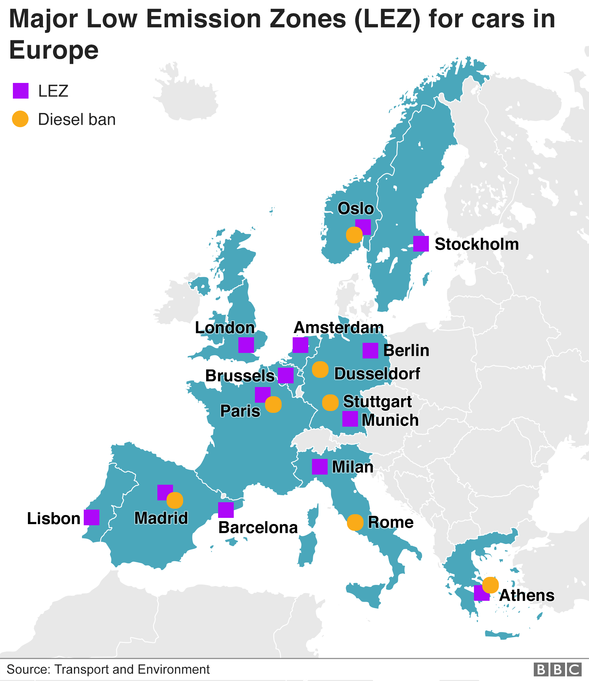
Low Emission Zones
LEZs around the world
  Europe → ~250 LEZs as of 2019
  Asia → Tokyo, Japan; Seoul, South Korea; Beijing, China, Hong Kong, Singapore
  Americas → Bogota, Columbia; Mexico City, Mexico
Current LEZs vary greatly by, e.g.,
  Area coverage
  Vehicle types restricted
  Required emission standards
  Time/day/month LEZ is in effect
  Entry fee and fine
  Enforcement
Source: McGrath (2019)
Notes:
While most of the EV-related policies and programs discussed in the previous slide are focused on reducing GHG emissions, LEZs are more concerned about improving air quality, especially in urban areas. Typically, vehicles with high emissions are not allowed to enter a LEZ or will have to pay a fee to enter. LEZs have been implemented around the world, but most notably in Europe where there are about 250 LEZs in different cities. These LEZs vary widely in many aspects such as geographic coverage, vehicle types restricted, required emission standards, period (time/day/month) when LEZ is in effect, entry fee and fine, enforcement, among others.

Slide 12
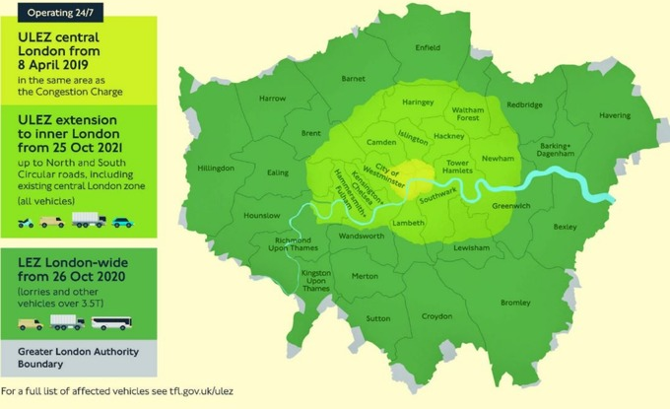
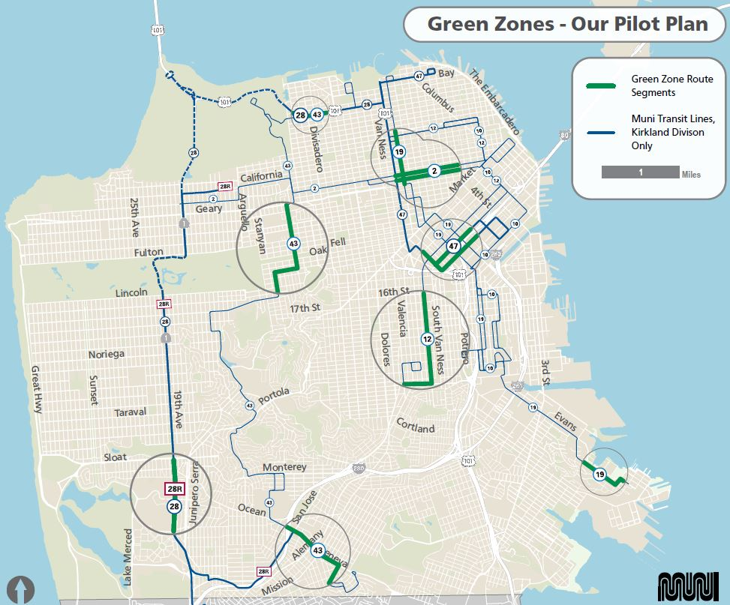
Ultra Low and Zero Emission Zones
Ultra Low Emission Zone in London
“Green Zones” in San Francisco
Source: Transport for London (2020)
Source: San Francisco Municipal Transportation Agency (2019)
Notes:
One of the largest LEZs in the world is the London LEZ, which has become increasingly stricter in terms of both emission requirements and vehicle types restricted. London turned part of its LEZ into Ultra Low Emission Zone (ULEZ) in April 2019.
There has also been interest in creating and implementing zero emission zones. For example, the San Francisco Municipal Transportation Agency (SFMTA) operates 68 hybrid diesel-electric buses that automatically switch to the electric-only mode as they enter “Green Zones” throughout the city of San Francisco. These geofenced zones include neighborhoods with high percentages of households with low incomes and people of color, and areas with poor air quality.

Slide 13
Environmental and Health Benefits of EVs
No tailpipe emission
  No exposure to pollutant emissions from tailpipe
  No carbon monoxide poisoning
No exposure to evaporative emissions in garage and at gas stations
Reduced noise pollution
Other benefits
  Energy efficiency – Higher energy conversion rate
  Performance – Faster acceleration and smoother ride
  Safety – Lower center of gravity, less likely to roll over
  Cost – Lower maintenance costs
  Energy independence – Electricity is a domestic energy source.
Notes:
No direct emission from EVs.
Leaving ICE vehicles on in closed space (e.g., garage) can result in heightened level of CO emission, which is odorless and colorless. This “CO poisoning” has led to several deaths in the U.S. [https://www.huffpost.com/entry/carbon-monoxide-poisoning-keyless-cars_n_5af9a863e4b044dfffb4774d]
Other benefits of EVs:
EVs have much higher energy conversion efficiency (77%) than gasoline vehicles (12-30%). [https://www.fueleconomy.gov/feg/evtech.shtml]

Slide 14
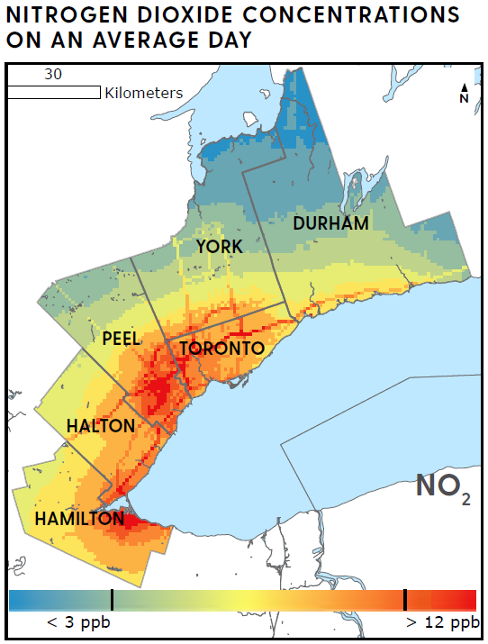
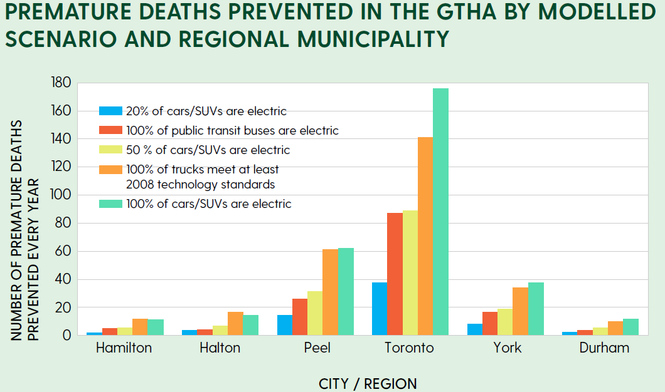
Case Study – Greater Toronto and Hamilton Area
Model traffic-related air pollution at high spatial resolution.
Estimate premature deaths prevented for various EV adoption scenarios.
Source: Environmental Defence and the Ontario Public, Health Association (2020)
Source: Environmental Defence and the Ontario Public, Health Association (2020)
Notes:
The study models traffic-related air pollution at high spatial resolution. The pollutants modeled include NO2 (nitrogen dioxide), PM2.5 (fine particulate matter), BC (black carbon, a significant portion of PM2.5 and mostly generated by diesel exhaust), and O3 (ozone). Then, estimate the exposure of the residents to these pollutants based on where they live, followed by the calculation of premature deaths prevented for various EV adoption scenarios.
The results show that a shift to electric cars and SUVs, electric public transit buses, and more efficient trucks in the study area would lead to cleaner air, save lives by improving respiratory and cardiovascular health, and provide billions in social benefits every year. The results show that each electric vehicle that replaces a gasoline-powered car would bring $9,850 in social benefits, which is far higher than the $5,000 purchase incentive per vehicle currently offered by the Canadian government.

Slide 15
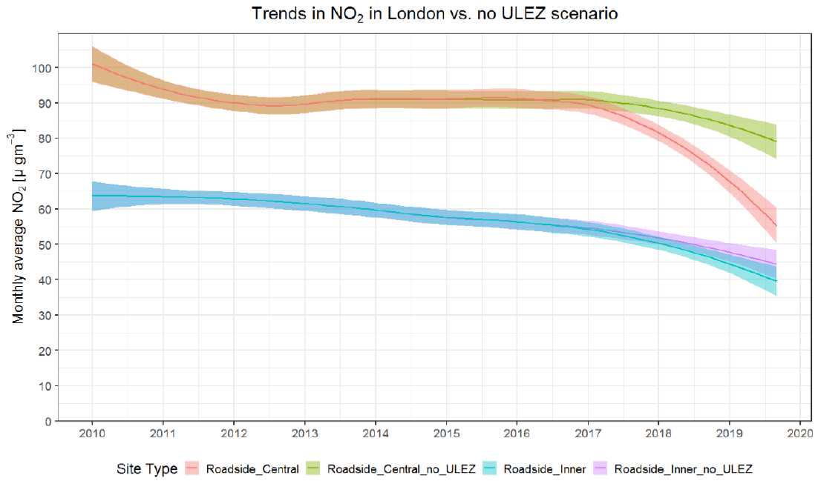
Case Study – London’s Ultra Low Emission Zone
Evaluation after six months (Greater London Authority, 2019) showed reductions in emissions from motor vehicles inside the zone.
  31% for NOx
  13% for PM2.5
  4% for CO2
The reduction in NOx emission also helped contribute to the drop in measured NO2 concentration by 29%.
Source: Greater London Authority (2019)

Slide 16
Potential Unintended Consequences
Emissions from electricity generation, depending on the sources
  Peaker plants
    Produce significant NOx emissions, especially during startups
    Impact local air quality and health of nearby communities
Unexpected increase in secondary pollutants
  Ozone
  Secondary particulate matter
Other considerations
  Safety issue for pedestrians and bicyclists due to EV’s lack of noise
  Battery recycling/disposal
Notes:
Again, while EVs do not produce direct emissions, their emissions footprint depends on how the electricity that powers them is generated. Also, utilities often have “peaker plant”, which is supplemental power plant that operates only when demand for power is high. Peaker plants usually run on natural gas, and not on renewable energy sources. While natural gas power plants are cleaner than coal-fired power plants, they still emit a significant amount NOx and other emissions, which impacts the nearby communities. For example, half of California’s natural gas power plants are concentrated in some of the most socioeconomically and environmentally disadvantaged communities in the state, and thus, these emissions harm communities that are already overburdened with pollution. [https://blog.ucsusa.org/mark-specht/natural-gas-power-plants-are-not-clean]
Reduced NOx emissions from increased adoption of EVs may initially cause unexpected increase in secondary pollutants such as ozone and secondary PM. Because of nonlinear production chemistry and titration of ozone, reduced NOx could result in ozone enhancement in urban areas, further increasing the atmospheric oxidizing capacity and facilitating secondary aerosol formation. [https://science.sciencemag.org/content/369/6504/702]
Early EVs used to cause unexpected safety issue because they were very quiet, making pedestrians and bicyclists unaware of their presence. Regulators in many countries now (or will) require EVs to generate warning sounds while traveling at low speed. [https://en.wikipedia.org/wiki/Electric_vehicle_warning_sounds]

Slide 17
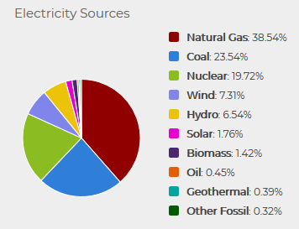
Emissions from Vehicles
Direct emissions
  Tailpipe emissions
  Evaporative emissions
  Break wear and tire wear emissions
Life-cycle (or “well-to-wheel”) emissions
  Also include emissions related to production, processing, distribution, use, and recycling/disposal of fuel and vehicle
  Depends on the mix of electricity generation sources
Electricity Source - U.S. Average
Source: U.S. Department of Energy (2020b)
Notes:
Direct emissions are emitted through the tailpipe, through evaporation from the fuel system and during the fueling process, and from break and tire wear. Direct emissions include smog-forming pollutants (such as nitrogen oxides), other pollutants harmful to human health, and greenhouse gases (GHGs), primarily carbon dioxide. All-electric vehicles produce zero direct emissions, which specifically helps improve air quality in urban areas. Plug-in hybrid electric vehicles (PHEVs), which have a gasoline engine in addition to an electric motor, produce evaporative emissions from the fuel system as well as tailpipe emissions when operating on gasoline. However, because most PHEVs are more efficient than comparable conventional vehicles, they still produce fewer tailpipe emissions even when relying on gasoline.
Life cycle emissions include all emissions related to fuel and vehicle production, processing, distribution, use, and recycling/disposal. For example, for a conventional gasoline vehicle, emissions are produced when petroleum is extracted from the ground, refined to gasoline, distributed to stations, and burned in vehicles. Like direct emissions, life cycle emissions include a variety of harmful pollutants and GHGs. All vehicles produce substantial life cycle emissions, and calculating them is complex. However, EVs typically produce fewer life cycle emissions than conventional vehicles because most emissions are lower for electricity generation than burning gasoline or diesel. The exact amount of these emissions depends on your electricity mix, which varies by geographic location.

Slide 18
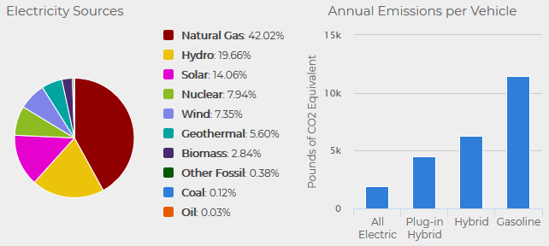
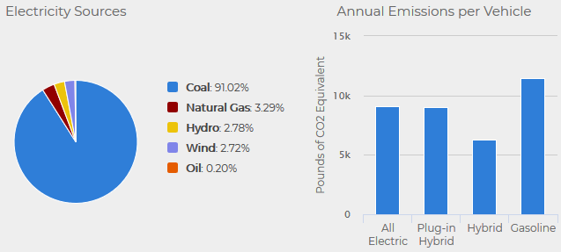
Electricity Sources and Life-Cycle Emissions
California
Source: U.S. Department of Energy (2020b)
West Virginia
Source: U.S. Department of Energy (2020b)
Notes:
This slide shows examples of how electricity mix could significantly impact the life-cycle emissions of EVs.
In California, more than half of the electricity is generated from renewable sources. Thus, EVs in the state have low life-cycle CO2 emissions.
On the other hand, in West Virginia almost 95% of the electricity is generated from fossil fuels (coal and natural gas) . Thus, EVs in the state have relatively higher life-cycle CO2 emissions.
An EV in West Virginia produces 4 times as much life-cycle CO2 emissions as the same EV in California.

Slide 19
Discussion
EVs, especially BEVs and PHEVs, make up the majority of ZEVs and NZEVs.
EV population are growing fast, as spurred by a variety of EV-related incentives and regulations.
EV cars have gradually overcome market barriers over the last decade while EV trucks are currently going through that phase.
EVs can help solve energy, climate, environmental, and health problems, but not congestion problem.
EVs need clean electricity from renewable sources to minimize their life-cycle emissions.
Notes:
EVs, especially BEVs and PHEVs, make up the majority of ZEVs and NZEVs on the road today.
While FCEVs are commercially available, they have not gained the same level of market acceptance and wide adoption as BEVs and PHEVs.
The trend is expected to continued in the next few decades.
EV population are growing fast, as spurred by a variety of EV-related incentives and regulations.
EV population has been increasing exponentially as the costs, especially that of the batteries, have come down. It is forecast that EVs will account for 31% of the world’s passenger cars by 2040.
The substantial growth in EV population is driven by EV-related incentives and regulations at the national, regional, and local levels in many parts of the world.
EV cars have gradually overcome market barriers over the last decade while EV trucks are currently going through that phase.
After taking decades to overcome key market barriers, EV cars now have respectable range while also being affordable. Also, there are now a large number of public EV charging stations throughout the U.S., many of which are fast chargers. These developments have helped fuel the growth of EV adoption.
EV trucks are overcoming the same market barriers at the moment.
EVs can help solve energy, climate, environmental, and health problems, but not congestion problem.
- EVs can help solve many of the pressing energy, climate, environmental, and health problems. But even if all the vehicles on the roads today turn into EVs, the traffic congestion problem won’t go away.
EVs need clean electricity from renewable sources to minimize their life-cycle emissions, as shown in the examples in the previous slide.

Slide 20
Research Gaps and Future Directions
ZEVs and refueling infrastructure in medium- and heavy-duty sector
  Technical viability, operational feasibility, economic workability
  Fleet adoption and market penetration
  Suitable ZEV technologies for different applications and duty cycles
  Impact on electricity demand and supply (e.g., electrical grid)
Life-cycle assessment of ZEVs
  Going beyond GHG emissions to also include pollutant emissions
  Going beyond emissions to also consider public health and welfare
Air quality and health benefits of ZEV adoption
  Validation through real-world measurements
  Impact on secondary pollutants in intermediate term
Notes:
ZEVs and refueling infrastructure in medium- and heavy-duty sector
Technical viability, operational feasibility, economic workability
Fleet adoption and market penetration → Who are potential early adopters?
Suitable ZEV technologies for different applications and duty cycles → Trucks are use in many applications with different duty cycles. Which ZEV technology is most appropriate for each application?
Impact on electricity demand and supply (e.g., electrical grid) → If EV trucks are widely adopted, how much electricity will be needed? How would the grid handle the increased demand?
Life-cycle assessment of ZEVs
Going beyond GHG emissions to also include pollutant emissions
Going beyond emissions to also consider public health and welfare
Air quality and health benefits of ZEV adoption
Validation through real-world measurements
Impact on secondary pollutants in intermediate term → Would adoption of EVs initially increase O3 and secondary PM2.5? What’s the level of EV market penetration needed to overcome this potential unintended consequence?

Slide 21
Take-Home Messages
EV population are growing fast.
  They will account for a large portion of vehicle population in the near future.
EV cars have gradually overcome market barriers over the last decade.
  EV trucks are currently going through that phase.
EVs have many environmental, health, and several other benefits.
  There are a few potential unintended consequences that should be considered.
EVs need clean electricity from renewable sources.
  To minimize life-cycle emissions

Slide 22
List of Abbreviations
BEV – Battery electric vehicle
CO2 – Carbon dioxide
EV – Electric vehicle
FCEV – Fuel cell electric vehicle
GHG – Greenhouse gas
NO2 – Nitrogen dioxide
NOx – Nitrogen oxides
NZEV – Near-zero emission vehicle
LEZ – Low emission zone
LPG – Propane
NGV – Natural gas vehicle
PHEV – Plug-in hybrid electric vehicle
PM2.5 – Fine particulate matter
ZEV – Zero emission vehicle

Slide 23
References
Auto Alliance, 2020. Advanced technology vehicle sales dashboard. https://autoalliance.org/energy-environment/advanced-technology-vehicle-sales-dashboard/.
Bloomberg NEF, 2018. Cumulative global EV sales hit 4 million. August 30, https://about.bnef.com/blog/cumulative-global-ev-sales-hit-4-million/.
Bloomberg NEF, 2020. Electric vehicle outlook 2020: Executive summary. August 30, https://bnef.turtl.co/story/evo-2020/?teaser=yes.
Gaton, B., 2018. The ICE age is over: Why battery cars will beat hybrids and fuel cells. November 14, https://thedriven.io/2018/11/14/the-ice-age-is-over-why-battery-cars-will-beat-hybrids-and-fuel-cells/.
International Energy Agency, 2019. Global EV outlook 2019. May, https://www.iea.org/reports/global-ev-outlook-2019.
Environmental Defence and the Ontario Public Health Association, 2020. Clearing the Air: How electric vehicles and cleaner trucks can reduce pollution, improve health and save lives in the Greater Toronto and Hamilton Area, Stakeholder report, June.
Greater London Authority, 2019. Central London Ultra Low Emission Zone – Six Month Report. October, https://www.london.gov.uk/sites/default/files/ulez_six_month_evaluation_report_final_oct.pdf.
Langbroek, J. H., Franklin, J. P., & Susilo, Y. O., 2017. Electric vehicle users and their travel patterns in Greater Stockholm. Transportation Research Part D: Transport and Environment, 52, 98-111.

Slide 24
References (continued)
McGrath, M., 2019. ULEZ: How does London's new emissions zone compare? April 8, https://www.bbc.com/news/science-environment-47816360.
Plötz, P., Schneider, U., Globisch, J., & Dütschke, E., 2014. Who will buy electric vehicles? Identifying early adopters in Germany. Transportation Research Part A: Policy and Practice, 67, 96-109.
Roberts, D., 2016. The electric cars available today, how much they cost, and how far they go — in one chart. September 23, https://www.vox.com/energy-and-environment/2016/9/23/13018294/electric-cars-price-range-one-chart.
San Francisco Municipal Transportation Agency, 2019. Nothin’ but a G thing, well actually a GZ thing. October 4, https://www.sfmta.com/blog/nothin-g-thing-well-actually-gz-thing.
Spurlock, C. A., Sears, J., Wong-Parodi, G., Walker, V., Jin, L., Taylor, M., Duvall, A., Gopal, A., and Todd, A., 2019. Describing the users: Understanding adoption of and interest in shared, electrified, and automated transportation in the San Francisco Bay Area. Transportation Research Part D: Transport and Environment, 71, 283-301.
Transport for London, 2020. ULEZ: Where and when. https://tfl.gov.uk/modes/driving/ultra-low-emission-zone/ulez-where-and-when.
U.S. Department of Energy, 2020a. Alternative fueling station locator. https://afdc.energy.gov/stations#/analyze?show_map=true&country=US&fuel=ELEC&ev_levels=all.
U.S. Department of Energy, 2020b. Emissions from hybrid and plug-in electric vehicles. https://afdc.energy.gov/vehicles/electric_emissions.html.

Slide 25
Reading List
Buekers, J., Holderbeke, M. V., Bierkens, J., and Panis, L. I., 2014. Health and environmental benefits related to electric vehicle introduction in EU countries. Transportation Research Part D, 33, 26-38.
Gladstein, Neandross, & Associates, 2020. The state of sustainable fleet 2020. August, www.StateofSustainableFleets.com.
House, M. L. and Wright, D. J., 2019. Using the health benefits of electric vehicles to justify charging infrastructure incentives. International Journal of Electric and Hybrid Vehicles, 11(2), 85 – 105.
Nealer, R., Reichmuth, D., and Anair, D., 2015. Cleaner cars from cradle to grave: How electric cars beat gasoline cars on lifetime global warming emissions. November, Union of Concerned Scientist.
Nopmongcol, U., Grant, J., Knipping, E., Alexander, M., Schurhoff, R., Young, D., Jung, J., Shah, T., and Yarwood, G., 2017. Air quality impacts of electrifying vehicles and equipment across the United States. Environmental science & technology, 51(5), 2830-2837.
Tanvir, S., Hao, P., and Boriboonsomsin, K., 2020. Emerging transportation technologies and implications for traffic-related emissions, air pollution exposure, and health. Traffic-Related Air Pollution, ISBN 978-0-12-818122-5, Elsevier, H. Khreis, M. J. Nieuwenhuijsen, J. Zietsman, and T. Ramani (Eds.), 511-530.
Tessum, C. W., Hill, J. D., and Marshall, J. D., 2014. Life cycle air quality impacts of conventional and alternative light-duty transportation in the United States. Proceedings of the National Academy of Sciences, 111(52), 18490-18495.

