Slide 1
www.carteeh.org

Slide 2
Lecture #58: Implications to Environmental Justice and Health Equity
Haneen Khreis
Texas A&M Transportation Institute
H-Khreis@tti.tamu.edu, (979) 317-2799 x42799
The author declares that there is no conflict of interest
Lecture Track(s): HT/TT/PPT
Notes:
Health Track (HT)—mainly targeted at urban planners, transportation planners, and engineers with limited knowledge of public health-related concepts;
Transportation Track (TT)—mainly targeted at environmental epidemiologists and public health professionals with limited knowledge of transportation-related concepts; and;
Planning and Policy Track (PPT)—mainly targeted at planners, civil servants, and policy and decision makers with particular interest in the science-policy link.

Slide 3
Introduction
Environmental justice is a public policy goal which aims to ensure that the adverse environmental and health impacts of government activities and policies do not fall disproportionally on certain segments of the society (Forkenbrock and Schweitzer, 1999)
The segments of society who usually bear the highest burden are lower socio-economic status populations (e.g. low income populations) and ethnic minorities (e.g. black or Hispanic populations in the US, South Asian in England etc.)
Environmental justice goals trace back to historic movements which emerged from multiple struggles such as the US Civil Rights actions, anti-toxins campaigns, labor movements, Native American land rights, and traditional environmentalism (Fuller and Brugge, 2020)
Environmental injustice has been a key feature of many transportation planning and policy practices across the world and an ongoing issue (Khreis and Nieuwenhuijsen, 2019; Fuller and Brugge, 2020)
Notes:
Extracted from Fuller and Brugge (2020):
“The environmental justice (EJ) movement is broad and diverse, involving people from a variety of backgrounds across the globe. EJ has no single figurehead, but instead its principles are moved forward by a network of grassroots activists and supporters. The movement emerged from multiple struggles including U.S. Civil Rights, anti-toxics, labor, Native American and traditional environmentalism. The Civil Rights movement, in particular, played a significant role, because inequalities in areas of civil life such as basic rights, healthcare, discrimination, segregation also extend into the environmental realm. Communities of color, in particular, as well as poor and immigrant neighborhoods continue to be targeted for the placement of industrial facilities such as chemical plants, oil refineries and hazardous waste landfills. Many thriving communities have been razed or divided to make way for highways and transportation hubs. The focus of EJ groups has been to address chemical exposures and disease risks as well as maintain and restore natural ecosystems; as compared to mainstream, largely white, environmental organizations that have traditionally focused more narrowly on the care and conservation of natural ecosystems.”

Slide 4
Introduction
Multiple adverse environmental exposures, and therefore their associated health impacts, related to transportation planning and policy are not equally distributed across populations:
Low- and middle-income countries account for >90% of the world’s roads fatalities from motor vehicle crashes, despite only having 48% of the world’s registered vehicles (World Health Organization, 2009)
Resources for physical activity including parks, walking and biking trails vary by neighborhood socioeconomic status: fewer options for the more deprived
Traffic-related air pollution is generally higher in lower socioeconomic status and ethnic minority neighborhoods (Casey et al., 2017)
Neighborhoods with higher poverty rates and proportions of black, Hispanic and Asian residents have higher noise levels than other neighborhoods
The distribution of, and access to, public green spaces can be differential by socioeconomic status: those with resources can move to greener areas (Khreis and Nieuwenhuijsen, 2019)
Notes:
Adopted from Khreis and Nieuwenhuijsen (2019):
“Many transportation-related exposures and lifestyles, and their associated health impacts, are not equally distributed amongst population groups
Perhaps the most prominent factors that determine the distribution of these exposures/lifestyles and their associated health impacts are age, income and race
These exposures-health inequities further contribute to well-established and gross health inequities that reflect social inequalities (Centers of Disease Control and Prevention 2011)
They further impact the most deprived groups disproportionality, not only because these groups are often more exposed, but also because these groups exhibit a variety of other factors which make them more vulnerable to their adverse environmental exposures (for example, poor diet, suboptimal health care, stress, violence, different height and metabolism)
The unequal distribution of health impacts, as determined by age, race or economic status, has been documented at different geographical levels ranging from country to neighborhood level
Low-income and middle-income countries, where motorization started later and where investments in road safety campaigns, safe infrastructure and road safety technologies are generally less, account for over 90% of the world’s roads fatalities, despite only having 48% of the world’s registered vehicles. The number of road deaths per 100,000 population in low-income countries is now at a level of 24, comparable to the level in developed countries such as The Netherlands in the 1970s. Although there is a high variability between different regions, motor vehicle crashes rates remain highest for motorbike commuters and active travel commuters (pedestrians and cyclists), followed by public transport commuters and finally car commuters. For example, half of the world’s road traffic deaths occur among motorcyclists, pedestrians and cyclists, with 31% of deaths among car occupants (remaining percentage is unspecified)
Physical inactivity and subsequently its associated health impacts may be disproportionately distributed according to socioeconomic factors. There is evidence that available resources for physical activity participation including parks, walking and biking trails vary by neighborhood socioeconomic status with the pattern of fewer options for the more deprived. Also, high socioeconomic groups appear to engage in more leisure-time physical activity
In addition, traffic-related air pollution is often disproportionately distributed amongst socioeconomic and vulnerable groups including children, low-income groups and minorities, as their schools and residences are often located in high traffic exposure areas, although some recent studies show a more mixed picture (Temam et al., 2017; Khreis et al., 2020)
Race has also been shown as an important factor linked to exposure and health disparities, especially in the United States. A recent study estimating annual average NO2 concentrations for the contiguous United States demonstrated that disparities in air pollution exposure were larger by race-ethnicity, than by income. On average, estimated NO2 concentrations remained 37% higher for non-whites than whites in 2010, which showed no progress compared to year 2000 (Clark et al. 2017)
Another pioneer United States national-level study paired information about the geographic locations and demographics of 84,969 public schools with air neurotoxicant exposure estimates pertaining to 24 known neurotoxicants. The study found that students attending “high risk” public schools nationwide (in the top 10% most burdened by air neurotoxicant exposures) were significantly more likely to be eligible for free/reduced price meals, and to be Hispanic, black, or Asian/Pacific Islander than white or another race. The study also showed that schools serving the youngest students (for example, pre-kindergarten) have greater risks than schools serving older students (Grineski and Collins, 2018)
Similarly, studies indicated that low-income individuals and visible minorities also tend to be located in areas most polluted by road traffic noise. Other exposures follow the same trend. The distribution of (access to) public green spaces can be differential by socioeconomic status in favor with those with resources to move to greener areas. Often, low-income groups and ethnic minorities are least able to relocate to protect themselves and little is done to mitigate the adverse impacts and protect vulnerable groups”

Slide 5
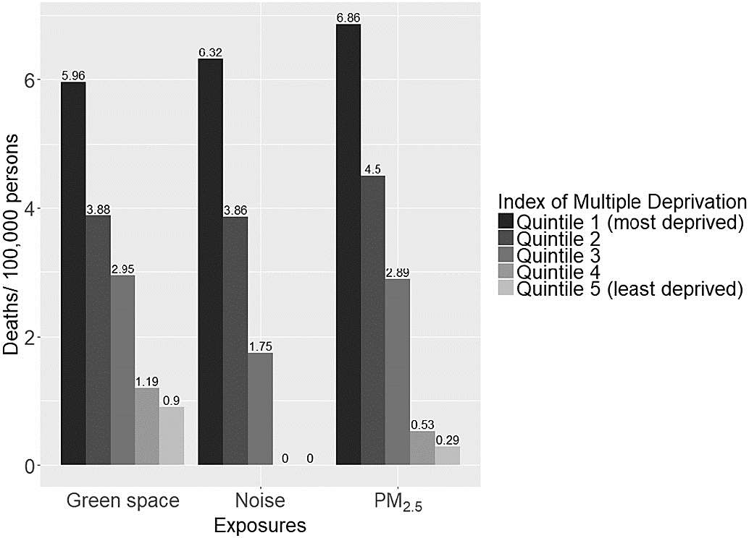
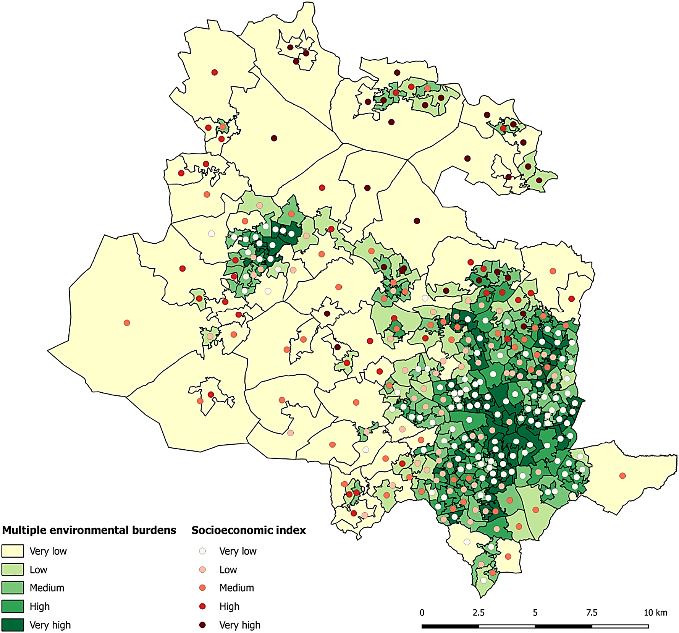
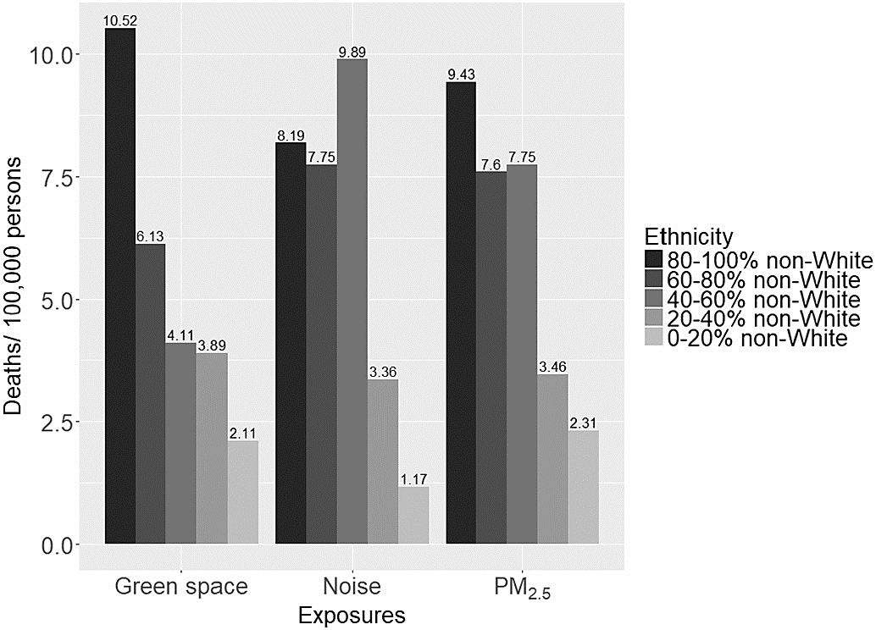
Introduction
Source (for three figures): Mueller et al. (2018)
Notes:
This example shows the distribution of attributable premature mortality due to multiple risk factors in Bradford, a deprived and multi-ethnic city in the North of England. This analysis showed that the distribution of adverse environmental exposures, all related to transportation planning and policy, is inequitable, where adverse exposures are concentrated in the more deprived and ethnic minority (South Asian) areas of the city.
The image on the left shows a multiple environmental burdens index overlaid by a socioeconomic status index. The multiple environmental burdens index was built by using the quintile distribution of the environmental exposures (air pollution, noise, green space). The sum of the quintiles represent the different cutoffs. The national Index of Multiple Deprivation (IMD) rank quintiles were used to define the cutoffs for the socioeconomic position (SEP) index.
The image on the top right shows the standardized mortality impacts by Lower Super Output Area (LSOA)-level deprivation score. The image on the bottom right shows the standardized mortality impacts by LSOA-level ethnicity.
Stratified analyses by SEP showed that residents of more deprived and more ethnically-diverse LSOAs were at higher risk for adverse environmental exposures and mortality with:
6–7 expected deaths/100,000 persons for the most deprived versus 0–1 expected deaths/100,000 persons for the least deprived across the environmental exposures (i.e. air pollution, noise, green space)
8–11 expected deaths/100,000 persons in LSOAs with the highest proportion of non-White residents versus 1–2 expected deaths/100,000 persons in LSOAs with the lowest proportion of non-White residents across the three environmental exposures (Mueller et al., 2018)

Slide 6
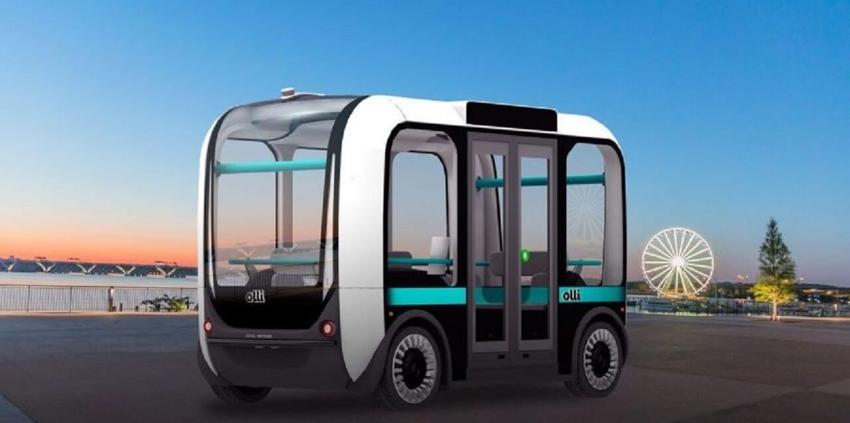
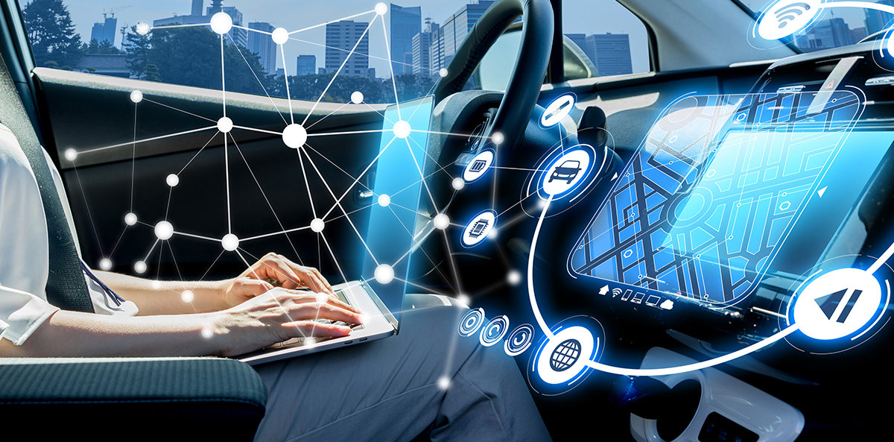
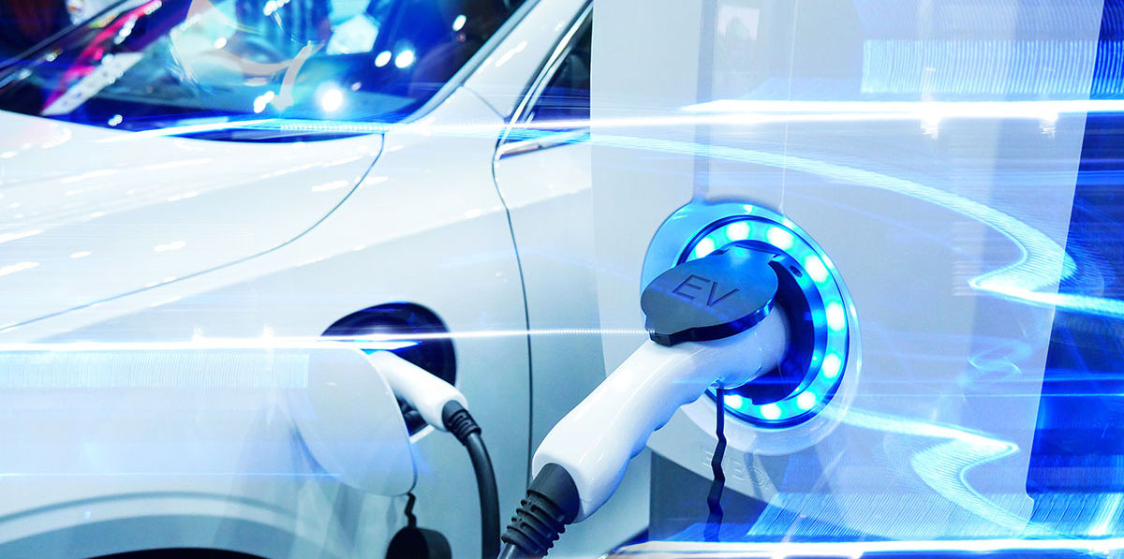
Technology and potential environmental justice impacts
Image 1
The transportation sector is going through many technological advancements with emerging technologies and disruptors
Some of the key technologies which are more discussed recently are autonomous, connected and electric vehicles (“zero-emission vehicles”), and near-zero emission passenger and freight vehicles, drones, delivery robots, 3-D printing and others (Khreis et al., 2019b)
These technologies have potential to change the magnitude and distribution of transportation-related exposures, such as vehicles crashes, air pollution and noise, with impacts on environmental justice and health equity
These discussions are in their infancy
Image 2
Image 3
Notes:
Source of image 1: https://www.3dprintingtoday.com/local-motors-ollie-minibus-printed-with-a-3d-printer-and-wants-to-revolutionize-transportation/
Source of image 2: https://www.cio.com/article/3294207/how-singapore-is-driving-the-development-of-autonomous-vehicles.html
Source of image 3: https://physicsworld.com/a/an-electric-car-future/

Slide 7
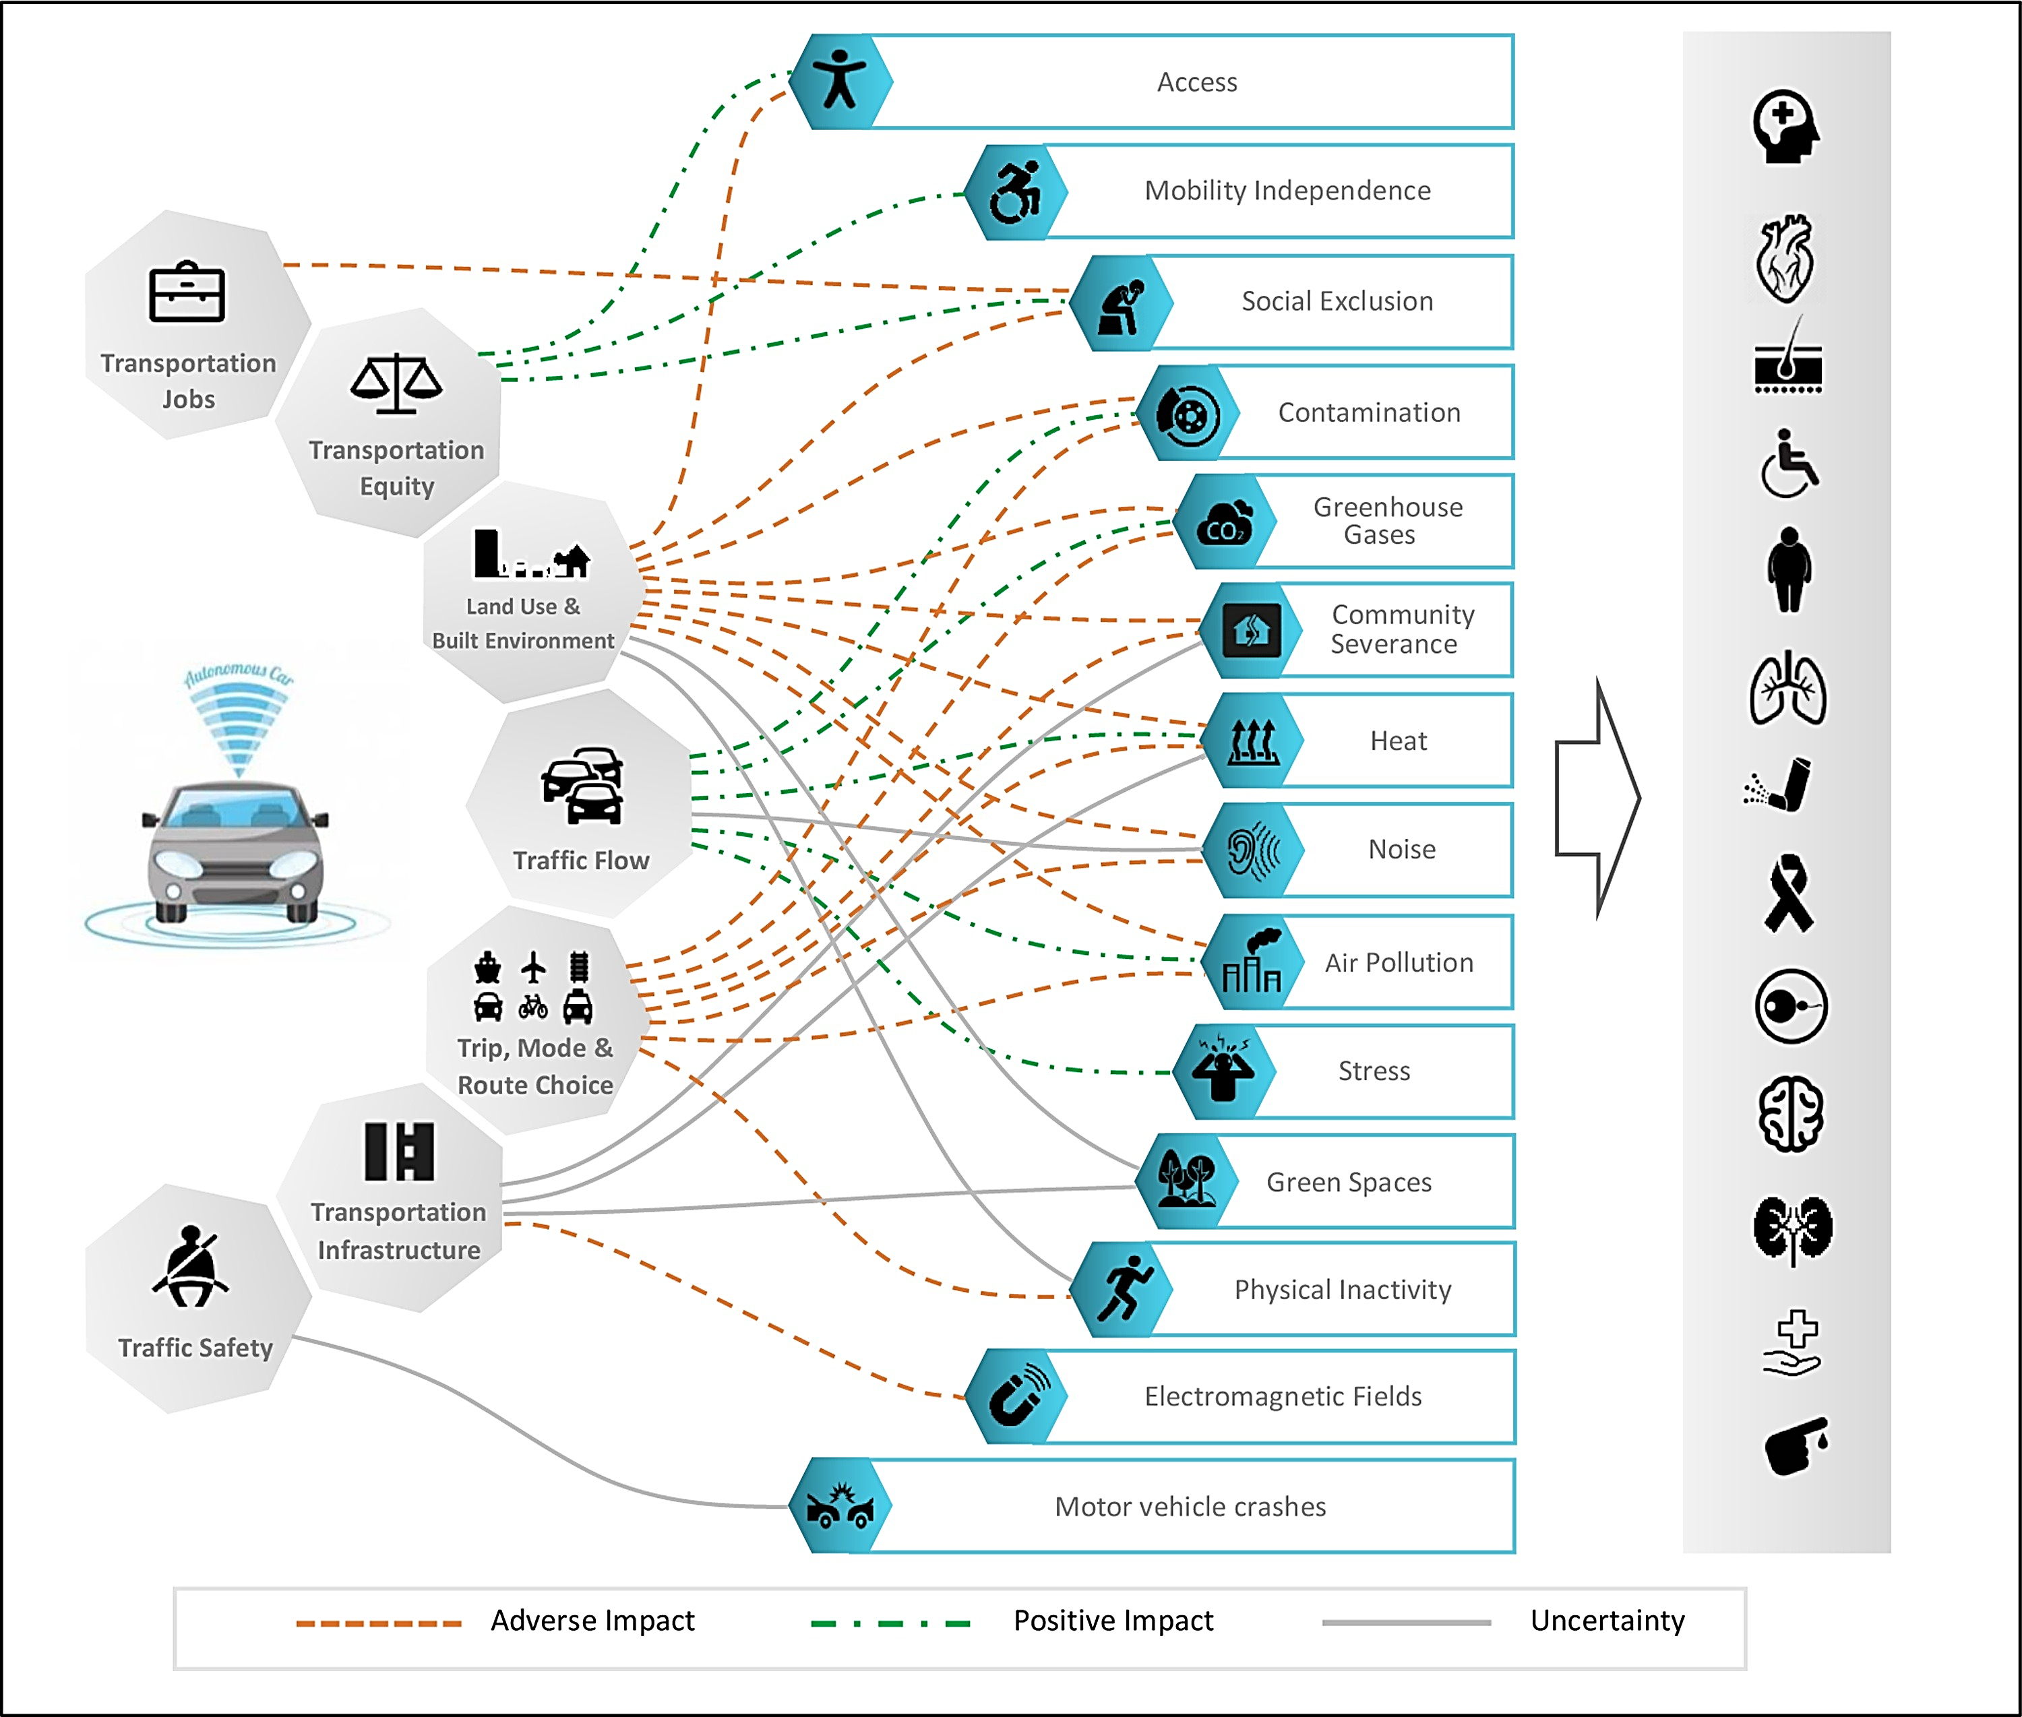
Environmental justice and health equity considerations of connected and automated vehicles
Autonomous vehicles (AVs) were associated with public health through 32 pathways (Sohrabi et al., 2020)
The impacts through any of these pathways is likely to be unequally distributed amongst populations
However, this is not well discussed or researched in the literature
Adaptation is also likely to differ by socioeconomics and demographics
Notes:
The below text is extracted from Sohrabi et al. (2020):
“The identified pathways (which link AVs to human health) are illustrated in the figure above and are briefly described next. The pathways are categorized into three groups, adverse, positive, and uncertain impacts, based on the direction of the effects. The potential contribution of AVs to job losses is associated with social exclusion and, consequently, mental diseases and increases in premature mortality. The potential constructive role of AVs in increasing equity in transportation is linked to higher levels of accessibility to healthy food and health care, mobility independence, and social inclusion. Urban sprawl and its consequences after AVs’ deployment can restrict accessibility and social inclusion and increase community severance. An increase in VMT is expected after urban sprawl, which may lead to a higher level of traffic-related noise, heat, GHG, air pollution, and contamination. While urban sprawl hinders active transportation, the possible reduction in parking demand may free up spaces in dense urban areas that can enhance active transportation-friendly urban design. Changes in land use will affect the amount and distribution of green spaces in urban areas, but the nature of this effect remains unclear. Smoother traffic flow can reduce heat, GHG, air pollution, and contamination. While traffic noise may be reduced by less acceleration and deceleration of AVs, the expected rise in flow speeds can increase overall noise emissions (WHO, 2018a). The stress attributable to driving and traffic congestion can also be mitigated in an automated system. The potential of AVs in encouraging public transit and active transportation users to switch to private cars will increase the total VMT in the system, which will result in higher levels of noise, heat, GHG, air pollution, and contamination. Also, the modal shift from active transportation to motorized vehicle transportation can reduce physical activity. In addition, increases in the number of cars on the roads may exacerbate community severance. Depending on the nature and magnitude of changes in transportation demand and modal shift after the implementation of AVs, the demand for transportation infrastructure will change. Transportation infrastructure is known as a source of urban heat, it contributes to community severance, and it occupies the green spaces in an urban area. In addition, the required equipment for AVs is a source of EMFs, which in case EMFs affect human health, the impact is more likely to be negative than positive. Finally, the potential of AVs to improve traffic safety may significantly contribute to public health by reducing morbidity and mortality from motor vehicle crashes. However, the possibilities of system operation failure, malfunctioning error, cybersecurity, safety overconfidence of passengers, and vehicle performance during unavoidable crashes need to be addressed to maximize the safety benefits of AVs.”

Slide 8
Environmental justice and health equity considerations of connected and automated vehicles
Some of the potential environmental justice and health equity implications of AVs are as follows:
Potential positive impacts include increasing accessibility to healthy food, health care, education, jobs, increasing mobility independence, and social inclusion, especially for previously excluded segments of the society like those with disabilities (e.g. physical, mental, visual), rural populations, the elderly and younger kids who cannot or do not want to drive or own a car, other non-licensed users
Potential negative impacts include a reduction or elimination of transportation jobs (e.g. taxi and truck drivers, public and on-demand transportation drivers, insurance appraisers, postal service mail carriers, police and sheriff's patrol officers, etc.). This may lead to social exclusion with adverse impacts on mental health, health care access, obesity and others
Negative impacts also include disrupting public transportation services by causing a modal shifts to AVs and removing affordable public transportation options
Notes:
The environmental justice and health equity implications of autonomous vehicles are not well researched in the literature and many of them are speculative as this technology is not yet widely adapted and therefore real-world data is missing
Some of the potential implications for environmental justice and health equity are overviewed above but this list is not exhaustive and has not been derived in a systematic manner
The impacts can be positive or negative and are likely to affect different segments of the society differently
Possible disruptive impacts on public transportation should be considered an equity issue owing to the impacts on the transit-dependent population
Extracted from Rojas-Rueda (2020): “For some population groups, driving is not a feasible option. Barriers to driving include the cost of full-time car ownership, the cost of learning to drive, difficulties with licensing, or factors related to health, disability, or age. For those affected communities, the difficulty in accessing transportation contributes to socioeconomic disadvantage. Some equity priorities in transportation are related to transportation costs, access to destinations, services (such as health services), and employment. A recent study modeled the equity impact of AVs in terms of job accessibility in Washington, DC. The study found that in all the scenarios modeled, AVs increased job accessibility, especially in more disadvantaged populations and in scenarios using ridesharing shared AVs. Two main recommendations to support social equity for AVs are (a) to engage and include disadvantaged communities in transportation planning, especially regarding shared AVs; and (b) to reduce barriers to using shared AVs, including financial, technological, language, and cultural barriers. In addition to these recommendations, a 2018 report related to the impact of AV on US workers found that the introduction of autonomous cars and trucks could directly eliminate 1.3–2.3 million workers’ jobs over the next 30 years; this issue also needs to be considered in terms of workers’ health.”

Slide 9
Environmental justice and health equity considerations of connected and automated vehicles
Some of the potential environmental justice and health equity implications of AVs are as follows:
The impact that AVs might have on environmental exposures like air pollution, greenhouse gases, noise and heat is yet unknown with speculations that these exposures could increase due to increases in vehicle miles traveled (VMT) and/or urban sprawl
The changes in distribution of these exposures after AVs adaptation is also unknown but there is speculation that disadvantaged communities may be more impacted (Cohen et al., 2017)
AVs might result in higher rates of bike and pedestrian collisions in disadvantaged communities (Cohen et al., 2017)
There is a gap in research on the potential distribution of impacts across population groups, with equity considerations absent from most literature (Cohn et al., 2019)

Slide 10
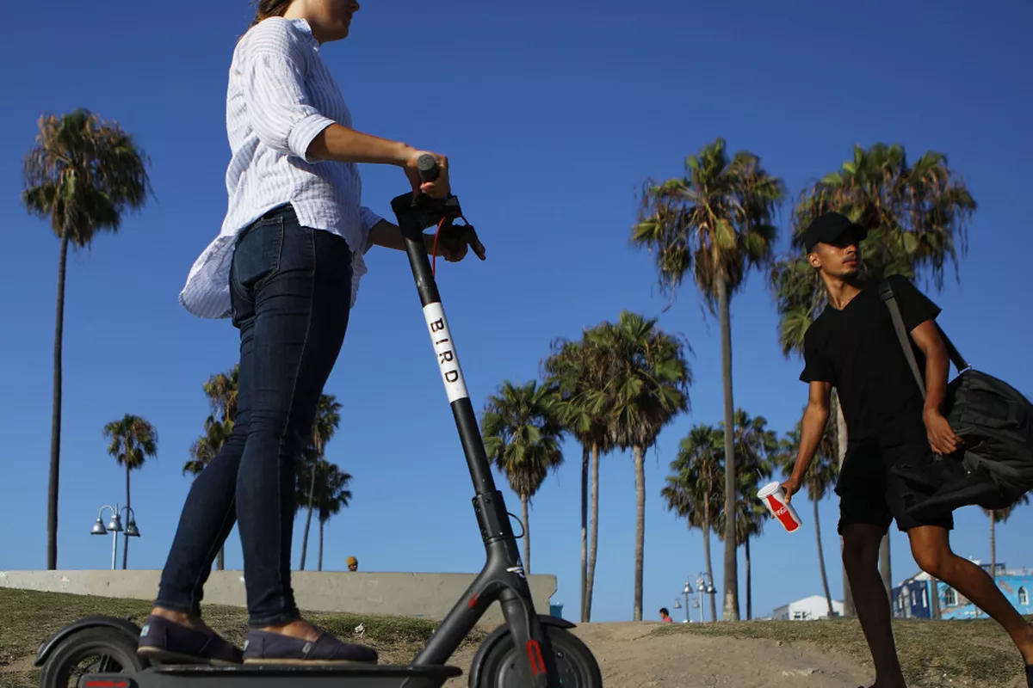
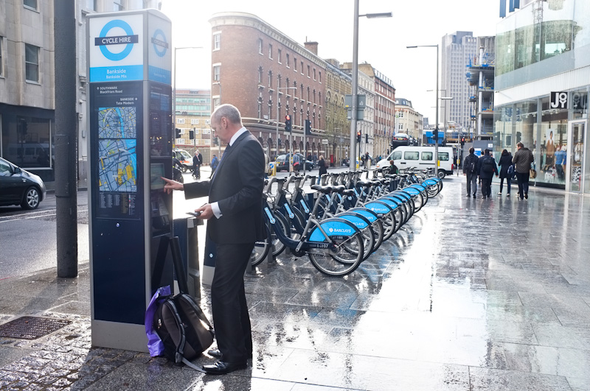
Environmental justice and health equity considerations of shared mobility
Examples of shared mobility include dock-less electric scooters, services by Transportation Network Companies (TNCs) such as Uber and Lyft, bike sharing systems, etc.
These options may result in a shift from vehicle ownership to usership
Companies like Uber and Lyft are looking into integrating the above options into a single app or service
Image 1
Image 3
Image 2
Notes:
Source of image 1: https://chicago.suntimes.com/2018/8/19/18478284/editorial-give-dockless-electric-scooters-a-fair-shake-and-sensible-rules
Source of image 2: http://gudphoto.com/bikenyc/2012/04/24/london-bike-share/
Source of image 3: https://www.businesstravelerusa.com/business-traveler-usa-story/emergency-stay-allows-uber-and-lyft-to-continue-in-California
Shared mobility includes:
Public transit
Scooter sharing
Bikesharing
P2P bike sharing
Carsharing
P2P vehicle sharing
Ride hailing/ ride splitting
Ride sharing/ car pooling
Ride sourcing/TNCs
Micro transit, for example, shuttles
Taxis
Mobility hubs

Slide 11
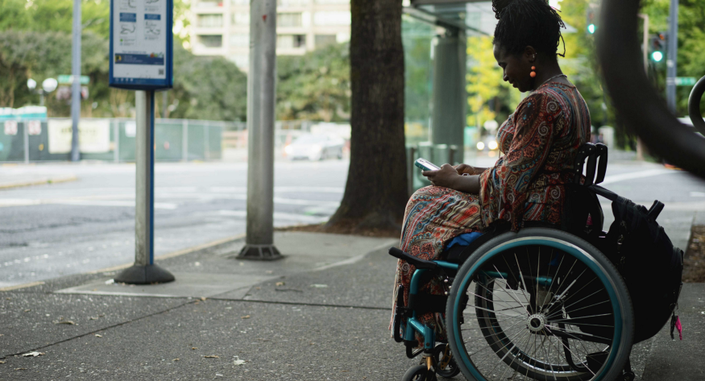
Environmental justice and health equity considerations of shared mobility
Shared mobility has the potential to improve environmental conditions, public health and social equity, and enhance first and last mile connections, but not as it is operating now
Transportation and shared mobility are being commodified with very little legislation and regulation
Potential benefits lie in the fact that shared mobility may promote moving away from the “one-car-per-adult” paradigm which is the basis of many transportation issues (Cabansagan, 2018)
The private sector plays the largest role in dictating the future of transportation and the public sector should play a stronger role in shaping and regulating these services
Source: https://medium.com/move-forward-blog/five-strategies-to-enhance-transportation-equity-in-shared-mobility-e36adfd7933e

Slide 12
Environmental justice and health equity considerations of shared mobility
A summary of equity challenges that can impact people’s ability to access transportation services, Source: Shaheen and Cohen (2018)
Notes:
Extracted from Shaheen and Cohen (2018):
“Shared mobility has the potential to offer communities a wide array of benefits including: increased mobility; greater environmental awareness; reduced vehicle emissions; and enhanced first-and-last mile connections to public transportation. While increasingly becoming more mainstream, the demographics of shared mobility users often differ from the general population. In general, users tend to be younger and have higher levels of educational attainment and incomes. They also are likely to be less diverse than the general population. Older adults, low-income individuals, rural communities, and minority communities have historically been less likely to use shared mobility. Additionally, access to the Internet, smartphones, and banking services-a pre-requisite for many shared mobility modes-tends to be lower among many of these groups. Earlier this year, we wrote about three key policy questions (the “3-D’s” — Divide, Discrimination, and Displacement) impacting shared and on-demand.
There are numerous equity challenges that can impact people’s ability to access transportation services, summarized in the figure above.
In this blog, we discuss three key equity challenges of concern to mobility providers and public agencies.
Equitable Service — It is important that shared mobility services provide equivalent levels of service to all users. This can include comparable wait times, pricing, and service availability. For example, a multi-institutional research study of 1,500 ride sourcing/transportation network company (TNC) rides taken in Seattle and Boston found that Uber drivers in Boston were over twice as likely to cancel the rides of passengers with names perceived to be of African origin versus Caucasian names (O’Brien, 2016). The study also found that drivers took women on longer, more expensive rides. Of the 581 trips taken, African-American travelers waited on average 20 percent longer than Caucasian travelers to have their ride accepted on Lyft or UberX, and it took about 30 percent longer for African-American travelers to be picked up than Caucasian travelers using UberX (Kubota, 2016) (Ge, Knittel, MacKenzie, & Zoepf, 2016). However, this concern is not specific to ride sourcing alone. A study of taxi drivers in Seattle found that they stopped more often for Caucasian riders than for African Americans (Scott, 2016). Similar concerns have been raised with other sharing economy service providers (e.g., Airbnb) (O’Brien, 2016).
Accessibility for Older Adults and People with Disabilities — Another challenge that can arise with shared mobility is the provision of services for older adults and people with disabilities. Shared mobility can present challenges when: 1) passengers with limited mobility do not offer accessible services or equivalent accessible alternatives and 2) when shared modes block American with Disabilities Act (ADA) access (e.g., ramps, curbs, etc.). A number of services have responded by adding accessible services. For example, in a number of cities Uber has implemented UberWAV allowing passengers with disabilities to request wheelchair accessible vehicles, and UberASSIST offers regular vehicles with specialized driver training. Other shared mobility operators offer similar programs. However, the lack of service availability in all markets or longer wait times for accessible vehicles can present equity challenges. For other shared modes, blocking curbs and ramps can pose a notable challenge. More public awareness is needed to prevent users from leaving equipment that could pose challenges to people with disabilities.
Crossing the Digital and Income Divide — Many shared mobility services require users to have a smartphone and a credit or debit card to use a service hindering access by low-income, minority, younger, older, and less-educated users and people with disabilities. These groups tend to have lower levels of smartphone ownership and generally rely more on cash, having more limited access to banking services. Since the majority of shared mobility services are accessed by a smartphone, the lack of familiarity with and access to smartphones with mobile data can preclude these populations from accessing Mobility on Demand (or MOD) services that could save them time or money.
Identifying the array of transportation equity issues can be challenging because several types of equity issues can affect a user’s ability to access a service. While shared mobility can raise equity concerns when services require a smartphone and credit/debit cards or do not provide accessible services to all users in all neighborhoods, it also has the potential to enhance mobility, access, and economic opportunity for travelers.
Shared mobility can be leveraged to create opportunities for enhanced access such as: improving mobility options (e.g., fares, routes); increasing travel speed and reliability; bridging first-and-last mile gaps in the transportation network; and expanding coverage to historically underserved users or communities.”

Slide 13
Environmental justice and health equity considerations of shared mobility
Potential positive impacts include repurposing parking lots to green or public spaces for example, reducing vehicle miles traveled, associated air pollution and greenhouse gases
This will likely require a shift from solo driving to shared trips
The distribution of these potential impacts is most unclear, especially because certain segments of the society do/will not have access to shared mobility (see previous slides and below)
Access to the internet, smartphones and banking services are key pre-requisites to shared mobility usage
Importantly, the demographics of shared mobility users is different than the general population and tends to be younger, more tech savvy populations with higher educational attainment and income and less diversity
Lower rates of use are documented for seniors, minorities, low-income and rural populations (Cohen, 2018) – the same populations with transportation poverty and access issues to begin with, and who bear the highest health burden caused by transportation
Notes:
Older adults, low-income individuals, rural communities, and minority communities have historically been less likely to use shared mobility
These are the same groups which are already most negatively impacted by transportation in terms of adverse environmental exposures and health outcomes
These groups are least likely to benefit from shared mobility. Shared mobility also has the potential to exacerbate the socioeconomic divide between the higher and lower socioeconomic populations if equity is not carefully considered and accounted for when these services are provided
These services and systems are largely designed and operated by the private sector and that is a concern as taking environmental justice communities into account is may be not in their interest and/or high up their agenda
Environmental justice communities are likely to face barriers to using shared mobility including financial, technological, and language and cultural barriers
Many of these new technologies rely on scaling up the number of users in a given rea which may result in these services, like carpooling or car-sharing, being unavailable in the same communities that need them the most

Slide 14
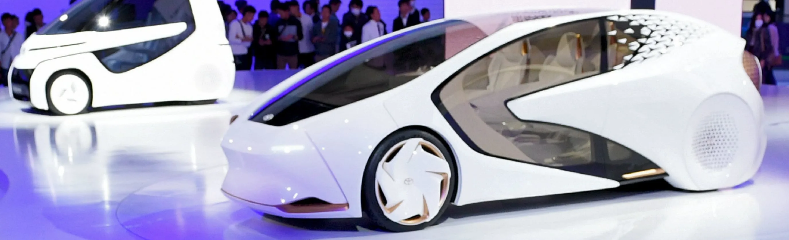
Environmental justice and health equity considerations of zero and near-zero emission vehicles
Source: https://asia.nikkei.com/Business/Business-deals/Toyota-charges-into-electric-car-race-with-Panasonic-tie-up
Zero emission vehicles refer to electric cars. Technically, it is zero exhaust/tailpipe emissions but non-exhaust/non-tailpipe emissions are still an issue from these vehicle
Near-zero emission vehicles is a term used in the United States for a vehicle that has zero evaporative emissions from its fuel system, has a 15-year (or at least 150,000-mile) warranty on its emission-control components, and meets SULEV tailpipe-emission standards
Also called partial-zero emission vehicles
The following slides will focus on electric vehicles as there is some documented evidence on them
Notes:
Zero emission vehicles refer to electric cars which do not emit pollutants from the exhaust or tailpipe
The term is used more commonly in the US, especially in California, for example, see the Zero-Emission Vehicle (ZEV) program from the California Air Resources Board (CARB)

Slide 15
Environmental justice and health equity considerations of zero and near-zero emission vehicles
Disadvantaged communities have difficulty affording electric vehicles or accessing their infrastructure, also known as charging deserts (Cohen et al., 2017)
Electric vehicles also have different pollution sources, namely electricity generation stations or units, which may be placed closer to environmental justice communities, increasing the divide in adverse environmental exposures and health impacts
A study comparing the emissions and health impacts of using electric vehicles (EVs) versus conventional vehicles (CVs) in 34 major cities in China found the following (Ji, 2012):
CO₂ emissions (g km⁻¹) vary and are an order of magnitude greater for EVs (135–274) and CVs (150-180) than for e-bikes (14–27)
PM_{2.5} emission factors generally are lower for CVs (gasoline or diesel) than comparable EVs … (continued on the next slide)
Notes:
For electric cars to be adapted by low and middle income communities and ethnic minorities, who are often disproportionally affected by the adverse environmental exposures of transportation, multiple steps need to be taken, including:
Directing financial resources and focusing the construction of charging infrastructure on environmental justice neighborhoods
Havin electric-car incentive programs for new and used cars focusing on environmental justice communities including rebates and credits and other financial assistance
Enhance electric-vehicles awareness including potential savings in fuel costs, battery ranges and improvements in air quality
The availability of charging infrastructure needs to be enhanced especially for adopters who live in apartments or other multifamily units and not in single family houses
Also, technical barriers may be at work, for example, the use of mobile apps to map out charging stations might exclude certain segments of the society from using these technologies (Gurley, 2019)

Slide 16
Environmental justice and health equity considerations of zero and near-zero emission vehicles
Intake fraction is often greater for CVs than for EVs because combustion emissions are generally closer to population centers for CVs (tailpipe emissions) than for EVs (electricity generation emissions)
For most cities, the net result is that primary PM_{2.5} environmental health impacts per passenger-km are greater for EVs than for gasoline cars (3.6× on average), lower for EVs than for diesel cars (2.5× on average) and equal between EVs and diesel buses
EVs could cause environmental equity problems in China, since a vast majority (>83%) of pollutant emissions inhaled and subsequent health effects due to urban EV use could be distributed to communities whose incomes are lower than the cities where EVs are adapted (Ji, 2012)
These results are in line with other work showing that air quality benefits of EVs may be negligible, unless adaptation is optimistically wide, and these benefits are mainly concentrated in urban areas
Notes:
The findings highlight the importance of considering exposures, and especially the proximity of emissions to people, when evaluating environmental health impacts and equity concerns for EVs
Soret et al. (2014) estimated that fleet electrification can reduce total NOx emissions by 11% and 17%, in Barcelona and Madrid respectively, only if 40% of all vehicles were substituted by electric vehicles (including two-wheelers, heavy duty vehicles, buses, and light-duty vehicles). However, they found that fleet electrification has a limited impact on PM₁₀ emissions of about 3–4% emissions reductions. No health impact assessment was conducted in this study.
Pathak and Shukla (2016) tested two potential transport scenarios for Ahmedabad, India, from 2010 to 2035. The first was “business as usual” and the second was a low-carbon scenario constituting several climate change mitigation measures, including a modal shift towards non-motorized and public transport, fuel switch, reduced demand, energy efficiency, decarbonization of electricity, and sustainable behavior. The quantitative assessment of transport activity under business as usual was a four-fold increase in energy demand. The low-carbon scenario, besides improving energy security by reducing oil demand, was estimated to reduce NO_{x} by 74% and PM_{2.5} by 83% from the passenger transport sector compared with business as usual in 2035. No health impact assessment was conducted in this study.
Xue et al. 2015 showed that, although increasing the proportion of new energy vehicles including hybrids, compressed natural gas, and electric vehicles will improve air quality in Xiamen, China, the greatest contribution to air pollution reduction comes from other policy scenarios. These include alternative fuels and diesel truck decreases contributing to nearly 30% of air pollution reductions, followed by an option to control the intensity of private vehicles.

Slide 17
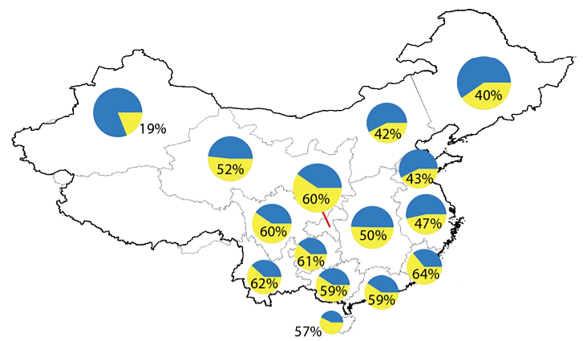
Environmental justice and health equity considerations of zero and near-zero emission vehicles
The figure to the right shows the portion of primary PM_{2.5} health impacts from electric generation unites experienced by rural versus urban populations. Icon area is proportional to PM_{2.5} emission factor (g km⁻¹) for an EV in that power grid. Numbers identify nonurban mortality impact proportions, i.e., of the total mortality impacts attributable to primary PM_{2.5} from electricity generation − here, owing to urban use of EVs. Urban use of EVs rather than CVs typically moves the emissions (and, exposures and health impacts) to more rural locations. In general, a substantial proportion − on average, about half − of the emissions from urban use of EVs are inhaled by nonurban populations, Source: Ji et al. (2012)
→ Urban use of EVs rather than CV shifts transportation’s air pollutant emissions from urban areas (tailpipes) to predominantly rural areas (power plants), changing the geographic distribution of health impacts
Notes:
The findings highlight the importance of considering exposures, and especially the proximity of emissions to people, when evaluating environmental health impacts and equity concerns for EVs
A follow up analysis by Ji et al. (2015) investigated these trends further by modeling PM_{2.5}-related health impacts attributable to urban EV use for 34 major cities. This work focused on environmental justice (EJ) by comparing pollutant inhalation versus income among impacted counties
The authors found that EVs could increase EJ challenge in China
Most (∼77%, range: 41–96%) emission inhalation attributable to urban EVs use is distributed to predominately rural communities whose incomes are on average lower than the cities where EVs are used. Results vary dramatically across cities depending on urban income and geography
Discriminant analysis revealed that counties with low income and high inhalation of urban EV emissions have comparatively higher agricultural employment rates, higher mortality rates, more children in the population, and lower education levels
The authors also find that low-emission electricity sources such as renewable energy can help mitigate EJ issues raised here. Findings here are not unique to EVs, but instead are relevant for nearly all electricity-consuming technologies in urban areas (Ji et al., 2015)

Slide 18
Non-exhaust emissions from electric vehicles
Non-exhaust emissions are also a factor of vehicle weight as road abrasion and tire wear are caused by friction
Tire, brake and road wear increase by around 50% when comparing a medium (1600 kg) and small (1200 kg) car
Compared to a small car, large cars (2000 kg) emitted more than double the amount of PM₁₀ (Simons, 2013)
Electric vehicles are generally heavier than internal combustion vehicle engines
On average, the electric versions are 280 kg or 24% heavier than their internal combustion engine counterparts
Source: California Air Resources Board (2020)
Notes:
Non-exhaust vehicle emissions result from tire wear, brake wear, road surface wear and resuspension of road dust and contain (larger) particulate matter (PM) emissions
The ratio of non-exhaust to exhaust particles has strongly increased in the last two decades, due to exhaust emission reductions
More than 20 years of research showing that the contribution of non-exhaust primary particles to the total traffic generated primary particles is significant in urban areas
Regulatory regimes seeking to reduce emissions from transport have largely focused on tailpipe emissions—i.e., the criteria pollutants and carbon dioxide (CO₂) that emerge with the exhaust from the tailpipe. However, there is more than 15 years of research showing that the contribution of non-exhaust primary particles to the total traffic generated primary particles is significant in urban areas. Non-exhaust PM factors include tire wear, brake wear, road surface wear and resuspension of road dust
Non-exhaust and exhaust vehicle emissions vary significantly in size and composition but studies characterizing non-exhaust PM and their relative contribution are few
The exhaust component consists predominantly of externally mixed soot particles and soot internally mixed with secondary particles
The abrasion component contained all particles with characteristic tracer elements (Fe, Cu, Ba, Sb, Zn) for brake and tire abrasion
The resuspension component comprises all internally mixed particles with a high proportion of silicates or Fe oxides/hydroxides which contain soot or abrasion particles as minor constituent
The total contribution of traffic to PM₁₀ was 27% at the urban background station and 48% at the curbside station (Weinbruch et al., 2014)
The corresponding values for PM₁ were 15% and 39%
The relative share of the different traffic components for PM₁₀ at the curbside station was 27% exhaust, 15% abrasion, and 58% resuspension (38%, 8%, 54% for PM₁)
For the urban background, the following relative shares were obtained for PM₁₀: 22% exhaust, 22% abrasion and 56% resuspension (40%, 27%, 33% for PM₁)
Compared to earlier studies, Weinbruch et al. observed a significantly lower portion of exhaust and a significantly higher portion of resuspension particles
Other model predictions (both MOVES and EMFAC) suggest that traffic-related emissions of both PM_{2.5} and PM₁₀ will eventually be dominated by non-exhaust sources (California Air Resources Board, 2020)
It can be hypothesized that each of the sources of non-exhaust PM emissions should be influenced by vehicle weight
We know that road abrasion and tire wear are caused by the friction between the tire thread and road surface. Friction is a function of the friction coefficient between the tires and the road, as well as a function of the normal force of the road. This force is directly proportional to the weight of the car. This means that increasing vehicle weight would increase the frictional force and therefore the rate of wear on both the tire and road surface
Brake wear is caused by the friction between the brake pads and the wheels. The energy needed to reduce the momentum of a vehicle is proportional to the vehicle's speed and mas
Therefore, as the mass of the vehicle increases, more frictional energy is needed to slow it down, leading to greater brake wear
Resuspension is caused by the wake of a vehicle, which in turn is determined by the size, weight and aerodynamics of the vehicle. Furthermore, heavier vehicles are able to grind down larger particles into smaller, more easily suspended PM. In addition, many heavier vehicles will also be larger, resulting in a larger wake. These factors together should cause increased resuspension
Evidence for influence of weight
In his paper, Simons (2013) presented new and updated datasets for emissions of passenger cars. He distinguishes between vehicle exhaust and non-exhaust emissions and is one of the first to define non-exhaust emissions as a factor of vehicle weight, with the intention of being applied to studies on hybrid and electric vehicles. Simons suggests that PM₁₀ emission factors could be scaled directly to vehicle weight and provides emission factors for tire, brake and road wear per kg of vehicle weight. For example, tire, brake and road wear increase by around 50% when comparing a medium (1600 kg) and small (1200 kg) car. Compared to a small car, large cars (2000 kg) emitted more than double the amount of PM₁₀
There is very little other research that directly links non-exhaust PM emissions to vehicle weight. Some authors have speculated about the possible influence of weight, but not directly measured it. Barlow (2014) mentions that vehicle weight is likely to be one of the factors affecting tire wear. He also says that in general, larger vehicles produce larger non-exhaust emissions. These assertions are only explained qualitatively, however. Similarly, Garg et al. (2000) mention that the inertia weight being stopped is one of the factors contributing to brake wear rate, but does not perform any tests with varying weights to confirm this.
Despite the lack of direct research, there is significant indirect evidence for the positive relationship between weight and non-exhaust PM emissions. Many studies and emission inventories suggest that heavier vehicle categories emit more PM (Timmers and Achten, 2016)

Slide 19
Non-exhaust emissions from electric vehicles
When factoring in the additional weight and non-exhaust PM factors, total PM₁₀ emissions from EVs are equal to those of modern internal combustion engine vehicles (ICEV)
For PM_{2.5} emissions, EVs deliver only a negligible reduction in emissions (Timmers and Achten, 2016)
Compared to an average gasoline ICEV, the EV emits 3% less PM_{2.5}
Compared to an average diesel ICEV, the EV emits 1% less PM_{2.5}
Source: Timmers and Achten (2016)
Notes:
By using the data from Simons (2013) on the effect of weight on emissions and the average exhaust and non-exhaust emission from the various emission inventories, we can compare the total PM emissions from EVs with those from gasoline and diesel cars. When we do this, we find that EVs emit the same amount of PM₁₀ as modern gasoline and diesel cars. See the table above
When we compare PM_{2.5} emissions, we can see that EVs bring about a negligible reduction in emissions. Compared to an average gasoline ICEV, the EV emits 3% less PM_{2.5}
Compared to an average diesel ICEV, the EV emits 1% less PM_{2.5}
From these calculations, it is clear that EVs are not significantly less polluting than modern ICEVs in terms of PM. We can also see that non-exhaust emissions currently account for more than 90% of PM₁₀ and 85% of PM_{2.5} emissions from traffic. These proportions are likely to keep increasing in the future as increasingly strict emission limits result in higher exhaust standards
Several studies have reached the same conclusion on the importance of non-exhaust emissions. Rexeis and Hausberger (2009) predicted that the percentage of non-exhaust PM of the total PM emissions will increase from 50% in 2000 up to 80–90% by 2020. Jörß and Handke (2007) modelled non-exhaust emissions of PM2.5 in Germany and found that non-exhaust sources accounted for 25% of traffic PM2.5 emissions in 2000 and are expected to contribute 70% of traffic PM2.5 by 2020. This conclusion was also reached by Denier van der Gon et al. (2013), who predicted non-exhaust will likely be the dominant source of total PM emissions from traffic by 2020
Worryingly, over the last decade, we have seen a steady increase in vehicle weight in almost all segments
This trend is expected to apply to EVs as well, as demand for longer range EVs increases. In order to achieve a longer range, EVs need larger batteries and require more structural weight to accommodate these batteries
Therefore, non-exhaust emissions from EVs and ICEVs are likely to keep increasing in the future. Strategies designed to reduce PM pollution by restricting vehicle exhaust emissions alone will no longer be very effective. There is a need for new policies and measures that specifically target non-exhaust PM emissions

Slide 20
Discussion
Transportation is a key driver of environmental injustice across a wide variety of environmental and life-style factors
Transportation technologies and disruptors are emerging at a rapid pace and include many innovations such as connected and automated vehicles, electric vehicles, near-zero vehicles, alternative fuels, shared mobility, 3-D printing, drones
The environmental justice, health and social equity impacts of those technologies and disruptors are under-researched in the literature and not a key theme in the policy decision making
These impacts will differ based on adaptation and policies surrounding them including credits, financial assistance, rebates, subsidies, low-income discounts, regulating non-exhaust and upstream emissions, accounting for environmental justice communities, ensuring universal access, complementing and integrating public transit, amongst others

Slide 21
Research Gaps and Future Directions
The environmental justice and health equity impacts of transportation technologies and disruptors is largely unknown and understudied
Conducting full-chain health impact assessments
Measuring pre and post key performance indicators and health outcomes
Gaps in the knowledge about users and non-users across socioeconomic, demographic, rural and other population groups, e.g. disabled people
Identify existing policy barriers to piloting and implementing equitable transportation technologies and services
Research on regulatory implications of public-private partnerships

Slide 22
Take-Home Messages
Transportation technologies and disruptors are a huge part of the mobility’s revolution and future but whose future it is, is yet unclear
By design, these innovations have the potential to further widen the divide between socioeconomic and sociodemographic groups and increase environmental injustice caused by the transportation sector
They, however, have a potential to reduce adverse environmental exposures such as traffic-related air pollution and noise, mainly by moving away from the one-car-per-adult paradigm and providing alternative more sustainable options
But this is very contingent upon supporting policies and regulation of the private markets and sectors which have been driving these innovations and their deployment with little, if any, regard to environmental justice and health equity
Other innovations which have not been discussed in this lecture are also relevant such as drones, 3-D printing, and alternative fuels

Slide 23
List of Abbreviations
AVs: Autonomous Vehicles
CARB: California Air Resources Board
CO₂: Carbon Dioxide
CVs: Conventional Vehicles
EVs: Electric Vehicles
ICEV: Internal Combustion Engine Vehicles
IMD: Index of Multiple Deprivation
LSOA: Lower Super Output Area
NO₂: Nitrogen Dioxide
PM: Particulate Matter
PM_{2.5}: Particulate Matter with less than 2.5 micrometers in diameter
SEP: Socioeconomic Position
TNC: Transportation Network Companies
VMT: Vehicle Miles Traveled
ZEV: Zero-Emission Vehicle

Slide 24
References
Barlow, T., 2014. Briefing Paper on Non-exhaust Particulate Emissions from Road Transport. Transport Research Laboratory.
Cabansagan, Clarrissa, 2018. Focusing on Equity as Shared Mobility Evolves. TransForum’s Blog. Available from: https://www.transformca.org/transform-blog-post/focusing-equity-shared-mobility-evolves
California Air Resources Board 2020. Brake & Tire Wear Emissions. Vehicle non-exhaust particulate matter sources. Available from: https://ww2.arb.ca.gov/resources/documents/brake-tire-wear-emissions
Casey, J.A., James, P. and Morello-Frosch, R., 2017. Urban noise pollution is worst in poor and minority neighborhoods and segregated cities. The Conversation. Available from: https://theconversation.com/urban-noise-pollution-is-worst-in-poor-and-minority-neighborhoods-and-segregated-cities-81888
Clark, L.P., Millet, D.B. and Marshall, J.D., 2017. Changes in transportation-related air pollution exposures by race-ethnicity and socioeconomic status: Outdoor nitrogen dioxide in the United States in 2000 and 2010. Environmental health perspectives, 125(9), p.097012.
Cohen, S., Shirazi, S. and Curtis, T., 2017. Can We Advance Social Equity with Shared, Autonomous and Electric Vehicles?. Institute of Transportation Studies at the University of California, Davis. Available from: https://www.transformca.org/sites/default/files/3R.Equity.Indesign.Final_.pdf

Slide 25
References
Cohen, A. 2018. Equity and Mobility on Demand. ITS Berkeley. Presentation - Available from: https://www.apta.com/wp-content/uploads/BP18-Cohen-Adam.pdf
Cohn, J., Ezike, R., Martin, J., Donkor, K., Ridgway, M. and Balding, M., 2019. Examining the equity impacts of autonomous vehicles: a travel demand model approach. Transportation research record, 2673(5), pp.23-35.
Forkenbrock, D.J. and Schweitzer, L.A., 1999. Environmental justice in transportation planning. Journal of the American Planning Association, 65(1), pp.96-112.
Fuller, C.H. and Brugge, D., 2020. Environmental justice: Disproportionate impacts of transportation on vulnerable communities. In Traffic-Related Air Pollution (pp. 495-510). Elsevier.
Garg, B.D., Cadle, S.H., Mulawa, P.A., Groblicki, P.J., Laroo, C. and Parr, G.A., 2000. Brake wear particulate matter emissions. Environmental Science & Technology, 34(21), pp.4463-4469.
Gurley, Gabrielle, 2019. Accelerating Equity in Electric Cars. The American Prospect. Available from: https://prospect.org/greennewdeal/accelerating-equity-in-electric-cars/#.X2jnxMUJZxc.twitter

Slide 26
References
Grineski, S.E. and Collins, T.W., 2018. Geographic and social disparities in exposure to air neurotoxicants at US public schools. Environmental research, 161, pp.580-587
Ji, Shuguang, "Electric Vehicles in China: Emissions, Health Impacts, and Equity. " PhD diss., University of Tennessee, 2012. Available from: https://trace.tennessee.edu/utk_graddiss/1532
Ji, S., Cherry, C.R., J. Bechle, M., Wu, Y. and Marshall, J.D., 2012. Electric vehicles in China: emissions and health impacts. Environmental science & technology, 46(4), pp.2018-2024.
Ji, S., Cherry, C.R., Zhou, W., Sawhney, R., Wu, Y., Cai, S., Wang, S. and Marshall, J.D., 2015. Environmental justice aspects of exposure to PM2. 5 emissions from electric vehicle use in China. Environmental science & technology, 49(24), pp.13912-13920.
Khreis, H. and Nieuwenhuijsen, M.J., 2019. The health impacts of urban transport: Linkages, tools and research needs. In Measuring Transport Equity (pp. 131-142). Elsevier.
Khreis, Haneen; Glazener, Andrew; Ramani, Tara; Zietsman, Josias; Nieuwenhuijsen, Mark J.; Mindell, Jennifer S.; Winfree, Gregory D.; Fox, Mary A.; Wunderlich, Robert; and Burke, Thomas A., 2019b. Transportation and Health: A Conceptual Model and Literature Review. College Station, Texas: Center for Advancing Research in Transportation Emissions, Energy, and Health, May 2019. Available at: https://www.carteeh.org/14-pathways-to-health-project-brief/

Slide 27
References
Khreis, Haneen; Alotaibi, Raed; Horney, Jennifer; McConnell, Rob (2020). The Impact of Baseline Incidence Rates on Burden of Disease Assessment of Air Pollution and Onset Childhood Asthma: Analysis of Data from the Contiguous United States. Annals of Epidemiology, online.
Kuzio, J., 2019. Planning for social equity and emerging technologies. Transportation research record, 2673(11), pp.693-703.
Mueller, N., Rojas-Rueda, D., Khreis, H., Cirach, M., Milà, C., Espinosa, A., Foraster, M., McEachan, R.R., Kelly, B., Wright, J. and Nieuwenhuijsen, M., 2018. Socioeconomic inequalities in urban and transport planning related exposures and mortality: A health impact assessment study for Bradford, UK. Environment international, 121, pp.931-941.
Pathak, M. and Shukla, P.R., 2016. Co-benefits of low carbon passenger transport actions in Indian cities: Case study of Ahmedabad. Transportation Research Part D: Transport and Environment, 44, pp.303-316.
Riggs, W. ed., 2018. Disruptive transport: Driverless cars, transport innovation and the sustainable city of tomorrow. Routledge.
Rojas-Rueda, D., Nieuwenhuijsen, M.J., Khreis, H. and Frumkin, H., 2020. Autonomous vehicles and public health. Annual review of public health, 41, pp.329-345.
Shaheeh, S., Cohen, A., 2018. Five Strategies to Enhance Transportation Equity in Shared Mobility. Move Forward. Available from: https://medium.com/move-forward-blog/five-strategies-to-enhance-transportation-equity-in-shared-mobility-e36adfd7933e
Simons, A., 2016. Road transport: new life cycle inventories for fossil-fuelled passenger cars and non-exhaust emissions in ecoinvent v3. The International Journal of Life Cycle Assessment, 21(9), pp.1299-1313.

Slide 28
References
Sohrabi, S., Khreis, H. and Lord, D., 2020. Impacts of Autonomous Vehicles on Public Health: A Conceptual Model and Policy Recommendations. Sustainable Cities and Society, p.102457.
Soret, A., Guevara, M. and Baldasano, J.M., 2014. The potential impacts of electric vehicles on air quality in the urban areas of Barcelona and Madrid (Spain). Atmospheric environment, 99, pp.51-63.
Temam, S., Burte, E., Adam, M., Antó, J.M., Basagaña, X., Bousquet, J., Carsin, A.E., Galobardes, B., Keidel, D., Künzli, N. and Le Moual, N., 2017. Socioeconomic position and outdoor nitrogen dioxide (NO2) exposure in Western Europe: A multi-city analysis. Environment international, 101, pp.117-124.
Timmers, V.R. and Achten, P.A., 2016. Non-exhaust PM emissions from electric vehicles. Atmospheric Environment, 134, pp.10-17.
Weinbruch, S., Worringen, A., Ebert, M., Scheuvens, D., Kandler, K., Pfeffer, U. and Bruckmann, P., 2014. A quantitative estimation of the exhaust, abrasion and resuspension components of particulate traffic emissions using electron microscopy. Atmospheric Environment, 99, pp.175-182.
World Health Organization, 2009. The state of road safety around the world. Global Status Report on Road Safety: Time for Action. Geneva: World Health Organization.
Xue, X., Ren, Y., Cui, S., Lin, J., Huang, W. and Zhou, J., 2015. Integrated analysis of GHGs and public health damage mitigation for developing urban road transportation strategies. Transportation Research Part D: Transport and Environment, 35, pp.84-103.

Slide 29
Reading List
Butler, L., Yigitcanlar, T. and Paz, A., 2020. How Can Smart Mobility Innovations Alleviate Transportation Disadvantage? Assembling a Conceptual Framework through a Systematic Review. Applied Sciences, 10(18), p.6306.
Cohen, A. and Shaheen, S., 2018. Planning for shared mobility. ISBN: 9781611901863. DOI: 10.7922/G2NV9GDD
Deka, D., 2004. Social and environmental justice issues in urban transportation, available from: https://trid.trb.org/view/756099
Mohai, P., Pellow, D. and Roberts, J.T., 2009. Environmental justice. Annual review of environment and resources, 34, pp.405-430.
Requia, W.J., Mohamed, M., Higgins, C.D., Arain, A. and Ferguson, M., 2018. How clean are electric vehicles? Evidence-based review of the effects of electric mobility on air pollutants, greenhouse gas emissions and human health. Atmospheric Environment, 185, pp.64-77.
Shaheen, S., Cohen, A. and Zohdy, I., 2016. Shared mobility: current practices and guiding principles (No. FHWA-HOP-16-022). United States. Federal Highway Administration.
Shaheen, S., Bell, C., Cohen, A. and Yelchuru, B., 2017. Travel behavior: Shared mobility and transportation equity (No. PL-18-007).
Verbeek, T., 2019. Unequal residential exposure to air pollution and noise: a geospatial environmental justice analysis for Ghent, Belgium. SSM-population health, 7, p.100340.

