Slide 1
www.carteeh.org

Slide 2

Lecture #60: Concluding Inspirational Talk—How Do We Make Health a Priority? Are We Doing the Right Research?
Leah Whigham, PhD, FTOS
Associate Professor, Department of Health Promotion & Behavioral Sciences
Director, Center for Community Health Impact
UTHealth School of Public Health
Leah.D.Whigham@uth.tmc.edu / 915-975-8517
"The author declares that there is no conflict of interest
Lecture Track(s): HT/TT/PPT
Notes:
Health Track (HT)—mainly targeted at urban planners, transportation planners, and engineers with limited knowledge of public health-related concepts;
Transportation Track (TT)—mainly targeted at environmental epidemiologists and public health professionals with limited knowledge of transportation-related concepts; and;
Planning and Policy Track (PPT)—mainly targeted at planners, civil servants, and policy and decision makers with particular interest in the science-policy link.

Slide 3
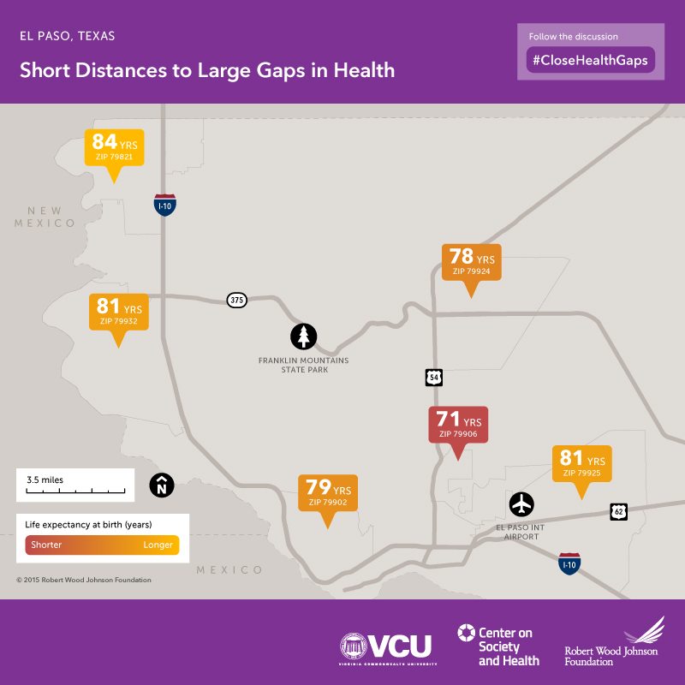
Why do we care about health?
Quality of life
Quantity of life
Economics
  Productivity
  Healthcare system costs
Social justice
National security
Notes:
https://societyhealth.vcu.edu/work/the-projects/mapselpaso.html

Slide 4
How do we make health a priority?
The right message to the right audience
The “Why” | The “Who cares”
Quality of life | People
Quantity of life | People
Economics - Productivity | Governments Business leaders
Economics - Healthcare system costs | Governments Healthcare system (providers, insurers) Business leaders
Social justice | People (some) Non-profit organizations (some) Governments (some)
National security | National leaders, military leaders

Slide 5
How do we drive impact?
Common Agenda
Backbone Organization
Continuous Communication
Shared Measurement System
Mutually Reinforcing Activities
Aligned partnerships
Organized through Collective Impact
Community-driven
Science-informed
Notes:
Kania J, Kramer M. Collective Impact. Stanford Social Innovation Review. Winter 2011.

Slide 6
Are we doing the right research?
Research Spectrum
Lab/Clinic
Community
Population
Notes:
Research across the spectrum is important; use of rigorous research methods is essential

Slide 7
Research Gaps and Future Directions
Rigorous research methods
Policy impact
Communication
  Policy makers
  Public and key stakeholders

Slide 8
Take-Home Messages
Partnership
Leadership
Communication
Science
Impact

Slide 9

Acknowledgements

