Slide 1
www.carteeh.org

Slide 2
Lecture #23: Personal Monitoring in Exposure Assessment and the Contribution of Traffic
Suriya Vallamsundar, Ph.D.,
Texas A&M Transportation Institute
s-vallamsundar@tti.tamu.edu, 972-994-2209
The author declares that there is no conflict of interest
Lecture Track(s): HT/TT
Notes:
Health Track (HT)—mainly targeted at urban planners, transportation planners, and engineers with limited knowledge of public health-related concepts;
Transportation Track (TT)—mainly targeted at environmental epidemiologists and public health professionals with limited knowledge of transportation-related concepts; and;
Planning and Policy Track (PPT)—mainly targeted at planners, civil servants, and policy and decision makers with particular interest in the science-policy link.

Slide 3
Introduction
  Motor vehicles emit large quantities of pollutants
  Criteria Pollutants (particulate matter, ozone, nitrogen oxides, carbon monoxide, oxides of sulfur and lead), Air Toxics and Green-house Gases
  Epidemiological studies consistently showed a link between traffic-related air pollution (TRAP) and adverse health effects (WHO, 2014)
Resolution: When dealing with TRAP, temporal and spatial resolution have a dominating effect on the distribution and impacts caused
  Spatial resolution: pollutants have a peaking tendency within a distance of 150-500m from roadways and accordingly people who live close to roadways are likely to suffer from adverse health effects
  Temporal resolution: pollutant dispersion tends to increase during overnight and early morning time periods and during fall and winter months due to stable atmospheric conditions
Notes:
The traffic related air pollution is abbreviated as TRAP. Recent statistics from WHO estimates outdoor TRAP to be responsible for 7 million annual premature deaths in 2014. When dealing with TRAP, spatial resolution is important as shown in figure (next s;ode) which gives the variation in concentration levels with distance from roadway edge. Concentration levels from vehicular emissions peak near roadways within a distance of 150-500m and then rapidly decline to background concentration levels. Based on this, studies have shown that people who live close to roadways are more likely to suffer from adverse health effects such as respiratory and allergic conditions compared to people who live 500m or further away

Slide 4
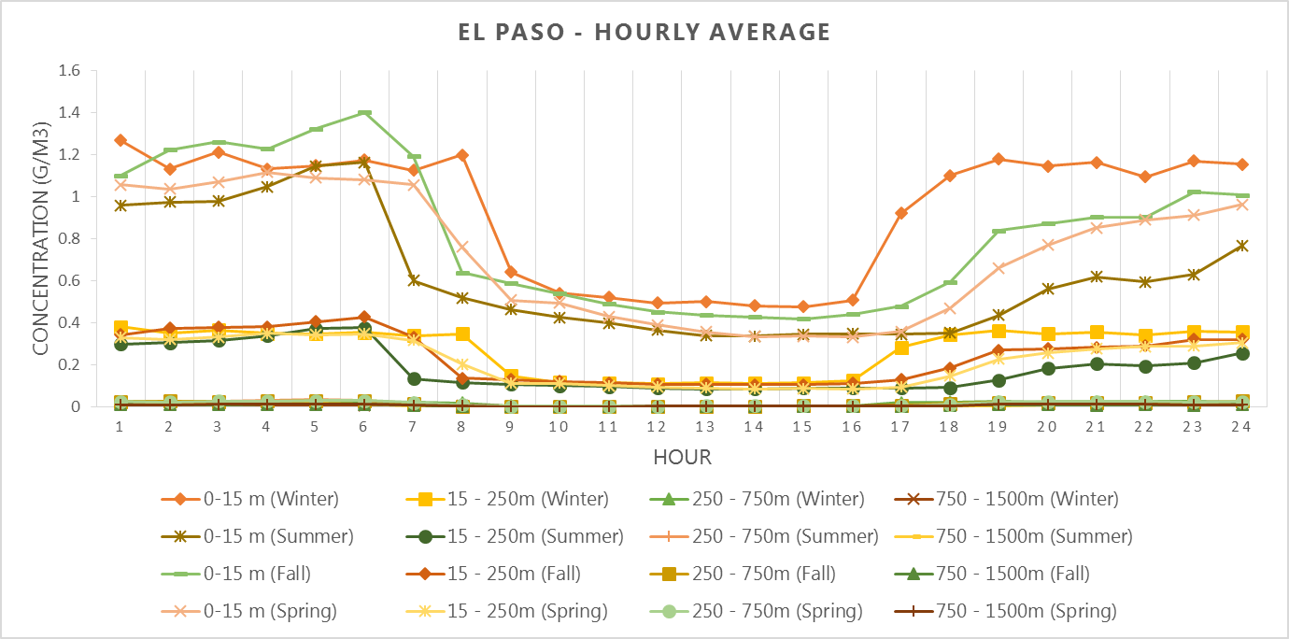
Temporal and Spatial Variation
Source: Askariyeh et al., 2018
Notes:
This figure shows the variation of pollutant concentration as a function of both roadway distance, time-of-day and season. Concentration estimates were found to be the highest near the roadway link and then gradually decreased with distance from roadway links. The rate of decline in concentration estimates was found to be steep for a distance of 250 m and the concentration estimates flattened for distances beyond 250 m. In terms of temporal resolution, concentration estimates were found to be higher for nighttime periods compared to daytime and fall and winter seasons compared to summer and spring seasons. The reason for high concentration estimates is attributed to the stable atmospheric conditions during nighttime periods and colder months. Sunlight during the daytime or warmer months helps in the mixing/dispersion of pollutants in the atmosphere. When the sunlight strikes the Earth’s surface during the day, it heats up more quickly and the heat is transferred to the air immediately above the ground, causing the warm air to rise and mix with the cooler air above. When the sun sets during the evening and nighttime periods, the Earth’s surface cools down much faster than air, resulting in cooler (heavier) air near the ground and warmer (lighter) air staying on top. This fairly stable atmospheric condition during nighttime periods leads to much reduced mixing and dispersion of pollutants and thereby higher concentrations.

Slide 5
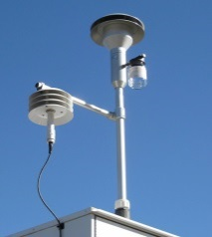
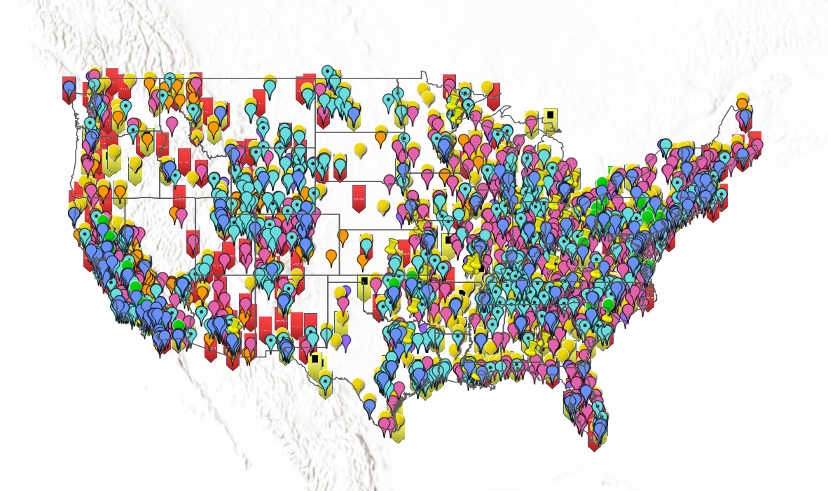
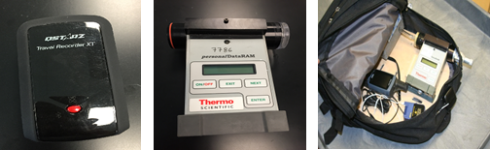
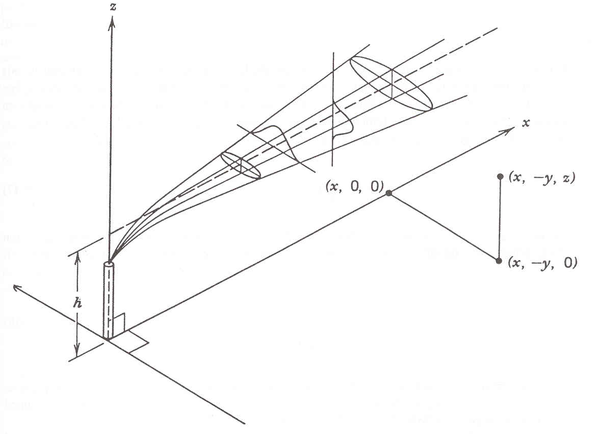
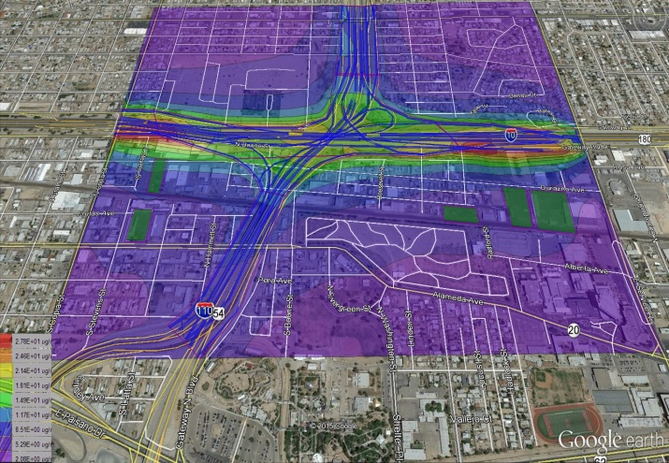
Overview
Exposure Assessment to TRAP
Ambient Monitors
Personal Monitoring
Modeling Tools
Figure Sources: EPA Airdata; Askariyeh et al, 2019, Turner, 1994
Notes:
Most commonly used ways to measure exposure to TRAP are shown in this slide.
Ambient monitors established by EPA: established region wide for regulatory compliance and community wide exposure. The issue is their source data in assessing the exposure levels of the study population and hence are limited by the number and spatial coverage of the monitoring stations.
Personal monitoring device: might be the most accurate, captures the actual pollutant concentration levels experienced by a person based on his location, and period of exposure. Issue is their cost making them often limited in terms of the sample size. However, recently emerging wearable sensors have offered the possibility to cover larger samples as they are much cheaper, but their accuracy have to be kept in mind as they are not as accurate as the field type measurement but recently many studies have started to use them.
Numerical models: Air dispersion or land use regression models, on the other hand, use numerical techniques to simulate the dispersion patterns of air pollutants based on a particular source of emission, the rate of emission release, meteorology and land use. These models can track concentrations specific to emission sources and can capture highly resolved spatial and temporal variations of concentration estimates. However, assumptions must be made with any type of model and resources may become intensive depending on the study area extent.

Slide 6
Ambient Monitoring
  Exposure to TRAP depends on two fundamental pieces of information
    Location and time of exposure
    Pollutant concentrations in distinct locations or microenvironments (e.g. indoor and outdoor microenvironments, and during transport)
  Most studies have employed census data and ambient monitoring data to evaluate population exposure to air pollutions (Kaur et al., 2007; Sarnat et al., 2010; Wang et al., 2006; Zhou et al., 2006)
  Ambient monitoring data has drawbacks – lack of sufficient number, cannot capture pollutants with short half-life, cannot find attributable emission source (Dons et al., 2011)
  Hence to avoid exposure misclassification, a large number of monitors with good coverage of a study area would be required to capture the spatial-temporal variation
  Using census data on the other hand also has drawbacks as it assumes people to be in fixed locations all the time contrary to reality (Dhondt et al., 2012;)
Notes:
Exposure to TRAP requires two key pieces of information (1) location and time of exposure, and (2) pollutant concentration and subsequent exposure in different locations. Traditionally, most studies have estimated TRAP exposure based on ambient monitoring data combined with census data. Ambient monitors are established by EPA for region wide for regulatory compliance and community wide exposure. The issue is their source data in assessing the exposure levels of the study population and hence are limited by the number and spatial coverage of the monitoring stations. On the other hand, census data also have drawbacks as it assumes people to be at fixed residential locations all the time when in reality people move and spend time in different locations.

Slide 7
Models
.
    Studies have employed a variety of models for exposure assessment. Models differ in terms of formulation, level of complexity, resource requirements and accuracy
    Most commonly used models are as follows:
      Proximity models: establish relationships between air pollution and exposure by assuming that individuals are exposed to higher concentrations if they are located near major emission sources (Jerrett et al., 2005). These models use metrics such as traffic density, distance to roadways, population etc.
      Interpolation methods (e.g., nearest neighbor, inverse distance weighting, kriging): interpolate a continuous surface of pollutant concentrations for the entire area based on ambient monitoring station data (Künzli et al., 2005; Sapkota et al., 2012)
      Regression models: Land use regression models combine ambient monitoring data with predictor variables to improve spatial resolutions of concentration estimates (Shekarrizfard et al., 2016)
      Air dispersion models (e.g., air dispersion, photochemical, puff models etc.): use mathematical formulation to determine the fate and transport of pollutant concentrations (Hatzopoulou et al., 2011; Vallamsundar et al, 2016)
    Exposure assessment performed by these models provide an estimate of the overall population exposure and does not provide exposure at the personal or individual level
Notes:
Other popular methods that have been utilized by researchers to study population exposure include: proximity based model, land use regression models, interpolation methods and air dispersion models.
Proximity models establish relationships between air pollution and exposure by assuming that individuals face greater risk if they are located near major emission sources. This method again has a high potential for exposure misclassification because the estimates are based on fixed residential location of people.
Land use regression models combine ambient monitoring data with predictor variables to improve spatial resolutions of concentration estimates and have been increasingly used in a number of population exposure studies. Again this method also depends on ambient monitoring.
Air dispersion models use mathematical and numerical techniques based on Gaussian formulation to simulate the dispersion patterns of air pollutants based on emissions, meteorology and land use. However, assumptions must be made regarding the chemical and physical transformation of pollutants and dispersion patterns, and model simulations may require significant resources in terms of input data and expertise.
Interpolation methods (e.g., nearest neighbor, inverse distance weighting, kriging) have been used to estimate air pollution exposures in previous studies. These methods interpolate a continuous surface of pollutant concentrations for the entire area based on ambient monitoring station data.
All these methods provide an overall estimate and cannot track exposure at an individual level

Slide 8
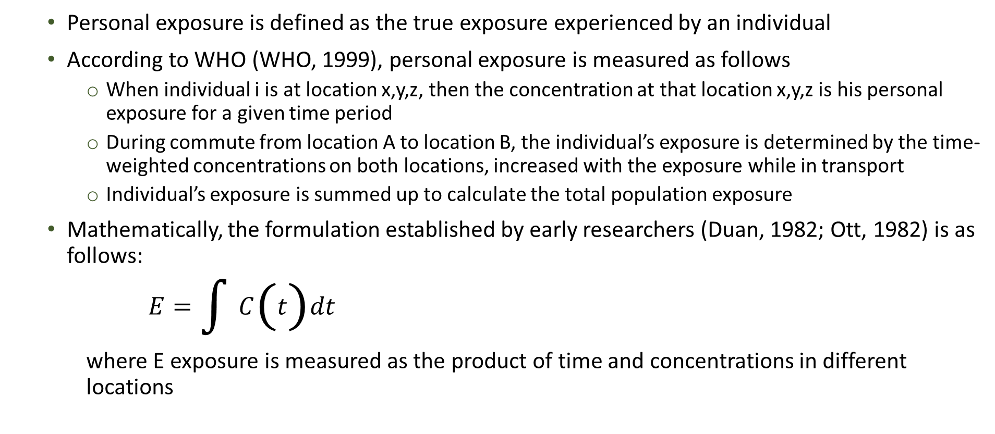
Personal Exposure
    Personal exposure is defined as the true exposure experienced by an individual
    According to WHO (WHO, 1999), personal exposure is measured as follows
    When individual i is at location x,y,z, then the concentration at that location x,y,z is his personal exposure for a given time period
    During commute from location A to location B, the individual’s exposure is determined by the time-weighted concentrations on both locations, increased with the exposure while in transport
    Individual’s exposure is summed up to calculate the total population exposure
    Mathematically, the formulation established by early researchers (Duan, 1982; Ott, 1982) is as follows:
$E=\int{C\left(t\right)dt}$
    where E exposure is measured as the product of time and concentrations in different locations
Notes:
As extracted from WHO, Personal exposure can be defined as the true exposure experienced by individuals. When individual i is at location x,y,z, then the concentration on that location x,y,z is his personal exposure for a given time period. But when the individual travels from location A to location B, the exposure is determined by the time-weighted concentrations on both locations, increased with the exposure while in transport. The exposure of a complete population is the sum of all individual exposures.
Formally, personal exposure to air pollution can be presented as a multiplication of concentrations with the time spent in different locations

Slide 9
Personal Exposure - Microenvironments
    In measuring personal exposure, it is important to account for the effect of location (or microenvironment) and personal activities (that impacts the rate of inhalation) in exposure assessment
    Although, people might spend most of their time indoors (e.g home), they travel by different means of transportation to different microenvironments (e.g. work, school, shops etc.) which leads to different levels of exposure (Kornartit et al., 2010)
    Important to understand the movement of people and the time spent in different microenvironment especially to assess their mobility effect on exposure to TRAP
    Studies have assessed the difference in exposure levels between assuming people to be at home (static exposure) versus being at different microenvironments (dynamic exposure)
    Studies have reported exposure differences ranging from 12% to 20% depending upon pollutant type between static approach and dynamic approach (Beckx et al., 2009; Dhondt et al., 2012a; Vallamsundar et al., 2016).
Notes:
When measuring personal exposure, it is important to include the different locations (or microenvironments) and activities people are involved in as it helps to determine the rate at which people are inhaling the pollutant mass. For e.g., studies assessing the personal exposure use census data which assumes people to be at home but in reality they move to different locations and are involved in different activities that could lead to different levels of exposure. Hence, it is key to incorporate the different locations, and the time spent in these locations to determine the true exposure experienced by people.
As extracted from Vallamsundar et al, studies have shown the importance of dynamic population modeling over the traditional static modeling for accurate estimation of population exposure to air pollution. They find significant exposure differences (ranging from 12% to 20% depending upon pollutant type) between static approach where people are assumed to be at fixed residential location and dynamic approach.

Slide 10
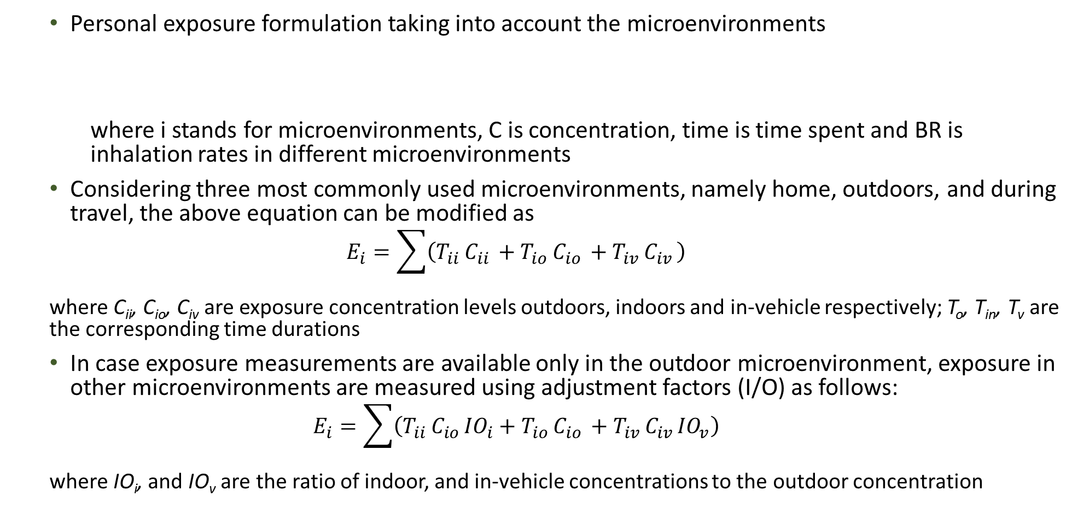

Personal Exposure - Microenvironments
    Personal exposure formulation taking into account the microenvironments
    where i stands for microenvironments, C is concentration, time is time spent and BR is inhalation rates in different microenvironments
    Considering three most commonly used microenvironments, namely home, outdoors, and during travel, the above equation can be modified as
    $$E_{i}=\sum{\left(T_{ii }C_{ii }+T_{io }C_{io }+T_{iv }C_{iv }\right)}$$
    where C_{ii}, C_{io}, C_{iv} are exposure concentration levels outdoors, indoors and in-vehicle respectively; T_{o}, T_{in}, T_{v} are the corresponding time durations
    In case exposure measurements are available only in the outdoor microenvironment, exposure in other microenvironments are measured using adjustment factors (I/O) as follows:
    $$E_{i}=\sum{\left(T_{ii }C_{io }{IO}_{i}+T_{io }C_{io }+T_{iv }C_{iv }{IO}_{v}\right)}$$
    where IO_{i}, and IO_{v} are the ratio of indoor, and in-vehicle concentrations to the outdoor concentration
Personal Exposure $=$ $\sum_{i=0}^{all i microenvironments}{C_{i}×{time}_{i}×{BR}_{i}}$
Notes:
As extracted from Askariyeh et al, 2019: Exposure is calculated as a product of concentration and time spent in different locations. When incorporating the different microenvironments, the formulation is changed to account for the concentration, time and inhalation rate in different microenvironments. Incorporating three commonly used microenvironments, formulation is customized into the following considering indoors, outdoors and in-vehicle.
$E_{i}=\sum{\left(T_{i }C_{i }+T_{o }C_{o }+T_{v }C_{v }\right)}$ (2)
where C_{i}, C_{o}, C_{v} are the concentration levels measured indoors, outdoors, and in-vehicle respectively; and T_{i}, T_{o}, T_{v} are the corresponding time durations. Concentrations predicted by the model corresponds only to the ambient concentrations and concentrations in other microenvironments (indoors and in-vehicle) depend on factors related to the pollutant type and its penetration rate, air exchange rate inside the building, and traffic conditions (idling, windows opened/closed) etc. To incorporate the changes in concentrations for each microenvironment, Eq(2) is modified into Eq(3). The adjustment factors are used to account for the difference in indoor and in-vehicle concentration compared to ambient concentration.
$E_{i}=\sum{\left(T_{ii }C_{io }{IO}_{i}+T_{io }C_{io }+T_{iv }C_{iv }{IO}_{v}\right)}$ (3)
where IO_{i}, and IO_{v} are the adjustment factors for indoor, and in-vehicle locations.

Slide 11
Personal Exposure - Microenvironments
The I/O ratios depend on the type of pollutant and location (Grau-Bové and Strlič, 2013)
The I/O ratio for indoors depend on the pollutant penetration factor, air exchange rate within the building and particle deposition rate (Wallace, 1996)
The I/O ratio for in-vehicle depends on the meteorological conditions, traffic activities (congestion), road conditions, and vehicle condition (windows open/closed) (Marshall et al., 2003)
Currently there are very few studies available in the literature that measure the I/O ratios under a wide spectrum of conditions. Table summarizes the literature findings of the average I/O ratio for PM_{2.5} in the U.S
Figure Source: Extracted from Vallamsundar et al., 2016
Notes:
As extracted from Vallamsundar et al, 2016. The I/O ratio for indoors depend on the factors related to the pollutant penetration factor, air exchange rate within the building and particle deposition rate. The I/O ratio for in-vehicle depends on the meteorological conditions, traffic activities (congestion), road conditions, and vehicle condition (windows open/closed). Currently there are very few studies available in the literature that measure the I/O ratios under a wide spectrum of conditions. Table summarizes the literature findings of the average I/O ratio for PM2.5 in the U.S. Based on the literature findings, the average I/O ratios for indoors and in-vehicle are 0.88 and 1.79 respectively, which are used in this study. A higher in-vehicle I/O is due to
the proximity to the emission source (roadways) and a lower indoor I/O is due to the building shielding effect.

Slide 12
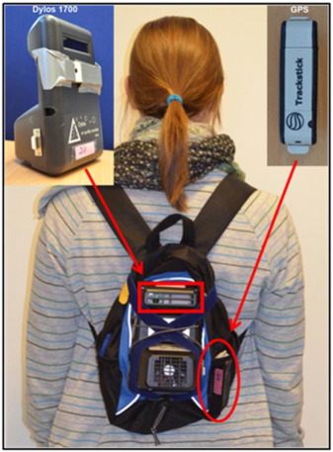
Personal Monitoring
    Ambient monitoring data and models provide an estimate of the overall population exposure based on several assumptions (such as fixed location information, model formulation etc.)
    Personal monitoring provides a wealth of information on the short-term exposures specific to the individual participants.
    Personal monitors accurately track the exposure levels in different microenvironments, and when combined with portable global positioning systems (GPS), they can partition exposure according to different locations (or microenvironments) visited
Figure Source: Extracted from Steinle et al., 2015
Notes:
While ambient monitoring data and models provide an overall estimate of exposure, they cannot track exposure at the individual level. Further, these methods have a number of assumptions made related to sparse network, model formulation etc. One of the most accurate way to measure the true exposure is to measure the actual exposure experienced by people through the use of personal samplers. These samplers or monitors provide a wealth of information on short-term exposure and when combined with location tracking devices, they also can accurately track the exposure levels in different locations. Figure shows a person equipped with a backpack containing air sampling device strapped onto the backpack with the inlet (red square) and fan exposed to the air, and the GPS device placed in the side mesh pocket

Slide 13
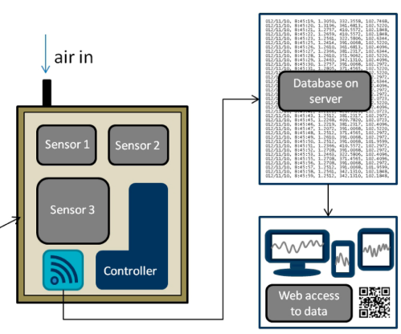
Emergence of Low-cost Sensors
Components of a LCS
    Recently there has been a change in personal monitoring with the emergence of low-cost sensors
    This emergence is due to the increase in computing power, possibility to couple sensors with smartphones and data sharing capabilities)
    LCS collects real-time air quality data that provides high-resolution spatial and temporal data
    They can help create a detailed spatial and temporal mapping of the city or urban districts (Millet et al., 2009) and thus can be used by people and communities to check air pollution levels outside
    Broadly classified as
      Fixed LCSs are heavier and larger than mobile units. However, they tend to have better battery life and more sensors attached.
      Mobile LCSs are smaller, wearable, and able to fit on backpacks or belt loops. They are dependent on cell phone apps to help communicate data to the user.
(Figure Source: Snyder et al., 2013)
Notes:
Key elements in an LCS are (a) the sensor element that responds to the pollutant species of interest and varies with the pollutant mass in a given volume of sampled air; (b) the transducer that converts the responses to electrical signals; (c) data storage capability or a link to a communication device (e.g., micro-radio transmitter or cell phone); and (d) a source of power (e.g., battery or energy harvesting). Individual sensors are usually integrated into a platform of sensors known as a sensor node. Each sensor node contains a sensor board, the sensors, and a control board which integrates all the elements of the hardware such as GPS, data storage, communication ports, and signal conditioning.
LCSs can be grouped into two categories as fixed or mobile. Fixed units are heavier and larger than mobile units. However, they tend to have better battery life and more sensors attached. Mobile units are a newer trend to create spatial-temporal maps of pollution as people move throughout their lives. They are smaller, wearable, and able to fit on backpacks or belt loops. They are dependent on cell phone apps to help communicate data to the user.

Slide 14
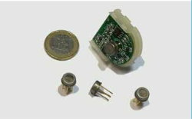
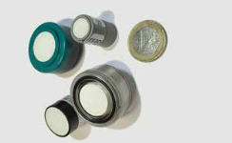
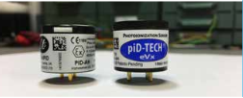
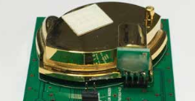
Types of Low-cost Sensors
Type | Common Gases Measured | Strength | Weaknesses
Electrochemical | CO, O₃, NO_{x} | Low Cost, small, real-time, sensitive, measure between mg/m³ to µg/m³ | Affected by humidity and temperature, interferences with carbon-monoxide (CO), VOC, NO₂, short lifespan
Metal Oxides | CO, O₃, NO_{x} | Small, stable, inexpensive, measure between mg/m³ to µg/m³ | Affected by humidity and temperature, fragile, less sensitive than electrochemical sensors
Photoionization Detector | CO₂ | Expensive, real-time, limited cost reactivity and interference, measure between mg/m³ to µg/m³ | Significant signal drift, need for frequent calibration
Optical Particle Detector | (Particle Matter) PM₁, PM_{2.5}, PM₁₀ | Small, inexpensive, commercially available | Must use models to calibrate and measure particle mass
Optical Sensor | CO, CO₂ | Compact, stable to changing humidity and temperature | Sensitive, must be calibrated
Source: European Commission, 2018, Snyder et al., 2013
Notes:
LCS can be classified in different ways based on the technology used to detect pollutants and their applications. Based on the technology, LCS can be classified as electrochemical and metal oxide sensors that detect pollutants based on the chemical reaction between gases in the air and the sensor, photoionization sensor that ionizes volatile organic compounds (VOCs) and measures the resulting electric current, optical particle detector that detects particulate pollution by measuring the light scattering particles and an optical sensor that detects gases by measuring the absorption of infrared light.

Slide 15
Calibration
    Key component to ensure satisfactory performance of LCS is the calibration process
    Ambient monitoring stations have several protocols in place to calibrate and validate the outputs at regular intervals
    Unlike ambient monitors, LCS do not have standardized protocols to calibrate them
    EPA recommends three options to calibrate these sensors (Williams et al., 2013)
      Option 1: employing the telemetry of local and federal air monitoring platforms to perform single-point calibration over wireless connections by syncing LCS with federal reference ambient monitors
      Option 2: developing LCS calibration kits for sale and distribution by the sensor developers. This would lead to direct calibration between lab tests and users
      Option 3: is one of most commonly used current technique that consists of a process of collocation wherein the LCS would be placed next to an ambient monitor to find bias trends
    Emerging methods of calibration in recent studies to address issues related to meteorological parameters
      Machine learning (Castell et al., 2017) and multivariate regression techniques (Spinelle et al., 2015)
Notes:
In 2013, the EPA suggested three options named the Straw-Man Approach (Williams et al., 2013).
Option 1 consisted of using the telemetry of local and federal air monitoring platforms to perform single-point calibration over wireless connections. Users would be able to zero their devices based on the EPA approved data in sync with the FEM approved monitors.
Option 2 consisted of developing LCS calibration kits for sale and distribution by the sensor developers. This would lead to direct calibration between lab tests and users. However, this calibration technique has not been developed as consumers realized the high costs and certifications it would require for this to work reliably.
Option 3 consisted of using collocated data from recognized FRM/FEM monitors to normalize response. Data could be taken from previous day air monitoring sites and posted to a generic website. Users could then compare the reference data to their data in order to find bias trends. This is the most common way community users calibrate their sensors.
In recent years due to performing issues related to meteorological parameters, machine learning techniques have been developed based on meteorology to help calibrate sensors that are affected by humidity and temperature. In a study done in Kirkeveien using AQmesh sensors, they suggested testing each sensor individually (Castell et al., 2017). With the growth of big data analytic trends, modeling, and machine learning, researchers are now capable of utilizing these techniques to post-process the data to correct for the impact of environmental conditions on electrochemical sensors.
Multivariate linear regression is another method used in a recent study (Spinelle et al., 2015). Their calibration was carried out using the least square method. They used NO₂, O₃, and NO for the reference measurements. In their study, NO₂ improved from 0.88 to 0.95 R² value. In the same study, they did an artificial neural network calibration (ANN). ANN are sophisticated modeling techniques able to model extremely complex functions. In this study, they focused on a radial based function ANN architecture.

Slide 16
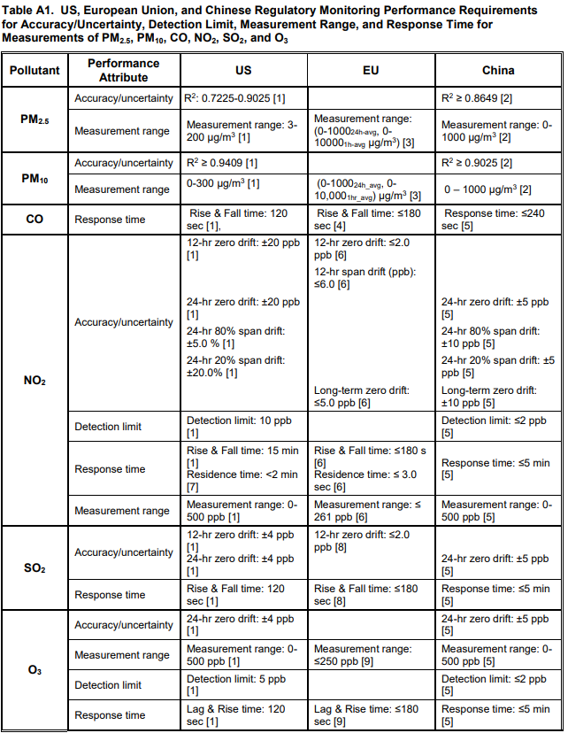
Validation
    Guidelines have been established by the United States, Europe and Chinese regulatory governments on the validation metrics of the LCS
    These metrics are quantified in form of R² or coefficient of determination to help in evaluating the effectiveness of the calibration techniques
    In more recent studies, other metrics such as mean bias, mean gross error, normalized mean bias, normalized mean gross error, correlation coefficient, and root mean square error have been used for validation (Schneider et al., 2017)
Source: Williams et al., 2018
Notes:
This table lists the guidelines established by the US, EU, and Chinese Regulatory Governments. It is important to note that these R² values cannot be reliably compared to each other because of differing factors between studies. For example, if some sensors were left to collect data longer than others, they would experience a larger time drift than the sensors that were collecting shorter data. This chart, however, can be the basis for starting research on which sensor to use in data collection. It also provides several sources in which to find in-depth comparisons. Finally, it shows some trends such as multi-sensors, such as Spec Sensors, may be effective in one aspect, CO, but lacking in other measurements, O₃.

Slide 17
Types of Low-cost Sensors
    Table lists some of the LCS currently used in research studies
Sensor | Pollutant | Mean R² | Measurement Range | Paper | Cost ($)
AirNut | PM_{2.5} | 0.86 | -- | (Karagulian et al., 2019) | 149
Aeroqual Series 500 | NO₂ | 0.88 | -- | (Karagulian et al., 2019) | 198
AirSensEur | O₃ | 0.89 | -- | (Karagulian et al., 2019) | 1800
AIRWino | PM₁₀ | 0.91 | -- | (Karagulian et al., 2019) | 1300
AirBeam | PM_{2.5} | 0.64 | Up to 400 µg/m³ | (Mukherjee et al., 2019) | 200
Met One | PM_{2.5} | 0.77 | 0 to 1000 µg/m³ | (Williams et al., 2014) | 5500
RTI MicroPEM | PM_{2.5} | 0.72 | 1 mg/m³ to 10,000 mg/m³ | (Williams et al., 2014) | 2000
Alphasense | PM₁ | 0.63 - 0.82 | -- | (District, 2019) | 310
Alphasense | PM_{2.5} | 0.65 - 0.80 | 0.3 – 20 µg/m³ | (District, 2019) | 310
Alphasense | PM₁₀ | 0.45 - 0.57 | -- | (District, 2019) | 310
Atmotube | PM_{2.5} | 0.88 | -- | (District, 2019) | 189
Spec Sensors | CO | 0.84 - 0.90 | -- | (District, 2019) | 500
Spec Sensors | NO₂ | 0.00 - 0.16 | -- | (District, 2019) | 500
Spec Sensors | O₃ | 0.00 - 0.24 | -- | (District, 2019) | 500
Dylos 1100 | PM | 0.81 | 500 nm and above 2.5 µg | (Challenge & Full, 2020) | 200
Aethalometer AE51 | Black Carbon | 0.79 – 0.94 | 0-1 mg BC/m³ | (Challenge & Full, 2020) | 6000
Notes:
This table shows some of research studies employing LCS for exposure analysis. The table shows the sensor name, pollutants measured in the study, validation quantified through R2, and cost.

Slide 18
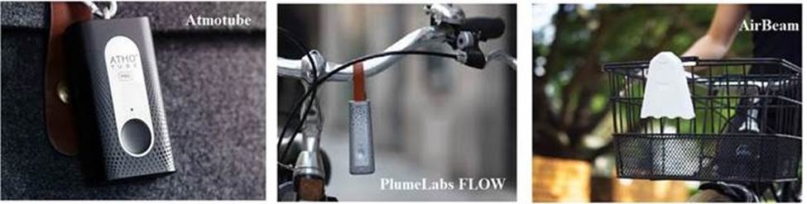
Low-cost Sensors in Motion
    Only limited number of LCS can withstand vibration and measure exposure when the person is in motion
    These LCSs are useful to measure personal exposure when people are running, biking, walking or doing physical activity
    Currently, some available LCS to measure exposure in motion are shown in the Figure below
    These LCS have an app that connects to the phone to provide continuous data and allows for export. In addition, these sensors provide real-time graphics of the rise and fall of the pollutant levels with time.
Notes:
One issue with the currently available LCS is that they are suitable for indoor or outdoor measurements at a fixed location. Limited sensors are available to measure exposure when the person is in motion such as running, biking, or walking. Some of the currently available commercial sensors are Atmotube, Flow and AirBeam that can withstand vibrations and measure exposure with a reasonable accuracy. These sensors have an app that connects to the phone for seamless data flow and exporting to other data platforms. These sensors measure a range of pollutants and through the app can show the variability of pollutant levels in relation to time and location.

Slide 19
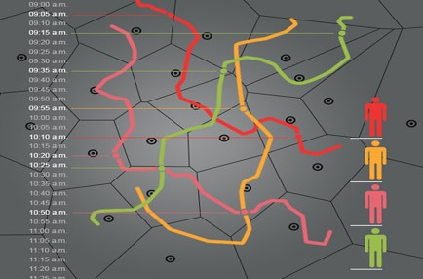
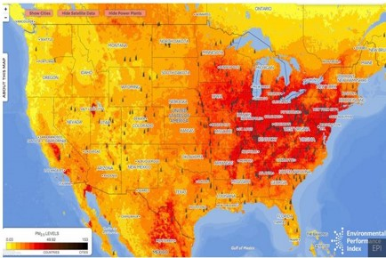
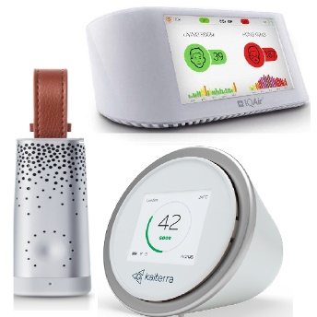
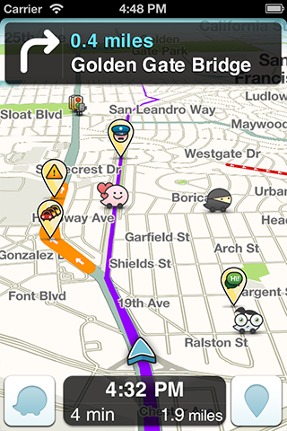
Future Research
Air Quality Maps
    Employing personal samplers for assessing population exposure is prohibitively expensive and is often limited to small areas or small sample sizes
    An emerging way to offset the cost of personal samples is the availability of low-cost sensors (LCS)
    LCS have been increasingly used in studies and have the potential to revolutionize the way air pollution data is collected and reported
    LCS have the possibility to cover larger samples and provide time-specific contribution based on crowd-sourced data
    Future potential of developing air quality maps or web based application for route selection etc.
Crowdsourced Information
Low Cost Sensors
App
Notes:
One major limitation of personal monitors is their cost that results in smaller samples. In recent years, emerging wearable sensors have offered the possibility to cover larger samples and provide a time-specific contribution. This paradigm change is accelerated by the advancement in commercialization resulting in low-cost and wearable sensors, increased computing power, coupling sensors with smartphones, and data sharing opportunities. Starting around 2004 with the introduction of cheaper microcontrollers, communities have begun using low-cost sensors (LCS) to monitor air pollution. LCS can be a check for communities on whether it is safe to work-out outside on any given day. LCS collects real-time air quality data that provides high-resolution spatial and temporal data. They can help create a detailed spatial and temporal mapping of the city or urban districts through web-based applications.

Slide 20
Limitations
Due to the underlying uncertainties related to the performance of LCSs, they have not been approved for regulatory monitoring purposes
Key limitations as extracted from Williams, 2019
  Unknown data quality of the LCS and how it was operated
  Undefined features of the LCS with respect to interferences, range of applicability
  Lack of a quality assurance project plan (QAPP)
  Lack of enough data analyses needed to validate raw data
  Inappropriate data conclusions (e.g., use of 5 min value to reflect health risk for a 24-hr based NAAQS)
  Vendor based health indices (pseudo air quality index (AQIs)) using real-time LCS data often undefined with respect to their underlying science or statistical basis
In addition to the above listed limitations, LCSs are sensitive to environmental factors (temperature and humidity)
  For e.g., PM sensors are found to overestimate at high humidity levels (Castell et al., 2017)
LCS are affected by long term drift and aging
Notes:
LCS data is susceptive to environmental factors. When a sensor is calibrated to an air monitor at one station and relocated, this introduces biases as different locations have different air pressure, temperatures, and humidity. Likewise, if a sensor is calibrated in the summer but used in the winter, meteorological conditions would skew the data. For example in a study done in Castell et al, 2017 using ten AQMesh units, there was a noticeable trend in which there was a higher bias when the temperature was below 5°C or above 10°C. More noticeable was the trend that some nodes were biased under similar humidity conditions. Thus, they concluded the need to evaluate each sensor before deploying it in the field.
LCSs are affected by long term drift and aging. Most sensors only last for a year or two. Therefore, when these studies are comparing reference sensors to LCS, one must consider the long-term effect drift has on the overall coefficient of determination (R2). LCS sensors are unreliable in data recording due to unknown factors such as tendencies to shut down or not record data for certain time periods.

Slide 21
Discussion
In light of the current uncertainties involved with their accuracy, EPA and other government agencies have not yet approved these sensors for regulatory monitoring purposes
However, more research and information is needed to understand the performance and bias caused by these sensors
Majority of studies in literature have focused on the calibration and validation of the LCS, including development of novel approaches to validate these sensors
One promising application is developing web based application and create high resolution spatial-temporal maps at the community level to help people to reduce their risk of exposure to air pollution
  To achieve this, there should be widespread usage of LCSs
  A collaboration between the consumer, market and research could help in wide-spread tracking of the pollution data
  Currently LCS is synced with the phone to measure location information. Future research can focus on obtaining physiological parameters such as heart rate and stress levels
Notes:
Due to issues with sensor performance and accuracy, LCS are not approved for regulatory monitoring purposes. More research and data is required to understand their performance, and bias, develop emerging ways to validate them or post-process the data with advanced learning or modeling techniques. Majority of studies have focused on the calibration and validation of the LCS including emerging techniques based on machine learning and regression analysis. Future applications could include developing applications to determine low exposure routes for users but can also provide important insights into the causation of microenvironments in a city. However, in order to make that happen, LCS needs to become more usable, and widespread. A collaboration between the consumer, market, and research to share the locational data combined with the pollution data will be beneficial to improving the overall health of the user and advancing the technology. Another promising application could include combining the sensors with other wearable devices to measure physiological metrics such as stress levels, breathing rate, oxygen intake that will help in providing a holistic picture.

Slide 22
Take-Home Messages
LCSs are an emerging new technology to measure personal exposure
They overcome the drawbacks inherent in traditional ambient monitoring in terms of sparse temporal-spatial coverage and personal samplers that are prohibitively expensive resulting in smaller samples
LCSs are increasingly being used by citizen scientists and community groups to measure air pollution in areas with no monitoring or to supplement the existing monitoring network
Key limitations include varying sensor performance, interpretation of sensor data across different sensors and validation
LCSs cannot replace traditional ambient monitoring, but do offer new opportunities to increase coverage and expand access to air quality monitoring to track air pollution
Notes:
LCS offer a number of advantages to measure personal exposure and overcome drawbacks inherent in ambient monitoring by covering larger area and temporal resolution at a minimum of 1 minute and being inexpensive (in the range of couple of hundreds of dollars), they overcome the drawbacks with personal samplers. Owing to these advantages they have been widely used by people to measure overall air quality levels in areas where no monitoring or sparse monitoring exist. Some of the key limitations is their reliability in terms of accuracy when compared to federally maintained reference monitors, sensitive to environmental factors, varying performance across different sensors and conditions (time period and season). These sensors while offer ways to complement the drawbacks with traditional monitoring techniques, they cannot replace federal monitors for regulatory air quality monitoring.

Slide 23
List of Abbreviations
GPS: Global positioning systems
I/O: Adjustment factors
LCS: Low-cost sensors
TRAP: Traffic-Related Air Pollution
WHO: World Health Organization

Slide 24
Acknowledgements
The author acknowledges materials adapted from the report titled chapter titled “Summary of Low-Cost Sensors and How They Apply to Air Pollution related to Public Health” by Peter Simmons, Suriya Vallamsundar, and Jeremy Johnson

Slide 25
References
Askariyeh, M.H., Vallamsundar, S. and Farzaneh, R., 2018. Investigating the Impact of Meteorological Conditions on Construction Emissions between Daytime and Nighttime Periods. Journal of the Transportation Research Board, 2672, pp: 99-110.
Askariyeh, M.H., Vallamsundar, S., Zietsman, J., Ramani, T., 2019. Assessment of Traffic-related Air Pollution: Case Study of Pregnant Women in South Texas. International Journal of Environmental Research and Public Health, 16(13):2433.
Beckx, C., Arentze, T., Panis, L.I., Janssens, D., Vankerkom, J., Wets, G., 2009. An integrated activity-based modelling framework to assess vehicle emissions: approach and application. Environment and Planning B: Planning and Design 36(6), pp: 1086 - 1102.
Castell, N., Dauge, F. R., Schneider, P., Vogt, M., Lerner, U., Fishbain, B., Broday, D., & Bartonova, A., 2017. Can commercial low-cost sensor platforms contribute to air quality monitoring and exposure estimates? Environment International, 99, pp: 293–302.
Challenge, S., & Full, I., 2020. Horizon 2020 Societal Challenge : Improving the air quality and reducing the carbon footprint of European cities Project : 690105 – ICARUS Full project title : Integrated Climate forcing and Air pollution Reduction in Urban Systems D1 .
Dhondt, S., Beckx, C., Degraeuwe, B., Lefebvre, W., Kochan, B., Bellemans, T., Int Panis, L., Macharis, C., Putman, K., 2012. Integration of population mobility in the evaluation of air quality measures on local and regional scales. Atmospheric Environment 59, pp: 67-74.
Dons, E., Beckx, C., Arentze, T., Wets, G., Int Panis, L., 2011. Using an Activity-Based Framework to Determine Effects of a Policy Measure on Population Exposure to Nitrogen Dioxide. Transportation Research Record: Journal of the Transportation Research Board, 2011. 2233: pp. 72-79.
Du, X., Wu, Y., Fu, L., Wang, S., Zhang, S., Hao, J., 2012. Intake fraction of PM2.5 and NOx from vehicle emissions in Beijing based on personal exposure data. Atmospheric Environment 57, pp: 233-243.
Duan, N., 1991. Stochastic microenvironment models for air pollution exposure. Journal of Exposure Analysis and Environmental Epidemiology 1, pp: 235-257.
Environmental Protection Agency. Interactive Map of Air Quality Monitors. Accessed at https://www.epa.gov/outdoor-air-quality-data/interactive-map-air-quality-monitors.
European Commission., 2018. Measuring air pollution with low-cost sensors. Report. Accessed at https://ec.europa.eu/environment/air/pdf/Brochure%20lower-cost%20sensors.pdf

Slide 26
References
Grau-Bové, J. and M. Strlič., 2013. Fine particulate matter in indoor cultural heritage: a literature review. Heritage Science 1, pp: 1-8.
Hatzopoulou, M., J.Y. Hao, and E.J. Miller., 2011. Simulating the impacts of household travel on greenhouse gas emissions, urban air quality, and population exposure. Transportation 38(6), pp. 871-887
Jerrett, M., Arain, A., Kanaroglow, P’, Portoglou, D., Sahsuvarogly, T., Morrison, J., Giovis, C., 2005. A review and evaluation of intraurban air pollution exposure models. Journal of exposure analysis and environmental epidemiology, 15(2), pp. 185-204.
Johannesson, S., Gustafson, P., Molnar, P., Barregard, L., Sallsten, G., 2007. Exposure to fine particles (PM2.5 and PM1) and black smoke in the general population: personal, indoor, and outdoor levels. Journal of Exposure Science and Environmental Epidemiology 17(7), pp: 613-624.
Karagulian, F., Barbiere, M., Kotsev, A., Spinelle, L., Gerboles, M., Lagler, F., Redon, N., Crunaire, S., & Borowiak, A., 2019. Review of the performance of low-cost sensors for air quality monitoring. Atmosphere, 10(9), 506.
Kaur, S., Nieuwenhuijsen, M.J., Colvie, R.N., 2007. Fine Particulate Matter and Carbon Monoxide Exposure Concentration in Urban Street Transport Microenvironment. Atmospheric Environment 41(23), pp. 4781-4810.
Kinghm, S., Briggs, D., Elliott, P., Fischer, P., Leb, E., 2000. Spatial variations in the concentrations of traffic related pollutants in indoor and outdoor air in Huddersffield, England. Atmospheric Environment 34(6), pp. 905-916.
Kornartit, C., Sokhi, R.S., Burton, M.A., Ravindra, K., 2010. Activity pattern and personal exposure to nitrogen dioxide in indoor and outdoor microenvironments. Environment International, 2010. 36(1), pp. 36-45
Künzli, N., Jerrett, M., Mack, W.J., 2005. Ambient air pollution and atherosclerosis in Los Angeles. Environmental Health Perspectives, 113(2): pp. 201-206.
Marshall. J.D., Riley. W.J., McKone. T.E., Nazaroff. W.W., 2003. Intake fraction of primary pollutants: motor vehicle emissions in the South Coast Air Basin. Atmospheric Environment 37, pp: 3455-3468.
Millet GP, Vleck VE, B. D., 2009. Physiological differences between cycling and running: lessons from triathletes. Sports Medicine, 39(3), pp. 179–206.
Mukherjee, A., Brown, S. G., Mccarthy, M. C., Pavlovic, N. R., Stanton, L. G., Snyder, J. L., Andrea, S. D., & Hafner, H. R., 2019. Measuring Spatial and Temporal PM2.5 Variations in Sacramento, Using a Network of Low-Cost Sensors. Sensors 19(21), pp. 4701.

Slide 27
References
Ott, W.R., 1982. Concepts of human exposure to air pollution. Environment International 7, pp. 179-196.
Riediker, M., Williams, R., Devlin, R., Griggs, T., Bromberg, P., 2003. Exposure to particulate matter, volatile organic compounds, and other air pollutants inside patrol cars. Environmental Science and Technology 37(10), pp. 2084-2093.
S. Steinle, S. Reis, C.E. Sabel, S. Semple, M.M. Twigg, C.F. Braban, S.R. Leeson, M.R. Heal, D. Harrison, C. Lin, H. Wu., 2015. Personal exposure monitoring of PM2.5 in indoor and outdoor microenvironments. Science of Total Environment, 508, pp. 383-394
Sapkota, A., Chelikowsky, A.P., Nachman, K.E., Cohen, A.J., Ritz, B., 2012. Exposure to particulate matter and adverse birth outcomes: A comprehensive review and meta-analysis. Air Quality, Atmosphere and Health, 5(4): pp. 369-381.
Sarnat, S.E., Klein, M., Sarnat, J.A., Flanders, W.D., Waller, L.A., Mulholland, J.A., Russell, A.G., Tolbert, P.E., 2010. An Examination of Exposure Measurement Error from Air Pollution Spatial Variability in Time-series Studies. Journal of Exposure Science and Environmental Epidemiology 20, pp. 135-146.
Shekarrizfard, M., Faghih-Imani, A., Crouse, D.L., Goldberg, M., Ross, M., Eluru, N., Hatzopoulou, M., 2016. Individual exposure to traffic related air pollution across land-use clusters. Transportation Research Part D: Transport and Environment, 46, pp. 339-350.
Snyder, E. G., Watkins, T. H., Solomon, P. A., Thoma, E. D., Williams, R. W., Hagler, G. S. W., Shelow, D., Hindin, D. A., Kilaru, V. J., & Preuss, P. W., 2013. The changing paradigm of air pollution monitoring. Environmental Science and Technology, 47(20), pp. 11369–11377.
Spinelle, L., Gerboles, M., Villani, M. G., Aleixandre, M., & Bonavitacola, F., 2015. Field calibration of a cluster of low-cost available sensors for air quality monitoring. Part A: Ozone and nitrogen dioxide. Sensors and Actuators, B: Chemical, 215, pp. 249–257.
Turner, D.B.: Workbook of Atmospheric Dispersion Estimates: An Introduction to Dispersion Modeling. 2nd edition. Lewis Publishers, Boca Raton, Florida, 1994.
Turpin, B.J., Weisel,C.P., Morandi, M., Colome, S., Stock,T., Eisenreich, S., and Buckley, B., 2007. Research Report on Relationships of Indoor, Outdoor, and Personal Air. Part I on Collection methods and descriptive analyses. Health Effects Institute, Boston.
Vallamsundar, S., Lin, J., Konduri, Karthik., Zhou, Xuesong., Pendyala, M. Ram., 2016. A comprehensive modeling framework for transportation-induced population exposure assessment. Transportation Research Part D: Transport and Environment 46, pp. 94-113.
Wallace, L., 1996. Indoor Particles: A review. Journal of Air & Waste Management Association 46(2), pp. 98-126.

Slide 28
References
Wang, S., Hao, J., Ho, M.S., Li, J., Lu, Y., 2006. Intake fraction of industrial air pollutants in China: Estimation and Application. Science of the Total Environment 354, pp. 127 – 141.
Wang, S., Hao, J., Ho, M.S., Li, J., Lu, Y., 2006. Intake fraction of industrial air pollutants in China: Estimation and Application. Science of the Total Environment 354, pp. 127 – 141.
Williams, R., 2019. EPA Tools and Resources Webinar:Low Cost Air Quality Sensors. 1–26. Accessed at https://www.epa.gov/sites/production/files/2019-04/documents/2019_sensors_update.pdf
Williams, R., Kaufman, A., Hanley, T., Rice, J., & Garvey, S., 2014. Evaluation of field-deployed low cost PM sensors. U. S. Environmental Protection Agency (EPA), EPA/600/R-(Washington DC).
Williams, R., Nash, D., Hagler, G., Benedict, K., Macgregor, I. C., Seay, B. A., Lawrence, M., Columbus, B., & Dye, T., 2018. Peer Review and Supporting Literature Review of Air Sensor Technology Performance Targets. Accessed at https://www.epa.gov/sites/production/files/2018-10/documents/peer_review_and_supporting_literature_review_of_air_sensor_technology_performance_targets.pdf
Williams, R., Watkins, T., and Long, R., 2014. Low Cost Sensor Calibration Options. EM: Air and Waste Management Association's Magazine for Environmental Managers. Air & Waste Management Association, Pittsburgh, PA, pp. 10-15,
World Health Organization, 1999. Monitoring ambient air quality for health impact assessment, WHO Regional Publications, European Series. World Health Organization - Regional Office for Europe, Copenhagen.
World Health Organization, 2014. Ambient (outdoor) air quality and health. Fact sheet, 313.
Zhang K., Batterman, S., 2009. Time allocation shifts and pollutant exposure due to traffic congestion: An analysis using the national human activity pattern survey. Science of the Total Environment 407(21), pp. 5493-5500.
Zhou. Y., Levy. J.I., Evans, J.S., Hammitt, J.K., 2006. The influence of geographic location on population exposure to emissions from power plants throughout China. Environment International 32, pp. 365-373.

