Slide 1
www.carteeh.org

Slide 2
Lecture #44: Transportation Decision Making—Tools and Methods
Tara Ramani, Ph.D.,P.E
Texas A&M Transportation Institute
t-ramani@tti.tamu.edu 979-317-2940
Materials used in the presentation are for education and discussion purposes only. Do not use or cite the materials without the permission of the author
The author declares that there is no conflict of interest
Lecture Track(s): TT/PPT
Notes:
Health Track (HT)—mainly targeted at urban planners, transportation planners, and engineers with limited knowledge of public health-related concepts;
Transportation Track (TT)—mainly targeted at environmental epidemiologists and public health professionals with limited knowledge of transportation-related concepts; and;
Planning and Policy Track (PPT)—mainly targeted at planners, civil servants, and policy and decision makers with particular interest in the science-policy link.

Slide 3
Introduction
Transportation system infrastructure and services are usually developed and managed by multiple (mostly public-sector) entities
These entities operate under a governance framework specific to their nation or region. Decision-making occurs within this context.
While approaches to transportation decision-making vary, they generally aim to achieve certain higher-level goals or objectives.
Quantitative and analytical tools and models can be used to support transportation decision-making and account for criteria of importance.
Notes:
Transportation is a derived demand- it exists within a broader social, economic and governance context. The transportation system as we commonly envision it includes the physical infrastructure and the operations occurring on it – however, it is a part of a much broader social and technical system. Transportation decisions are not made in a vacuum – they generally occur following prescribed planning processes, and operate within certain regulatory and policy (i.e. governance) frameworks. Usually, decisions are made to serve broader goals. Traditionally, quantitative and analytical tools to support transportation decision-making were focused on a single criteria or consideration of factors in monetary terms only (as in the case of a benefit-cost analysis). However, there is a movement towards multi-criteria approaches that consider factors that were not usually quantified in a purely economic analysis. This lecture discusses some key concepts regarding transportation decision-making, and their applications in the area of transportation, emissions and health.

Slide 4
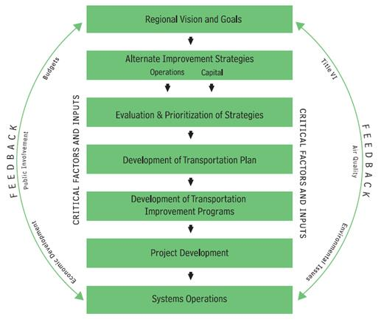
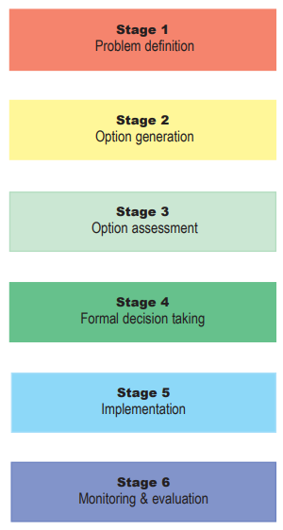
Transportation Planning Process
United States
Europe
Steps
  Identify goals/problems to be solved
  Identify options or solutions
  Prioritize and select from options
  Implement
  Monitor/evaluate
Decision-making occurs within this broader process
Source: European Union, Successful Transport Decision Making
Source: Federal Highway Administration, The Transportation Planning Briefing Book
Notes:
Transportation decision making occurs within the context of transportation planning and delivery process. The two diagrams on this slide show the transportation planning processes as outlined in the US Federal Highway Administration guidebook, and a handbook developed by the European Union. While the terminology used in each are different, we see that the steps outlined involve some commonalities:
1. identifying some high level goals (or problems to be solved), 2. considering the available options, 3. assessment/evaluation or prioritization among these options, 4. implementation of the options, 5. monitoring, evaluation or feedback. This entire process will generally involve entities from national, state/regional and local governments, and the process will be undertaken following applicable laws and regulations.

Slide 5
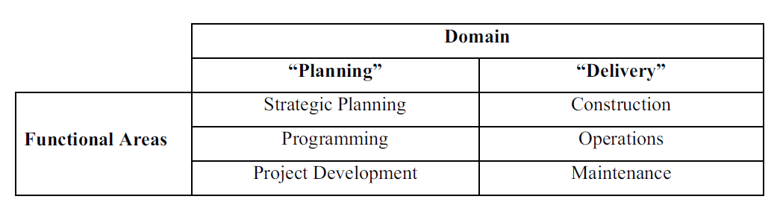
Transportation Decision-Making Domains
Decision-making can occur at various stages of the transportation planning process – long- and short- term planning and in the implementation
The tools and methods employed will differ based on this context
Domains and Functional Areas
Source: Gudmundsson et al (2016) "Sustainable transportation: Indicators, frameworks, and performance management.”, Springer
Notes:
The transportation planning process discussed in the previous slide generally includes longer-term planning activities that devolve into short-range implementation or delivery. Gudmundsson et al. (2016) classified transportation decision making as occurring in these two main domains of “planning” and “delivery”, with specific functional areas occurring under each. Decision making approaches and tools will vary according to this context. As stated by the authors, “Different indicators and different decision-making frameworks are likely to be at play, at least in part, across these quite distinct domains and functions. Strategic planning might, for example, be interested in the long-term economic growth benefits of a regional transportation plan, while a decision on whether to renew a road surface every 10 or 11 years would necessarily focus on the costs and environmental impacts.”

Slide 6
Approaches to Transportation Decision Making
Meyer and Miller (2001) list five approaches to decision-making
  Rational actor model
  “Satisficing model”
  Incremental approach
  Organizational process model
  Political bargaining model
Decision-making tools and approaches based on engineering or economic analyses tend to prevail
Common tools/methods in the context of transportation and health
  Benefit-Cost Analyses
  Multi-Criteria Decision Making
  Performance measures and indicators
  Health impact assessments
Notes:
Meyer and Millers textbook on transportation planning includes a widely cited classification of transportation decision-making approaches, with the rational actor model being the most commonly-used approach (i.e. to select from alternatives to maximize utility with respect to a specific goal). Gudmundsson et al (2016) discuss other classifications of decision-making approaches, such as the vision-led, plan-led and consensus-led approaches (Emberger et al, 2008), in which the plan-led approach is one that “tends to take the form of a more rational or systems-based analysis by technocrats”
In general, prevailing decision making practices have favored quantifiable data, which has led to an emphasis on engineering and economics based analyses (Cascetta et al., 2015).
For the remainder of the lecture, we will focus on some key decision-making approaches/tools that can be applied in the context of transportation and health, with examples. These approaches are not completely distinct from each other. When applied in the context of health and transportation, they may have overlaps and commonalities such as the consideration of multiple criteria relating to human and environmental health and the quantification of the same.

Slide 7
Benefit-Cost Analyses (BCA)₁
“A benefit-cost analysis is a systematic evaluation of the economic advantages (benefits) and disadvantages (costs) of a set of investment alternatives”
  Generally used for project selection/prioritization
  B/C Ratio = Net Present Value (NPV) of Benefits/NPV of Costs
  Ratio above 1 represents a net benefit
  Limitations – not every benefit or cost is quantifiable in economic terms
Benefit-cost analyses can be used at all stages of the transportation planning lifecycle, to assess alternatives
Benefit-cost analyses are distinct from economic impact analyses, which also consider follow-on impacts outside the scope of a benefit-cost analysis
Sources: Minnesota Department of Transportation
TRB Transportation Economics Committee
Notes:
Benefit-costs analyses are based on bringing all possible costs and benefits into a common framework (of monetary value). Costs and benefits over a particular analysis period are converted to net present value, with a B/C ratio greater than 1 representing a net benefit on the investment, with a higher ratio being considered more favorable.

Slide 8
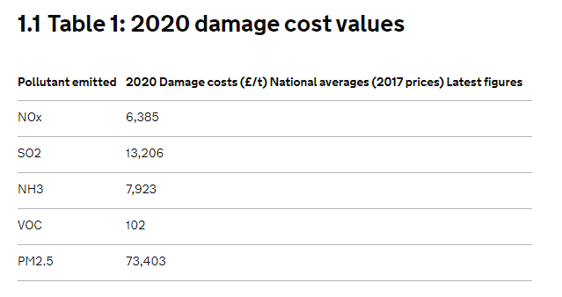
Benefit-Cost Analyses₂
Highway Project Example
Costing Out Environmental Impacts
Benefits
Initial right-of-way acquisition
Costs
Changes in user travel times
Changes in vehicle operating costs (fuel, oil, tires, maintenance, depreciation)
Changes in collisions
Changes in emissions (combined costs of CO, NO_{X}, PM₁₀, VOC, SO_{X}, and road dust)
Changes in agency costs for highway maintenance and operations
Changes in highway residual values
Construction costs
Source: UK Government - Air Quality Appraisal Damage Cost Guidance
Source: Highway Economic Requirements System - State Version
Notes:
The example on the left of the slide shows the list of benefits and costs that may be considered for a highway project example of a benefit-cost analysis. It is often a challenge to quantify the benefits (or disbenefits) that may occur due to environmental impacts such as air pollution. As shown in the right hand portion of the slide, air pollutant damage costs are used to allow for these factors to be included in a benefit-cost analysis. They are generally based on studies that estimate the costs of the damages caused by these pollutants, and are expressed as a cost per ton of a pollutant being emitted.

Slide 9
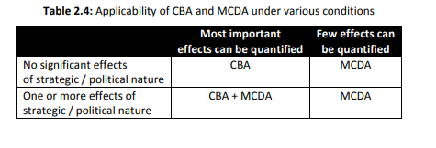
Multi-Criteria Decision Making
In BCA, all aspects are monetized, i.e. expressed in the same units.
In multi-criteria decision making (MCDM) or multi-criteria decision analysis (MCDA), the factors considered can include those not easily quantifiable in monetary terms, as well as qualitative criteria
It can handle subjectivity (i.e. takes into account decision-makers preferences)
Common MCDM approaches
  Multi-attribute utility theory
  Analytic hierarchy process
  Outranking methods
Source: Barfod and Leleur (2014)
Source: Barfod and Leleur (2014)
Notes:
In a benefit-cost analysis, all aspects under consideration are monetized and expressed in monetary units. While these analyses, in theory, do incorporate a range of cost and benefit considerations, they tend to ignore factors that are not easily quantified. Multi-criteria decision making (MCDM), sometimes referred to as Multi-criteria decision analysis (MCDA) are an area of study that allow for more qualitative factors to be included in the process. It also allows for decision-makers’ preferences to be incorporated into the analyses through standardized approaches such as the analytic hierarchy process. It can also promote greater stakeholder involvement in decision making.
The use of MCDA and benefit-cost analyses are not mutually exclusive, and their use in specific scenarios may depend on the context, as shown in the table. As stated in the DTU Compendium (Barfod and Leleur, 2014) , “MCDA may be seen as an extension of the CBA. In practice, the CBA represents only a part of the decision making basis; other non-monetised impacts represent another, and the final choice is based on a weighing of these different parts. Using only CBA this weighing may be completely opaque. The MCDA methods offer a tool for approaching the subjectivities in the decision process and for reaching a decision in a methodological and transparent way. In MCDA both the monetised impacts of the CBA as well as more strategic impacts can be accommodated in one approach. This also implies that equity considerations can be explicitly accounted for in the MCDA”

Slide 10
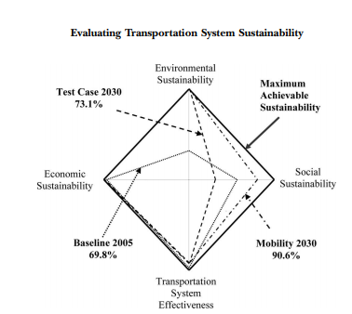
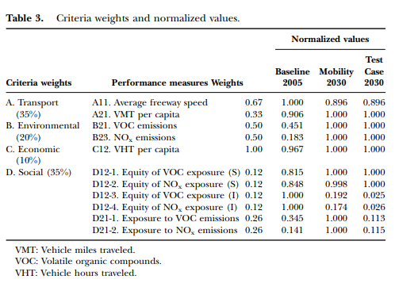
MCDM Examples
Source: Ramani (2008)
Source: Jeon et al (2010)
Notes:
This slide shows two example applications of multi-criteria decision making applied in the transportation context. In the first, by Jeon et al (table and figure on the left side of the page), different regional transportation plans are evaluated against economic, social, environmental, and transportation system criteria and scored on a 0-1 scale (shown as percentages in the figure). In the other example, by Ramani, a highway improvement scenario is contrasted with a baseline case along four links of a corridor on the basis of an aggregated score on a 0-1 scale, reflecting a combined sustainability score. Both these examples use “multiattribute utility theory” or MAUT approach, in which different indicators are quantified, then normalized or scaled (usually on a 0-1 or percentage scale with a score of 0 and 1 representing the worst and best possible outcomes based on predefined criteria), and then aggregated on the basis of weight associated with different criteria. Simply put, the MAUT approach used a weighted sum of normalized utlity values for individual criteria to be used to score alternatives.
Some other key MCDM concepts that are relevant include the concept of utility functions (how the utility of a particular criteria varies between the maximum and minimum values, it is usually assumed to be linear unless specific otherwise), as discussed further in Ramani (2008), and the concept of sensitivity analyses, which can be used to vary criteria weights to determine to what extent weighting may affect the ultimate outcome when selecting between options.
Sources:
Jeon, Christy Mihyeon, Adjo A. Amekudzi, and Randall L. Guensler. "Evaluating plan alternatives for transportation system sustainability: Atlanta metropolitan region." International Journal of Sustainable Transportation 4.4 (2010): 227-247.
Ramani, T.L., 2008. An improved methodology for multi-criteria assessment of highway sustainability (Masters Thesis, Texas A & M University).

Slide 11
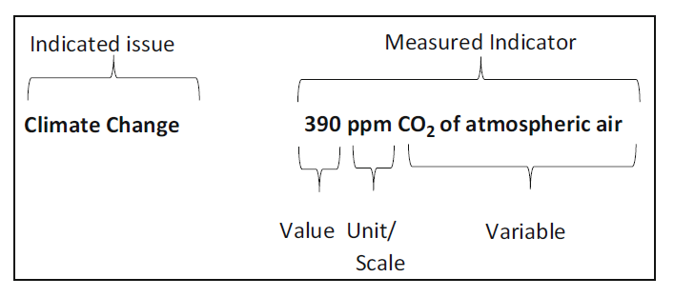
Performance Measures/Indicators
Performance measures/indicators – quantifiable criteria used to evaluate progress
May be used within quantitative decision analysis processes, or outside of it
General Applications
  Description/reporting
    Evaluation
    Accountability/troubleshooting
    Decision Support
    Communication
Source: Gudmundsson et al (2016) "Sustainable transportation: Indicators, frameworks, and performance management.”, Springer
Notes:
Performance measures (or indicators) are quantifiable criteria that can be used to evaluate progress toward achieving goals. The can serve as a decision-support tool in their own right, or form a part of a formal, quantitative decision-making process (such as the MCDM examples shown previously). They have a wide range of applications, and can be used for purposes such as reporting, evaluation, ensuring accountability or troubleshooting issues, decision-support, and communication.
While the terms are often used interchangeably, a performance measure can be considered to be an indicator used within a specific goal-oriented context. A hierarchy of goals→ objectives→ measures can help define robust performance measures. Performance measures or indicators should be measurable, and have a specific unit and scale of measurement, as shown in the example of climate change, being an issue, which could be measured by carbon dioxide concentrations in the atmosphere.
Sources:
Gudmundsson, H., Marsden, G., Hall, R., and Zietsman, J.., 2016. Sustainable transportation: Indicators, frameworks, and performance management.
Zietsman, J., Ramani, T., Potter, J., Reeder, V., Deflorio, J. 2011. A guidebook for sustainability performance measurement for transportation agencies (Vol. 708). Transportation Research Board.

Slide 12
Health Impact Assessments
Health impact assessments (HIAs) are used to determine possible health effects of a particular project or plan, including of transportation investments
Even when HIAs are not mandated as part of the transportation planning process, they are increasingly being used by decision-makers
Transportation-health considerations (Source: CDC Transportation Health Impact Assessment Toolkit
  Reduce Vehicle Miles Traveled (VMT)
  Expand Public Transportation
  Promote Active Transportation
  Incorporate Healthy Community Design Features
  Improve Safety for All Users
  Ensure Equitable Access to Transportation Networks
Notes:
Health impact assessments are conducted for a wide range of transportation and non-transportation projects. In the area of transportation, they are increasingly being used by transportation agencies. HIAs can be conducted with varying levels of rigor, from being highly qualitative assessments, to requiring extensive quantitative data. In general, HIAs can be viewed as a decision-support tool that can help account for health-related impacts. This slide provides an example of the types of considerations that can be used to assess transportation investments’ health impacts.

Slide 13
Research Gaps and Future Directions
Consideration of a wider range of transportation impacts (i.e. multiple, diverse criteria)
More rigorous quantification or assessment of hard-to-quantify factors
Tools for improved collaboration and stakeholder engagement
Notes:
As transportation moves towards becoming more interdisciplinary, and as broader considerations such as health and sustainability are given importance, there is a growing need for decision making tools to support this environment. Even traditional tools like cost-benefit analyses can incorporate factors that were previously considered as intangible, once research is available to establish monetary costs. Multi-criteria decision making can support more collaborative decision-making, in which subjective evaluations by stakeholders can be used to elicit priorities or rank options using processes such as the Analytic Hierarchy Process.

Slide 14
Take-Home Messages
Transportation decision-making occurs within a broader social and governance context
Decision-support tools can help systematize the assessment of options and their selection
    Cost-benefit analyses can help put a monetary value to factors under consideration
    Multi-criteria approaches can handle subjectivity and stakeholder priorities
    Performance measurement can support decision making
    Health impact assessments can support more explicit consideration of health in transportation decisions
Notes:
Transportation decision-making does not occur in a vacuum. Rather it reflects the existing priorities and needs of the decision-makers and to some extent, of society at large, and is constrained by the transportation planning process. The decision-support tools we discussed in this lecture can help make more systematic assessments of transportation investments, with multi-criteria approaches and HIAs supporting the consideration of a broader range of criteria in more flexible terms than a pure monetary cost-benefit analysis.

Slide 15
List of Abbreviations
BCA – Benefit-cost analysis
B/C ratio – Benefit-cost ratio
NPV- Net present value
CO2 – Carbon dioxide
MCDM – Multi-criteria decision making
MCDA – Multi-criteria decision analysis
HIA – Health impact assessment
VMT – Vehicle miles of travel

Slide 16
References
Barfod, M.B. and Leleur, S., 2014. Multi-criteria decision analysis for use in transport decision making.
Cascetta, E., Cartenì, A., Pagliara, F. and Montanino, M., 2015. A new look at planning and designing transportation systems: A decision-making model based on cognitive rationality, stakeholder engagement and quantitative methods. Transport policy, 38, pp.27-39.
Emberger, G., Pfaffenbichler, P., Jaensirisak, S. and Timms, P., 2008. “Ideal” decision-making processes for transport planning: A comparison between Europe and South East Asia. Transport Policy, 15(6), pp.341-349.
Gudmundsson, H., Marsden, G., Hall, R., and Zietsman, J.., 2016. Sustainable transportation: Indicators, frameworks, and performance management.
Jeon, C, Amekudzi, A., and Guensler, R.. "Evaluating plan alternatives for transportation system sustainability: Atlanta metropolitan region." International Journal of Sustainable Transportation 4.4 (2010): 227-247.
Meyer, M.D. and Miller, E.J., 2001. Urban transportation planning: A decision-oriented approach.
Ramani, T.L., 2008. An improved methodology for multi-criteria assessment of highway sustainability (Masters Thesis, Texas A & M University).
Zietsman, J., Ramani, T., Potter, J., Reeder, V., Deflorio, J. 2011. A guidebook for sustainability performance measurement for transportation agencies (Vol. 708). Transportation Research Board.

Slide 17
References
Links
  CDC Transportation Health Impact Assessment Toolkit https://www.cdc.gov/healthyplaces/transportation/hia_toolkit.htm
  European Union, Successful Transport Decision Making http://civitas.eu/sites/default/files/guidemapshandbook_web.pdf
  Federal Highway Administration, The Transportation Planning Briefing Book https://www.fhwa.dot.gov/planning/publications/briefing_book/fhwahep18015.pdf
  Highway Economic Requirements System - State Version http://bca.transportationeconomics.org/models/hers-st
  Minnesota Department of Transportation, Benefit Cost Analysis, https://www.dot.state.mn.us/planning/program/benefitcost.html
  TRB Transportation Economics Committee http://bca.transportationeconomics.org/home/bca-vs-economic-impact-analysis
  UK Government - Air Quality Appraisal Damage Cost Guidance https://www.gov.uk/government/publications/assess-the-impact-of-air-quality/air-quality-appraisal-damage-cost-guidance

Slide 18
Reading List
Dannenberg, A.L., Ricklin, A., Ross, C.L., Schwartz, M., West, J., White, S. and Wier, M.L., 2014. Use of health impact assessment for transportation planning: importance of transportation agency involvement in the process. Transportation Research Record, 2452(1), pp.71-80.
Jeon, C.M., 2010. Incorporating uncertainty into transportation decision making: Sustainability-oriented approach. Transportation research record, 2174(1), pp.58-67.
Litman, T., 2003. Integrating public health objectives in transportation decision-making. American Journal of Health Promotion, 18(1), pp.103-108.
Sinha, K.C. and Labi, S., 2011. Transportation decision making: Principles of project evaluation and programming. John Wiley & Sons.
Triantaphyllou, E., 2000. Multi-criteria decision making methods. In Multi-criteria decision making methods: A comparative study (pp. 5-21). Springer, Boston, MA.

