Slide 1
www.carteeh.org

Slide 2
Lecture #48: Policies to Mitigate Traffic-Related Emissions
Georges Bou-Saab
Arcadis U.S., Inc.
Email: GeorgesBouSaab@arcadis.com, Phone: 515-231-4525
I declare that there is no conflict of interest while preparing the lecture
Lecture Track(s): PPT
Notes:
Health Track (HT)—mainly targeted at urban planners, transportation planners, and engineers with limited knowledge of public health-related concepts;
Transportation Track (TT)—mainly targeted at environmental epidemiologists and public health professionals with limited knowledge of transportation-related concepts; and;
Planning and Policy Track (PPT)—mainly targeted at planners, civil servants, and policy and decision makers with particular interest in the science-policy link.

Slide 3
Introduction: GHG Emissions by Sector
​GHG emissions from transportation is the largest contributor of U.S. GHG emissions.
Notes:
The transportation sector is one of the largest contributors to anthropogenic U.S. greenhouse gas (GHG) emissions. According to the Inventory of U.S. Greenhouse Gas Emissions and Sinks 1990–2018 (the national inventory that the U.S. prepares annually under the United Nations Framework Convention on Climate Change), transportation accounted for the largest portion (29%) of total U.S. GHG emissions in 2018. Cars, trucks, commercial aircraft, and railroads, among other sources, all contribute to transportation end-use sector emissions. (Green Vehicle Guide, EPA 2020)
The Transportation sector includes the movement of people and goods by cars, trucks, trains, ships, airplanes, and other vehicles. The majority of greenhouse gas emissions from transportation are carbon dioxide (CO2) emissions resulting from the combustion of petroleum-based products, like gasoline, in internal combustion engines. The largest sources of transportation-related greenhouse gas emissions include passenger cars and light-duty trucks, including sport utility vehicles, pickup trucks, and minivans. These sources account for over half of the emissions from the transportation sector. The remaining greenhouse gas emissions from the transportation sector come from other modes of transportation, including freight trucks, commercial aircraft, ships, boats, and trains, as well as pipelines and lubricants. Relatively small amounts of methane (CH4) and nitrous oxide (N2O) are emitted during fuel combustion. In addition, a small amount of hydrofluorocarbon (HFC) emissions are included in the Transportation sector. These emissions result from the use of mobile air conditioners and refrigerated transport. (Greenhouse Gas Emissions, EPA 2021)
In 2018, greenhouse gas emissions from transportation accounted for about 29 percent of total U.S. greenhouse gas emissions, making it the largest contributor of U.S. greenhouse gas emissions. In terms of the overall trend, from 1990 to 2018, total transportation emissions have increased due, in large part, to increased demand for travel. The number of vehicle miles traveled (VMT) by light-duty motor vehicles (passenger cars and light-duty trucks) increased by 46.1 percent from 1990 to 2018, as a result of a confluence of factors including population growth, economic growth, urban sprawl, and periods of low fuel prices. Between 1990 and 2004, average fuel economy among new vehicles sold annually declined, as sales of light-duty trucks increased. Starting in 2005, average new vehicle fuel economy began to increase while light-duty VMT grew only modestly for much of the period. Average new vehicle fuel economy has improved almost every year since 2005 slowing the rate of increase of CO2 emissions, and the truck share is about 52 percent of new vehicles in model year 2018. (Greenhouse Gas Emissions, EPA 2021)

Slide 4



Introduction: Health and Emissions Reduction
Severe health problems are associated with air pollution exposure related to roadway traffic.
There are three routes to reducing GHGs from transportation:
Activity
Technology
Fuels
Notes:
Smog and health (Mobile Source Pollution, EPA 2016):
Ground level or "bad" ozone is not emitted directly into the air but is created by chemical reactions between oxides of nitrogen (NOx) and volatile organic compounds (VOC) in the presence of sunlight. Ozone at ground level is a harmful air pollutant, because of its effects on people and the environment, and it is the main ingredient in “smog." Breathing ozone can trigger a variety of health problems, particularly for children, the elderly, and people of all ages who have lung diseases such as asthma. Breathing ozone can:
Make it more difficult to breathe deeply and vigorously;
Cause shortness of breath, and pain when taking a deep breath;
Cause coughing and sore or scratchy throat;
Inflame and damage the airways;
Aggravate lung diseases such as asthma, emphysema, and chronic bronchitis;
Increase the frequency of asthma attacks;
Make the lungs more susceptible to infection;
Continue to damage the lungs even when the symptoms have disappeared; and
Cause chronic obstructive pulmonary disease (COPD).
Particle pollution (also called particulate matter or PM) is the term for a mixture of solid particles and liquid droplets found in the air. Some particles, known as primary particles are emitted directly from a source, such as construction sites, unpaved roads, fields, smokestacks or fires. Others form in complicated reactions in the atmosphere of chemicals such as sulfur dioxides and nitrogen oxides that are emitted from power plants, industries and automobiles. These particles, known as secondary particles, make up most of the fine particle pollution in the country. Particulate Matter is associated with (Mobile Source Pollution, EPA 2016):
Premature death in people with heart or lung disease,
Nonfatal heart attacks,
Irregular heartbeat,
Aggravated asthma,
Decreased lung function, and
Increased respiratory symptoms, such as irritation of the airways, coughing or difficulty breathing;
Reduced visibility (haze) in many parts of the U.S., including many of our national parks and wilderness areas; and
Lake and stream acidification.
Near roadway air pollution and health (Mobile Source Pollution, EPA 2016):
People who live, work or attend school near major roads appear to have an increased incidence and severity of health problems associated with air pollution exposures related to roadway traffic. Children, older adults, people with preexisting cardiopulmonary disease, and people of low socioeconomic status are among those at higher risk for health impacts from air pollution near roadways. These risks include:
Higher rates of asthma onset and aggravation;
Cardiovascular disease;
Impaired lung development in children;
Pre-term and low-birthweight infants;
Childhood leukemia; and
Premature death.
There are three routes to reducing GHGs from transportation: increasing the efficiency of vehicle technology, changing how we travel and transport goods, and using lower-carbon fuels. All three are needed to help achieve societal goals on climate (Green Vehicle Guide, EPA 2019).
Activity - Choosing to take more public transit or telecommuting as well as driving cars more efficiently can have a big impact on GHGs from personal travel. Communities can use smart growth principles to make it easy for people to walk, bike, or take shorter car trips. GHGs from shipping can be reduced by shifting some packages from long-haul trucks to more efficient rail or marine vessels. Truck drivers can better optimize their delivery routes.
Technology - Weight reduction and improvements to engines and tires are just a few of the ways today's cars and trucks are becoming more fuel efficient. Some advanced technology vehicle - all electric vehicles and hydrogen fuel cell vehicles - are fuel efficient and emit zero harmful tailpipe emissions.
Fuels - There are many lower carbon transportation fuels in the market today and more in development. These include biofuels, renewable natural gas, electricity, and hydrogen.

Slide 5








Traffic Emission Sources
On-Road
Non-Road
Notes:
Sources of air pollution are on-road vehicles and engines (light-duty vehicles, heavy duty vehicles, and motorcycles) and non-road vehicles and engines (aircraft, nonroad diesel equipment, marine engines, ocean vessels, locomotives, lawn and garden equipment, recreation vehicles) - Overview of Air Pollution from Transportation, EPA 2020
Emissions from passenger cars have grown slower than those from other highway vehicles and locomotives, and emissions from aircraft (domestic flights) have grown relatively slowly (Transportation GHG Emissions and Trends, U.S. DOT 2016).

Slide 6
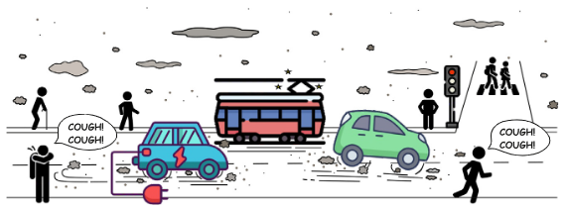
Traffic Emissions Classification
Exhaust (direct)
Non-exhaust (indirect)
Source: Piscietello et al., 2020
Notes:
Particulate matter (PM) is recognized as one of the main risk factors for adverse health effects and premature deaths worldwide. Human exposure to PM (especially the fine fraction) is correlated to the outbreak of allergy aggravation, respiratory, cardiovascular and even cerebrovascular diseases. Particulate matter can be directly emitted in the environment as primary aerosols or formed in the atmosphere by gas-to-particle conversion processes, i.e. secondary aerosol. Sources of particulate matter can be natural or anthropogenic: wind-blown dust, pollens, plant fragments, sea salt, combustion generated particles, road dust and material produced in the atmosphere by photo-chemical processes (Piscietello et al., 2020).
Traffic-related PM is classified into exhaust emissions (EE), which are the results of fuel oxidation and lubricant volatilization during the combustion process, and non-exhaust emissions (NEE), which are related to brake, tire, clutch and road surface wear and resuspension of road dust. Another relevant source of non-exhaust PM emissions in urban environments is represented by rail transport (trains, trams and subways). Besides the diverse generation process, these emissions also differ in size distribution and chemical composition of the released particles (Piscietello et al., 2020).
Exhaust emissions mainly contribute to the fine (PM 2.5 and PM 10)and ultrafine (PM 0.1) fractions of particulate matter. More specifically, particles formed in the engine and emitted through the tailpipe (primary particles) range from 0.03μm to 0.5μm, whereas the secondary particles originating from condensation phenomena in the exhaust plume are below 0.03μm. On the other hand, non-exhaust emissions mainly contribute to PM10 and, to a lesser extent, to PM2.5. From a chemical composition point of view, primary EE contain a variety of hydrocarbons and combustion by-products, whereas NEE are mainly composed of heavy metals, such as zinc (Zn), copper (Cu), iron(Fe) and lead (Pb). As it can be expected, a similar chemical composition is also found in the secondary aerosol they generate. The volatile organic compounds in EE react with sunlight and form organic secondary aerosols. On the other hand, NEE mainly produce inorganic secondary aerosols. However, in the case of NEE, it is particularly difficult to discriminate between primary and secondary PM, and therefore to apportion them accordingly (Piscietello et al., 2020).
Non-exhaust emissions (NEE) of particulate matter (PM) from brake, tire, road pavement and railway wear, as well as resuspension of already deposited road dust, account for up to 90% by mass of total traffic-related PM emitted (Piscietello et al., 2020).

Slide 7
Range of Policies
Policy options to reduce traffic related emissions:
  Transportation fuel taxes
  Vehicle efficiency standards
  Low carbon standards for transportation fuels
  Renewable fuels standards
  Land use controls and travel demand management measures
  Public investments in transportation infrastructure
Notes:
A strategy to reduce GHG emissions from transportation will need to focus on all three elements: the fuels used to power the vehicles, characteristics of the vehicles themselves, and total miles traveled (Center for Climate and Energy Solutions , 2008).
Taxes can be assessed on all fuels used in all modes of transportation. Taxes that raise the price of fuel will prompt consumer and carrier interest in energy-efficient vehicles and operations as well as alternatives to energy intensive transportation activity. A tax structure favoring low-GHG fuels can also foster interest in alternative fuels and more emissions-efficient vehicle types (Transportation Research Board, 2011).
The revenue from a tax could be used to increase funding for transportation infrastructure, transit, and other means to reduce miles traveled. Tax proceeds could also be redistributed to assist low-income groups for which a tax on fuels would represent a larger fraction of disposable income than for higher income groups (Center for Climate and Energy Solutions , 2008).
Vehicle efficiency standards already exist for cars and light trucks. They are based on energy consumed or emissions per vehicle mile. Establishing standards for larger passenger and freight-carrying modes is more complicated because of the variability in vehicle types and uses. The standard must account for the work performed by these vehicles (volume or tonnage of freight, volume of passengers). Vehicle energy and emissions efficiency standards are one dimensional in that they do not cause vehicle operators to seek out operating efficiencies (e.g., energy-saving routing) or to reduce the volume of transportation activity. The resultant lowering of the fuel cost of transportation may lead to some additional travel activity, offsetting a portion of the energy and emissions savings from the increased vehicle energy and emissions efficiency (Transportation Research Board, 2011).
Low-carbon fuel standards can be applied to the entire transportation fuel supply. he main effect of a low-carbon fuel standard is to reduce the GHGs generated by the fuel supply (during consumption and production) by increasing the demand for and supply of alternative fuels. If fuel prices increase as a consequence, the standards will also cause some reduction in transportation activity and greater interest in energy-efficient vehicles and operations (Transportation Research Board, 2011).
The first option - a volumetric requirement for renewable fuels - requires that fuel providers sell a certain quantity of specified fuels over a certain time period. Such mandates have the advantage of offering suppliers a guaranteed market for their products, thus accelerating the penetration of new technologies. Current renewable mandates are based on the feedstock that the fuel is produced from (e.g., corn ethanol). Many renewable fuels are also low carbon fuels. However, whether a renewable fuel is indeed a low carbon fuel on a life-cycle basis depends on a variety of factors, including characteristics of the biomass feedstock, the process of converting that feedstock into a fuel, and the combustion of that fuel in a vehicle. The potential downside to a purely volumetric approach is that producers are constrained to sell certain amounts of the fuel, without regard to its life-cycle carbon emissions (Center for Climate and Energy Solutions , 2008).
Land use controls and travel demand management measures apply mainly to travel in metropolitan areas, especially by cars and light trucks. They have limited applicability to other modes and to travel in rural areas. The main effect of these policies is to reduce the amount of energy and emissions intensive transportation activity. They would need to be accompanied by other policies, such as efficiency standards and fuel taxes, to affect the efficiency of vehicles and the GHG profile of the fuel supply (Transportation Research Board, 2011).
Investing in transportation infrastructure is applicable to all modes in which governments own and operate the transportation infrastructure, such as the highways, airways, and waterways. It can make operations more efficient in terms of energy use and emissions. However, capacity expanding investments that reduce the fuel and time cost of travel may lead to an increase in total travel activity, offsetting some of the energy and emissions savings (Transportation Research Board, 2011).
Policies can be implemented at the urban/local, regional/state, or federal/national level. Policy-making has increasingly become complex as actors move between different levels of action and authority is dispersed across different levels (local, state, national) (Hooghe and Marks, 2001).
Policies focused on the transportation sector can follow one of several paths. Transportation emissions can be included in a national, multisector cap-and-trade program or they can be placed outside a cap-and-trade program and managed through sector-specific measures or both. The critical issue for transportation is that individuals generally undervalue fuel economy, which makes it difficult to harness market forces (such as a cap-and-trade program) to drive investment in long-term transportation technology. Thus sector-specific measures to promote energy efficiency and low carbon technologies may be needed to ensure significant GHG reductions from transportation (Center for Climate and Energy Solutions , 2008).

Slide 8
Implementation Considerations and Contingencies
Fuel tax is already implemented, hence higher taxes can be administered.
Tightened vehicle efficiency standards for light duty vehicles while other modes might present some challenges.
Limited experience with low carbon fuel standards but can lower cost of supplying alternative fuels.
Notes:
Because taxes are already imposed on fuels used in most transportation modes, higher fuel taxes would be straightforward to administer. The major challenge to early implementation is to find innovative ways to engender and sustain public support for higher taxes, which have been resisted during the past two decades. If fuel taxes can be sustained and continually raised, they can generate increasing impacts on transportation energy use and emissions over time as consumers and suppliers of vehicles and energy adjust their purchases, behavior, travel activity, and products offered. Complementary policies that facilitate fuel and emissions-saving responses, such as compatible land use and transportation infrastructure planning, may make the higher fuel taxes more acceptable to consumers (Transportation Research Board, 2011).
Vehicle energy and emissions efficiency standards are in effect and being tightened for cars and light trucks. While vehicles in other modes are candidates for standards, instituting them presents technical and administrative challenges. Continued tightening of standards that yield smaller reductions in energy use and emissions will test consumer acceptance. In the absence of higher fuel prices, purchase incentive programs such as feebates may be needed to motivate consumer interest in higher levels of vehicle efficiency (Transportation Research Board, 2011).
The prospects for early implementation are unclear since there is limited experience with such programs. If the standards raise the price of fuel, as would be expected, the implementation challenge will be similar to that of raising fuel taxes. As with other policies to control GHG emissions, the ability to account for and verify emissions will affect implementation potential. Low-carbon fuel standards may be helpful in attracting and sustaining investment in alternative fuels, potentially lowering the cost of supplying them over time. If fuel prices remain high as a consequence, the challenge will be in maintaining public support for the program (Transportation Research Board, 2011).

Slide 9
Implementation Considerations and Contingencies (Continued)
Several states provide incentives to promote biofuel production.
States need a more active role in decision making process related to land use control and travel demand management.
Motivational factors other than energy and emissions saving are needed to influence investment in transportation infrastructure.
Notes:
The Energy Independence and Security Act of 2007 (EISA 2007) updates the federal Renewable Fuel Standard (RFS), originally enacted under the Energy Policy Act of 2005. The Act increases the previous volumetric targets for renewable fuels from 7.5 billion gallons in 2012 to 36 billion gallons by 2022. Of the total requirement for 2022, 21 billion gallons must come from “advanced biofuels,” which include cellulosic ethanol and biodiesel. The updated RFS takes carbon considerations into account more than a traditional RFS, by including requirements on the life-cycle GHG profile for the various fuel types. Any new renewable production facility, including those for corn-based ethanol, must achieve at least a 20 percent GHG reduction, relative to the baseline, i.e., the average life-cycle GHG emissions for gasoline or diesel fuel. Advanced biofuels must achieve a reduction from the baseline by 50 percent or more. The U.S. EPA is also required to consider any indirect effects of increased fuel production, including significant emissions from land use changes (Center for Climate and Energy Solutions , 2008).
Because land use planning and many travel demand measures are traditionally the responsibility of local governments, states will likely need to take a more active role in coordinating and aligning these decisions. The early implementation challenge will entail establishing these state and regional programs to influence and coordinate local decisions. Because the built environment changes only gradually over time, many decades will be required for land use planning to have national effects on transportation energy use and emissions. Once in place, however, a more compact built environment may have lasting impacts on energy use and emissions and align well with other policies such as higher fuel taxes (Transportation Research Board, 2011).
The prospects for early implementation of public investment will depend in large part on motivations other than energy and emissions savings, especially congestion relief and safety enhancement. Because adding physical capacity to transportation systems is becoming more costly and time-consuming, the more likely investments will be in measures that control traffic and allocate use of the systems more effectively. Fundamental changes in the operations and structure of the transportation system, such as through the introduction of the Next Generation Air Transportation System and intelligent transportation system technologies, could lead to more far-reaching energy and emissions benefits over time (Transportation Research Board, 2011).

Slide 10

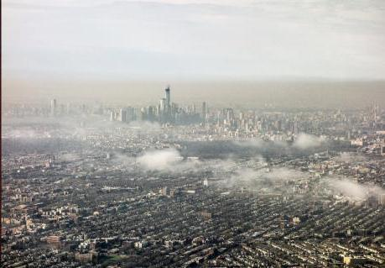
Documented Emission Reductions
Historic success of reducing air pollution from transportation in the U.S.
NYC 1973
NYC 2013
Source: EPA, 2021
Notes:
History of reducing air pollution from transportation in the U.S. (EPA, 2021):
After World War II, economic growth, population growth, rapid suburbanization, and the closing of some public transit systems led to more reliance on personal vehicles for transportation. The number of cars and trucks in the United States increased dramatically, as did the number of highways. One result of the rapid increase of motor vehicles was air pollution, especially in cities, that had serious impacts on public health and the environment.
Congress passed the landmark Clean Air Act in 1970 and gave the newly-formed EPA the legal authority to regulate pollution from cars and other forms of transportation. EPA and the State of California have led the national effort to reduce vehicle pollution by adopting increasingly stringent standards. The U.S. vehicle pollution control under the Clean Air Act is a major success story by many measures:
New passenger vehicles are 98-99% cleaner for most tailpipe pollutants compared to the 1960s.
Fuels are much cleaner—lead has been eliminated, and sulfur levels are more than 90% lower than they were prior to regulation.
U.S. cities have much improved air quality, despite ever increasing population and increasing vehicle miles traveled.
Standards have sparked technology innovation from industry.
Reducing pollution from transportation sources has led to healthier air for Americans. In cities, smog has been visibly reduced.
Over forty years of clean air policies have improved air quality and improved the health of Americans, and the environment. Since 1970, EPA has set and implemented emissions standards to control pollution from everything from passenger vehicles, heavy duty trucks and buses, construction and farm equipment, locomotive and marine engine and even lawn and garden equipment. These standards are a critical part of the progress and improved air quality we have achieved despite increased economic activity and more miles traveled on average per person.
Compared to 1970 vehicle models, new cars, SUVs and pickup trucks are roughly 99 percent cleaner for common pollutants (hydrocarbons, carbon monoxide, nitrogen oxides and particle emissions). New heavy-duty trucks and buses are roughly 99 percent cleaner than 1970 models.
Motor vehicles were once the major contributor of lead emissions. EPA began to phase out lead in gasoline starting in the 1970’s and leaded gasoline was fully prohibited after 1995. As a result, levels of lead in the air decreased by 94 percent between 1980 and 1999.
EPA vehicle emissions standards directly sparked the development and implementation of a range of technologies. The automotive catalytic converter, in particular is considered to be one of the great environmental inventions of all time. Emissions standards led to the adoption of many modern automotive technologies—computers, fuel injection, and on-board diagnostics—resulting in cars that are not only much cleaner, but also higher quality, more reliable, and more durable. The vehicle emissions control industry employs approximately 65,000 Americans with domestic annual sales of $26 billion.
Efforts to reduce air pollution from transportation have proven to be cost effective. For every one dollar spent on programs to reduce emissions, the American people receive nine dollars of benefits to public health and the environment.

Slide 11
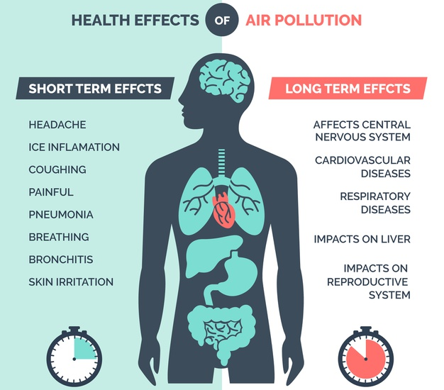
Documented Health Impacts
Notes:
The health impacts listed here are impacted by exposure to transportation related air pollution (TRAP). TRAP exposure has been associated with:
Premature mortality – early death (Beelen et al., 2014)
Bone effects – loss of bone mineral density (Prada et al., 2017)
Cancer – lung cancer (Raaschou-Nielsen et al., 2013)
Cardiovascular effects – heart attack, arrhythmias, acute coronary events, cardiovascular disease (Brook et al., 2010; Link and Dockery, 2010; Mustafić et al., 2012; Cesaroni et al., 2014)
Cerebrovascular effects – stroke (Stafoggia et al., 2014)
Metabolic effects – obesity, diabetes (Jerrett et al., 2014; Eze et al., 2015)
Neurological and cognitive effects – dementia, autism spectrum disorder (Raz et al., 2015; Power et al., 2016)
Reproductive effects – preterm birth, low birth weight, reduced sperm quality, congenital anomalies, pregnancy-induced hypertensive disorders (Vrijheid et al., 2011; Sapkota et al., 2012; Pedersen et al., 2013, 2014; Fleischer et al., 2014; Lafuente et al., 2016)
Respiratory effects – asthma, chronic obstructive pulmonary disorder, bronchitis, respiratory infection (Lindgren et al., 2009; Gasana et al., 2012; MacIntyre et al., 2014; Khreis et al., 2017)
Reducing traffic emissions will reduce TRAP thus improving air quality and health outcomes (World Health Organization, 2012).

Slide 12

Unintended Consequences
Social exclusion
Inequities in access
Climate change
Source: University of Minnesota, 2018
Notes:
Establishing environmental policies for transportation thus must take account of the level of contribution and the geographical scale, otherwise, some policies may just move the problems elsewhere and have unintended consequences (Jean-Paul Rodrigue, 2020).
A unique spatial analyses was performed identifying substantial discrepancies in traffic-related emissions generation and exposure by socioeconomic and demographic groups. It demonstrated a compelling environmental and social injustice narrative with strong policy implications for the UK and beyond. In the first instance, this research presented a decadal update for England and Wales to Mitchell and Dorling’s 2003 analysis of environmental justice in the UK. Using 2011 UK Government pollution and emissions data with 2011 UK Census socioeconomic and demographic data based on small area census geographies, this paper demonstrated a stronger relationship between age, poverty, road NO_{x} emissions and exposure to NO₂ concentrations. Areas with the highest proportions of under-fives and young adults, and poorer households, have the highest concentrations of traffic-related pollution. In addition, exclusive access to UK annual vehicle safety inspection records (‘MOT’ tests) allowed annual private vehicle NO_{x} emissions to be spatially attributed to registered keepers. Areal analysis against Census-based socioeconomic characteristics identified that households in the poorest areas emit the least NO_{x} and PM, whilst the least poor areas emitted the highest, per km, vehicle emissions per household through having higher vehicle ownership, owning more diesel vehicles and driving further. In conclusion, the analysis indicated that, despite more than a decade of air quality policy, environmental injustice of air pollution exposure has worsened. New evidence regarding the responsibility for generation of road traffic emissions provides a clear focus for policy development and targeted implementation (Barnes et al. 2019).
China has enacted a number of ambitious pollution control policies to mitigate air pollution in urban areas. Unintended side effects of these policies to other environmental policy arenas and regions have largely been ignored. To bridge this gap, we use a multiregional input-output model in combination with an atmospheric chemical transport model to simulate clean air policy scenarios and evaluate their environmental impacts on primary PM 2.5 and secondary precursor emissions, as well as CO2 emissions and water consumption, in the target region and spillover effects to other regions. Our results show that the reduction in primary PM 2.5 and secondary precursor emissions in the target regions comes at the cost of increasing emissions especially in neighboring provinces. Similarly, co-benefits of lower CO2 emissions and reduced water consumption in the target region are achieved at the expense of higher impacts elsewhere, through outsourcing production to less developed regions in China (Fang et al. 2019).
Air pollution still represents a major environmental hazard in urban areas in the European Union (EU). EU's regulatory framework in air pollution policy for the past decade contributed to a series of unintended consequences. The increasing influence of climate change objectives on the air pollution agenda led to a shift in the regulatory approach to emissions from vehicles by focusing solely on the overriding interest of reducing carbon dioxide emissions and developing individual policies to that effect. This resulted in a disconnect between regulatory approaches to urban air quality and vehicle emissions standards with the effect of producing unintended consequences of unlawful levels of air pollution, in particular nitrogen oxides and particulate matter emissions as well as unintended consequences for the car industry and consumers (Aleksandra Cavoski, 2017).
The additive, multiplicative or synergetic consequences of transport activities. They consider the varied effects of direct and indirect impacts on an ecosystem, which are often unpredictable. Climate change, with complex causes and consequences, is the cumulative impact of several natural and anthropogenic factors, in which transportation plays a role. The share of transportation in global CO2 emissions is increasing. The complexities of the impacts have led to much controversy in environmental policy, the role of transportation, and mitigation strategies. This is made even more complex by the fact that priorities between environmental and economic considerations shift in time, which can have an impact on public policy. The transportation sector is often subsidized, especially through the construction and maintenance of road infrastructure, which tends to be free of access. Sometimes, public stakes in transport modes, terminals, and infrastructure can be at odds with environmental issues. If the owner and the regulator are the same (different branches of the government), then there is a risk that regulations will not be effectively complied to (Jean-Paul Rodrigue, 2020).

Slide 13
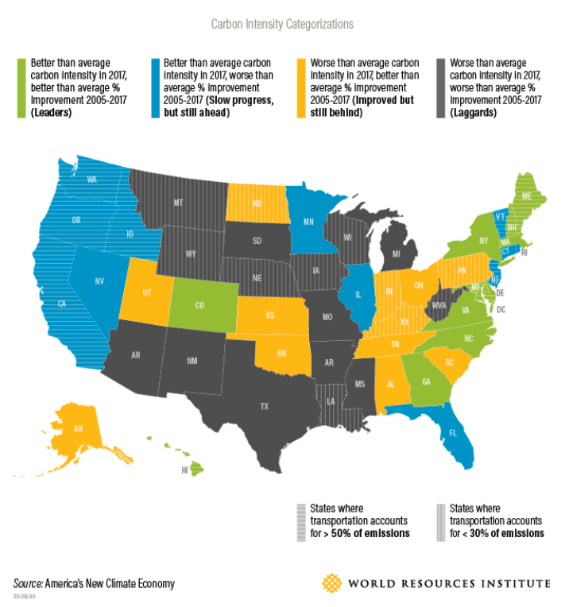
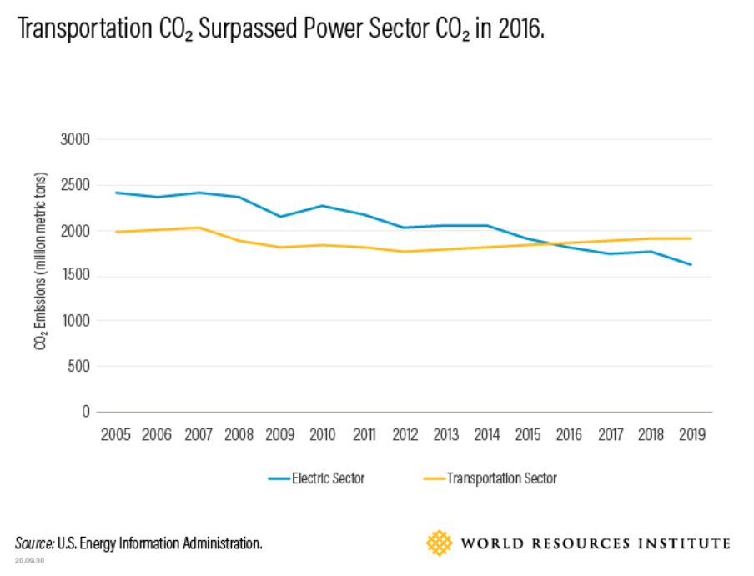
Example 1: California shows how the U.S. can reduce transport emissions.
Notes:
Article by Dan Lashof (Director at World Resource Institute, U.S.) and Devashree Saha (Senior Associate at the World Resource Institute, U.S.), 2020:
https://www.wri.org/insights/california-shows-how-us-can-reduce-transport-emissions

Slide 14


Example 2: How to cut U.S. emissions faster? Do what these countries are doing.
Notes:
Article by Brad Plumer and Blacki Migliozzi at The New York Time, 2019:
https://www.nytimes.com/interactive/2019/02/13/climate/cut-us-emissions-with-policies-from-other-countries.html

Slide 15
Discussion
Traffic emissions are a major source of air pollution, especially in urban areas which are growing rapidly.
Various policies are available to reduce traffic emissions:
  Pricing, land-use, infrastructure, behavioral, technology, and management, standards, and services.
Different factors play into policy including the context in which they are created and implemented.
Notes:
Center for Climate and Energy Solutions , 2008:
Reducing GHG emissions from transportation, which comprise one third of total U.S. CO2 emissions, will need to be a key part of any strategy to limit economy-wide emissions.
Transportation energy use and emissions are determined by three elements: the fuels used to power the vehicles, characteristics of the vehicles themselves, and total miles traveled.
Of the various transportation modes, passenger vehicles consume the most energy, followed by truck, rail and ship transport of freight, and then air travel.
To reduce emissions, the sector can be included in a multi-sector cap-and-trade program or managed through sector-specific measures, or both. The critical issues for transportation policy are understanding market imperfections, where individuals are somewhat insensitive to changes in fuel price and tend to undervalue fuel economy. This makes it difficult to harness market forces (such as a cap-and-trade program) to drive investment in long-term transportation technology.
To guarantee significant emission reductions from the transportation sector, especially in the short term, sector-specific policies can complement (or substitute for) the cap. These policies will need to focus on all three elements of the sector for major emission sources within the transportation sector. Policy tools include pricing policies (e.g., taxes, tolls, and congestion changes), standards (e.g., fuel economy standards), and funding for research, development, and deployment.
Policies for the transportation sector will have to address several objectives at the same time: energy security and GHG reduction goals, a transition to low carbon fuels and alternative vehicle types, and an alignment of infrastructure and land use planning with GHG goals.

Slide 16
Research Gaps and Future Directions
Several policies are biased against mobility management.
Overall effects of many policies are not well understood.
Potential for poor coordination and difficulties evaluating programs.
Future research direction will mostly focus on new technology.
Notes:
Most comprehensive studies indicate that both cleaner vehicles and mobility management strategies are needed to achieve energy conservation and emission reduction targets, but many emission reduction analyses are biased against mobility management because they (Todd Litman, 2017):
Ignore mobility management or only considers a few strategies - Emission reduction planning sometimes ignores mobility management altogether, or only considers a limited number of potential strategies.
Ignore co-benefits - Current analysis gives little consideration to benefits such as congestion reduction, road and parking facility cost savings, consumer savings, reduced traffic accidents, and improved mobility for non-drivers, although these benefits are often larger in total value than emission reduction benefits.
Ignore induced travel impacts - Current analysis generally ignores the additional external costs that result when increased vehicle fuel efficiency and subsidized alternative fuels stimulates additional vehicle travel, called a rebound effect.
Considers mobility management emission reductions difficult to predict - Although case studies and models exist for many of these strategies, this information is not widely applied to energy planning.
Considers mobility management programs difficult to implement - Such programs often involve multiple stakeholders, such as regional and local governments, employers and developers, and various special interest groups. As a result, they tend to seem difficult and risky compared with other emission reduction strategies that only require changes to utility operations, fuel production or vehicle designs.
Assumes vehicle travel reductions harm consumers and the economy - In fact, many mobility management strategies benefit consumers directly and increase economic productivity. There is plenty of evidence that, with improved travel options and efficient incentives, consumers would choose to drive less, rely more on alternative modes, and be better off overall as a result.
The overall effects of the state’s policies aimed at reducing transportation GHGs are largely unclear. The Legislature might want to consider options to facilitate a more consistent evaluation of these policies, such as requiring regular retrospective evaluations of these policies and prioritizing policies that are designed in ways that facilitate evaluation (Legislative Analyst’s Office, 2018).
Although implementing multiple programs could be justified in some instances, the wide range of programs creates several challenges, including (1) interactions whereby emission reductions from one policy offset those from a different policy, (2) challenges in evaluating the net effects of each policy, (3) a potential lack of coordination among policies, and (4) higher administrative costs (Legislative Analyst’s Office, 2018).
Future directions of research will be mainly directed towards the development of new technologies. In particular, the aim should be to improve the range and efficiency of electric vehicles, which should be the only ones to circulate in urban areas, to implement and optimize the operation of autonomous vehicles, possibly shared (as well as electric traction), both to reduce consumption and occupation of public spaces, and to make mobility more equitable, allowing everyone to move (the elderly, the disabled, people on low incomes, etc.) (Gallo and Marinelli, 2020).
Other gaps in knowledge include (Sims et al., 2014):
Data and understanding relating to freight logistical systems and their economic implications are poor, as are the future effects on world trade of decarbonization and climate change impacts. Hence, it is difficult to design new low-carbon freight policies.
Future technological developments and costs of batteries, fuel cells, and vehicle designs are uncertain.
The infrastructure requirement for new low-carbon transport fuels is poorly understood.
Cost of components for novel vehicle powertrains cannot be determined robustly since rates of learning, cost decreases, and associated impacts are unknown.
Assessments of mitigating transport GHG emissions, the global potential, and costs involved are inconsistent.
Prices of crude oil products fluctuate widely as do those for alternative transport fuels, leading to large variations in scenario modelling assumptions.
A better knowledge of consumer travel behavior is needed, particularly for aviation.
Limited understanding exists of how and when people will choose to buy and use new types of low-carbon vehicles or mobility services (such as demand responsive transit or car-share).There are few insights of behavioral economics to predict mobility systematically and whether producers will incorporate low-carbon technologies that may not maximize profit.
How travelers will respond to combinations of low-carbon strategies (mixes of land use, transit, vehicle options) is especially important for fast-growing, developing countries where alternative modes to the car-centric development path could be deployed, is unknown.
Understanding how low-carbon transport and energy technologies will evolve (via experience curves and innovation processes) is not well developed. Most vehicles rely on stored energy, so there is a need to better understand the cost and energy density of non-hydrocarbon energy storage mediums, such as batteries, supercapacitors and pressure vessels.
The rate of social acceptance of innovative concepts, such as induction charging of electric vehicles, and driverless cars (all currently being demonstrated) is difficult to predict, as is the required level of related infrastructure investments. Recent rapid developments in metro systems in several cities illustrate how quickly new transport systems can be implemented when the demand, policies, and investments all come together and public support is strong.

Slide 17
Take-Home Messages
There are a variety of policies to target traffic emissions.
Reducing traffic emissions will improve air quality and health outcomes.
Policy efficacy depends on different factors: policy content, stakeholders involved, policy process, and political, economic, and social context.

Slide 18
List of Abbreviations
Abbreviation | Meaning | Abbreviation | Meaning
CAA | Clean air act | NOx | Nitrogen oxide
CO2 | Carbon dioxide | PM | Particulate matter
CO | Carbon monoxide | PM 2.5 | Particulate matter with diameter equal to or less than 2.5 micrometers
COPD | Chronic obstructive pulmonary disease | PM 10 | Particulate matter with diameter equal to or less than 10 micrometers
EE | Exhaust emissions | TRAP | Traffic-related air pollution
EPA | Environmental protection agency | U.S. | United States
GHG | Greenhouse gas | VOC | Volatile organic compound
NEE | Non-exhaust emissions | WHO | World Health Organization

Slide 19
References
Beelen, R. et al. (2014) ‘Effects of long-term exposure to air pollution on natural-cause mortality: an analysis of 22 European cohorts within the multicentre ESCAPE project’, The Lancet, 383(9919), pp. 785–795. doi: 10.1016/S0140-6736(13)62158-3.
Brook, R. D. et al. (2010) ‘Particulate Matter Air Pollution and Cardiovascular Disease’, Circulation, 121(21), pp. 2331–2378. doi: 10.1161/CIR.0b013e3181dbece1.
Cesaroni, G. et al. (2014) ‘Long term exposure to ambient air pollution and incidence of acute coronary events: prospective cohort study and meta-analysis in 11 European cohorts from the ESCAPE Project’, BMJ, 348(jan21 3), pp. f7412–f7412. doi: 10.1136/bmj.f7412.
Eze, I. C. et al. (2015) ‘Association between Ambient Air Pollution and Diabetes Mellitus in Europe and North America: Systematic Review and Meta-Analysis’, Environmental Health Perspectives, 123(5), pp. 381–389. doi: 10.1289/ehp.1307823.
Fleischer, N. L. et al. (2014) ‘Outdoor Air Pollution, Preterm Birth, and Low Birth Weight: Analysis of the World Health Organization Global Survey on Maternal and Perinatal Health’, Environmental Health Perspectives, 122(4), pp. 425–430. doi: 10.1289/ehp.1306837.
Gasana, J. et al. (2012) ‘Motor vehicle air pollution and asthma in children: A meta-analysis’, Environmental Research. Elsevier, 117, pp. 36–45. doi: 10.1016/j.envres.2012.05.001.

Slide 20
References
Jerrett, M. et al. (2014) ‘Traffic-related air pollution and obesity formation in children: a longitudinal, multilevel analysis’, Environmental Health, 13(1), p. 49. doi: 10.1186/1476-069X-13-49.
Khreis, H. et al. (2017) ‘Exposure to traffic-related air pollution and risk of development of childhood asthma: A systematic review and meta-analysis’, Environment International. Elsevier Ltd, 100, pp. 1–31. doi: 10.1016/j.envint.2016.11.012.
Lafuente, R. et al. (2016) ‘Outdoor air pollution and sperm quality’, Fertility and Sterility, 106(4), pp. 880–896. doi: 10.1016/j.fertnstert.2016.08.022.
Lindgren, A. et al. (2009) ‘Traffic-related air pollution associated with prevalence of asthma and COPD/chronic bronchitis. A cross-sectional study in Southern Sweden’, International Journal of Health Geographics, 8(1), p. 2. doi: 10.1186/1476-072X-8-2.
Link, M. S. and Dockery, D. W. (2010) ‘Air pollution and the triggering of cardiac arrhythmias’, Current Opinion in Cardiology, 25(1), pp. 16–22. doi: 10.1097/HCO.0b013e32833358cd.
MacIntyre, E. A. et al. (2014) ‘Air Pollution and Respiratory Infections during Early Childhood: An Analysis of 10 European Birth Cohorts within the ESCAPE Project’, Environmental Health Perspectives, 122(1), pp. 107–113. doi: 10.1289/ehp.1306755.

Slide 21
References
Mustafić, H. et al. (2012) ‘Main Air Pollutants and Myocardial Infarction’, JAMA, 307(7), p. 713. doi: 10.1001/jama.2012.126.
Pedersen, M. et al. (2013) ‘Ambient air pollution and low birthweight: a European cohort study (ESCAPE)’, The Lancet Respiratory Medicine, 1(9), pp. 695–704. doi: 10.1016/S2213-2600(13)70192-9.
Pedersen, M. et al. (2014) ‘Ambient Air Pollution and Pregnancy-Induced Hypertensive Disorders’, Hypertension, 64(3), pp. 494–500. doi: 10.1161/HYPERTENSIONAHA.114.03545.
Power, M. C. et al. (2016) ‘Exposure to air pollution as a potential contributor to cognitive function, cognitive decline, brain imaging, and dementia: A systematic review of epidemiologic research’, NeuroToxicology. Elsevier B.V., 56, pp. 235–253. doi: 10.1016/j.neuro.2016.06.004.
Prada, D. et al. (2017) ‘Association of air particulate pollution with bone loss over time and bone fracture risk: analysis of data from two independent studies’, The Lancet Planetary Health. Elsevier B.V., 1(8), pp. e337–e347. doi: 10.1016/S2542-5196(17)30136-5.
Raaschou-Nielsen, O. et al. (2013) ‘Air pollution and lung cancer incidence in 17 European cohorts: prospective analyses from the European Study of Cohorts for Air Pollution Effects (ESCAPE)’, The Lancet Oncology, 14(9), pp. 813–822. doi: 10.1016/S1470-2045(13)70279-1.

Slide 22
References
Raz, R. et al. (2015) ‘Autism Spectrum Disorder and Particulate Matter Air Pollution before, during, and after Pregnancy: A Nested Case–Control Analysis within the Nurses’ Health Study II Cohort’, Environmental Health Perspectives, 123(3), pp. 264–270. doi: 10.1289/ehp.1408133.
Sapkota, A. et al. (2012) ‘Exposure to particulate matter and adverse birth outcomes: a comprehensive review and meta-analysis’, Air Quality, Atmosphere & Health, 5(4), pp. 369–381. doi: 10.1007/s11869-010-0106-3.
Stafoggia, M. et al. (2014) ‘Long-Term Exposure to Ambient Air Pollution and Incidence of Cerebrovascular Events: Results from 11 European Cohorts within the ESCAPE Project’, Environmental Health Perspectives, 122(9), pp. 919–925. doi: 10.1289/ehp.1307301.
Vrijheid, M. et al. (2011) ‘Ambient Air Pollution and Risk of Congenital Anomalies: A Systematic Review and Meta-analysis’, Environmental Health Perspectives, 119(5), pp. 598–606. doi: 10.1289/ehp.1002946.
World Health Organization (2012) Health Effects of Black Carbon. Available at: https://www.euro.who.int/__data/assets/pdf_file/0004/162535/e96541.pdf?ua=1.

Slide 23
References
Center for Climate and Energy Solutions (2008) Policies to Reduce Emissions from the Transportation Sector. Available at: https://www.c2es.org/document/policies-to-reduce-emissions-from-the-transportation-sector/
Transportation Research Board (2011) Policy Options for Reducing Energy Use and Greenhouse Gas Emissions from U.S. Transportation. Available at: https://www.nap.edu/catalog/13194/policy-options-for-reducing-energy-use-and-greenhouse-gas-emissions-from-us-transportation
U.S. Environmental Protection Agency (2021) Greenhouse Gas Emissions. Available at: https://www.epa.gov/ghgemissions/global-greenhouse-gas-emissions-data#Sector
U.S. Environmental Protection Agency (2019) Green Vehicle Guide. Available at: https://www.epa.gov/greenvehicles/routes-lower-greenhouse-gas-emissions-transportation-future
U.S. Environmental Protection Agency (2020) Green Vehicle Guide. Available at: https://www.epa.gov/greenvehicles/fast-facts-transportation-greenhouse-gas-emissions
U.S. Environmental Protection Agency (2016) Mobile Source Pollution. Available at: https://www.epa.gov/mobile-source-pollution/how-mobile-source-pollution-affects-your-health

Slide 24
References
U.S. Environmental Protection Agency (2020) Overview of Air Pollution from Transportation. Available at: https://www.epa.gov/transportation-air-pollution-and-climate-change/learn-about-air-pollution-transportation
U.S. Environmental Protection Agency (2021) History of Reducing Air Pollution from Transportation in the United States. Available at: https://www.epa.gov/transportation-air-pollution-and-climate-change/accomplishments-and-success-air-pollution-transportation
U.S. Department of Transportation (2016) Transportation GHG Emissions and Trends. Available at: https://www.transportation.gov/sustainability/climate/transportation-ghg-emissions-and-trends
Piscitello, A. et al. (2020) ‘Non-exhaust traffic emissions: Sources, characterization, and mitigation measures’, Science of the Total Environment, 766. doi: 10.1016/j.scitotenv.2020.144440.
Barnes, J. et al. (2019) ‘Emissions vs exposure: Increasing injustice from road traffic-related air pollution in the United Kingdom’, Transportation Research Part D: Transport and Environment, 73, pp. 56-66. doi: 10.1016/j.trd.2019.05.012.
Fang, D. et al. (2019) ‘Clean air for some: Unintended spillover effects of regional air pollution policies’, Science Advances, 5(4), doi: 10.1126/sciadv.aav4707

Slide 25
References
U.S. Environmental Protection Agency (2020) Overview of Air Pollution from Transportation. Available at: https://www.epa.gov/transportation-air-pollution-and-climate-change/learn-about-air-pollution-transportation
Legislative Analyst’s Office (2018) Assessing California's Climate Policies—Transportation. Available at: https://lao.ca.gov/Publications/Report/3912
Rodrigue, J.P. (2020), Transportation and the Environment, The Geography of Transport Systems. Available at: https://transportgeography.org/contents/chapter4/transportation-and-environment/
Cavoski, A. (2017) ‘The unintended consequences of EU law and policy on air pollution’, Reciel, Special Issue: International and EU Law on Air Pollution, 26(3), pp. 255-265. doi: 10.1111/reel.12211
Gallo, M. and Marinelli, M. (2020) ‘Sustainable Mobility: A Review of Possible Actions and Policies’, Sustainability, 12(7499). doi: 10.3390/su12187499
Litman, Todd (2017). Smart Transportation Emission Reduction Strategies, Victoria Transport Policy Institute. Available at: https://www.vtpi.org/ster.pdf

Slide 26
Acknowledgements
These lecture slides were created with support from the Texas A&M Transportation Institute’s Center for Advancing Research in Transportation Emissions, Energy, and Health, a U.S. Department of Transportation’s University Transportation Center, College Station, TX. The grant number is 69A3551747128. More information about the Center for Advancing Research in Transportation Emissions, Energy, and Health is available at: https://www.carteeh.org/.

