Slide 1
www.carteeh.org

Slide 2
Lecture #51: Overlap with Sustainable Transportation and Built Environment Policies
Tara Ramani, Ph.D.,P.E
Texas A&M Transportation Institute
t-ramani@tti.tamu.edu 979-317-2940
Materials used in the presentation are for education and discussion purposes only. Do not use or cite the materials without the permission of the author
The author declares that there is no conflict of interest
Lecture Track(s): TT/PPT
Notes:
Health Track (HT)—mainly targeted at urban planners, transportation planners, and engineers with limited knowledge of public health-related concepts;
Transportation Track (TT)—mainly targeted at environmental epidemiologists and public health professionals with limited knowledge of transportation-related concepts; and;
Planning and Policy Track (PPT)—mainly targeted at planners, civil servants, and policy and decision makers with particular interest in the science-policy link.

Slide 3
Introduction
The concept of sustainable transportation encompasses environmental, economic, and social dimensions, in the present and the future
Several policies that promote sustainable transportation (through the transportation system or built environment) have health co-benefits, and vice-versa
As our framing of the health-transportation linkages becomes broader and holistic, there is convergence with sustainability concepts
Notes:
“Sustainable transportation” is a concept that has been extensively discussed by researchers and practitioners over the years. It derives from the broader concept of sustainability or sustainable development. Broadly speaking, sustainability considers the three dimensions (economic, environmental, social) , as well as present and future needs. Health and sustainability are linked in several ways, as seen further in the lecture. For example, policies to promote sustainable transportation often include actions to reduce vehicle miles of travel, reducing emissions of pollutants and greenhouse gases. This has a direct link to health. Similarly, promotion of built environment policies that promote walking and active transportation improve “sustainable transportation”, but also benefit health. In this lecture, we will discuss the concept of sustainable transportation, and discuss how it relates to health and transportation. As we move to defining health in a broader sense (such as through a holistic set of pathways, as we will discuss later in the lecture), it is seen that there is a convergence with the concept of sustainability.

Slide 4
What is Sustainability?
Sustainability encompasses a holistic consideration of economic, social, and environmental progress over the long-term.
Sustainability Triple Bottom Line
Economy
Society
Environment
Notes:
Before we discuss sustainable transportation, it is important to understand sustainability as a global issue that goes beyond transportation. United Nations Brundtland Commission, in 1987, defined sustainable development as “development that meets the needs of the present without compromising the ability of future generations to meet their own needs”. This definition continues to be the most commonly used definition of the term. Sustainability is generally referred to as having a “triple bottom line” or “three pillars” or “dimensions”. These refer to the economic, social, and environmental aspects of sustainability. The social dimension is also sometimes referred to as “equity”, giving rise to the “3-Es” of sustainability. The core tenet of sustainable development is that all three dimensions, or the triple bottom line, must be considered, as opposed to conventional development that usually only addresses economic aspects, or only considers things that can be monetized. There are also the concepts of “weak” and “strong” sustainability that relate to how the dimensions are allowed to be “traded off” with one another.
Sustainability is a concept that is not specific to transportation, but has several overlaps due to the critical nature of transportation in our everyday lives. The economy is dependent on accessible and efficient movement of people and commerce. Social well-being depends on accessible and efficient transportation services but it may also impact communities negatively. The environment can be negatively impacted by transportation, and requires mitigating actions to be taken.

Slide 5
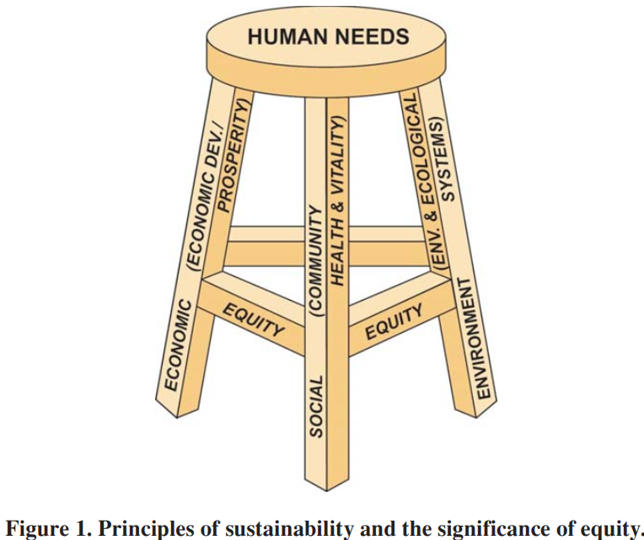
Sustainability Principles
Fundamental principles of sustainability:
  Preserving and restoring environmental and ecological systems;
  Fostering community health and vitality;
  Promoting economic development and prosperity; and
  Ensuring equity among population groups over generations.
Equity connects each element of Triple Bottom Line Sustainability
Source: A Guidebook for Sustainability Performance Measurement for Transportation Agencies. National Academies Press. https://doi.org/10.17226/14598
Notes:
A report developed by the National Cooperative Highway Research Program, or NCHRP, defined sustainability principles as follows, and this serves as a good starting point to understand sustainability and transportation linkages. It termed the principles as follows:
Preserving and restoring environmental and ecological systems;
Fostering community health and vitality;
Promoting economic development and prosperity; and
Ensuring equity among population groups over generations.
Equity is considered as a principle that needs to be reflected in every aspect of the triple bottom line, as shown in the diagram, where it reinforces the three-legged sustainability stool. This implies that any environmental, economic, or social impact or benefit should not disproportionately apply to only certain demographics or population groups.

Slide 6
Transportation and Sustainability
Major consumer of energy, linked to GHG emissions
Affects wildlife habitat and movement
Affects water quality through erosion, sediment, and contamination
Affects air quality through pollutant emissions
Impacts on local communities
Consumption of non-renewable resources
Lack of mobility and access for certain population groups or areas
“Sustainable transportation” - reflects how sustainability principles are applied to the transportation sector
There are several areas in which transportation impacts and sustainability principles overlap
Notes:
Until now, we have discussed sustainability in general, and not specific to transportation. There are several ways in which transportation impacts sustainability. Sustainability principles and considerations can apply to every stage of the transportation life cycle. “Sustainable transportation” - reflects how sustainability principles are applied to the transportation sector, though it can also be viewed as “transportation in support of sustainability”. On this slide, we see several areas in which transportation impacts sustainability, as detailed in the figure.

Slide 7
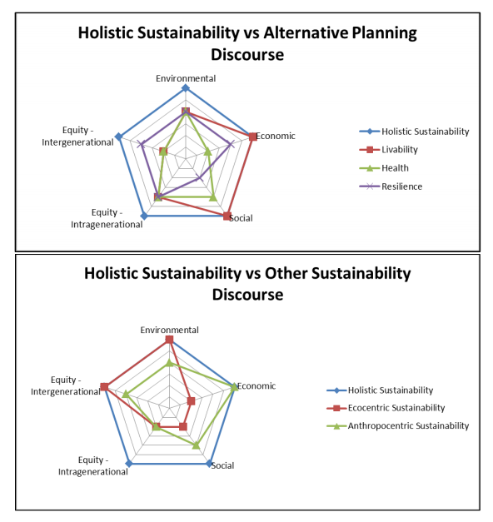
Convergences in Sustainability Discourse
Given that sustainability is such a broad concept, it has overlaps with other concepts promoted for improving transportation and the built environment
For example, policies and programs addressing the following often overlap with sustainability concerns:
  Climate change
  Resilience
  Context-sensitive solutions
  Health
  Equity/environmental justice
  Environment
  Connectivity
  Neighborhood revitalization
  Smart growth
  Multimodal transportation
Source: Ramani, T.L., 2017. Validating alternative conceptualizations of sustainable transportation (Doctoral dissertation).
Notes:
Sustainability is such a broad concept, and has faced criticism for being a catch-all descriptor for any desirable attribute for the system or society as a whole (Black, 1996). It has also been described as a “wicked problem” (see for example, Frame (2008). Given that sustainability is so broad, it overlaps with other frameworks and concepts for transportation and the built environment (aspects such as health or livability). Further, policies in areas such as climate change, resilience, health, etc, as seen in the list on the slide, all link to sustainability. An example of an assessment of how sustainability overlaps with the concepts of livability and health is shown in the figure on the slide. If we consider inter- and intra-generational equity, and the three dimensions of sustainability being the space which “holistic” sustainability occupies, each alternative concept, such as different views on sustainability (ecocentric or anthropocentric), or frameworks related to sustainability can all exist within this pentagon. Therefore, there are many built environment and transportation policies that address health and sustainability implicitly, even if it is not their explicit stated purpose.

Slide 8
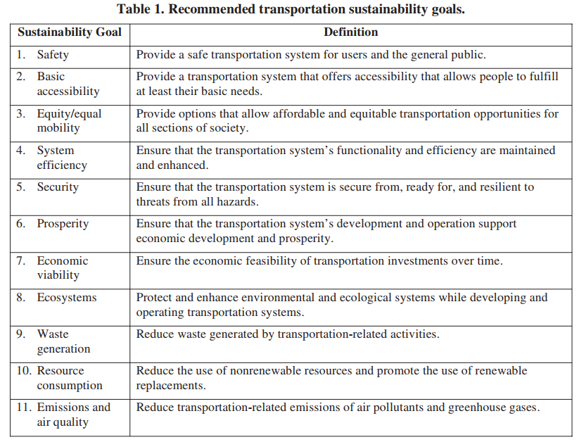
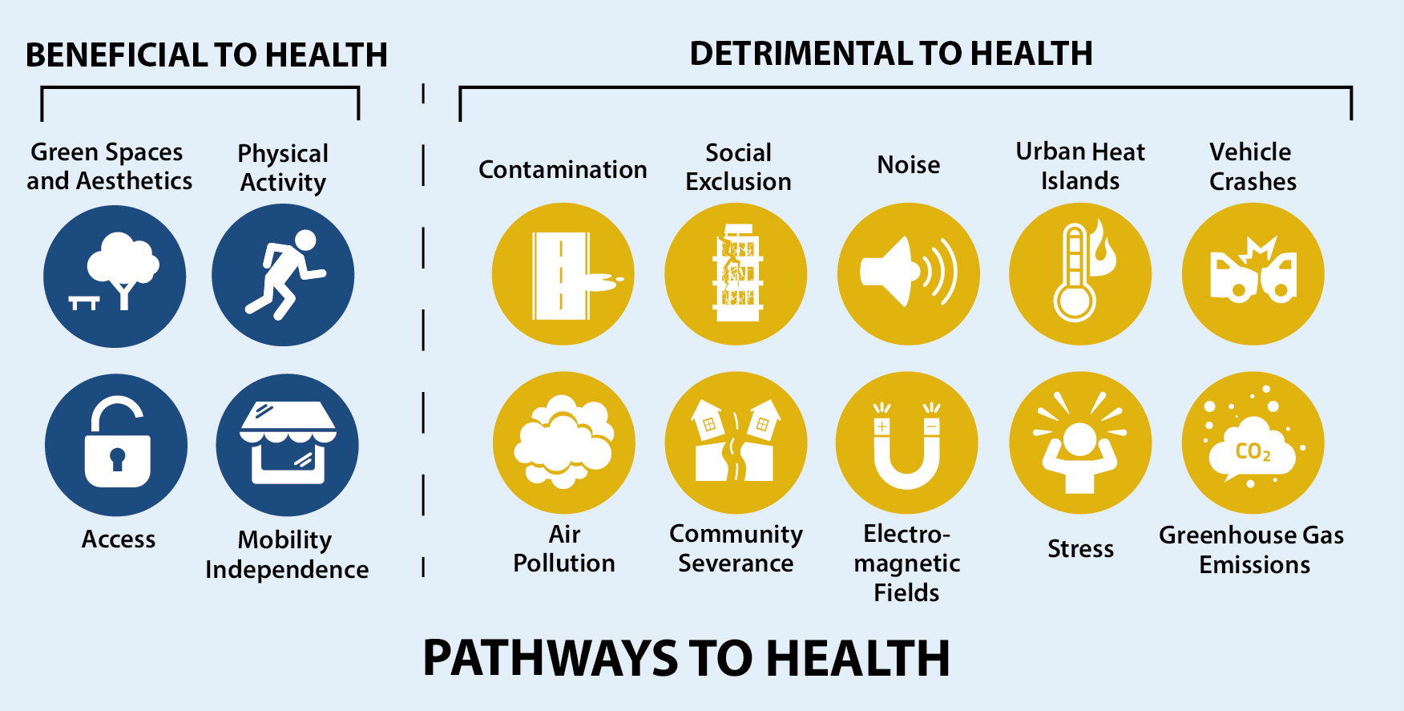
Health and Sustainability Considerations in Transportation
Notes:
This slide provides a more tangible example of the overlaps between sustainable transportation concepts and health and transportation concepts. To the left is a set of sustainable transportation goals (Zietsman et al, 2011), and to the right is a set of “transportation-health” pathways (Glazener et al, 2021). Both can be viewed as providing a comprehensive set of considerations for the transportation sector, though one is phrased more as goals while the other is more impact-focused. Regardless, there are several overlaps between the two, ranging from concerns of climate change and emissions, to safety, to environmental contamination, to the need for equitable access and mobility.

Slide 9
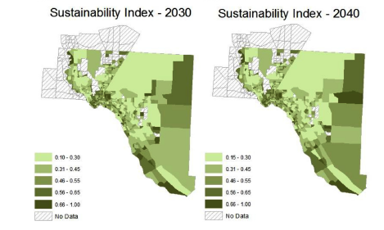
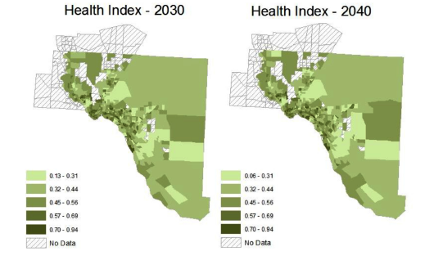
Case Study – Contrasting Health and Sustainability for Transportation
While there are several conceptual overlaps between health and sustainable transportation, the concepts are not necessarily interchangeable
In the example case study shown here, a set of “sustainability indicators” and “health indicators” were developed for a regional transportation system and aggregated into a composite index
  There was low correlation between the two indices
  Areas scoring well from a health perspective tended to be located closer to downtown and urbanized areas
Source: Ramani, T., 2018. Using indicators to assess sustainable transportation and related concepts. Transportation research record, 2672(3), pp.92-103.
Notes:
While the previous slides showed that there are several conceptual overlaps between health and sustainable transportation, the concepts are not necessarily interchangeable. This is demonstrated by a case study (Ramani, 2018), which contrasted a set of “sustainability indicators” and “health indicators” which were used to develop a sustainability and health index for the regional transportation system in a city in Texas. The indices were quantified for traffic analysis zones in the region, and the results showed that the indices did not correlate well with each other. For example, areas performing well from a sustainability perspective were more widely dispersed, while those performing well from a health perspective tended to be located in downtown and urbanized areas. This is likely due to the selection of indicators/construction of the index, where factors such as access to other modes of transportation played a greater role in the health index, while aspects such as greenhouse gas emissions and safety were reflected in the sustainability index. A limitation of this approach to contrasting health and sustainability concepts, is that it is all about the indicators you select for tracking, or improvement through targeted policy. Thus, this should be taken more as an example of thinking through policies and programs’ intended impacts, than of known differences.

Slide 10
Discussion
“Sustainable transportation” – generally includes consideration of environmental, economic and social impacts of transportation
  Equity in all of the dimensions is also important
There are many transportation and built environment policies and programs that address some aspects of sustainability.
  This includes policies geared towards health and transportation.
Notes:
Sustainability is a broad and all-encompassing concept. Its scope is so broad, that it can sometimes be a detriment, in that it can be used to mean anything and everything. Due to this, there are several transportation policies and initiatives that address some aspects of sustainability, ranging from climate change efforts, to resilience, to smart growth, to context sensitive solutions or environmental justice. Health is another emerging paradigm that is closely linked to sustainability, though its scale and scope does differ (as seen in the case study on the previous slide, health considerations tend to be a bit more localized and shorter-term. However, this is changing as aspects such as climate change are increasingly viewed as a health issue, and the concepts appear to converge.

Slide 11
Research Gaps and Future Directions
Advancing a sustainability agenda that is holistic (i.e. addresses all three dimensions and inter- and intra-generational equity) is a challenge
Individual policies and programs for transportation and the built environment (including those aimed at health) can help address targeted areas. However:
  Convergence and conflicts in policy goals need to be addressed systematically
  Appropriate indicators must be used to track progress
Notes:
When it comes to sustainable transportation, a key issue remains in ensuring that a holistic view of sustainability is maintained. When it comes to transportation policies and programs, efforts related to health, climate change, active transportation, etc. can all potentially support a sustainability agenda. However, convergences and conflicts must be addressed, and appropriate indicators used to ensure that some aspects of the holistic sustainability picture are not neglected.

Slide 12
Take-Home Messages
Sustainability is a broad and all-encompassing concept, covering
  Three dimensions – environmental, economic, social
  Equity (inter- and intra-generational)
Sustainable transportation addresses these broad sustainability issues as they relate to transportation
Other transportation and built environmental policies (such as those promoting health and transportation or climate change mitigation) address aspects of sustainable transportation
Notes:
In conclusion, sustainable transportation is a useful framework to consider all possible ways in which transportation affects the health and well-being of humans and the planet. It is broader than any other framework used to inform transportation policy, and aspects of it can be address through policies relating to health, climate change, or active transportation.

Slide 13
References
Black, W.R., 1996. Sustainable transportation: a US perspective. Journal of transport geography, 4(3), pp.151-159.
Frame, B., 2008. ‘Wicked’,‘messy’, and ‘clumsy’: long-term frameworks for sustainability. Environment and Planning C: Government and Policy, 26(6), pp.1113-1128.
Glazener, A., Sanchez, K., Ramani, T., Zietsman, J., Nieuwenhuijsen, M.J., Mindell, J.S., Fox, M. and Khreis, H., 2021. Fourteen pathways between urban transportation and health: A conceptual model and literature review. Journal of Transport & Health, 21, p.101070. msy’: long-term frameworks for sustainability. Environment and Planning C: Government and Policy, 26(6), pp.1113-1128.
Ramani, T.L., 2017. Validating alternative conceptualizations of sustainable transportation (Doctoral dissertation).
Ramani, T., 2018. Using indicators to assess sustainable transportation and related concepts. Transportation research record, 2672(3), pp.92-103.
Zietsman, J., Ramani, T., Potter, J., DeFlorio, J. and Reeder, V. 2011. A guidebook for sustainability performance measurement for transportation agencies (Vol. 708). Transportation Research Board.

Slide 14
Reading List
Gudmundsson, H., Marsden, G. and Josias, Z., 2016. Sustainable transportation: Indicators, frameworks, and performance management.
Jeon, C.M., Amekudzi, A.A. and Guensler, R.L., 2013. Sustainability assessment at the transportation planning level: Performance measures and indexes. Transport Policy, 25, pp.10-21.
Pei, Y.L., Amekudzi, A.A., Meyer, M.D., Barrella, E.M. and Ross, C.L., 2010. Performance measurement frameworks and development of effective sustainable transport strategies and indicators. Transportation research record, 2163(1), pp.73-80.
Ramani, T., Zietsman, J. and Pryn, M.R., 2018. Towards sustainable transport planning in the United States. European Journal of Transport and Infrastructure Research, 18(3).

