Slide 1
www.carteeh.org

Slide 2
Lecture #6: Vehicle Emission Standards and Underlying Evidence Base
Suriya Vallamsundar, Ph.D.,
Texas A&M Transportation Institute
s-vallamsundar@tti.tamu.edu, 972-994-2209
The author declares that there is no conflict of interest
Lecture Track(s): HT/TT
Notes:
Health Track (HT)—mainly targeted at urban planners, transportation planners, and engineers with limited knowledge of public health-related concepts;
Transportation Track (TT)—mainly targeted at environmental epidemiologists and public health professionals with limited knowledge of transportation-related concepts; and;
Planning and Policy Track (PPT)—mainly targeted at planners, civil servants, and policy and decision makers with particular interest in the science-policy link.

Slide 3
Overview
  History of mobile source emission controls in the United States
  Vehicle emission standards in the world
  Key regulations in the United States governing transportation, emissions and air quality
    National Environmental Policy Act (NEPA)
    Clean Air Act
    NAAQS
    Transportation Conformity Act
Notes:
This provides an overview of the topics to be covered starting from the history of mobile source emission controls in the US and around the world, high level overview of emission standards around the world, key regulations in the US governing transportation air quality issues, that includes the NEPA, clean air act, National Ambient Air Quality Standards, and Transportation Conformity Act

Slide 4


History of mobile source emission controls
1943 – Mysterious “smog” in Los Angeles Valley
Source: South Coast AQMD
Notes:
As extracted from SCAQMD: The first vehicle standards in the United States were established as a response to the smog found in Los Angeles valley in 1943
As extracted from South Coast AQMD: On July 26, 1943, in the midst of World War II, Los Angeles was attacked -- not by a foreign enemy, but a domestic one -- smog. The Los Angeles Times reported that a pall of smoke and fumes descended on downtown, cutting visibility to three blocks. Striking in the midst of a heat wave, the "gas attack" was nearly unbearable, gripping workers and residents with an eye-stinging, throat-scraping sensation. It also left them with a realization that something had gone terribly wrong in their city, prized for its sunny climate.

Slide 5
History of mobile source emission controls
1959
California formed Motor Vehicle Pollution Control Board
1967
California Air Resources Board (CARB) was established
1970
US Environmental Protection Agency (EPA) Created
1970
Clean Air Act Amended
Health based National Ambient Air Quality Standards (NAAQS)
90% reduction in emissions from new cars
1975
Catalysts introduced on new cars
Source: EPA, History of vehicle emissions standards
Notes:
As extracted from EPA
1959: Following the smog event, California formed the Motor Vehicle Pollution Board
1967: California Air Resource Board was established as the governing body to regulate emissions in California
As extracted from EPA
1970: Congress passes the first major Clean Air Act, requiring a 90 percent reduction in emissions from new automobiles by 1975. President Richard Nixon establishes EPA, and the new agency is given it broad responsibility for regulating motor vehicle pollution. New cars must meet EPA emission standards for hydrocarbons (HC), carbon monoxide (CO), nitrogen oxide (NO_{x}). The law also directs EPA to set health-based "National Ambient Air Quality Standards" for six pollutants. Also the Clean Air Act (discussed later) was amended to include health based NAAQS.
1975: The "first generation" catalytic converters are built, significantly reducing vehicle emissions. Unleaded gasoline is also introduced because lead in gasoline may cause disintegration of catalytic converters. This results in dramatic reductions in ambient lead levels and alleviates many serious environmental and human health concerns associated with lead pollution.

Slide 6
History of mobile source emission controls
1975
Energy Policy Conservation Act
Established CAFE program and set first fuel economy goals
1978
Corporate Average Fuel Economy (CAFE) Standards introduced
27.5 mpg since 1985 for passenger cars and light trucks
22.2 mpg since 2007 for light truck (including SUVs and vans)
1983
Vehicle Emissions Inspection and maintenance (I/M) programs established
1985
EPA final regulations to cut lead by 90% starting Jan 1, 1986
1990
Clean Air Act Amended
Reformulated gasoline
Alternative fuels
Source: EPA, History of vehicle emissions standards
Notes:
As extracted from EPA
1975:Congress passes the Energy Policy Conservation Act, setting the first fuel economy goals.
1978: The Corporate Average Fuel Economy (CAFE) program establishes a phase-in of more stringent fuel economy standards beginning with 1975 model vehicles.
1983: Inspection and Maintenance (I/M) programs are established in areas with air pollution problems, requiring passenger vehicles to undergo periodic testing for malfunctioning emission control systems.
1985: EPA sets stringent standards for emissions of NO_{x} from heavy-duty engines and of PM from heavy-duty diesel-powered trucks and buses. EPA issues final regulations to cut the amount of lead in gasoline by 90 percent starting January 1, 1986. The new standard is 0.10 grams per gallon.
1990: Congress amends the Clean Air Act to require further reductions in HC, CO, NO_{x}, and PM emissions. The amendments also introduce lower tailpipe standards; more stringent emission testing procedures; expanded I/M programs; new vehicle technologies and clean fuels programs; and transportation management provisions. The 1990 amendments also give EPA, for the first time, specific authority to regulate emissions from nonroad engines and vehicles.

Slide 7
History of mobile source emission controls
1994
Tier 1 vehicle emission standards introduced
For passenger cars only
1996
EPA completed 25-yr mission to completely remove lead from gasoline.
Lead is banned from gasoline as of Jan 1, 1996
1999
Tier 2 vehicle emission standards program adopted
77-95% lower light-duty vehicle standards (beginning in 2004)– Same standards for light trucks and cars; gasoline and diesel
2007
Heavy-Duty 2007 Standards (2000 rulemaking)
Diesel sulfur control (15 ppm maximum, beginning in 2006)– 90% lower heavy-duty gasoline & diesel vehicle standards
2010
New CAFE standards for model year 2012 - 2016
Source: EPA, History of vehicle emissions standards
Notes:
As extracted from EPA:
1994: Tier 1 vehicle emission standards are introduced that applies only to passenger cars. EPA issues final regulations requiring that gasoline sold in certain areas be reformulated to reduce vehicle emissions of toxic and ozone-forming compounds.
1996: EPA completes its 25-year mission to completely remove lead from gasoline. Lead is banned from gasoline as of January 1, 1996.
1999: EPA finalizes more protective tailpipe emissions standards, marking the first time that SUVs and other light-duty trucks are subject to the same national pollution standards as cars. At the same time, EPA finalizes lower standards for sulfur in gasoline to ensure the effectiveness of low emission-control technology and reduce harmful air pollution.
2007: EPA issues final regulations to reduce air toxics from mobile sources. The final standards significantly lower emissions of benzene and the other air toxics in three ways: (1) By lowering benzene content in gasoline; (2) By reducing exhaust emissions from passenger vehicles operated at cold temperatures (under 75 degrees); and (3) By reducing emissions that evaporate from, and permeate through, portable fuel containers.
2010: EPA and the Department of Transportation’s National Highway Traffic Safety Administration (NHTSA) finalize a joint rule to establish a national program consisting of new standards for model year 2012 through 2016 light-duty vehicles to reduce greenhouse gas emissions and improve fuel economy. These are EPA’s first national greenhouse gas (GHG) emissions standards under the Clean Air Act.

Slide 8
History of mobile source emission controls
2011
First ever regulations to reduce Green house gases (GHGs) for heavy duty trucks and buses
2012
Green House Gases (GHGs) regulations extended to include light duty and medium duty vehicles from 2017 through 2025
2014
EPA finalized Tier 3 standards for all vehicles that set new emission standards and lowered the sulfur content of gasoline
2015
EPA extended the standards to include model years 2018 through 2027
2016
United Nations' International Civil Aviation Organization adopted carbon-dioxide emission standards for aircrafts
Source: EPA, History of vehicle emissions standards
Notes:
As extracted from EPA:
2011: EPA and NHTSA announce the first-ever regulations to reduce greenhouse gas emissions and improve fuel efficiency of heavy-duty trucks and buses. This national program applies to combination tractors (semi-trucks), heavy-duty pickup trucks and vans, and vocational vehicles (including buses and refuse or utility trucks).
2012: EPA and NHTSA extend the national program to further reduce greenhouse gas emissions and improve fuel economy for passenger cars, light-duty trucks, and medium-duty passenger vehicles through model year 2017 through 2025.
2014: The EPA finalized Tier 3 Standards for gasoline and the vehicles passenger cars, light-duty trucks, medium-duty passenger vehicles, and some heavy-duty vehicles. Starting in 2017, Tier 3 sets new vehicle emissions standards and lowers the sulfur content of gasoline, considering the vehicle and its fuel as an integrated system.
2015: The EPA and NHTSA propose model years 2018 to 2027 greenhouse gas emissions and fuel economy standards for medium and heavy duty vehicles.
2016: United Nations' International Civil Aviation Organization adopted international carbon dioxide emissions standards for aircraft. EPA is working currently working through the process of potentially setting GHG standards for greenhouse gas emissions from certain classes of aircraft.

Slide 9
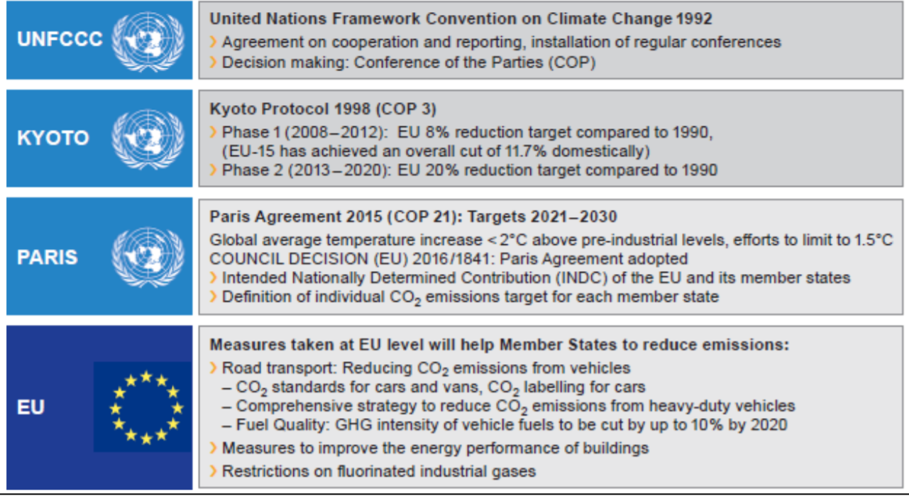
Vehicle Standards around the world
Europe
European Union (EU) regulates the emissions standards in Europe
First standards were developed in 1988
Main driver is attributed to reducing GHGs
Key agreements that drive the EU regulations are shown in the figure
Germany was the leader followed by Sweden in regulating vehicle emissions in the EU
Figure Source: Continental Automotive
Notes:
The European union is the governing body to regulated emission standards in Europe targeted mostly on CO2
Initial standards were developed in 1988 with Germany being the leader followed by Sweden to impose stricter limitation of mobile source emissions
The standards are built based on key agreements as shown in the figure
EU set a target of net zero GHGs emissions reduction for 2050

Slide 10
Vehicle Standards around the world
Overview of vehicle emission standards around the world
Most counties have defined their standards based on either the US Clean Air Act or EURO standards
China
China passed their first emission regulations in 2000
China's State Environmental Protection Administration (SEPA) tightened the standards in 2007, 2010 and 2016 aligning closely with EURO emission standards
Canada
First standards established was the Canadian Environmental Protection Act, 1999 for regulating emissions from on-road vehicles
Most regulations aligned emissions standards with the US standards
Japan
First standards passed in 1968 based on US Clean Air Act modified to reflect local conditions
India
The first standards aligned with EURO standards were passed in 2000 called Bharat emissions standards
These standards have evolved over time and were tightened in 2014, 2017, and 2020
Source: Continental Automotive
Notes:
The first vehicle emissions standards was established by the US following the LA smog problem in 1963. Following that, Japan passed their first standards, followed by Canada, Australia, Germany, Sweden, and other European counties. More recently, countries such as India, China, Brazil etc. have passed their own emission standards in 2000’s. This slide lists some of the emission standards around the world. It is important to note that most counties have defined their standards based on either the US Clean Air Act or EURO standards by modifying them based on local conditions. For e.g., Japan modified the drive test cycle to include more slow city driving to represent the congested conditions.

Slide 11
Key Regulations in the United States: NEPA
National Environmental Protection Act (NEPA)
Enacted on January 1, 1970
Aims to coordinate to the fullest extent possible, all environmental investigations, reviews, and consultations as a single process
Alternative courses of action be evaluated and decisions be made in the best overall public interest
Public involvement and a systematic interdisciplinary approach involving consultative partners from different federal and state agencies be essential parts of the development process for proposed actions
Measures necessary to mitigate adverse impacts be incorporated into the action
Source: EPA, NEPA
Notes:
The next few slides provides an overview of key regulations in the United States governing transportation emissions and air quality impacts
As extracted from EPA:
The National Environmental Policy Act (NEPA) was signed into law on January 1, 1970. NEPA requires federal agencies to assess the environmental effects of their proposed actions prior to making decisions. The range of actions covered by NEPA is broad and includes:
making decisions on permit applications,
adopting federal land management actions, and
constructing highways and other publicly-owned facilities.
Using the NEPA process, agencies evaluate the environmental and related social and economic effects of their proposed actions. Agencies also provide opportunities for public review and comment on those evaluations.

Slide 12
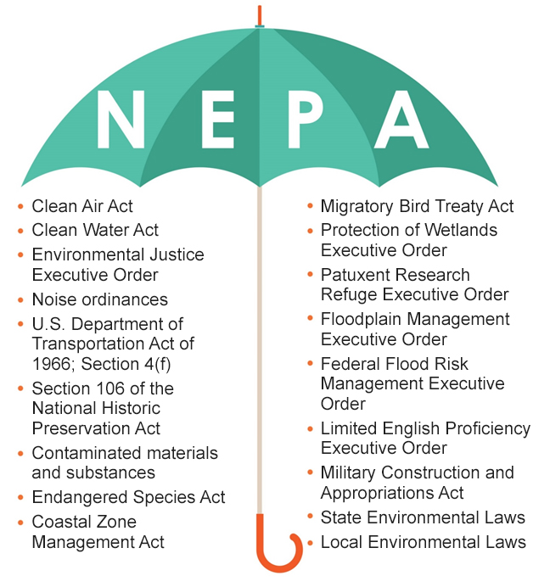
NEPA
Laws that correspond to transportation and air quality issues
Figure Source: U.S Dept of Veteran Affairs
Notes:
This figure shows the laws that come under the NEPA. Due to the number and variety of laws, NEPA is often referred to as the umbrella law as its analysis incorporates a broad range of federal laws, regulations, and executive orders. The highlighted laws correspond to the regulation of mobile source emissions and air quality related to the transportation sector.

Slide 13
Key Regulations: Clean Air Act
Clean Air Act (CAA), 1970
  Established National Ambient Air Quality Standards (NAAQS) and six criteria pollutants
  Established requirements for State Implementation Plan (SIP)
CAA Amendments, 1977
  Introduced Transportation Conformity
CAA Amendments, 1990
  Current Legal authority
  Expanded Transportation Conformity Provisions
    Identified the actions states/MPOs must take to reduce emissions from on-road mobile sources in nonattainment/maintenance areas
  Established 5-year NAAQS review period
Source: EPA, Clean Air Act
Notes:
As extracted from EPA,
The Clean Air Act (CAA) is the comprehensive federal law that regulates air emissions from stationary and mobile sources. Among other things, this law authorizes EPA to establish National Ambient Air Quality Standards (NAAQS) to protect public health and public welfare and to regulate emissions of hazardous air pollutants.
Major amendments were added to the Clean Air Act in 1977 (1977 CAAA). The 1977 Amendments primarily concerned provisions for the Prevention of Significant Deterioration (PSD) of air quality in areas attaining the NAAQS. The 1977 CAAA also contained requirements pertaining to sources in non-attainment areas for NAAQS. A non-attainment area is a geographic area that does not meet one or more of the federal air quality standards. Both of these 1977 CAAA established major permit review requirements to ensure attainment and maintenance of the NAAQS.
Another set of major amendments to the Clean Air Act occurred in 1990 (1990 CAAA). The 1990 CAAA substantially increased the authority and responsibility of the federal government. New regulatory programs were authorized for control of acid deposition (acid rain) and for the issuance of stationary source operating permits. The NESHAPs were incorporated into a greatly expanded program for controlling toxic air pollutants. The provisions for attainment and maintenance of NAAQS were substantially modified and expanded. Other revisions included provisions regarding stratospheric ozone protection, increased enforcement authority, and expanded research programs.

Slide 14
Key Regulations: NAAQS
National Ambient Air Quality Standards (NAAQS)
  Standards set by EPA as per the Clean Air Act to regulate pollutants that are considered to be harmful to the public health and the environment
  Under 40 CFR Part 50, CAA 1970
  Pollutants regulated are referred to as “criteria pollutants”
  NAAQS is classified into two standards
    Primary standards: To protect public health
    Secondary standards: To protect public welfare
  These standards are reviewed from time to time and revised accordingly
Source: EPA, NAAQS
Notes:
As extracted from EPA, The CAA, which was last amended in 1990, requires EPA to set National Ambient Air Quality Standards (40 CFR part 50) for pollutants considered harmful to public health and the environment. The Clean Air Act identifies two types of national ambient air quality standards. Primary standards provide public health protection, including protecting the health of "sensitive" populations such as asthmatics, children, and the elderly. Secondary standards provide public welfare protection, including protection against decreased visibility and damage to animals, crops, vegetation, and buildings.

Slide 15
Key Regulations: Emissions Standards
Vehicle emissions standards mandated by the CAA set specific limits on the amount of emissions released from vehicles
Compliance to standards are determined by testing tailpipe emissions with defined driving cycles
These standards restrict emissions of carbon monoxide, oxides of nitrogen, particulate matter, formaldehyde, non-methane organic gases or non-methane hydrocarbons
Emission Standards
  Tier 1 phased in from 1994-1997 with classification based on vehicle gross weight and cargo capacity for each vehicle categories
  Tier 2 phased in from 2004 – 2009 are tighter standards extending Tier 1 standards to include additional heavier vehicles
  Tier 3 phased in from 2017-2025 are stringent than Tier 2 and extend to include heavy duty vehicles
Source: EPA, Emissions Standards
Notes:
Vehicle emission standards are mandated by the CAA that place a limit on the amount of tailpipe emissions released by vehicles. For light-duty vehicles, there are 3 sets of standards released from the 1970s.
Tier 1 standard based on gross vehicle weight and cargo capacity separate for different vehicle categories. This applied to older cars with model years 2003 or older. The Tier 1 standards applied to vehicles up to 8500 lbs GVWR. Tier 2 were more tighter than Tier 1 and apply to all vehicles that were covered by Tier 1 and, vehicles that are rated between 8,500 and 10,000 lbs GVWR. Their classification was based on a binning approach. Tier 3 standards were introduced to be tighter standards than Tier 2 and included emission standards for heavy-duty vehicles (HDV), such as heavy-duty pick-ups and vans, chassis-certified as complete vehicles.
Currently all cars on the road have to conform to the current Tier 3 standards or the previous Tier 2 standards.

Slide 16
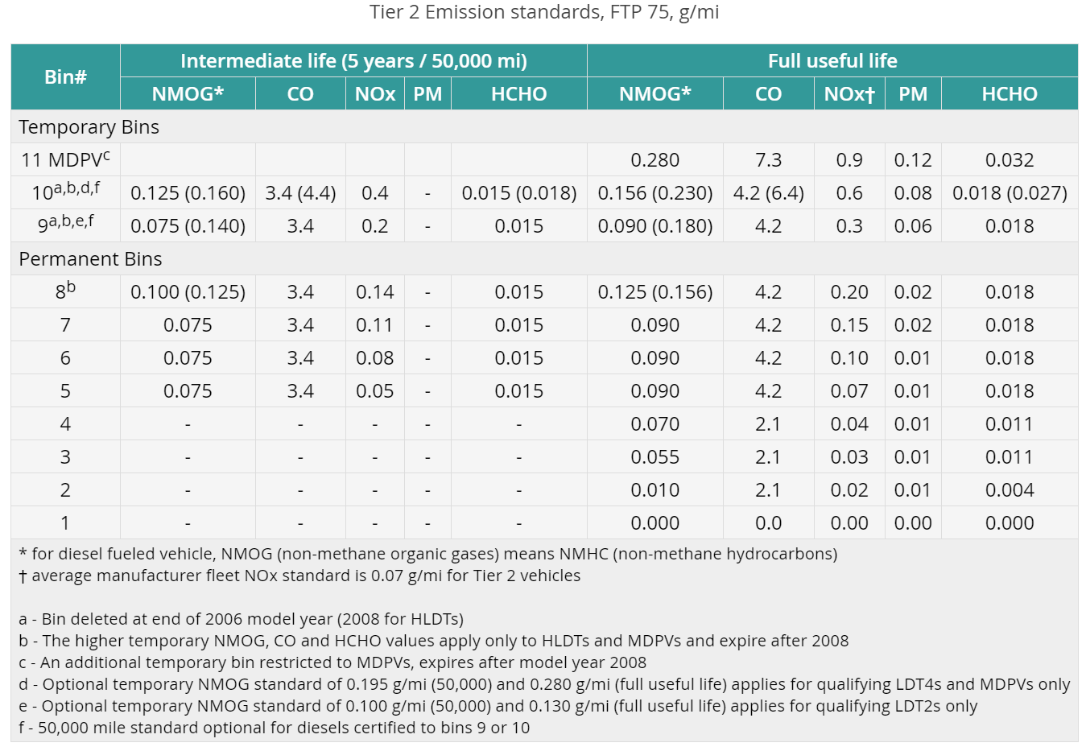
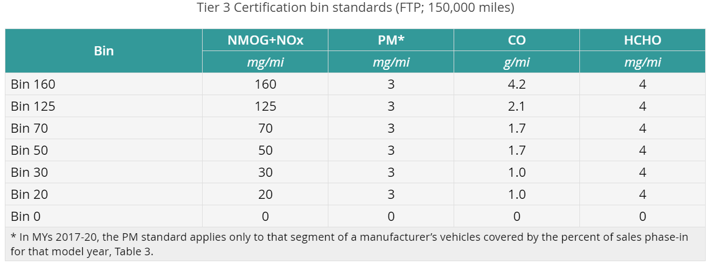
Key Regulations: Emissions Standards
Source: NCTCOG, Dieselnet
Notes:
As extracted from NCTCOG,
Tier 2: Under the Tier 2 standards, passenger vehicles are certified to individual "bins", and each bin corresponds to a specific emission rate for each pollutant. The lower the Bin number, the cleaner the vehicle, with Bin 1 being equivalent to zero emissions. From 2004-2008, the bins ranged from Bin 1 to Bin 11. Bins 9-11 began phasing out in 2006 and expired for the heaviest vehicles in 2008, so the available vehicle certifications range from Bin 1 to Bin 8, beginning with model year 2009. Manufacturers must ensure that the vehicle fleets they produce average to a Tier 2 Bin 5 certification, which is equal to an emission rate of 0.07 grams per mile of nitrogen oxides (NOx). For comparison, a vehicle certified as a Low Emission Vehicle (LEV) under the National Low Emission Vehicle program, which was in place from 2001-2003, emitted NOx at a rate of 0.3 grams per mile.
As extracted from Dieselnet:
The structure of Tier 3 standards is similar to the Tier 2 standards—manufacturers must certify vehicles to one of seven available “certification bins” and must meet a fleet-average emission standards for their vehicle fleet in a given model year. The standards are more stringent than Tier 2 standards and include a number of other important changes:
Both the certification limits (bins) and the fleet average standards are expressed using the sum of NMOG+NOx emissions,
The bins are named using their corresponding NMOG+NOx limit in mg/mi. The highest emission bin—Bin 160 (NMOG+NOx = 160 mg/mi)—is equivalent to Tier 2 Bin 5,
The fleet average NMOG+NOx emissions must reach 30 mg/mi (Bin 30 = Tier 2 Bin 2) by 2025,
The required emission durability has been increased to 150,000 mi, up from 120,000 mi.
Gasoline vehicles are tested—for exhaust and evaporative emissions—using gasoline containing 10% of ethanol (E10).

Slide 17
Mobile Source Air Toxics
MSATS
  In addition to criteria pollutants, other key pollutants released from transportation sources include mobile source air toxics (MSATs) and greenhouse gases (GHGs)
  MSATs are compounds emitted from highways and non-road sources that contain benzene and other hydrocarbons such as 1,3-butadiene, formaldehyde, acetaldehyde, acrolein, and naphthalene
  MSATs are addressed through FHWA Interim Guidance for NEPA Analysis
  First MSAT rule passed by EPA in 2001 identified 21 compounds as being hazardous and cause adverse health effects
  Second rule passed in 2007 identified additional components and also identified several emissions certification standards to be implemented to reduce the amount of MSATs released
Source: FHWA, MSATs
Notes:
As extracted from FHWA: Pollutants are generated by a wide variety of sources and enter the air, water, and soil through different media. Toxic air pollutants-also known as Hazardous Air Pollutants or HAPs-are those that are known to cause or suspected of causing cancer or other serious health ailments. In 2001, EPA issued its first Mobile Source Air Toxics Rule, which identified 21 mobile source air toxic (MSAT) compounds as being hazardous air pollutants that required regulation. A subset of six of these MSAT compounds were identified as having the greatest influence on health and included benzene, 1,3-butadiene, formaldehyde, acrolein, acetaldehyde, and diesel particulate matter (DPM). More recently, EPA issued a second MSAT Rule in 2007, which generally supported the findings in the first rule and provided additional recommendations of compounds having the greatest impact on health. The rule also identified several engine emission certification standards that must be implemented. Unlike the criteria pollutants, toxics do not have National Ambient Air Quality Standards (NAAQS) making evaluation of their impacts more subjective.

Slide 18
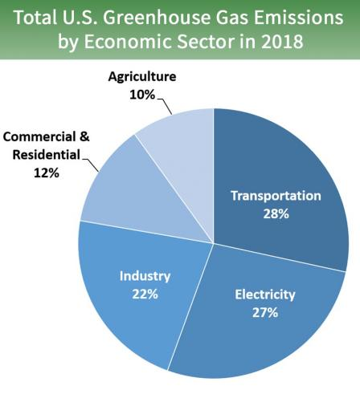
Greenhouse gases (GHGs)
  Greenhouse gases (GHGs) trap heat in the atmosphere leading to global warming and climate change
  Transportation accounts for 28% of US GHGs emissions out of which carbon-dioxide is the primary pollutant
  EPA regulates the GHGs by establishing two fuel economy standards for light duty vehicles:
    Phase 1 (model years 2012 – 2016)
    Phase 2 (model years 2017 – 2025)
  In 2020, NHTSA and EPA amended the CAFE and GHGs standards
Figure Source: EPA, GHGs
Notes:
As extracted from EPA: The national program for greenhouse gas emissions (GHG) and fuel economy standards for light-duty vehicles (passenger cars and trucks) was developed jointly by EPA and the National Highway Traffic Safety Administration (NHTSA).
The standards were established in two phases:
Phase 1 - Model years 2012 - 2016; and
Phase 2 - Model years 2017 - 2025.
As part of the 2017-2025 standards rulemaking, EPA made a regulatory commitment to conduct a Midterm Evaluation of the longer-term standards for model years 2022-2025, in coordination with NHTSA and the California Air Resources Board.
In April 2020, NHTSA and EPA amended the Corporate Average Fuel Economy (CAFE) and greenhouse gas emissions standards for passenger cars and light trucks and established new less stringent standards, covering model years 2021 through 2026.

Slide 19
Key Regulations: Designations
NAAQS and CAA
  After EPA sets a new NAAQS, the CAA requires EPA if areas of the country meet the NAAQS
  Based on the evaluation of an area’s air quality levels (measured through the ambient monitoring stations as well as characterized through air quality modeling) and the NAAQS, the area can be designated as one of the following
  “In attainment”: If the air quality in a geographic area meets the NAAQS, it is called an attainment area
  “In non-attainment”: areas that don't meet the NAAQS are called nonattainment areas
  “Maintenance”: areas that met the NAAQS, but previously has violated them
  “Unclassifiable”: some areas where EPA is not able to determine the status based on available data
  These designation vary by pollutant
  EPA’s green book contains information about the designation status for all areas in the country
Source: EPA, NAAQS Designation Process
Notes:
As extracted from EPA:
After EPA sets a new National Ambient Air Quality Standard or revises an existing standard for each regulated pollutant, the Clean Air Act requires EPA to determine if areas the country meet the new standards.
States and tribes submit recommendations to the EPA as to whether or not an area is attaining the national ambient air quality standards for a criteria pollutant. The states and tribes base these recommendations on air quality data collected from monitors at locations in urban and rural settings as well as other information characterizing air quality such as modeling. After working with the states and tribes and considering the information from air quality monitors, and/or models, EPA will "designate" an area as attainment or nonattainment for the standard.
If the air quality in a geographic area meets or is cleaner than the national standard, it is called an attainment area (designated “unclassifiable/attainment”); areas that don't meet the national standard are called nonattainment areas. In some cases, EPA is not able to determine an area's status after evaluating the available information. Those areas are designated "unclassifiable."
Once designations take effect, state and local governments must develop implementation plans outlining how areas will attain and maintain the standards by reducing air pollutant emissions. Tribes may elect to develop tribal implementation plans but are not required to do so.

Slide 20
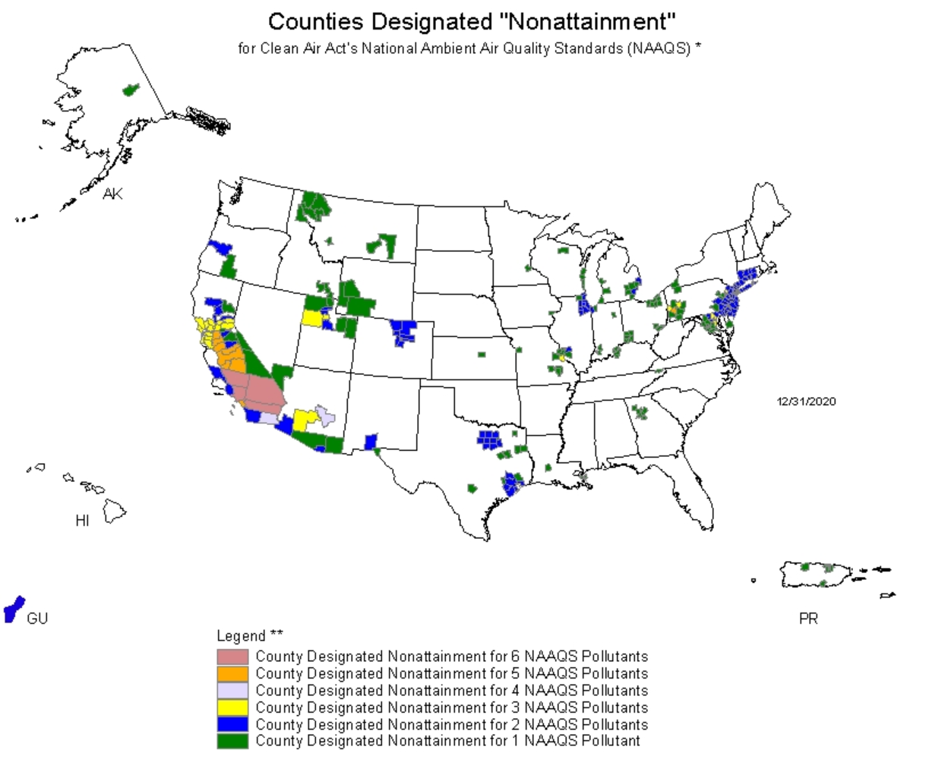
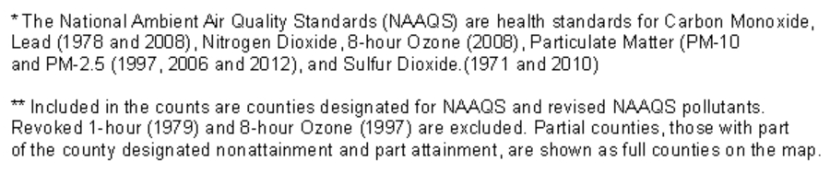
Key Regulations: CAA Designations
Source: EPA, Green Book
Notes:
The EPA Green Book provides detailed information about area’s NAAQS designations, classifications and nonattainment status. This map shows the counties designated as nonattainment for multi-pollutant (all criteria pollutants).

Slide 21
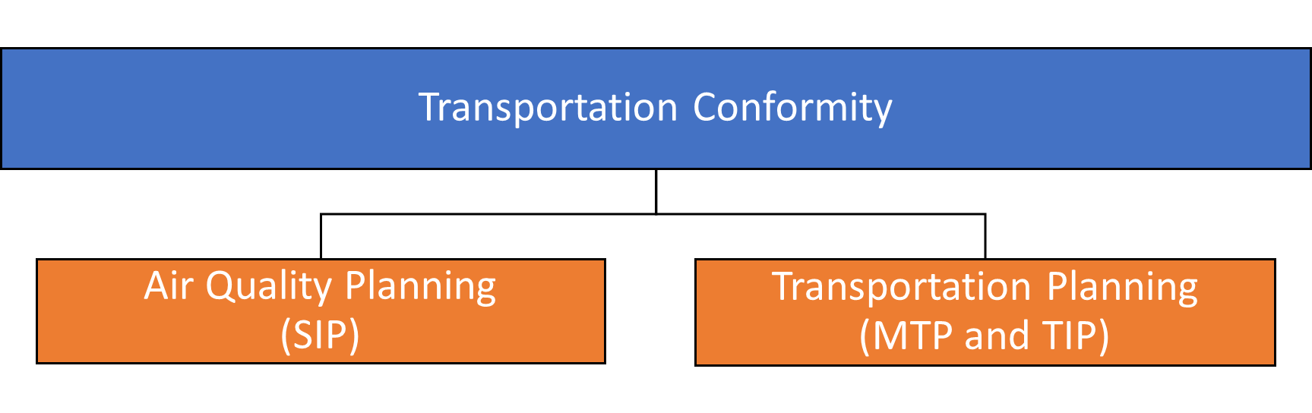
Key Regulations: Transportation Conformity
Transportation Conformity is a process that connects air quality planning and transportation planning
Source: FHWA, Transportation Conformity; TTI
Notes:
The transportation conformity process is to ensure transportation plans, programs and projects supported by federal funding are consistent with the air quality goals of the State Implementation Plan. The process applicable to nonattainment and maintenance areas is to ensure federally funded highway and transit projects do not worsen the existing air quality levels. Transportation conformity establishes a basic framework that links air quality planning and transportation planning as shown in figure. Transportation planning is a process used by the state and local governments to decide which transportation projects to fund at the statewide and metropolitan planning level.
Transportation planning consists of planning at different levels including the (a) statewide long-range transportation plan (includes the planning of the state-maintained roadways for a period of 24 years), (b) metropolitan transportation plan (MTP) (includes transportation plans over a period of 20-25 years for urban areas that exceed 50,000 people), (c) transportation improvement program (TIP) (represents a medium-term - typically four years - capital improvement program of multimodal transportation projects) and (d) statewide transportation improvement program (STIP) (comprises of all the regional TIPs developed in the state. To ensure conformity, a metropolitan planning organization (MPO) evaluates regional emission estimates from the proposed projects in comparison with the emission budgets from the SIP. A conformity determination ensures the proposed emissions are less than the emission budgets established in the SIP. In cases where the proposed emissions are higher than the emission budgets, transportation control measures (TCM) are employed to reduce on-road emissions through measures such as reduced traffic activity, relieving congestion, etc. The conformity determination is made by the federal agencies (FHWA, FTA) in consultation with interagency consultative partners consisting of representatives from the EPA, the state department of transportation, state air agency, and other stakeholders.

Slide 22
Key Regulations: Transportation Conformity
Transportation Conformity
  The CAA amendments of 1990 requires transportation projects that are funded by federal funds to conduct an extensive process known as the transportation conformity to ensure the area does not worsen the current air quality levels
  According to the CAA, transportation projects cannot
    Cause new violations of the NAAQS
    Increase the frequency or severity of existing standards
    Delay attainment of the standards
  Conformity applied only for nonattainment and maintenance areas for the six criteria pollutants
  They are regulated at three levels:
  State level: state implementation plan (SIP) to allocate statewide emissions budgets and outline plans to retain emissions within the budgets
  County and MPO level: transportation improvement programs (TIP) to demonstrate efforts to reduce transportation emissions
  Project level: federal or state funded transportation projects must carry out project level environmental impact analysis
Source: FHWA, Transportation Conformity
Notes:
The Clean Air Act Amendments of 1990 requires that transportation investments in nonattainment and maintenance areas be consistent with state commitments, to meet National Air Ambient Quality Standards (NAAQS).
Traffic-related air pollution is well established as a major risk to human health. In light of this evidence, the CAA requires a planning process known as transportation conformity to ensure that federally supported highway project activities will not cause new air quality violations or worsen existing standards in nonattainment areas.
This process helps to ensure the following
Better integration of transportation and air quality planning
Enhancement of analytic tools to transportation and air quality planning
Compilation of current data
Effective interagency consultation

Slide 23
Take-Home Messages
Mobile source emissions represent a key source of air pollution and are found to adversely impact the environment and human health
Regulations governing the mobile source emissions and air quality has evolved over time both in the US and the world
NEPA helps to ensure federal and state actions do not worsen the existing air quality
CAA provides a legal framework for addressing air quality and public health
CAA authorizes EPA to set NAAQS and based on NAAQS, areas are categorized into attainment, nonattainment and maintenance areas based on air monitoring and modeling data
Areas in violation of the NAAQS (nonattainment areas) must adhere to specific provisions as regulated by the transportation conformity process
Notes:
To address the adverse impacts caused by mobile sources, key regulations are in place both in the United States and around the world. The first step towards regulating these emissions in the US was in the 1950s and has since then evolved over time. Currently the key regulations are the NEPA, under which the Clean Air Act set the NAAQS to regulate criteria pollutants and other regulations to address other pollutants (GHGs and MSATs). Transportation conformity is a federally- required mechanism for areas that do not meet the NAAQS to make sure that their transportation plans or programs do not worsen the existing air quality levels.

Slide 24
List of Abbreviations
CAA: Clean Air Act
CAFE: Corporate Average Fuel Economy
CARB: California Air Resources Board
EPA: Environmental Protection Agency
GHGs: Greenhouse Gases
I/M: Vehicle emissions inspection and maintenance program
MTP: Metropolitan transportation plan
MSAT: Mobile source air toxics
NAAQS: National Ambient Air Quality Standards
NHTSA: National Highway Traffic Safety Administration
NEPA: National Environmental Policy Act
SCAQMD: South Coast Air Quality Management District
SIP: State Implementation Plan
TIP: Transportation Improvement Program
TRAP: Traffic-Related Air Pollution

Slide 25
References
Continental Automotive. Report on Worldwide Emission Standards and Related Regulations. Passenger Cars / Light and Medium Duty Vehicles. Accessed at https://www.continental-automotive.com/getattachment/8f2dedad-b510-4672-a005-3156f77d1f85/EMISSIONBOOKLET_2019.pdf
Diesel Net. Emissions Standards. Accessed at https://dieselnet.com/standards/us/ld_t3.php.
Environmental Protection Agency. Clean Air Act. Accessed at https://www.epa.gov/laws-regulations/summary-clean-air-act.
Environmental Protection Agency. Emissions Standards. Accessed at https://www.epa.gov/greenvehicles/light-duty-vehicle-emissions#standards.
Environmental Protection Agency. Green Book. Accessed at https://www3.epa.gov/airquality/greenbook/mapnpoll.html.
Environmental Protection Agency. Greenhouse Gases. Accessed at https://www.epa.gov/regulations-emissions-vehicles-and-engines/regulations-greenhouse-gas-emissions-passenger-cars-and
Environmental Protection Agency. National Ambient Air Quality Standards. Accessed at https://www.epa.gov/criteria-air-pollutants/naaqs-table.
Environmental Protection Agency. NAAQS Designation Process. Accessed at https://www.epa.gov/criteria-air-pollutants/naaqs-designations-process.
Environmental Protection Agency. National Environmental Policy Act. Accessed at https://www.epa.gov/nepa/what-national-environmental-policy-act.

Slide 26
References
Environmental Protection Agency. Timeline of Major Accomplishments in Transportation, Air Pollution, and Climate Change. Accessed at https://www.epa.gov/transportation-air-pollution-and-climate-change/timeline-major-accomplishments-transportation-air#2000.
Environmental Protection Agency. Transportation Conformity. Accessed at https://www.epa.gov/state-and-local-transportation/general-information-transportation-and-conformity.
Federal Highway Administration. Mobile Source Air Toxics (MSATs). Accessed at https://www.fhwa.dot.gov/ENVIRONMENT/air_quality/air_toxics/.
Federal Highway Administration. Transportation Conformity. Accessed at https://www.fhwa.dot.gov/environment/air_quality/conformity/guide/guide00.cfm.
North Central Texas Council of Governments. Current Emissions Standards. Accessed at https://resources.nctcog.org/trans/air/vehicles/tech/compliance/
South Coast Air Quality Management District. The Southland's War on Smog: Fifty Years of Progress Toward Clean Air (through May 1997). Accessed at https://www.aqmd.gov/home/research/publications/50-years-of-progress
Texas A&M Transportation Institute. 2016. Maintaining project consistency with transportation plans throughout the project life cycle with an emphasis of maintaining air quality conformity.

Slide 27
Reading Material
Environmental Protection Agency. Light Duty Vehicle Emissions. Accessed at https://www.epa.gov/greenvehicles/light-duty-vehicle-emissions
Weiner, E., 2010. Urban Transportation Planning in the United States: History, Policy, and Practice. Springer.

