Slide 1
www.carteeh.org

Slide 2
Lecture #39: Undertaking Health Impact and Burden of Disease Assessment of Traffic-Related Air Pollution—Part 1
Haneen Khreis
Texas A&M Transportation Institute
H-Khreis@tti.tamu.edu, (979) 317-2799 x42799
The author declares that there is no conflict of interest
Lecture Track(s): HT/TT/PPT
Notes:
Health Track (HT)—mainly targeted at urban planners, transportation planners, and engineers with limited knowledge of public health-related concepts;
Transportation Track (TT)—mainly targeted at environmental epidemiologists and public health professionals with limited knowledge of transportation-related concepts; and;
Planning and Policy Track (PPT)—mainly targeted at planners, civil servants, and policy and decision makers with particular interest in the science-policy link.

Slide 3
Introduction
Quantitative burden of disease (BoD) and health impact assessments (HIA) provide methods for quantifying the positive and/or negative health impacts of baseline conditions (burden of disease assessments) and public policies, projects and programs (health impact assessments), and the distribution of these impacts
The definitions, overall methods, examples, strengths and limitations of these methods have been overviewed in details in lecture #38
This lecture specifically deals with the practicalities of conducting such exercises including the exact methods and calculations, data requirements and data sources, in the context of the health impacts of traffic-related air pollution (TRAP)
TRAP BoD and HIAs are different than BoD and HIAs of air pollution in general
TRAP requires specific assessment of the traffic-related component of air pollution and therefore requires different methods such as a full-chain HIA (lecture #40) or source apportionment methods for the exposure assessment
These specific methods require different input data sets and models which may be more resources and time intensive

Slide 4
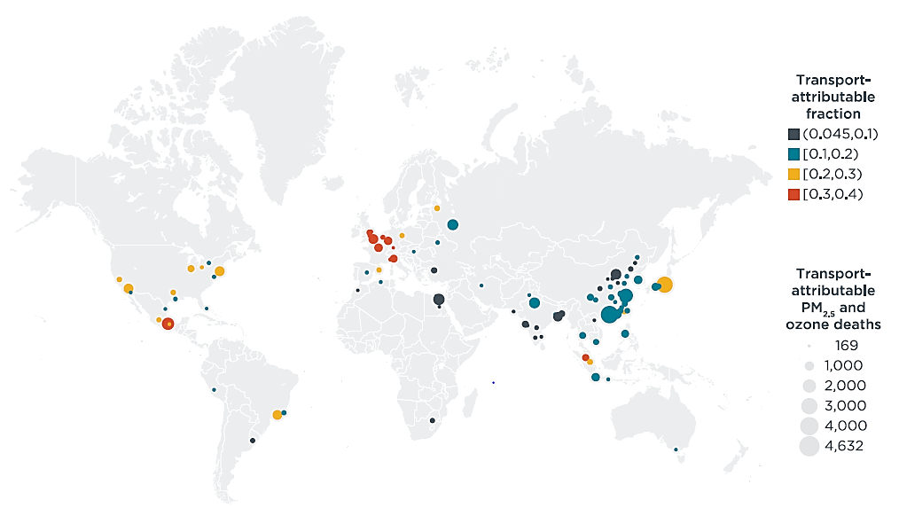
Introduction
Total number of transportation-attributable PM_{2.5} and ozone deaths in 2015 by urban area. Bubble size indicates total
number of transportation-attributablePM_{2.5} and ozone deaths using central relative risk estimates. Bubble color indicates
transportation-attributable fraction (TAF) of total PM_{2.5} and ozone deaths, Source: Anenberg et al. (2019)
Notes:
Example of a burden of disease assessment results using the transportation-related portion of PM2.5.
Abstract from Anenberg et al. (2019):
“Emissions from the transportation sector are a major contributor to ambient air pollution, the leading environmental health risk factor globally. This study aims to quantify the contribution of tailpipe emissions from global transportation, disaggregated by four sub-sectors, to the global disease burden associated with ambient fine particulate matter (PM2.5) and ground-level ozone in 2010 and 2015. We use the GEOS-Chem global chemical transport model to simulate transportation-attributable PM2.5 and ozone concentrations, combined with epidemiological health impact assessment methods consistent with the Global Burden of Disease 2017 study to estimate the associated burden of disease. We estimate that emissions from the transportation sector were associated with 361 000 (95% CI, 258 000–462 000) PM2.5 and ozone deaths in 2010 and 385 000 (95% CI, 274 000–493 000) in 2015. These results translate into 11.7% of total global ambient PM2.5 and ozone deaths in 2010 and 11.4% in 2015. Together, PM2.5 and ozone concentrations from transportation tailpipe emissions resulted in an estimated 7.8 million years of life lost and approximately $1 trillion (2015 US$) in health damages globally in 2015. Among transportation sub-sectors, on-road diesels contributed most to the health burden from transportation tailpipe emissions in nearly all trade blocs, for bothPM2.5 and ozone, though other sub-sectors also contributed substantially (particularly on-road non-diesel vehicles for ozone mortality, and shipping and non-road mobile sources forPM2.5 mortality). These results indicate that despite recent adoption of more stringent vehicle emission regulations in many countries, the transportation sector remains a major contributor to the air pollution disease burden globally. Future work may explore the degree to which currently adopted policies, as well as expected growth in the transportation sector in India, Africa, and other rapidly developing locations, will influence future transportation-attributable public health burdens.”

Slide 5
Methods
Undertaking a quantitative BoD or HIA combines several steps:
defining the exposure(s) of interest, exposure(s) measures and ranges;
defining the health outcome(s) of interest associated with the exposure(s) and their frequency (incidence) amongst the exposed population;
selecting exposure-response functions (risk estimates) to quantify the strength of association between selected exposure(s) and selected health outcome(s);
combining exposure(s) data with population data and exposure-response functions to quantify the attributable proportional health burden of the health outcome of interest and;
quantifying the uncertainty in the estimated health burden (range of potential effects) (Perez et al., 2009, World Health Organization, 2015)
Notes:
Each of these steps and what they practically involve will be overviewed in this lecture

Slide 6
Methods – Step 1: Exposure Assessment
The first step for undertaking a quantitative BoD or HIA is defining the exposure(s) of interest, exposure(s) measures and ranges
In this context, the exposure of interest is air pollution and specifically TRAP
Methods for the assessment of air pollution and TRAP have been overviewed in lectures #17 to 24 and will not be further discussed here. Briefly, these include ground monitors, land-use regression models, chemical transport models, satellites, mobile monitoring
These methods can be used to derive exposure estimates for the population of interest, usually at a geographical level where census data is available such as the census block (Alotaibi et al., 2019) or tract in the United States or the output area in the United Kingdom (UK) (Khreis et al., 2019)
Notes:
The exposure is assessed at a level where population counts can be obtained so that the exposure estimate is assigned to the population living in each geographical catchment area and most often an average exposure estimate at that geographical level is assigned to everyone who lives in that area.
Long-term, annual, average air pollution exposures, are often used.

Slide 7
Methods – Step 2: Health Outcome
The second step for undertaking a quantitative BoD or HIA is defining the health outcome(s) of interest associated with the exposure(s) and their frequency (incidence) amongst the exposed population
In this context, the exposure of interest is air pollution and specifically TRAP, and the health outcome can be any that has been associated with TRAP in epidemiological studies
Health effects that have been associated with TRAP have been overviewed in lectures #30, 31 and 32 and will not be further discussed here
Another resource that synthesizes health effects associated with TRAP, as identified in systematic review and meta-analyses, can be found in Lam et al. (2020)
Notes:
It is highly recommended that when selecting the outcome of interest, one picks an outcome that has been associated with air pollution and TRAP in multiple rigorous studies, and ideally in systematic reviews and meta-analyses as such analyses are considered more reliable and more generalizable in the absence of local effect sizes from the specific population of interest.
The argument for causation is also stronger when using systematic reviews and meta-analyses and would be stronger if toxicological evidence supports epidemiological observations.

Slide 8
Methods – Step 2: Health Outcome
The incidence of the health outcome of interest amongst the exposed population can be obtained through a variety of sources with no clear guidance on which sources are preferable
The best option would be to find the incidence rate of the health outcome of interest in the specific population under study using for example, cohort study data if available, general practitioner’s or hospitals data if feasible
Some cohort study directories exist, including the following which are not an exhaustive list:
Birthcohorts.net: https://www.birthcohorts.net/ (World)
The Cohort Directory: https://mrc.ukri.org/research/facilities-and-resources-for-researchers/cohort-directory/ (UK)
Dementias Platform UK: https://portal.dementiasplatform.uk/CohortDirectory (UK)
NIEHS-Funded Epidemiology Resources Faceted Search Tool: https://tools.niehs.nih.gov/cohorts/ (World)
Low and Middle Income Longitudinal Population Study Directory: https://www.ifs.org.uk/tools_and_resources/longitudinal (World)
Global Cohort Portal: https://www.neurodegenerationresearch.eu/jpnd-global-cohort-portal/ (World)
Gateway to Global Aging Data: https://g2aging.org/ (World)
Notes:
It is best to find the incidence of the health outcome of interest in the specific population under study. For example, if one is studying a specific city, one should start by looking for incidence rates data for the health outcome investigated from that specific city. This data can come from a variety of sources such as cohort studies conducted in these cities or gaining access to general practitioner’s or hospitals data, although the latter can be more costly, time-consuming and most likely requires intensive ethical reviews and approvals.
It is always a good idea to reach out to public health departments or environmental departments in the region of interest to figure out what data exists and can be best used for the local BoD/HIA.

Slide 9
Methods – Step 2: Health Outcome
However, most often this data is either unavailable or costly, time-consuming or difficult to obtain and studies use incidence data from a larger geographical analysis such as county level, regional or national data
Data sources are variable by location and include publications that calculate incidence rates for the health outcome of interest
A good source of national data on the incidence of various health outcomes is the Global Burden of Disease study database: http://ghdx.healthdata.org/gbd-results-tool
There is evidence that using local versus national incidence rates for example for childhood asthma in BoD assessments makes a difference to the final estimates especially when city to city or state to state variations are of interest (Khreis et al., 2019; Khreis et al., 2020)
Notes:
Most often studies have to use incidence rates data from larger geographical regions than the study area and scale these estimates down to the local study population based on population counts.
Very few studies investigate the impact that using local versus national incidence rates on BoD estimates. This is an area that warrants further investigation.

Slide 10
Methods – Step 3: Exposure-Response Functions
The third step for undertaking a quantitative BoD or HIA is selecting exposure-response functions (risk estimates) to quantify the strength of association between selected exposure(s) and selected health outcome(s)
Exposure-response functions specifically coming from the population under study are best but are often either unavailable or rely on small sized population data and are therefore imprecise with for example wide confidence intervals
Meta-analytic exposure-response functions are therefore preferable as they provide larger sample sizes/more precise estimates but potentially higher and unexplained heterogeneity
Notes:
Selecting the most appropriate exposure-response functions is another important decision that needs careful consideration in quantitative BoD or HIA.
Ideally, one would have an exposure-response function that is pertinent to the population under study, for example from cohort studies in the study area which investigate the association between the exposure and the health outcome of interest. This would more accurately reflect the level of risk studies, the population characteristics and their particular response to the exposure. The choice of pollutant to be used in the analysis is also another important aspect for consideration and should be considered in light of the available epidemiological evidence and supporting mechanistic or toxicological evidence (for example, see discussion in Khreis et al., 2019 and Thurston et al., 2020). Uncertainty is introduced where epidemiological evidence is lacking or causality has not been established.
Often, this data is unavailable.
In the absence of specific local exposure-response functions, the use of pooled exposure-response functions from meta-analyses is encouraged as those could be more generalizable and have more statistical power due to the pooling of larger human population data.
It is important to note that extrapolating risk estimates from one population to another implies that causality of the health effect in the population under study is simply assumed. While estimates that come from meta-analyses are preferred, they are limited in the sense that they represent a pooled, generalized estimate. Differences in risk between different studies and different populations (heterogeneity) may actually reflect the true variability in the association between the exposure and the health outcome and therefore different susceptibilities of populations, especially if underlying population parameters vary by a lot.
Risk characterization: The risk estimate obtained from the exposure-response function that most epidemiological studies report in terms of relative risk (RR), or odds ratios (OR). The risk estimate is scaled to the difference in exposure level resulting of the comparison of the baseline exposure level with the counterfactual exposure level, as will be shown in the next slides.

Slide 11
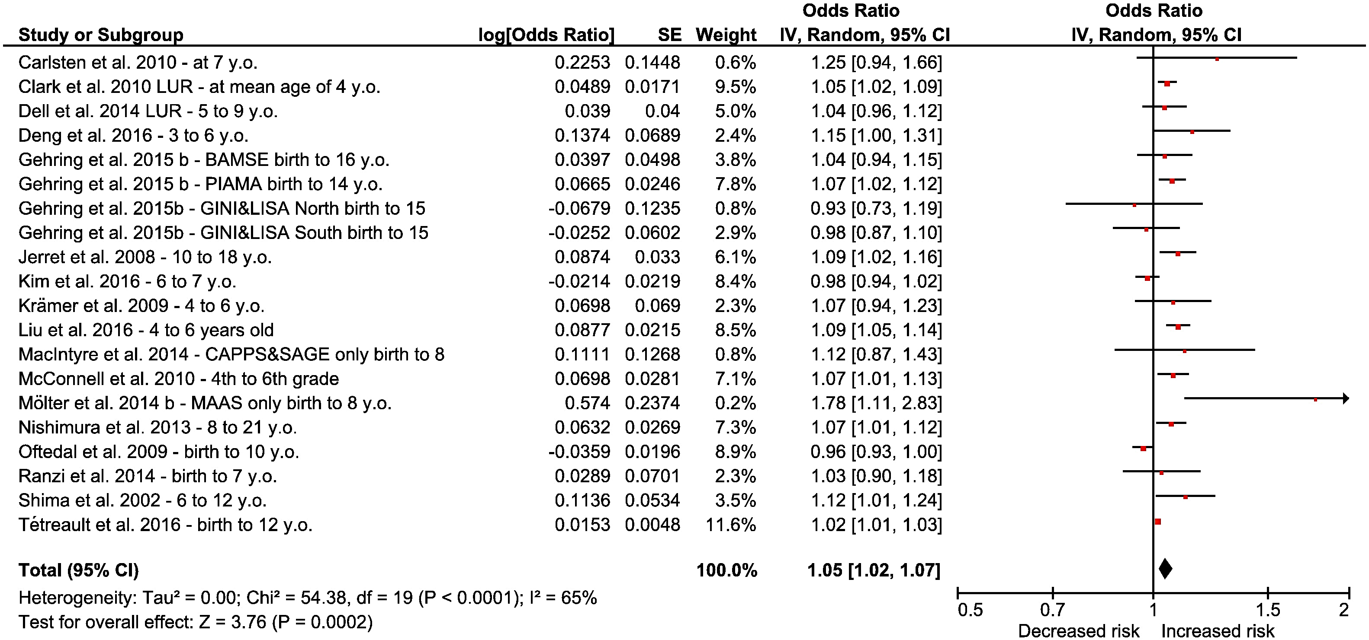
Methods – Step 3: Exposure-Response Functions
Exposure-response function/ risk estimate
NO₂ random-effects meta-analyses. Individual and summary random-effects estimates for associations between NO₂ per 4 μg/m³ and asthma at any age. Source: Khreis et al. (2017)
Notes:
An example of a pooled exposure-response function quantifying the association between the exposure to nitrogen dioxide (NO2) and the onset of childhood asthma is shown in this slide. This exposure-response function has been used in various publications estimating the burden of disease of childhood asthma attributable to air pollution in different regions across the world (see examples below)
Achakulwisut, P., Brauer, M., Hystad, P. and Anenberg, S.C., 2019. Global, national, and urban burdens of paediatric asthma incidence attributable to ambient NO2 pollution: estimates from global datasets. The Lancet Planetary Health, 3(4), pp.e166-e178.
Alotaibi, R., Bechle, M., Marshall, J.D., Ramani, T., Zietsman, J., Nieuwenhuijsen, M.J. and Khreis, H., 2019. Traffic related air pollution and the burden of childhood asthma in the contiguous United States in 2000 and 2010. Environment international, 127, pp.858-867.
Khreis, H., Cirach, M., Mueller, N., de Hoogh, K., Hoek, G., Nieuwenhuijsen, M.J. and Rojas-Rueda, D., 2019. Outdoor air pollution and the burden of childhood asthma across Europe. European Respiratory Journal, 54(4).

Slide 12
Methods – Step 4: Quantifying Attributable Cases
The fourth step is combining exposure(s) data with population data and exposure-response functions to quantify the attributable proportional health burden of the health outcome of interest
This involves a number of calculations which will be overviewed next
Notes:
Population data can be obtained from the census.

Slide 13
Methods – Step 4: Quantifying Attributable Cases
The selected exposure-response function needs to be scaled to the difference in exposure between the current (baseline) exposure levels and the counterfactual exposure levels. This is done at the geographical level of analysis for example, census block The scaling is done as follows (Mueller et al., 2020):
n is the number of exposure categories (census tracts, neighborhoods, districts, etc.)
i is an element of the set i∈{1,…,n}
$${RR}_{i}=e^{\left(\frac{ln({RR}_{E})}{E} × {ED}_{i}\right)}$$
${RR}_{E}$ is the relative risk obtained from the exposure-response function,
$E$ is the exposure unit that corresponds to the${RR}_{E}$ obtained from the exposure-response function,
${ED}_{i}$is the exposure level difference, which is the difference in the exposure level resulting of the comparison of the baseline exposure level with the counterfactual exposure level

Slide 14
Methods – Step 4: Quantifying Attributable Cases
The population attributable fraction (PAF) is then calculated
PAF defines the proportional health burden of the health outcome of interest that is attributable to exposure level difference${ED}_{i}$ and is calculated as follows (Mueller et al., 2020):
${PAF}_{i}$= $\frac{P_{i} × {RR}_{i }− 1}{P_{i}{ × RR}_{i}}$
$P_{i}$ is the proportion of exposed population,
${RR}_{i}$ is the previously scaled relative risk

Slide 15
Methods – Step 4: Quantifying Attributable Cases
Finally, the total attributable burden or attributable number of cases is calculated
The attributable burden (AB) describes the total burden of the health outcome of interest that is attributable to the exposure level difference${ ED}_{i}$
The AB is calculated as follows (Mueller et al., 2020):
$$AB=\sum_{i=1}^{n}{{TB}_{i}} × {PAF}_{i}$$
${TB}_{i}$ is the total burden of the health outcome of interest,
${PAF}_{i}$ is the previously calculated proportional health burden of the health outcome of interest that is attributable to the exposure level difference ${ED}_{i}$

Slide 16
Methods – Step 5: Quantifying Uncertainty
The final step is quantifying the uncertainty in the estimated health burden (range of potential effects)
This could be done through a variety of methods using the ranges of the input data used in the BoD/HIA such as:
Using the ranges of the exposure estimates
Using the ranges of the incidence rate for the health outcome of interest
Using the ranges for the exposure-assessment functions
Using a combination of the above
The uncertainty is often presented as 95% confidence intervals (CI)
Notes:
The uncertainty in the BoD estimates or health impacts stems from uncertainties in the input data used in the modeling including the exposure estimates, the incidence rates for the health outcomes of interest, and the exposure-response functions used.
It is often presented as 95% confidence intervals which provide a range of the estimated health impacts in the form of a lower bound and an upper bound, with the central estimate falling within this range.
There is no specific guidance including a lack of standards and best practices on how to quantify uncertainty and present it in BoD and HIA.
Estimating the ranges of uncertainty associated with all data inputs is perhaps the most comprehensive method and give an indication of which inputs affect the final estimates the most.

Slide 17
Methods – Step 5: Quantifying Uncertainty
One method of presenting the range of BoD or health impact estimates is using the most conservative estimate resulting from all of the input’s data lower ranges as the lower 95% CI, and using the most extreme estimate resulting from all of the input’s data upper ranges as the upper 95% CI
This method will result in the widest possible 95% CI around the central BoD estimate
This method, however, requires running the analysis for these multiple combinations and is often not done in practice
Notes:
An example of the results using this method is shown in the next slide

Slide 18
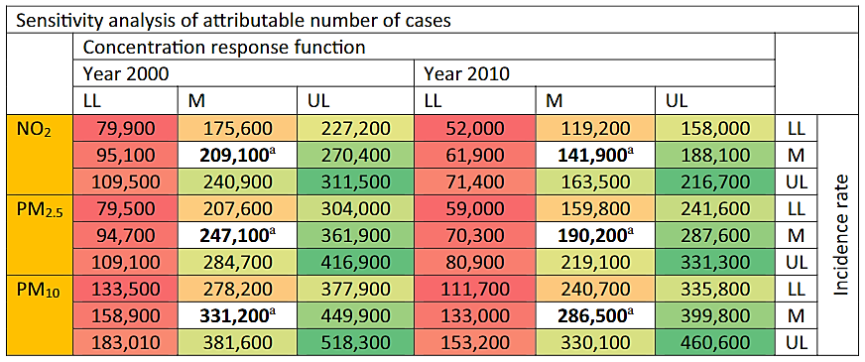
Methods – Step 5: Quantifying Uncertainty
ª Estimates using mean exposure-response function and mean incidence rate. Dark red is the most conservative estimate, using the lower 95% CI bound for both the exposure-response function and the incidence rate. Dark green is the most extreme estimate, using the upper 95% CI bound for both the exposure-response function and the incidence rate. Source: Alotaibi et al. (2019)
Notes:
To produce the most conservative and most extreme estimates, and explore the impact of uncertainty in the exposure-response functions, the incidence rate used, and the combination thereof on the estimated burden of disease, Alotaibi et al. re-ran multiple sensitivity analyses and report them in the table shown on this slide.
Most conservative estimates
For the most conservative estimates, the analysis was repeated using the lower 95% CI bound for both the exposure-response function and the incidence rate. The attributable number of asthma incidence cases due to air pollution reduced by 60%–69%.
Most extreme estimates
For the most extreme estimates, the analysis was repeated using the upper 95% CI of both the exposure-response function and the incidence rate. The attributable number of asthma incidence cases due to air pollution increased by 49%–74%.

Slide 19
Discussion
BoD and HIA require a number of steps which are data intensive and have been overviewed in this lecture
There is a lack of best practices and standards for selection of the most appropriate data and the conduct of BoD and HIAs
Uncertainty in the final estimates is introduced through uncertainties in the input data used in these models including:
The exposure estimates
The incidence rates
And the exposure-response functions
These uncertainties can be quantified and are often presented as 95% CI around the central estimate
This lecture focused on BoD and HIA in the context of air pollution but the same overarching methods can be used for other exposures such as traffic noise and motor vehicle crashes (Sohrabi and Khreis, 2020) and transportation-related physical activity (Mueller et al., 2020b)

Slide 20
Discussion
It is also important to note that BoD assessments are used for many purposes, including public health surveillance and determining strategies for public health investments
Some leading BoD assessments from for example the Institute for Health Metrics and Evaluation (IHME) and the World Health Organization (WHO) do not break out the air pollution disease burden by source
There are a few examples in the literature of source apportionment for air pollution’s BoD from the Health Effects Institute for China and India (for example, see GBD MAPS Working Group, 2018)

Slide 21
Discussion
There are a few examples of programs available to automate the BoD assessment process including:
InMAP: An Intervention Model for Air Pollution → a recently developed model which offers a new approach to estimating the human health impacts caused by air pollutant emissions and how those impacts are distributed among different groups of people. Available from: http://spatialmodel.com/inmap/
Air quality - AirQ+: software tool for health risk assessment of air pollution from WHO/Europe → a software that estimates the effects of short-term changes in air pollution (based on risk estimates from time-series studies) and long-term exposures (using life-tables approach and based on risk estimates from cohort studies). Available from: https://www.euro.who.int/en/health-topics/environment-and-health/air-quality/activities/airq-software-tool-for-health-risk-assessment-of-air-pollution
BenMAP-CE: Environmental Benefits Mapping and Analysis Program - Community Edition → a United States Environmental Protection Agency open-source computer program that calculates the number and economic value of air pollution-related deaths and illnesses. Available from: https://www.epa.gov/benmap

Slide 22
Research Gaps and Future Directions
There is a lack of best standards and practices on how to conduct BoD or HIA
There is a lack of syntheses on the datasets available for such exercises
There is a lack of best standards and practices on how to select input data from a variety of data sources
There are a few studies available quantifying the impacts of uncertainties in the input data on uncertainties in the final BoD or HIA estimates
There is a lack of stakeholders engagement in the design of the questions, scenarios and analyses of such exercises which limits the utility of the models and findings
Notes:
Extracted from Mueller et al. (2020):
“Besides exposure proxies, health outcomes might also be approximated if no detailed data is available for the population under study. While for instance an all-cause mortality rate might be available at the city level, this mortality rate will most likely vary among the population by e.g. age, sex, or socio-economic status. Disease incidence rates might be more difficult to obtain due to different diagnosis, recording and reporting practices. Other health outcomes, such as burden of disease outcomes, including YLLs, YLDs and DALYs, are most likely not available for the population under study. In this case, national estimates have to be used that can be obtained through the GBD Study and the GBD Results Tool (http://ghdx.healthdata.org/gbd-results-tool) and have to be scaled-down to the population under study. This scaling, however, despite possibly being sensitive to age and sex variations, is most likely insensitive to other influential population parameters, such as differences in health status between urban and rural populations, ethnicity, socio-economic status, etc. This may lead to misclassification of the true baseline health burden for the population under study. In addition, results of HIAs can be controversial when comparing the health burden of less severe but common health outcomes to severe but rare outcomes (Hänninen & Knol 2011). Tainio (2015) and Mueller et al. (2017) compared the health burden of traffic-related air pollution with road traffic noise in Warsaw and Barcelona, respectively. While both studies attributed a larger mortality burden to traffic related-air pollution, both studies attributed a larger total burden of disease to road traffic noise, with especially noise annoyance and noise-related sleep disturbance contributing strongly, due to a high prevalence in both populations, despite small disability weights.”

Slide 23
Research Gaps and Future Directions
The resolution of health data including incidence rates is often an issue as baseline health conditions vary, not only city to city, but also neighborhood to neighborhood and depend on factors like ethnicity, sex, socioeconomic status which are not accounted for in most BoD and HIA
Derive sub-population exposure-response functions by ethnicity, sex, socioeconomic class, etc.
Different impacts of exposures on different populations in the study area needs to be better taken into account
Integrated models for multiple exposures (accounting for confounding) and multiple health outcomes are needed
Some pollutants are widely discussed in the literature such as particulate matter, NO₂, and black carbon and some are have not been quantified yet such as ultra-fine particles and hazardous air pollutants (HAPs)

Slide 24
Take-Home Messages
BoD and HIA are becoming more common and have many benefits including their potential to influence policy decision-making
These methods are data intensive and there is a lack of best practices and standards for the selection of input data from a wide variety of sources that are yet not synthesized
Assessors should cast a wide net when trying to select the best and most appropriate input data including investigating whether local data for example for health incidence rates is available
Uncertainties are important to quantify and are introduced partly as a result of uncertainties in the input data
Uncertainties in the central estimates can be expressed as a range of potential effects and in uncertainty matrices

Slide 25
List of Abbreviations
AB: Attributable Burden
BoD: Burden of Disease
CI: Confidence Intervals
HAPs: Hazardous Air Pollutants
HIA: Health Impact Assessment
IHME: Institute for Health Metrics and Evaluation
NO₂: Nitrogen Dioxide
OR: Odds Ratio
PAF: Population Attributable Fraction
PM_{2.5}: Particulate Matter with a diameter less than 2.5 micrometers
PM₁₀: Particulate Matter with a diameter less than 10 micrometers
RR: Risk Ratio
TRAP: Traffic-Related Air Pollution
UK: United Kingdom
WHO: World Health Organization

Slide 26
References
Alotaibi, R., Bechle, M., Marshall, J.D., Ramani, T., Zietsman, J., Nieuwenhuijsen, M.J. and Khreis, H., 2019. Traffic related air pollution and the burden of childhood asthma in the contiguous United States in 2000 and 2010. Environment International, 127, pp.858-867.
Anenberg, S.C., Miller, J., Henze, D.K., Minjares, R. and Achakulwisut, P., 2019. The global burden of transportation tailpipe emissions on air pollution-related mortality in 2010 and 2015. Environmental Research Letters, 14(9), p.094012.
GBD MAPS Working Group. 2018. Burden of Disease Attributable to Major Air Pollution Sources in India. Special Report 21. Boston, MA: Health Effects Institute. Available from: https://www.healtheffects.org/system/files/GBD-MAPS-SpecRep21-India-revised_0.pdf
Khreis, H., Kelly, C., Tate, J., Parslow, R., Lucas, K. and Nieuwenhuijsen, M., 2017. Exposure to traffic-related air pollution and risk of development of childhood asthma: a systematic review and meta-analysis. Environment international, 100, pp.1-31.
Khreis, H., Ramani, T., de Hoogh, K., Mueller, N., Rojas-Rueda, D., Zietsman, J. and Nieuwenhuijsen, M.J., 2019. Traffic-related air pollution and the local burden of childhood asthma in Bradford, UK. International Journal of Transportation Science and Technology, 8(2), pp.116-128.

Slide 27
References
Khreis, H., Alotaibi, R., Horney, J., and McConnell, R., 2020. The Impact of Baseline Incidence Rates on Burden of Disease Assessment of Air Pollution and Onset Childhood Asthma: Analysis of Data from the Contiguous United States. Annals of Epidemiology, accepted.
Lam, J., Vesterinen, H., Woodruff, T., 2020. Systematic Reviews and Meta-Analyses of Air Pollution Epidemiological Studies. Book Chapter, Traffic-Related Air Pollution: Emissions, Human Exposures, and Health. Editors: Khreis, H., Nieuwenhuijsen, M., Ramani, T., Zietsman, J. Elsevier.
Mueller, N., Rojas-Rueda, D., Nieuwenhuijsen, M.J., 2020. Quantitative Health Impact and Burden of Disease Assessment of Traffic-Related Air Pollution. Book Chapter, Traffic-Related Air Pollution: Emissions, Human Exposures, and Health. Editors: Khreis, H., Nieuwenhuijsen, M., Ramani, T., Zietsman, J. Elsevier.
Mueller, N., Rojas-Rueda, D., Khreis, H., Cirach, M., Andrés, D., Ballester, J., Bartoll, X., Daher, C., Deluca, A., Echave, C. and Milà, C., 2020 (b). Changing the urban design of cities for health: The superblock model. Environment international, 134, p.105132.

Slide 28
References
Perez, L., Künzli, N., Avol, E., Hricko, A.M., Lurmann, F., Nicholas, E., Glliland, F., Peters, J. and McConnell, R., 2009. Global goods movement and the local burden of childhood asthma in southern California. American Journal of Public Health, 99(S3), pp.S622-S628.
Sohrabi, S. and Khreis, H., 2020. Burden of disease from transportation noise and motor vehicle crashes: Analysis of data from Houston, Texas. Environment international, 136, p.105520.
Thurston, George D., John R. Balmes, Erika Garcia, Frank D. Gilliland, Mary B. Rice, Tamara Schikowski, Laura S. Van Winkle et al. "Outdoor Air Pollution and New-Onset Airway Disease. An Official American Thoracic Society Workshop Report." Annals of the American Thoracic Society 17, no. 4 (2020): 387-398.
World Health Organization, 2015. Quantitative assessment of environmental health impacts at population level [Online]. Available: http://www.who.int/heli/tools/quantassess/en/ [Accessed 12 January 2017].

Slide 29
Reading List
Cohen, A.J., Brauer, M., Burnett, R., Anderson, H.R., Frostad, J., Estep, K., Balakrishnan, K., Brunekreef, B., Dandona, L., Dandona, R. and Feigin, V., 2017. Estimates and 25-year trends of the global burden of disease attributable to ambient air pollution: an analysis of data from the Global Burden of Diseases Study 2015. The Lancet, 389(10082), pp.1907-1918.
Shaddick, G., Thomas, M.L., Amini, H., Broday, D., Cohen, A., Frostad, J., Green, A., Gumy, S., Liu, Y., Martin, R.V. and Pruss-Ustun, A., 2018. Data integration for the assessment of population exposure to ambient air pollution for global burden of disease assessment. Environmental science & technology, 52(16), pp.9069-9078.
World Health Organization, 2016. Ambient air pollution: A global assessment of exposure and burden of disease.
World Health Organization, 2016. Health risk assessment of air pollution: General principles.

Slide 30
Acknowledgements
The author acknowledges substantial materials adapted from the chapter titled “Quantitative Health Impact and Burden of Disease Assessment of Traffic-Related Air Pollution” by Natalie Mueller, Mark J. Nieuwenhuijsen, and David Rojas-Rueda
The author also acknowledges critical review and feedback from Susan Anenberg, Associate Professor at the Milken Institute School of Public Health at the George Washington University

